Slide 1
Harnessing the Power of Big Data: A Big Data Analysis of E-commerce Reviews using PySpark
CS 532 Project
Team members: Kartik Gupta, Shreya Gupta, Varad Pimpalkhute

Slide 2
Objective
Aim is to build an end-to-end pipeline for a rating classification system that can be scaled with the customer reviews.
We fetch the customer reviews and product details for Amazon Magazine Subscription and after training multiple ML models, we classify customer sentiment for new entries.
Data Source : https://jmcauley.ucsd.edu/data/amazon_v2/
Category : Magazine Subscription (89,689 reviews)
Lastly, we also compare the performance of various ML model both in terms of accuracy and training/inference time.

Slide 3
Motivation
Online platforms such as Amazon, Yelp, and TripAdvisor host a vast number of customer reviews daily.
Manual analysis is time-consuming, labor-intensive, and prone to human biases.
Automation is essential to efficiently process and analyze the vast amount of feedback available online.
Businesses can gauge customer satisfaction levels and identify areas for improvement.
PySpark for distributed computing, allowing efficient processing of large-scale data.

Slide 4
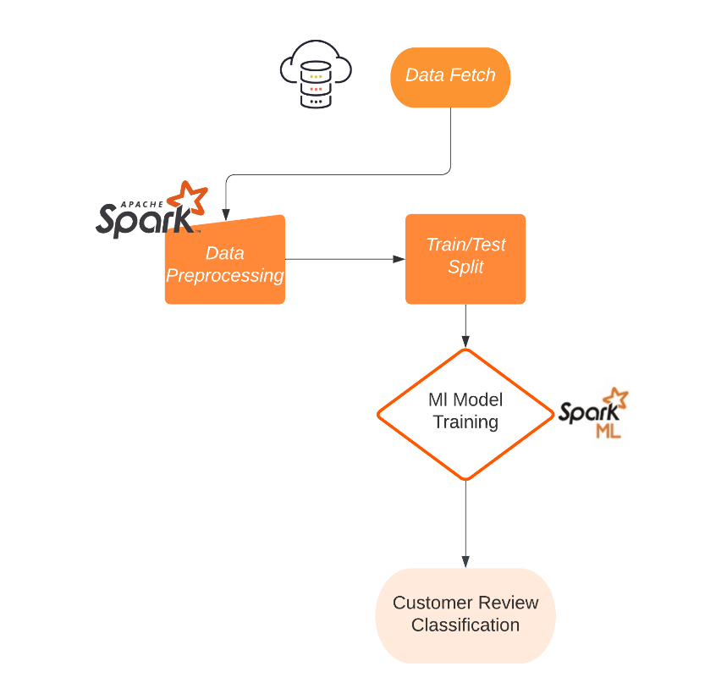
Pipeline

Slide 5
Methodology - Data preprocessing
Create a dataframe from the reviews dataset and select relevant columns
Next, filter out the null values for reviewText field and replace null values in summary column with empty string for the summary field
A primary key is created to ensure uniqueness of records
Datatype of fields are changed from default strings to their appropriate types (long, int, etc.)
Finally, the dataframe is split into training, validation, and test dataframes

Slide 6
Methodology - Algorithms
Naive Bayes
Naive bayes is a probabilistic classification algorithm based on Bayes’ theorem, assuming strong independence between the features
Formula: P(y|X) = (P(X|y) * P(y)) / P(X), where P(y|X) is the posterior probability, P(X|y) is the likelihood, P(y) is the prior probability, and P(X) is the evidence.
Use Case: It is often used for text classification, spam filtering, and sentiment analysis.
Support Vector Machine (SVMs)
SVM is an algorithm for classification tasks that finds an optimal hyperplane to maximize the margin between classes.
Formula: The decision boundary is w^T * x + b = 0, where w is the weight vector perpendicular to the hyperplane, x is the input feature vector, and b is the bias term.
Use Case: It is widely used for text classification, image recognition, and anomaly detection tasks.
Logistic Regression
Logistic Regression is a classification algorithm that predicts the probability of categorical outcomes using a logistic function.
Formula: h(x) = 1 / (1 + e^(-z)), where h(x) is the predicted probability, z = w^T * x + b is the linear function
Use Case: It is commonly used for binary classification tasks. In case of our dataset, we can run as a MultiClass Classification task.

Slide 7
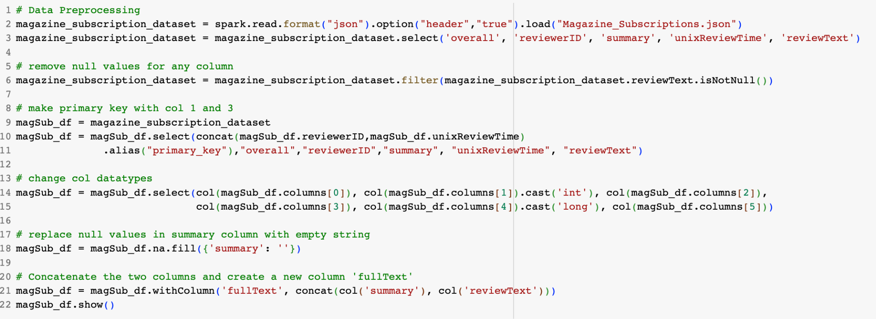
Code Snippets - Data Processing

Slide 8
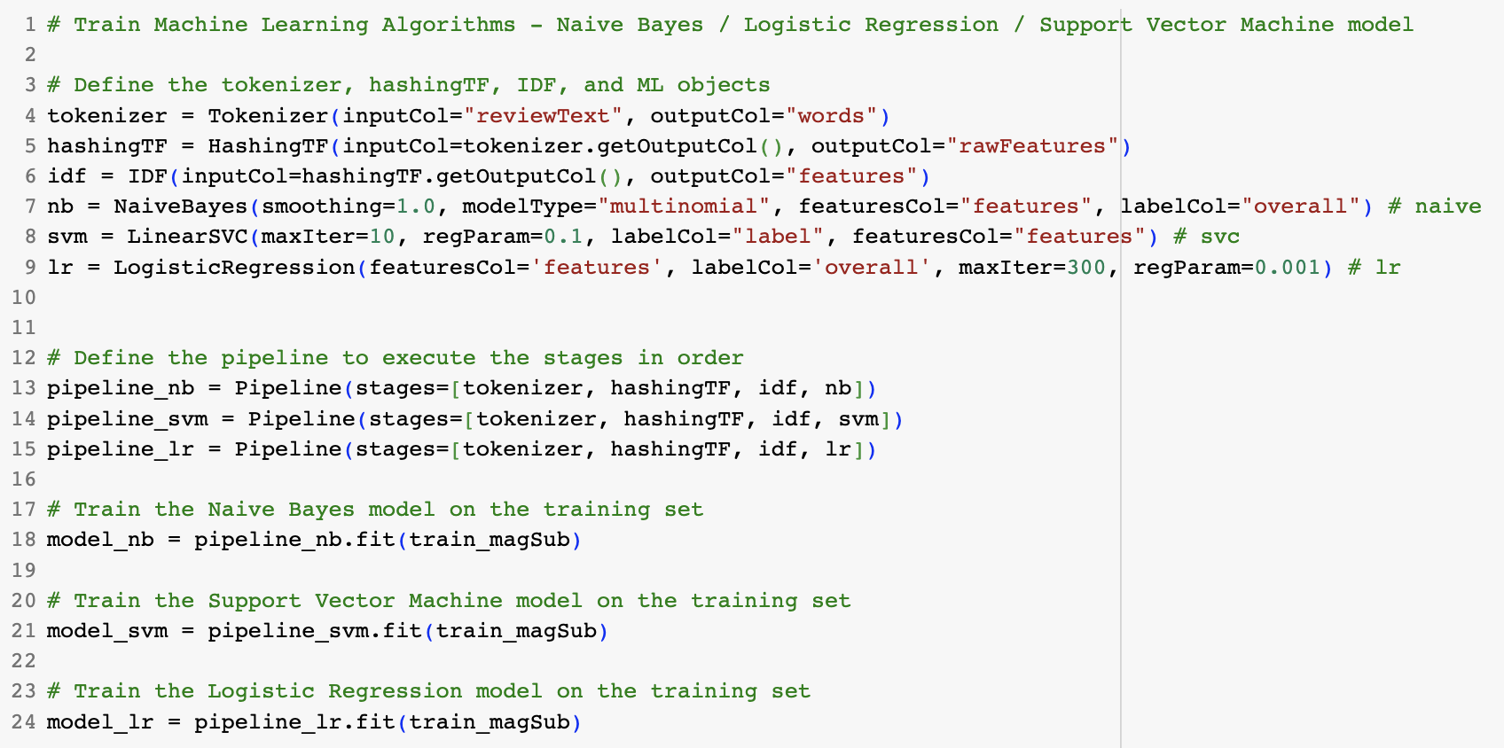
Code Snippets - Algorithms

Slide 9
Contributions
Environment Setup and Data Processing:
Collaboratively set up the environment, including installing dependencies and configuring tools.
Worked together on data fetching and pre-processing to ensure effective dataset acquisition and processing.
Model Training for Sentiment Classification:
Each team member focused on one ML model: Logistic Regression, SVM, or Naive Bayes.
Explored and trained individual models to classify customer review sentiment.
Leveraged the unique characteristics of each model to achieve optimal results.
Model Evaluation and Test Set Performance:
Individually evaluated the performance of the trained models.
Tested the models using dedicated test sets to assess accuracy and reliability.
Analyzed the results to determine the effectiveness of each model in real-world scenarios.
Latency Measurements and Spark Power:
Collaboratively captured and recorded latency numbers throughout the project.
Utilized Apache Spark to measure and understand computational efficiency.
Explored the advantages and potential benefits of using Spark in the project.

Slide 10
Possible Improvements
Feature engineering
Extract meaningful information such as sentiment scores, word frequencies, or use word embeddings to represent data in a more meaningful way.
Handling class imbalance
As the dataset is highly imbalanced, we can use techniques such as oversampling or undersampling to improve performance.
Distributed training
As the dataset is large, distributed training across multiple machines or GPUs can speed up the training process. We can use model/data parallelism.
Model training/evaluation
Ensure robust model training by utilizing appropriate techniques such as cross-validation and using evaluation metrics such as F1 score, AUC/ROC curves.
Deployment and monitoring
Establish a robust deployment pipeline to ensure the models are readily accessible and scalable.
Infrastructure scalability
Scaling up resources, such as using distributed computing frameworks, can enable faster training/inference times, allowing more faster model deployment.

Slide 11
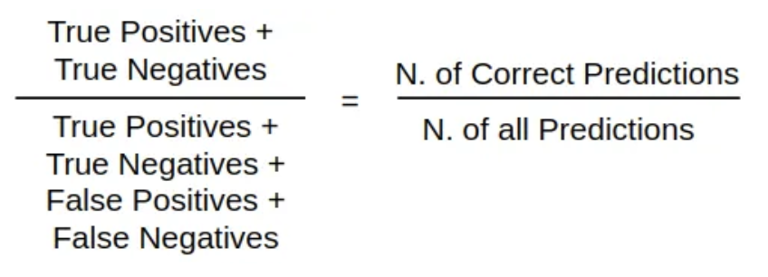
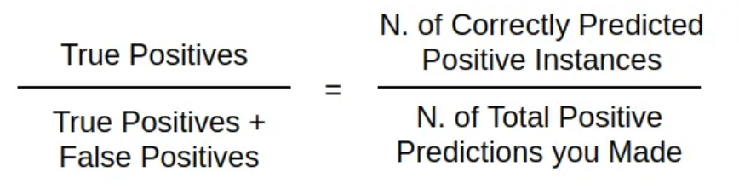
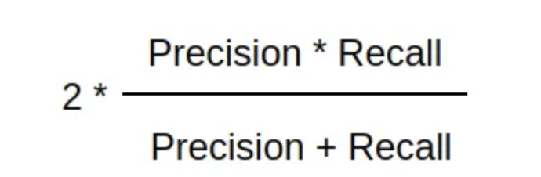
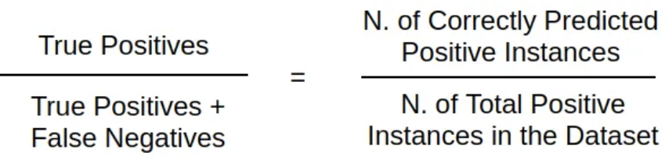
Tests - Evaluation Metrics
For the classification tasks, we evaluate the models on the following metrics
Accuracy
Precision
Recall
F1 score

Slide 12
Experimental Results
Metrics for Model Training and Testing
Naive Bayes
Accuracy: 0.848
Precision: 0.867
Recall: 0.849
F1-Score: 0.856
Latency: 33.04
SVM
Accuracy: 0.868
Precision: 0.86
Recall: 0.869
F1-Score: 0.862
Latency: 41.58
Logistic Regression
Accuracy: 0.877
Precision: 0.873
Recall: 0.877
F1-Score: 0.875
Latency: 103.69

Slide 13
Goals
First Milestone
Download the data
Setting up the environment
Data pre-processing
Second Milestone
Experimenting with different ML models using SparkML
Testing the models
Data pre-processing
Evaluation of the models and analysis of Latency and Throughput
Milestones achieved
First milestone - completed
Second milestone - completed
Deliverables - completed
Deliverables
End-to-end pipeline for sentiment classification on our dataset
Final Video presentation
Complete code for our project

Slide 14
Thank you!
Team members: Kartik Gupta, Shreya Gupta, Varad Pimpalkhute

