Slide 1
IndusTech
By Ratha Ariyanaygam , Saad Qazi , Abhirup Das

Slide 2
About the Application
The industry revolution 4.0 is the Fourth generation of mass product.
The app allow the user to chick up on the there device and machine without being there.
It will make it easier to check machine to see if they are working optimal condition
the app use a Scanner as an input to check through the database to find the machine that your look for.

Slide 3
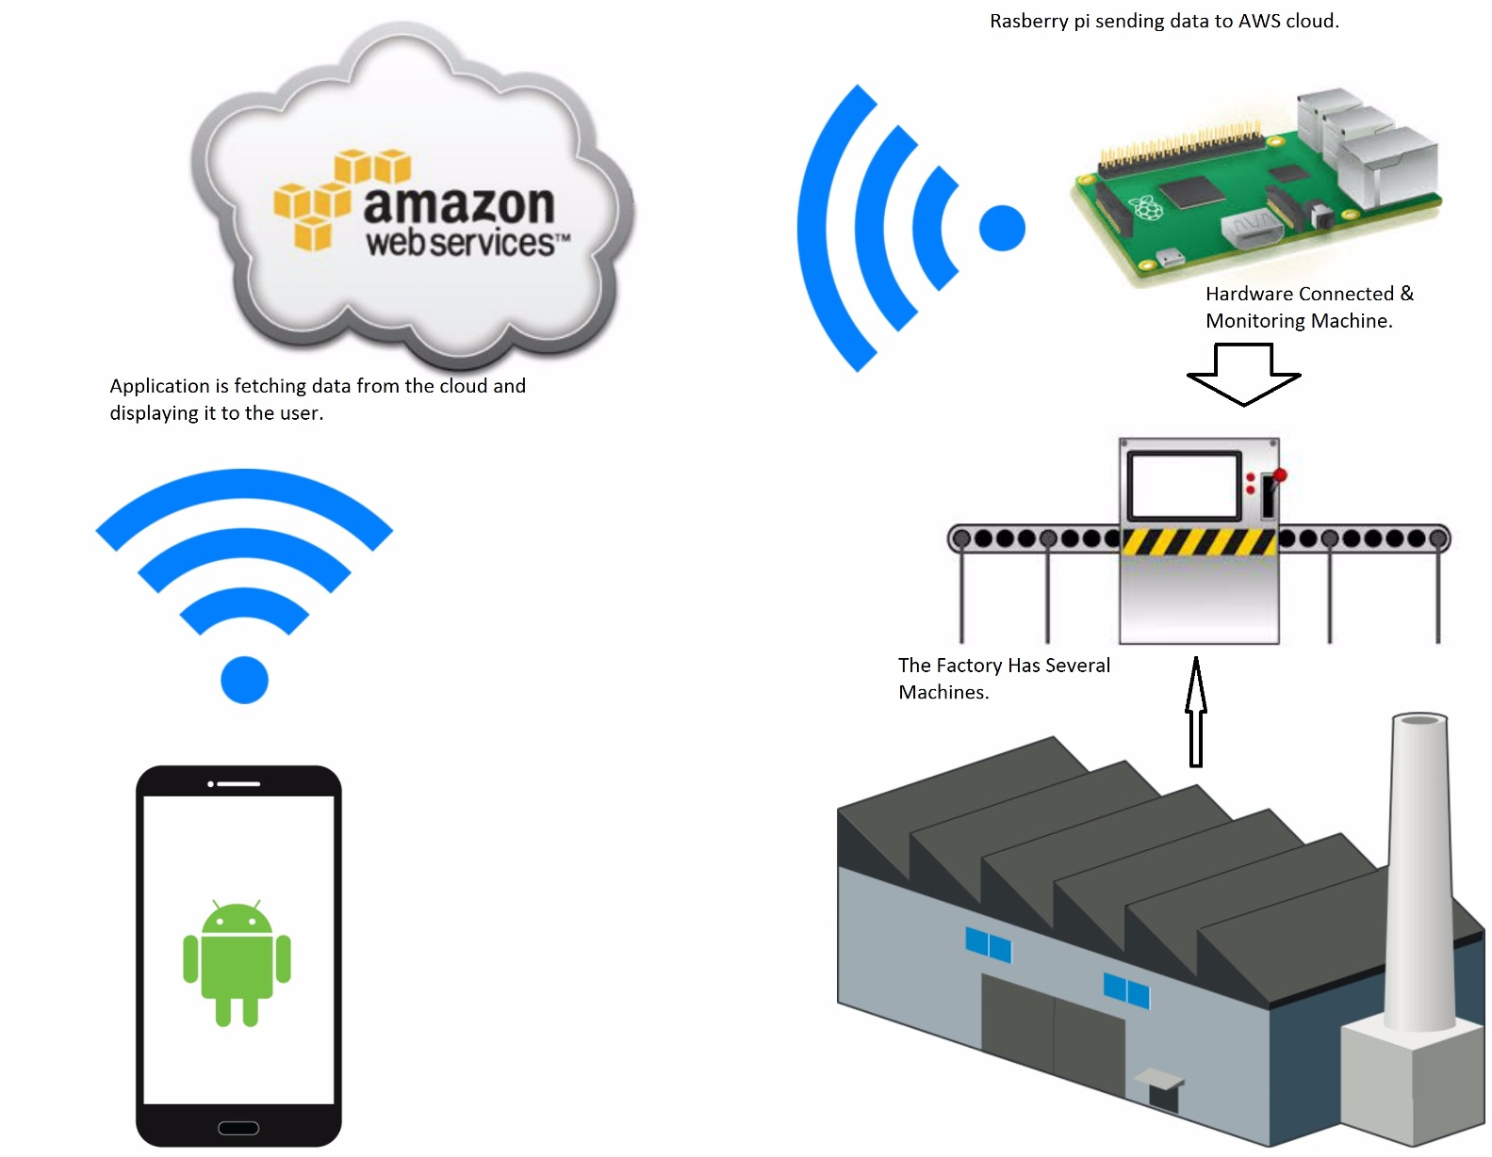
Diagram

Slide 4
Test #1
Test title: Validating Login
Test Purpose: This test case will be for checking that username and password is stored in the database, if the user is not found it will not allow the user to login and go to the next activity.
Pre-condition: user must have an account(username and password) which is pre-entered by us in the database
Steps:
1.Enter username and password in database
2.On login page, enter correct username which was chosen in step 1, but incorrect password in text fields.
3.Click login button. Expected
Result:validation tag should appear as soon as user clicks button, will be prompted to enter correct username & password.

Slide 5
Test case #2
Test title: Querying database for searching machines
Test Purpose: to ensure correct query statements are executed when given input from the user, ie can't enter wrong keys(id) to fetch data.
Pre-condition: data must be entered into database correctly from the raspberry Pi
Steps:
1. Navigate to RTV Activity
2. Enter machine id not in database
3. Enter query

