Slide 1
EXECUTIVE PRESENTATION ·
MarketPulse
A multi-market expansion & monetization strategy for Ai Palette
Market-entry sequencing · pricing & packaging · the standardization ↔ localization trade-off
Figures are illustrative, benchmark-anchored estimates Ai Palette is private (no public financials).

Slide 2
EXECUTIVE SUMMARY
Standardize the engine, localize the edge, price to willingness-to-pay
Expansion fails when it over-localizes (engineering bloat) or under-localizes (lost deals). MarketPulse makes localization, packaging, pricing and go-to-market one connected, repeatable system.
PRODUCTIZE THE SCALE
MONETIZE TO WTP
SEQUENCE & PROVE
~80% of the platform is global; localize only the ~20% edge as configurable Market Packs. Package into 3 maturity tiers.
Hybrid pricing (subscription + usage + seats) with regional price multipliers 0.45–1.00×. Price localization, not product localization.
Deepen SEA+India → attack US → broaden to EU/Japan. Validated by a weighted score, SHAP explainability, and an MDP optimal policy.
~$28M
110%+
~80%
3 waves
Year-5 ARR (base case)
Target net revenue retention
Code shared across markets
Sequenced market entry
Illustrative, benchmark-anchored · Ai Palette is private
1

Slide 3
THE EXPANSION BLIND SPOT
Naïve expansion punishes you twice ; and the clock is ticking
1
Markets are heterogeneous
Consumer behavior, categories, language, channels, pricing tolerance, compliance and support all differ region to region.
WHY NOW
The category just consolidated.
Mintel acquired Black Swan Data (Jun-2025), folding the strongest pure-play predictor into a slow incumbent — vacating the nimble, end-to-end, multi-market position Ai Palette can own.
2
Both naïve responses fail
Localize everything → engineering bloat & fragile releases. Localize nothing → weak local insight & lost enterprise deals.
3
Complexity outruns revenue
Without a framework, operational cost rises faster than revenue as you add markets.
The window is open but closing.
Source: Mintel press release, Jun-2025
2

Slide 4
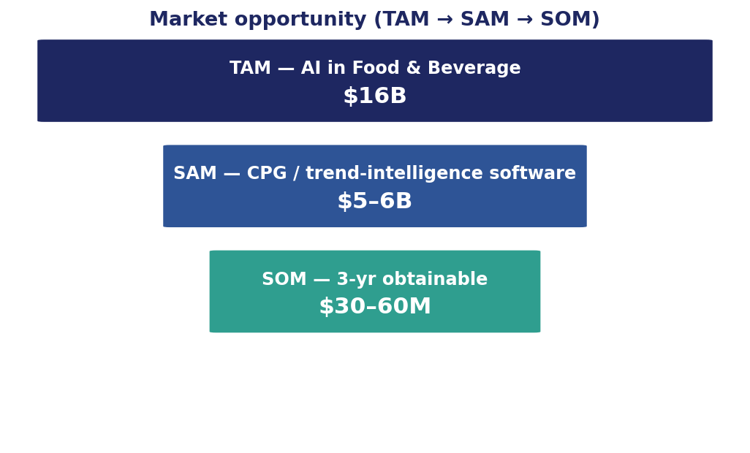
MARKET OPPORTUNITY
A focused slice of a large, double-digit-growth market
WHAT THE NUMBERS SAY
$16B
TAM — AI in Food & Beverage (2025), ~39% CAGR
$5–6B
SAM — CPG / trend-intelligence software, ~10% CAGR
$30–60M
SOM — 3-yr obtainable across Wave 1–2 markets
Large enough to support a tiered multi-market model; small enough that focus & sequencing matter.
Sources: GrandView, Verified Market Reports · figures illustrative
3

Slide 5
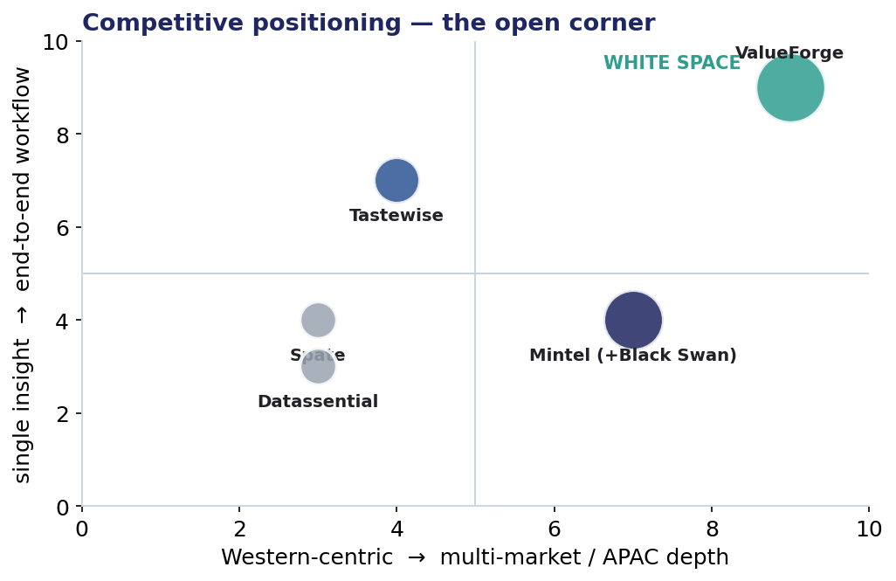
COMPETITIVE LANDSCAPE
Post-consolidation, the end-to-end + APAC corner is open
THE WHITE SPACE
End-to-end workflow
Ai Palette runs signal→concept→screen; incumbents stop at insight.
Multi-market / APAC depth
18 languages, 24 countries — built in, not bolted on.
Explainable & generative
Concept Genie + SHAP-style scoring vs. static reports.
Consolidation tailwind
Black Swan absorbed into Mintel — the nimble seat is empty.
Source: company sites, CB Insights, Mintel (Jun-2025)
4

Slide 6
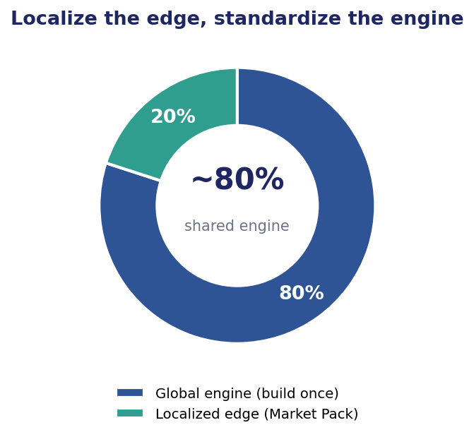
PHASE 1A · THE CORE TRADE-OFF
Localize the edge, standardize the engine — ship Market Packs, not code forks
WHAT STAYS GLOBAL vs. LOCALIZED
GLOBAL — build once
ML & forecasting core · generative model · data-ingestion framework
LOCALIZE — the edge
Local data sources · language/NLP · category taxonomy · compliance/residency · enterprise workflow
DEFER
Full UI translation — English-first is acceptable in B2B
The bloat firewall: a Market Pack = {language · data connectors · taxonomy · brand set · compliance · currency · support}. Adding a market = a config, not a branch.
See docs/03 — localization matrix
5

Slide 7
PHASE 1B · FEATURE TIERING
Three tiers mapped to enterprise maturity — one product, gated by entitlements
ESSENTIALS
GROWTH
ENTERPRISE
Exploratory
Operationalizing
Industrialized
1 market · ~3 categories
Trend discovery, dashboards
Self-serve · PLG-assisted
Several markets/categories
+ Concept Genie + Screen Winner
Priority support · hybrid motion
All markets · integrations
residency · governance · CSM
Sales-led
< $10K ACV
$25–60K ACV
$80K+ ACV
Four upsell levers — markets · categories · usage · seats — drive land-and-expand toward 110%+ NRR.
See docs/04 — feature tiering
6

Slide 8
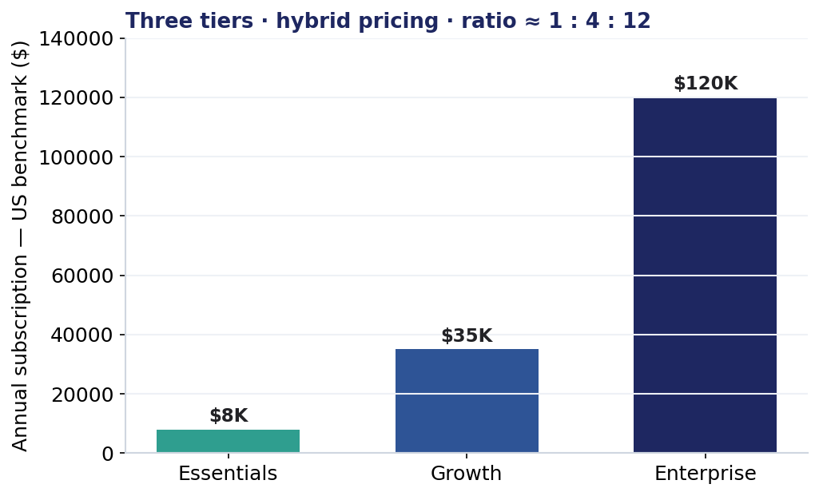
PHASE 2A · PRICING & PACKAGING
A hybrid model — subscription anchor + usage value-metric + seats
WHY HYBRID
Subscription
revenue anchor & budget predictability
Usage / credits
value metric = markets × categories × Concept Genie runs; powers NRR
Seats
secondary expansion lever, not the primary meter
2025 benchmarks: pure per-seat is declining (57%↓); usage is mainstream (61%); hybrid posts the highest growth (~21%).
Sources: Monetizely, Maxio 2025 SaaS pricing studies
7

Slide 9
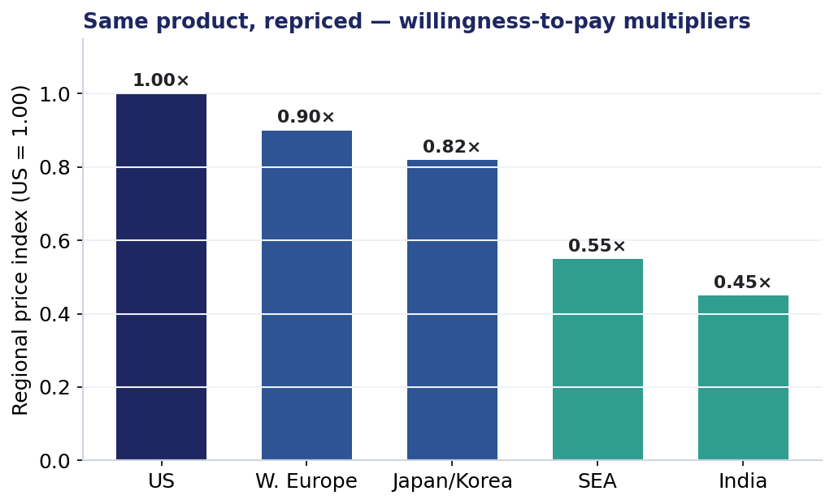
PHASE 2A · REGIONAL WILLINGNESS-TO-PAY
Same product, repriced — price localization, not product localization
HOW IT WORKS
We never change the product per region. We apply a price multiplier and shift the tier mix we lead with — protecting margin in high-WTP markets and adoption in price-sensitive ones, on one codebase.
WTP ORDER
US > W. Europe > Japan/Korea > SEA > India.
Lead Enterprise in the West; lead Growth + Essentials in SEA/India to widen the funnel.
See docs/05 — pricing & packaging
8

Slide 10
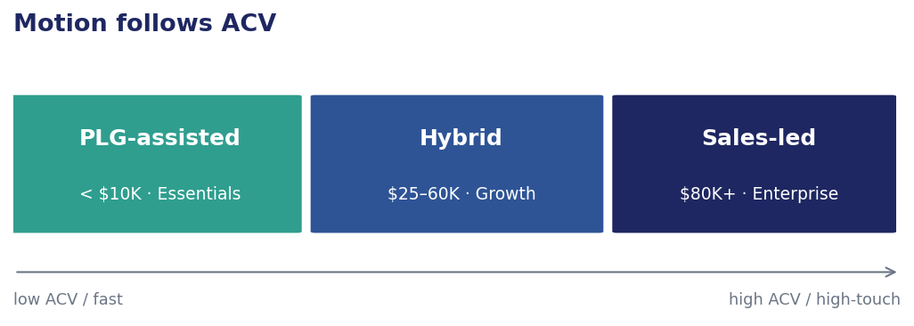
PHASE 2B · GO-TO-MARKET
Motion follows ACV — spend human service only where it pays for itself
OVERHEAD CONTROL
Self-serve flywheel
a free sample trend report becomes the Essentials funnel — low CAC.
Channel partners
absorb local sales/support in Japan/Korea & MEA — enter without a full local team.
Tiered service
PLG-assisted < $10K · Hybrid $25–60K · Sales-led > $80K — the benchmark thresholds for PLG vs. sales-led.
docs+chatbot at the bottom; named CSM + SLA only at Enterprise.
Sources: ProductLed, Thoughtlytics 2025 · see docs/06
9

Slide 11
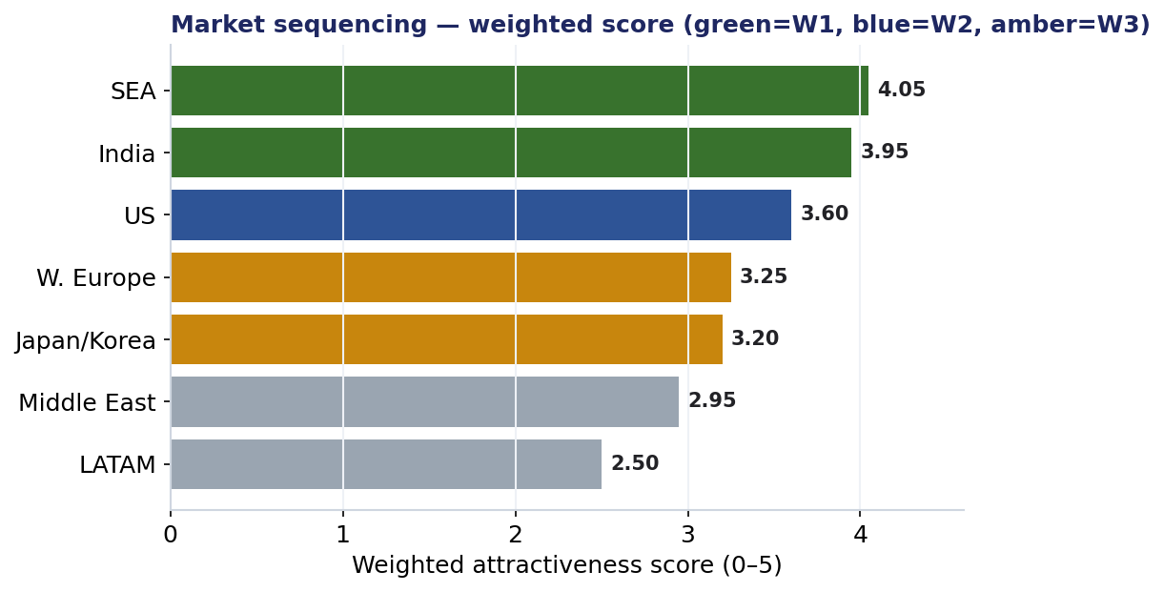
MARKET-ENTRY SEQUENCING
Scored, not guessed — a weighted rubric ranks where to go and when
WAVE 1 · 0–9 mo
Deepen SEA + India
Cheapest, highest data-readiness; build references.
WAVE 2 · 6–18 mo
Attack the US
Highest WTP + global-HQ pull-through; fund field sales.
WAVE 3 · 18–30 mo
W. Europe + Japan/Korea
Reuse US compliance; partner-led in Japan.
Rubric: revenue 30% · data 20% · home 15% · comp 15% · reg 10% · cost 10% — see docs/07
10

Slide 12
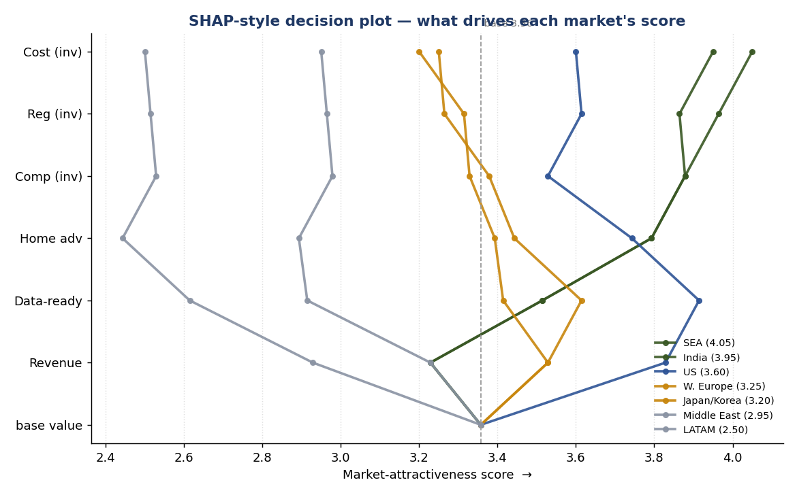
WHY THE RANKING HOLDS — EXPLAINABLE SCORING (SHAP)
Each market's score, decomposed into its drivers
THE READ
The score is an additive model, so Shapley values are exact and closed-form.
US earns the top Revenue contribution — but is dragged down by weak Home-advantage and high Competition.
SEA & India climb on Data-readiness + Home-advantage, which is why they out-rank the US on the blended score.
See decision-science/explain_scores.py · docs/11
11

Slide 13
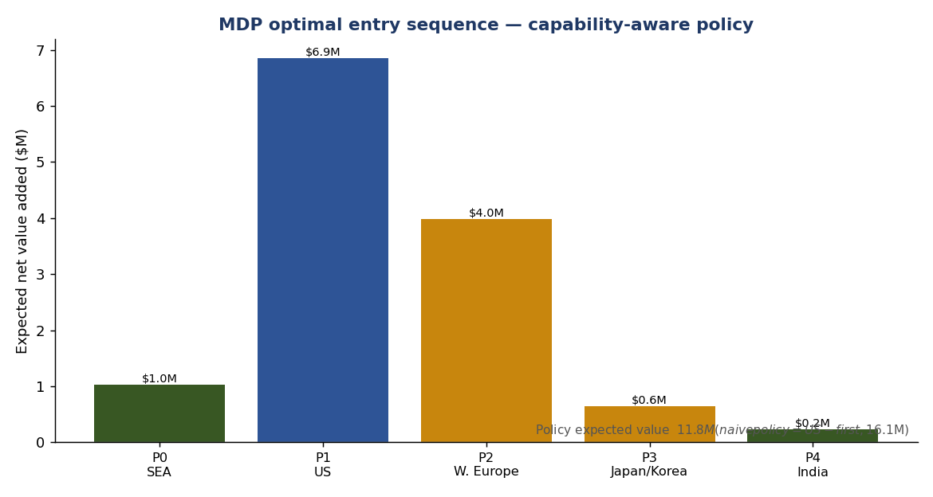
SEQUENCING IS THE OPTIMAL POLICY OF AN MDP
Risk-adjusted optimization validates Wave-1-then-US
THE INSIGHT
Modeled as states (markets entered), actions (which to enter), uncertain success, and reuse synergies.
Naïve / risk-neutral → US-first.
Price in cold-start risk (no references, unproven motion) and the optimum flips to SEA → US → EU/Japan — exactly our recommended sequence.
See decision-science/mdp_sequencing.py · docs/11
12

Slide 14
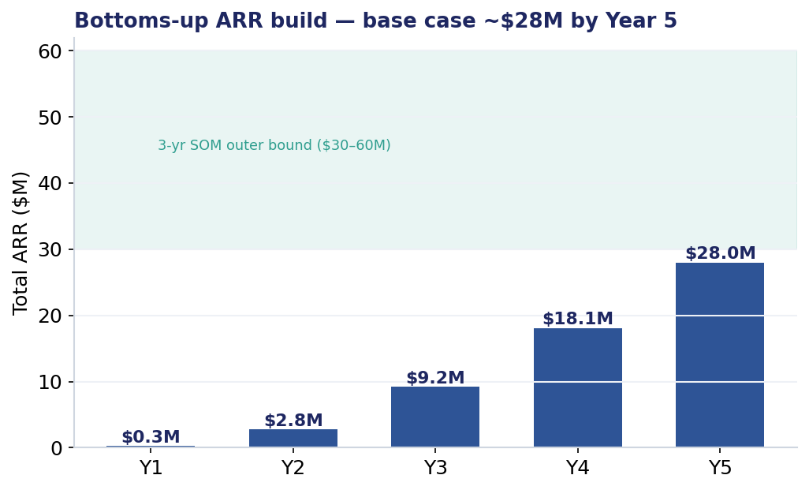
THE NUMBERS — BOTTOMS-UP ARR
A conservative ramp compounds to ~$28M ARR by Year 5
~$9.2M
Year-3 total ARR (base case)
~$28M
Year-5 total ARR (base case)
110%+
Net revenue retention
Method: accounts × capture × blended ACV, compounded by NRR. Sits below the SOM outer bound — a realistic ramp, not a ceiling.
See arr-model/ (Streamlit) + DeliverableC_ARR_Model.xlsx · docs/10
13

Slide 15
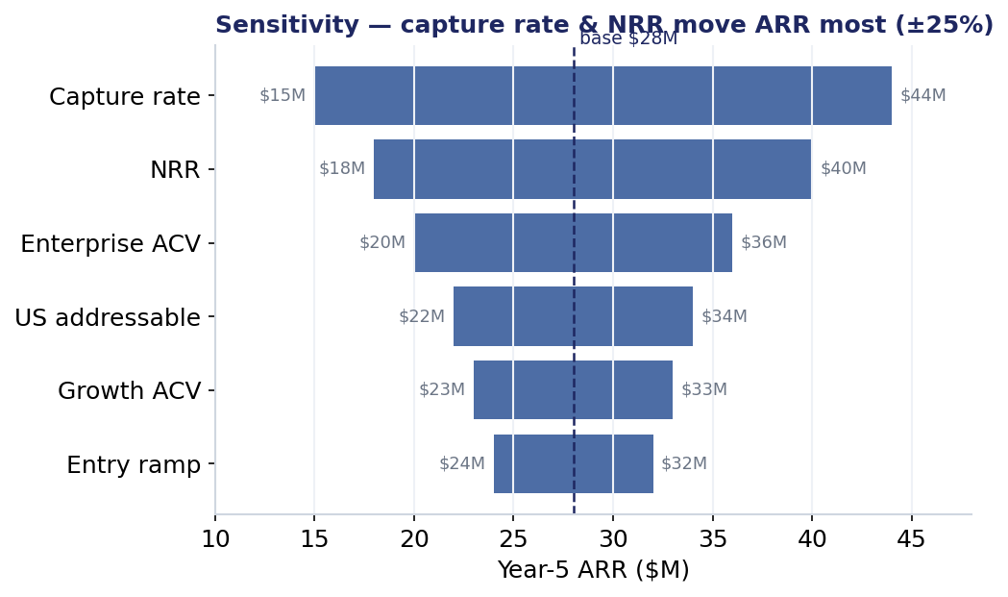
WHAT MOVES THE NUMBER
Capture rate and retention are the biggest levers
SO WHAT
Capture rate
GTM efficiency is the #1 driver → front-load cheap references (Wave 1).
NRR
Retention compounds hardest late → invest in the 4 upsell levers.
ACV mix
Enterprise ACV matters → why US (Wave 2) carries the model.
±25% sensitivity · interactive in arr-model/app.py
14

Slide 16
DELIVERABLE B PREVIEW · COMMERCIAL ARCHITECTURE
Tiers × markets × localization × monetization, in one map
Market | Wave | Lead tier | Localization depth | Price idx | Lead ACV* | Motion
SEA | 1 | Growth | Standard pack + taxonomy | 0.55 | ~$19K | Hybrid
India | 1 | Essentials/Growth | Standard · volume | 0.45 | ~$16K | PLG-assisted
US | 2 | Enterprise | Full + residency + integrations | 1.00 | ~$120K | Sales-led
W. Europe | 3 | Enterprise | Full + GDPR (reuse US) | 0.90 | ~$108K | Sales-led
Japan/Korea | 3 | Enterprise | Full via partner | 0.82 | ~$98K | Partner-led
Middle East | Later | Growth | Standard · inbound/partner | 0.70 | ~$25K | Partner/inbound
LATAM | Later | Essentials/Growth | Minimal→standard | 0.50 | ~$18K | PLG-assisted
*Lead ACV = US tier benchmark × regional price index. Full live model in DeliverableB_Commercial_Architecture.xlsx.
Deliverable B = the 8-tab workbook with live formulas
15

Slide 17
ROADMAP & THESIS
Growth that compounds, not fragments
Q1–Q2
Market-Pack architecture · Essentials self-serve · usage metering
Q2–Q3
Hybrid price book + regional multipliers · decision engine live
Q3–Q4
US Enterprise motion: integrations, residency, security · anchor logos
Year 2
W. Europe (reuse compliance) + Japan/Korea (partners) · Market Launchpad
Standardize the engine, localize the edge, package by maturity, price by willingness-to-pay, and let motion follow ACV — one repeatable, explainable engine so expansion compounds instead of fragmenting.

