Slide 1
Mergers, MBOs & Other Corporate Reorganizations

Slide 2
Mergers, MBOs & Other Corporate Reorganizations
Final Review

Slide 3
Q1(i)
True or False: The case of Roche shows that in times of crisis it is impossible to raise debt; therefore firms should raise equity.

Slide 4
Q1(i)
True or False: The case of Roche shows that in times of crisis it is impossible to raise debt; therefore firms should raise equity.
Solution: False. The Roche–Genentech case shows that although bank lending was restricted, the bond market still provided financing. Capital markets tend to be less procyclical than bank lending.

Slide 5
Q1(ii)
True or False: In Chapter 11 the absolute priority rule can never be broken.
Solution: False. In the LATAM case, new senior debt was proposed that would rank ahead of existing debt to solve a debt overhang problem.

Slide 6
Q1(ii)
True or False: In Chapter 11 the absolute priority rule can never be broken.

Slide 7
Q1(iii)
True or False: Excess returns from asset manager engagements indicate insider information and violate securities laws.

Slide 8
Q1(iii)
True or False: Excess returns from asset manager engagements indicate insider information and violate securities laws.
Solution: False. The information is soft information obtained through engagement and fits under the mosaic rule, which is permissible.

Slide 9
Q1(iv)
True or False: Large block ownership is undesirable because it always leads to private benefits of control and reduces share prices.

Slide 10
Q1(iv)
True or False: Large block ownership is undesirable because it always leads to private benefits of control and reduces share prices.

Slide 11
Q1(iv)
True or False: Large block ownership is undesirable because it always leads to private benefits of control and reduces share prices.
Solution: False. Regulation can limit private benefits, and blockholders can reduce agency costs associated with dispersed ownership.

Slide 12
Q1(v)
True or False: Lenders should only give haircuts to borrowers that are insolvent.

Slide 13
Q1(v)
True or False: Lenders should only give haircuts to borrowers that are insolvent.
Solution: False. Haircuts may also be given to distressed but solvent firms to resolve debt overhang and enable profitable investments.

Slide 14
Q2(a)
Acquirer Plc has plans to acquire Target Corp; both companies are all-equity financed. Preacquisition (before any merger information or rumors are circulating), Acquirer is trading for $40 per share and has 200 million shares outstanding. Target is trading for $30 per share, with a pre-merger value of $4.5 billion. Assume that the present value of projected synergies is $1 billion and that the deal will be financed with cash (i.e., cash merger). The board of Target indicated that it would sell the firm if it is offered $5 billion in cash.
i) What is the value of Acquirer after the acquisition? Should Acquirer acquire Target? What is the NPV of the deal for Acquirer?

Slide 15
Q2(a)
Acquirer value before merger = 200m × $40 = $8bn. Target value = $4.5bn. Synergies = $1bn. Offer = $5bn.
Solution:

Slide 16
Q2(a)
Acquirer value before merger = 200m × $40 = $8bn. Target value = $4.5bn. Synergies = $1bn. Offer = $5bn.
Solution:
Post‑merger value of Acquirer = 8 + 4.5 + 1 − 5 = $8.5bn.
NPV for Acquirer = 8.5 − 8 = $0.5bn.
Decision: Acquire Target.

Slide 17
Q2(b)
Find Acquirer share price after acquisition and premium paid.
Solution:

Slide 18
Q2(b)
Find Acquirer share price after acquisition and premium paid.
Solution:
Post‑merger share price = 8.5bn / 0.2bn shares = $42.5.
Premium = (5 − 4.5)/4.5 = 11.11%.

Slide 19
Q2(c)
Maximum price Acquirer could pay.
Solution:

Slide 20
Q2(c)
Maximum price Acquirer could pay.
Solution:
Maximum payment = Target value + Synergies = 4.5 + 1 = $5.5bn.
Any price below $5.5bn keeps the acquisition profitable.

Slide 21
Q2(d)
Stock swap merger: maximum exchange ratio.
Solution:

Slide 22
Q2(d)
Stock swap merger: maximum exchange ratio.
Solution:
Target value with synergies = $5.5bn.
Acquirer share price = $40.
Shares issued = 5500/40 = 137.5m.
Exchange ratio = 137.5/150 = 0.9167.
Meaning: maximum new Acquirer shares per Target share while maintaining positive NPV.

Slide 23
Q2(e)
Exchange ratio so Target receives equity worth $5bn.
Solution:

Slide 24
Q2(e)
Exchange ratio so Target receives equity worth $5bn.
Solution:
Solve x/(200+x) × 13,500 = 5,000.
x = 117.647m shares issued.
Exchange ratio = 117.647 / 150 = 0.7843.

Slide 25
Q3(a)
Given its recent performance there is now great fear that Pleito, PLC may go bankrupt soon. The firm has assets which may be worth £100 million if things go well or £20 million if things don’t go well. It is known by all market participants that the likelihood of each scenario is 50%. The firm currently has debt outstanding with face value of £50 million due next year. Please assume that there are no costs of financial distress, and the appropriate discount rate is zero.

Slide 26
Q3(a)
Assets worth £100 (good) or £20 (bad), each with 50%. Debt face value £50.
What are the current market values of the assets, equity, and debt?
Solution:

Slide 27
Q3(a)
Assets worth £100 (good) or £20 (bad), each with 50%. Debt face value £50.
What are the current market values of the assets, equity, and debt?
Solution:
Debt value = 0.5×50 + 0.5×20 = £35m.
Equity value = 0.5×50 + 0.5×0 = £25m.
Enterprise value = £60m.

Slide 28
Q3(b)
Project: invest £1m; payoff £5m (good), −£10m (bad).
Solution:

Slide 29
Q3(b)
Project: invest £1m; payoff £5m (good), −£10m (bad).
Solution:
Debt = 0.5×50 + 0.5×9 = £29.5m.
Equity = 0.5×54 + 0.5×0 = £27m.
Enterprise value = £56.5m.
Equity increases → shareholders would invest.

Slide 30
Q3(c)
Name of agency problem.
Solution: Risk shifting (asset substitution).

Slide 31
Q3(d)
New project: invest £10m, payoff £15m in both states (financed externally).
Solution:

Slide 32
Q3(d)
New project: invest £10m, payoff £15m in both states (financed externally).
Solution:
Debt = 0.5×50 + 0.5×35 = £42.5m.
Equity = 0.5×65 + 0.5×0 = £32.5m.
Enterprise value = £75m.

Slide 33
Q3(e)
Could the firm raise £10m from equity or junior debt?
Solution:

Slide 34
Q3(e)
Could the firm raise £10m from equity or junior debt?
Solution:
No. Equity gains £7.5m and debt gains £7.5m, so neither would invest £10m. This illustrates the debt overhang problem.

Slide 35
Q4(a)
A private company, LIME Inc. is being considered as a target by a private equity firm. The shareholders of LIME value the enterprise at $2,000 million. End of current year EBITDA is $250 million, and D&A/Capex (i.e. D&A/EBITDA) is 15%. The tax rate is 40%. The forecast holding period is 5 years. Forecast CAGR for EBITDA is 6.95% and the EV/EBITDA multiple after 5 years is expected to be10x. The financing of LIME includes senior and junior debt: Senior debt: 2.8x EBITDA ($700) at 5% interest (amortized out of annual net earnings) Junior debt: 1.6x EBITDA ($400) at 8.0% interest (with a bullet repayment).

Slide 36
Q4(a)
LIME wants you to lay out the annual income statement and the annual financing of the company. In addition, show the valuation of the company now (i.e year 0) and in the year of exit.

Slide 37
Q4(a)
Private equity LBO analysis.
Solution:
EBITDA grows from $250m to about $350m over 5 years.
Senior debt amortizes from $700m to $85m.
Junior debt remains $400m.
Exit EV ≈ $3,498m.
Equity value increases from $900m to about $3,013m.

Slide 38
Q4(a)

Slide 39
Q4(b)
Calculate IRRs.
Solution:

Slide 40
Q4(b)
Calculate IRRs.
Solution:
Enterprise IRR ≈ 11.8%.
Equity IRR ≈ 27.3%.

Slide 41
Q4(c)
WACC = 13%. Is acquisition attractive?
Solution:

Slide 42
Q4(c)
WACC = 13%. Is acquisition attractive?
Solution:
Enterprise IRR (11.8%) < WACC → not attractive on enterprise basis.
However equity IRR (27.3%) appears attractive because leverage magnifies returns. Proper comparison should match equity IRR with cost of equity.

Slide 43
Q4(d)
Where have PE returns come from (Acharya & Kehoe study)?
Solution:

Slide 44
Q4(d)
Where have PE returns come from (Acharya & Kehoe study)?
Solution:
Returns largely driven by operational improvements (alpha), especially higher margins and productivity. Many successful deals replaced management and improved efficiency.

Slide 45
Key issues that we will discuss
Session 1
Introduction to M&A (Merger vocabulary; M&A market and cast of characters; deal analysis: synergies, means of payment; valuation methods for M&A)
Session 2
M&A performance and value creation: evidence; the value of control
Case study: Roche-Genentech (The Swiss pharmaceutical company was a majority owner of US biotech firm Genentech from the early 90s. It is considering making a tender offer for the remaining part of Genentech that it doesn’t own. What is the logic of this merger? What are the valuation and governance issues that arise?)
Session 3
Setting deal terms, bidding tactics in M&A
Case study: Buffett's Bid for Media General's Newspapers (Berkshire Hathaway wants to acquire Media General’s newspaper division. Why is Buffett interested in this company which is in an industry in decline?)

Slide 46
Key issues that we will discuss
Session 4
Regulatory aspects and advisory fees in M&A
Financial distress, debt overhang, out-of-court restructuring
Session 5
Case study: Preem (The refinery Corral/ Preem is in financial distress and must quickly restructure its debt out-of-court to avoid a liquidation of the business.)
Guest Lecture
Session 6
Distressed restructuring inside bankruptcy
Case study: Latam Airlines (In 2020, Latam Airlines became the largest airline in the world to be driven to bankruptcy by COVID-19. With a complex debt structure and international investor composition, the company decided to file for bankruptcy protection in the U.S.)

Slide 47
Key issues that we will discuss
Session 7
Different forms of ownership and governance across countries; how ownership influences control transactions, e.g., mergers; regulatory protection of minority shareholders
Session 8
Shareholder activism by hedge funds. Who are the activists? How does it work & what are the outcomes?
Guest lecture
Session 9
Shareholder activism by active and passive asset managers
Private Equity: structure of PE transactions, incentives and performance
Session 10
Guest lecture
Conglomerates, virtues and vices

Slide 48
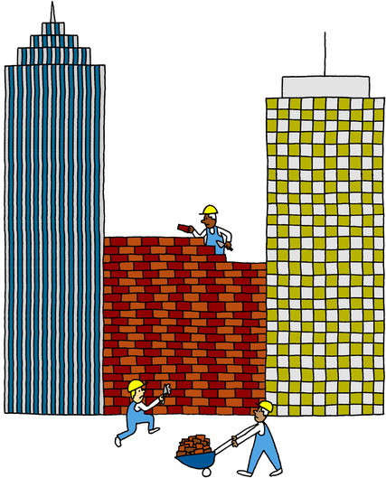
Mergers and Acquisitions
Reasons behind it
Synergies: Combined firm is more valuable than the merging firms separately
Revenue synergies
Cost synergies
Tax gains
Financing gains
Agency
Market for corporate control
Empire building
Overconfidence
Source: Jordan Awan, New York Times
Notes:
The market for corporate control is the role of equity markets in facilitating corporate takeovers. ... The lower the stock price, relative to what it could be with more efficient management, the more attractive the take-over becomes to those who believe that they can manage the company more efficiently.
mergers are planned and executed by managers who maximize their own utility instead of their shareholders' value. ... (1986) found that management share ownership and the number of inside directors were negatively associated with merger results.
Overconfident managers are unambiguously more likely to conduct mergers only if they have sufficient internal resources. Moreover, if overconfidence increases merger frequency, it also lowers average deal quality and induces a lower average market reaction to the announcement of merger bids.

Slide 49
Taxonomy of mergers
Horizontal vs. vertical
Related vs. unrelated (diversifying)
Hostile vs. friendly
Cash (fixed $ amount per share) vs. stock (fixed # of shares of acquirer)
Industrial buyer (corporate) vs. financial buyer (PE fund)
Single-bidder vs. multiple bidders
Majority vs. minority

Slide 50
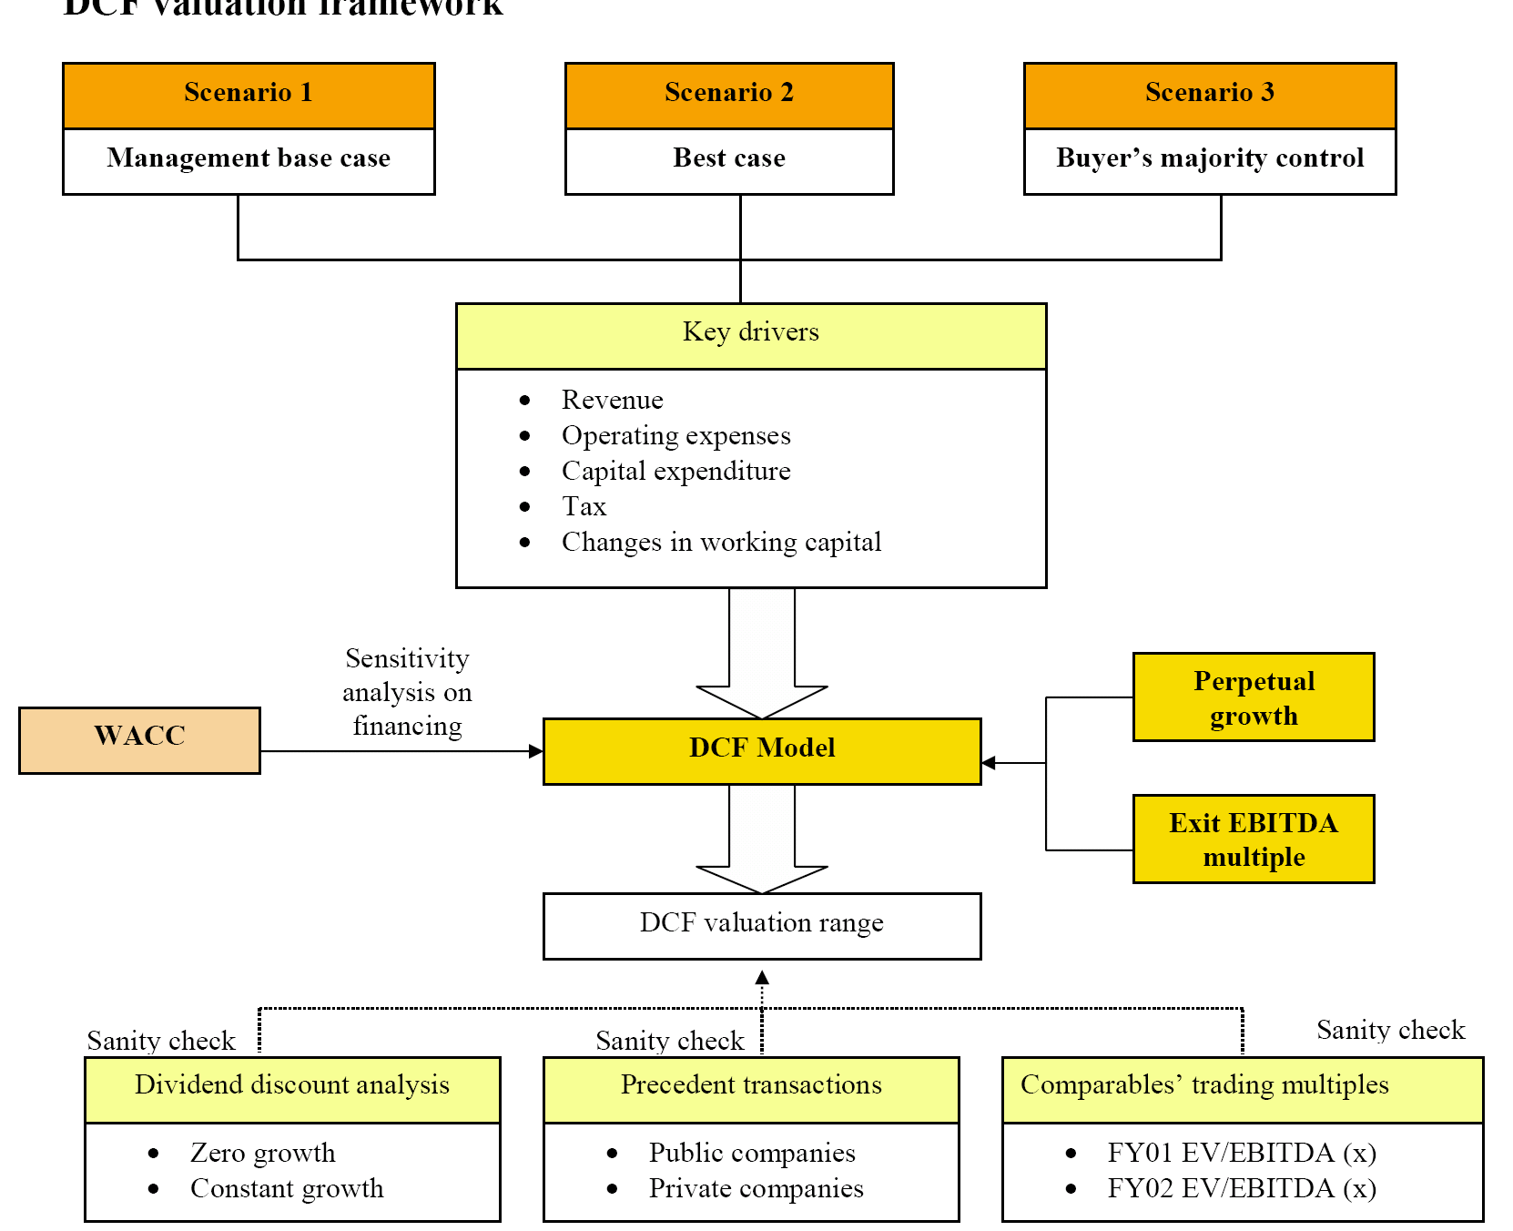
An Overview of Valuation
Base case
Worst case
WACC / APV

Slide 51
Control
What is the “Value of Control”?
Estimates of the value of control
What determines the value of control?
Calculating merger value creation from stock market data
Merger arbitrage

Slide 52
Session 3
Method of payment
How to set the Exchange Ratio in a merger
Advanced financing provisions: Collars, CVRs, and Earnouts
How to sell a company
How to buy a company
Bid tactics and bid rules
Clauses protecting acquirers

Slide 53
Session 5
Bidding tactics
Hostile takeovers
Regulatory aspects
Securities law
Antitrust law
Foreign investment laws

Slide 54
Session 6
Financial distress
Costs of financial distress
Direct
Indirect
Resolving financial distress
Debt restructuring
Bankruptcy
Reorganization
Liquidation

