Slide 1
mDB

Slide 2
m DB
Memory
Relation
Data
Base
Non-Strict

Slide 3
mDB
db1
db2
db3
db...
dbx
tab1
tab2
tab3
tab4
int8,int16,int32,int64,
uint8,uint16,uint32,uint64,
float,double
string,mstring,vstring,vmstring
date,time,datetime,
struct,union,vector,col-family
tabx
tab5
tab6
tab7
tab8

Slide 4

dbx
tab1
tab2
tab3
tab4
HASH
ATL
RBT
B+
tab5
tab6
tab7
tab8
NT
...

Slide 5
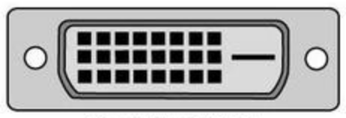
API
Absolute
Single
Interface
Parameter Driver
Configuration Driver
?

Slide 6

Function
Storage
Distribution
Access
mDB
Active/Standby
Local DB
pDB
Load Share
Remote DB
hDB
Cluster
SQL

Slide 7

Feature
(1), multi-storage capability
(2), multi-distribution capability
(3), loose coupling & tight coupling

Slide 8
Future
(1), Data Model: Struct, Union, Vector, Col-Family,...
(2), Distribution Model: Cloud
(3), Interface: JDBC/ODBC, NoSQL, Compute-Language...

