Slide 1
DSP——FIR Filter Module 1: Basic PBL
Notes:
This is the basic PBL module of FIR.

Slide 2
Outline
Introduction
What is FIR Filter?
Quick Start
Audio Signal Demonstration
Python Implementation
FIR Accelerated IP Implementation
Hardware Testing

Slide 3

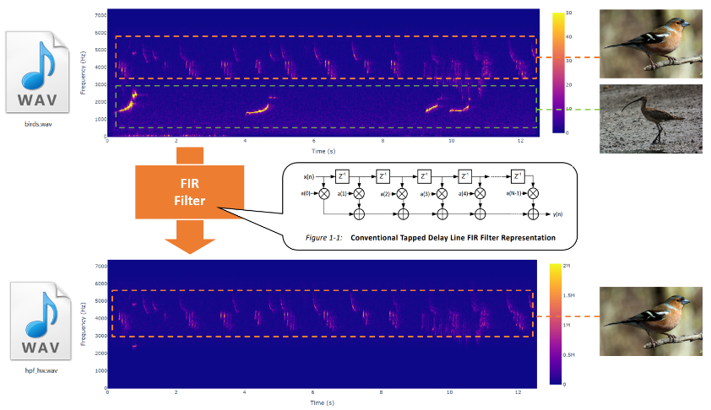

Introduction
① Objective of this lab
Separating the two bird sounds in the audio and get separate bird sound.
② Skills you will get
Having hardware design ideas
Learning the basic flow of accelerated core design
Learning the deployment to PYNQ using HLS
Notes:
Background introduction of this project: There is an audio segment mixed with two bird calls (playback audio), which can be filtered by a hardware FIR filter to obtain the sound of one of the birds (playback audio).
And after completing this project, you can acquire the following skills：Having hardware design ideas；Learning the basic flow of accelerated core design；Learning the deployment to PYNQ using HLS

Slide 4
What is FIR Filter?

Slide 5
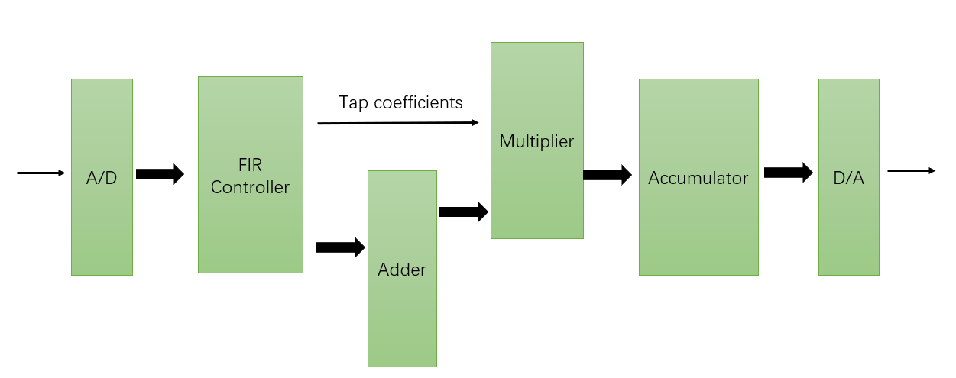
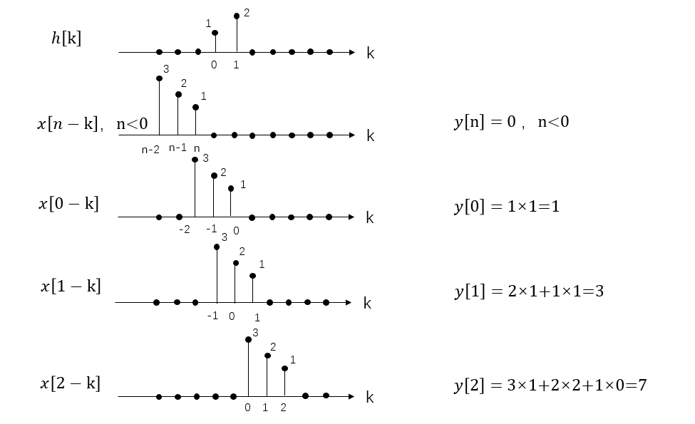
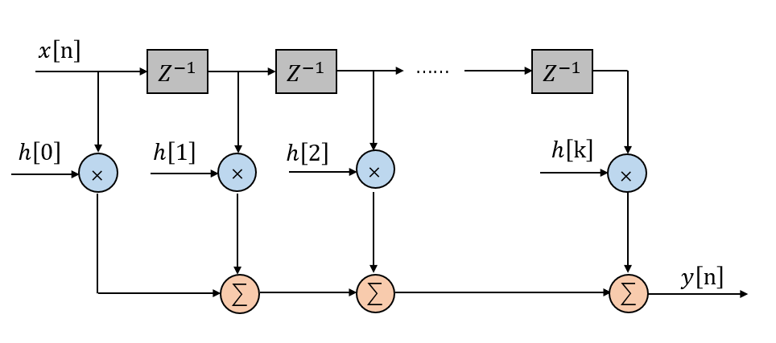
What is FIR Filter?
Finite Impulse Response Filter (FIR)
y[n] = h[0]x[n-0] + h[1]x[n-1]+···+h[k]x[n-k]
① Calculation steps:
② FIR work principle & hardware design:
You can get more explanation and details of FIR here: https://en.wikipedia.org/wiki/Finite_impulse_response.
Notes:
Fir，Finite Impulse Response Filter（有限脉冲响应滤波器），y[n] = h[0]x[n-0] + h[1]x[n-1]+···+h[k]x[n-k]
Is the mathematical calculation formula.。
①Calculation steps: h[k] is the tapped coefficient, and we can see that the coefficients only have values at k=0 and k=1. Each addition of 1 to n is a translation of the x function to the right by 1 bit. When n<0, x[n-k] only has values at the negative half-axis in the state of k<0, so the values of h[k] and x[n-k] are staggered from each other and multiplied and accumulated to 0. When n=0, both h[k] and x[0-k] have values at k=0, so y[0]=x[0]h[0] =1*1=1. When n=1, both h[k] and x[1-k] have values at k=0,k = 1, so y[1] = x[0]h[0] + x[1]h[1] = 2*1+1*1 = 3. When n=1, h[k] and x[2-k] both have values at k=0,k=1, so y[1] = x[0]h[0] + x[1]h[1] = 3*1+2*2 = 7.
② FIR work principle & hardware design:
The signal is passed through an analog-to-digital converter (A/D). After the control signal is given by the FIR Controller, the filtered signal is obtained by Adder, Multiplier, Accumulator, etc. and finally output by Digital to Analog (D/A) conversion.
Regarding its hardware structure, it is mainly divided into two parts: time delay line (TDL) and multiply-accumulate （MAC)。First the current signal x[n] is multiplied with the coefficient h[0], x[n-1] is multiplied with the coefficient h[1], and the results of both are accumulated. x[n-2] is multiplied with the coefficient h[2] and the results are again accumulated, and so on and so forth until finally multiplied with x[n-k] and the coefficient h[k] for the last accumulation. The final answer is the filtered signal for the current point in time.

Slide 6
Quick Start

Slide 7
Preparations Before Quick Start
Anaconda download address: https://www.anaconda.com/download
Vitis HLS and vivado download address: https://www.xilinx.com/support/download/index.html/content/xilinx/en/downloadNav/vitis.html
If you use PYNQ-Z2 physical board, you should configure it first: https://harrykwok.gitee.io/pynq_learning_kits/zh/Article/Base/Board/Board.html#pynq-z2%E8%AE%BE%E7%BD%AE%E5%BC%95%E5%AF%BC
What you need:
Jupyter notebook (anaconda)
Vitis HLS
Vivado
PYNQ-Z2 remote lab service or physical board
Notes:
Essential software and configurations

Slide 8
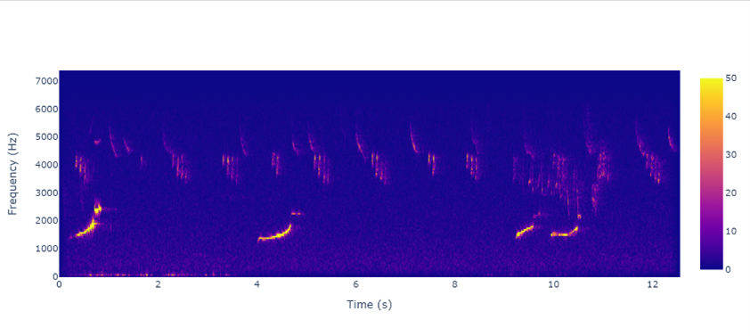
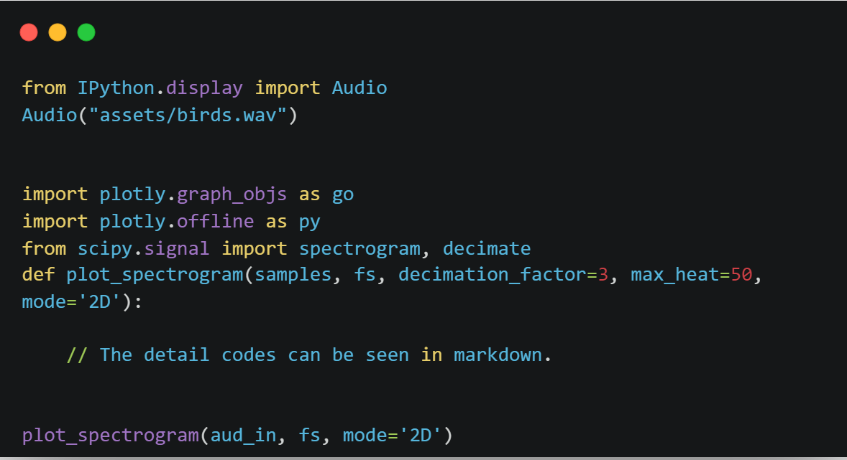
Audio Signal Demonstration
Chaffinch:3-5kHz
Eurasian curlew:1.2-2.6kHz
We need a high-pass filter
with a cutoff frequency of 2.8kHz !
(In Jupyter notebook)
Notes:
First let's import the audio. We can use the interactive feature of jupyter notebook to hear the sounds of two birds interspersed with the audio. The bird with a lower frequency and shorter chirp duration is the Eurasian curlew; the bird with a higher frequency and longer chirp duration is the chaffinch.
To leave some margin, this cutoff frequency can be set to 2.8kHz. Atthe same time you also choose to filter chaffinch sounds between 3-5kHz, both can be achieved. Inthis chapter, we will implement the former.

Slide 9
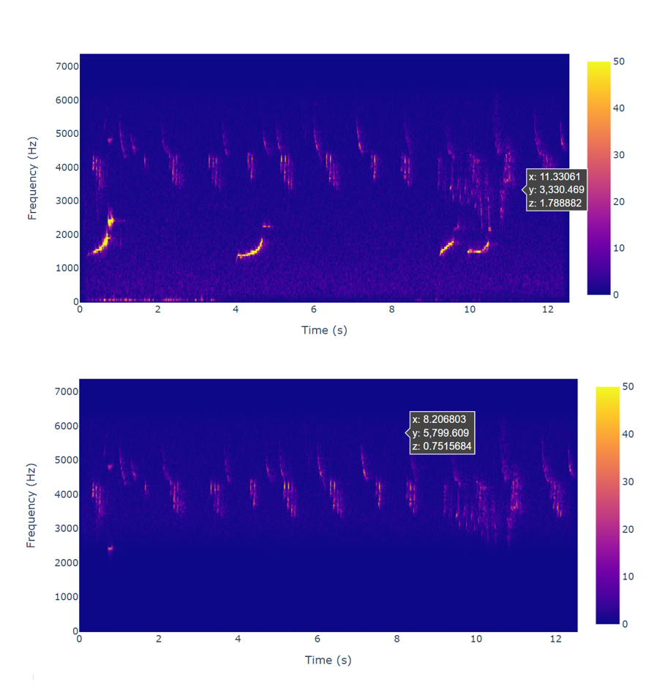
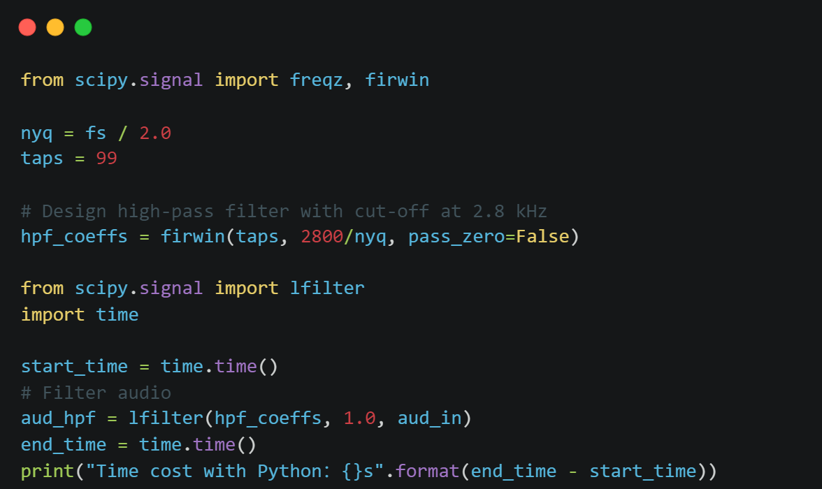
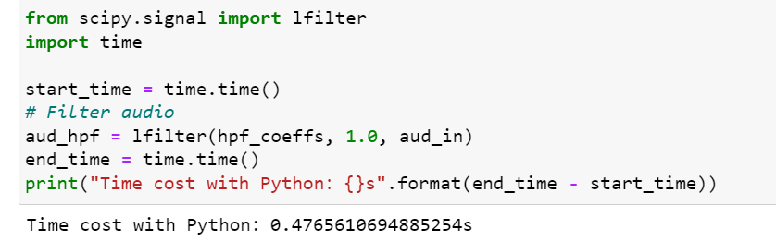
Python Implementation
Before
After
(In Jupyter notebook)
The performance is highly dependent on the Ifilter function, and generally such functions are highly optimized and put into the library.
Notes:
Python Implementation: see the performance of software first.
In Python, we use the Scipy library and the Numpy library in concert. First we use Scipy's firwin function to get the FIR filter tap coefficients by specifying the filter order, target cutoff frequency, etc.
After that, we input the tap coefficients into the lfilter function of the Scipy library, specify the audio file, and finally get the filtered signals.
The performance is highly dependent on the Ifilter function, and generally such functions are highly optimized and put into the library.

Slide 10
Quick Start Workflow
FIR Accelerated IP Implementation
Vitis HLS ---- Design FIR IP
Vivado ---- IP Integration
You can follow the workflow below with tcl or turn to the tutorial with GUI.
We have source codes in the folder ./src. (fir.cpp fir.h fir_tb.cpp)
Notes:
How does it perform on the hardware?
We first use Vitis HLS to design FIR IP by using c++. Then we use Vivado to make IP integration to enable it work on the PYNQ board.
In the following part, we provide two way for you to study. One is using GUI, the other is using tcl. They can achieve the same result and you can choose one based on your own capability.

Slide 11
Vitis HLS ---- Design FIR IP
1.1 Create a new project
1.2 C-simulation
1.3 C-synthesis
1.4 C/RTL Co-simulation
1.5 Export RTL
Question: What is the function of each step about HLS?
Notes:
Let us look at the stesps of design FIR IP in vitis HLS. There are five steps. Can you think what the function of each step?
Create a new project: create a new HLS project
C-simulation: Pre-synthesis validation that the C program correctly implements the required functionality.
C-synthesis:Integrate into corresponding hardware languages, and show some performance like latency, clock period and resource usage.
C/RTL Co-simulation:Post-synthesis verification that the generated RTL code performs as expected.
Export IP: generate IP for following steps in vivado.

Slide 12
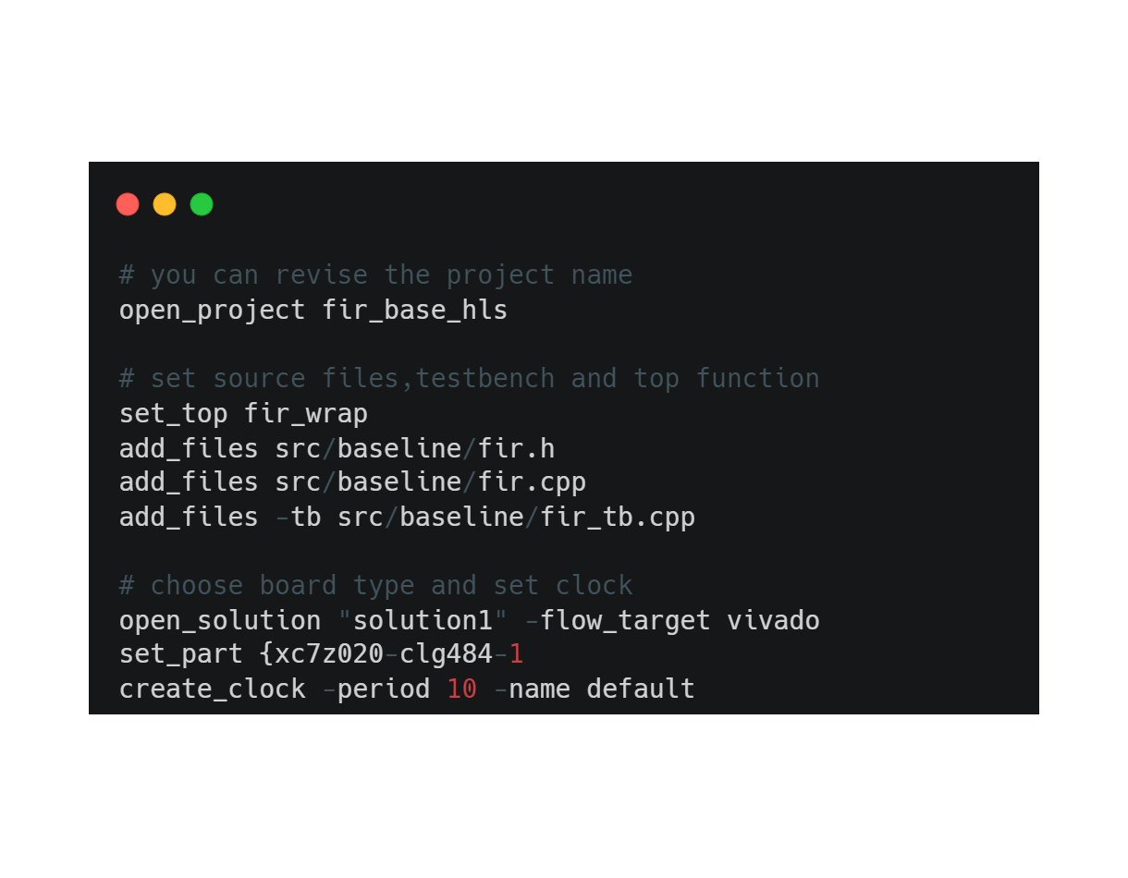
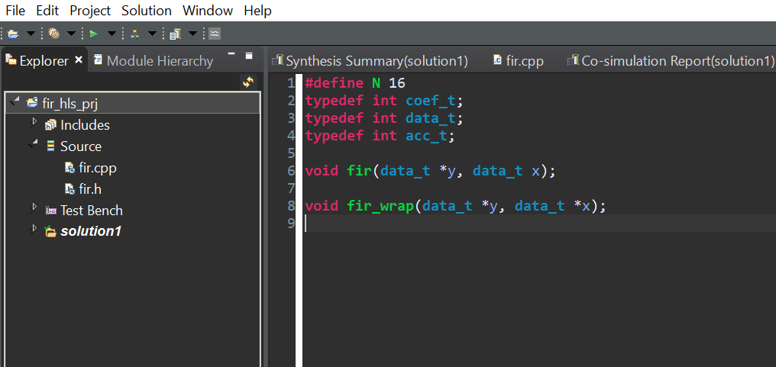
1.1 Create a new project
Source files
Testbench
You can change the source files and testbench according to the actual situation.
Notes:
You can change the source and testbench according to the actual situation.

Slide 13
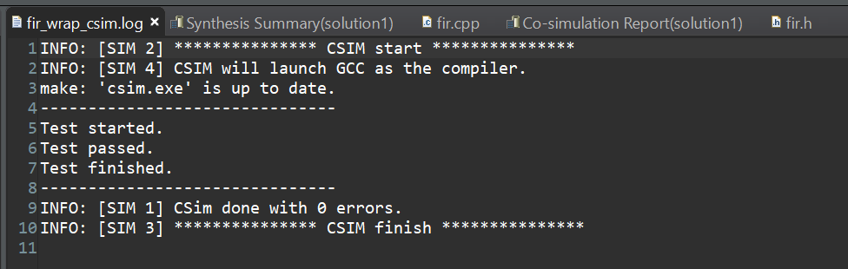
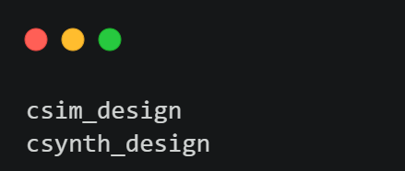
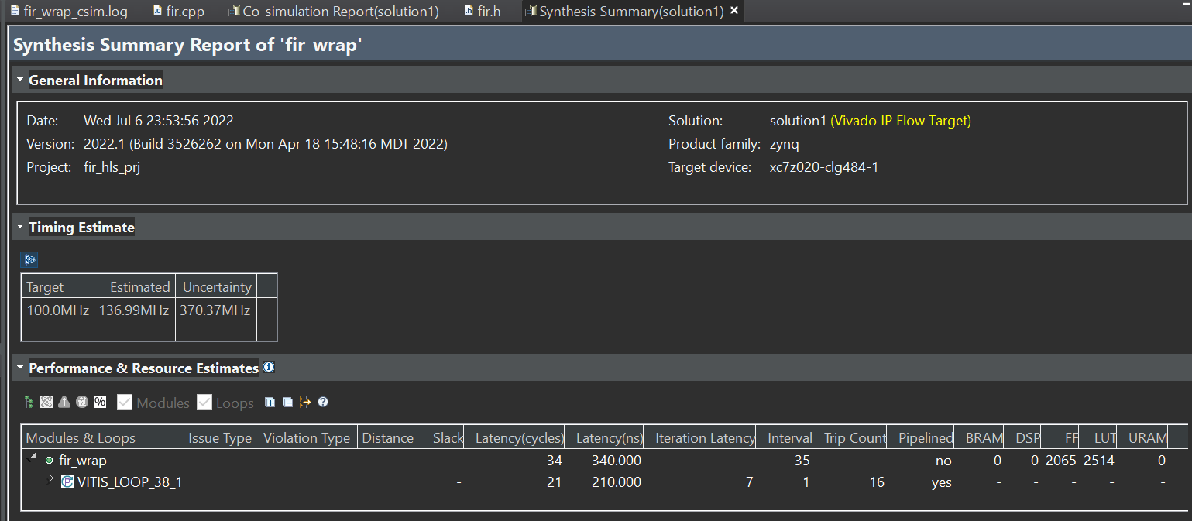
1.2-1.3 C-Simulation & C-Synthesis

Slide 14
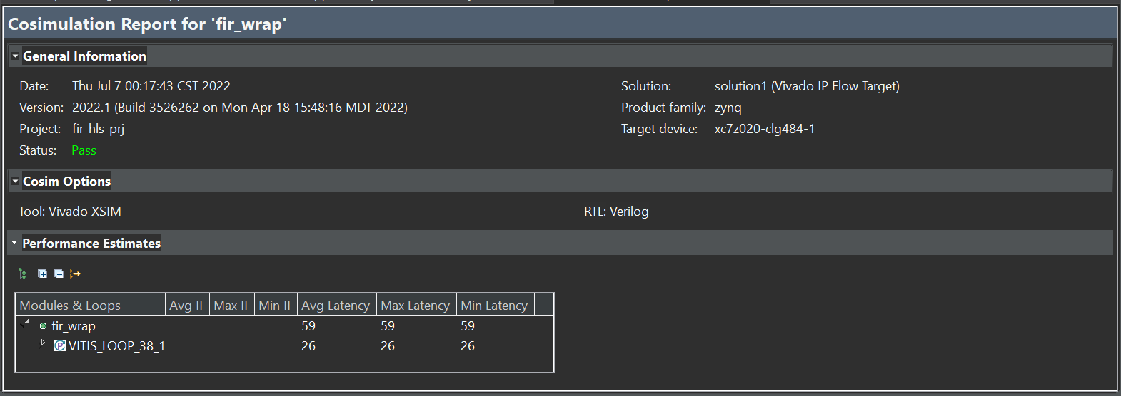
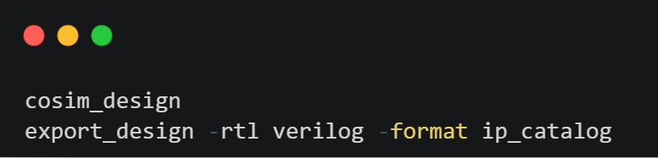
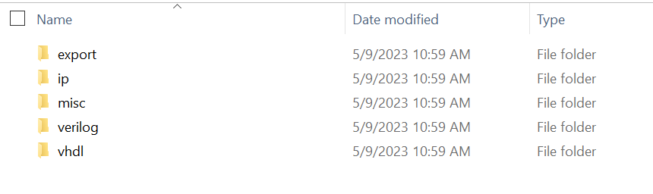
1.4-1.5 C/RTL Co-sim & Export RTL
Notes:
The generated export is a zip file that needs to be extracted into a folder for subsequent operations.

Slide 15
Vivado ---- IP Integration
2.1 Create a new project
2.2 Import IP
2.3 Create a block design
2.4 Synthesis and generation of bitstreams
Question: What is the function of each step about Vivado?
Notes:
There are four steps. Can you think what the function of each step?
Create a new project: create a new vivado project
Import IP: Add your own IP
Create a block design: Combine IP and ZYNQ processing system, configure interfaces and connections, and finally verify and wrap
Synthesis and generation of bitstreams: Conduct synthesis (generate hardware), implementation, and generate bitstream

Slide 16
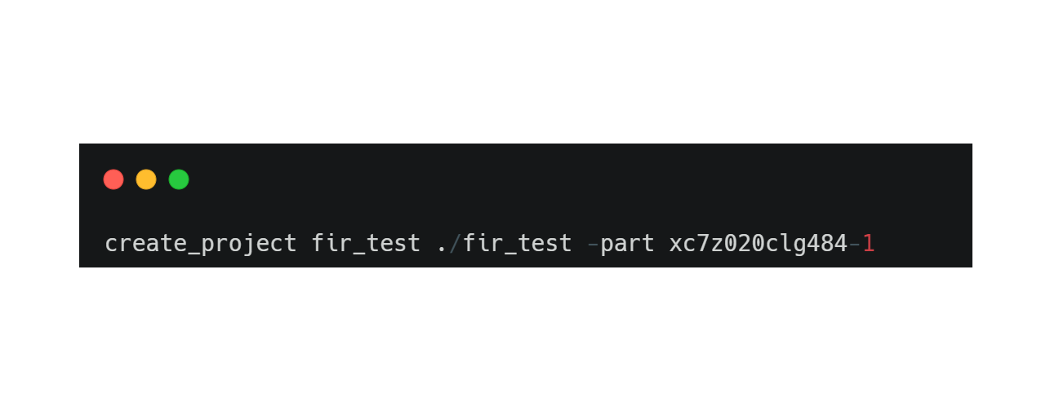
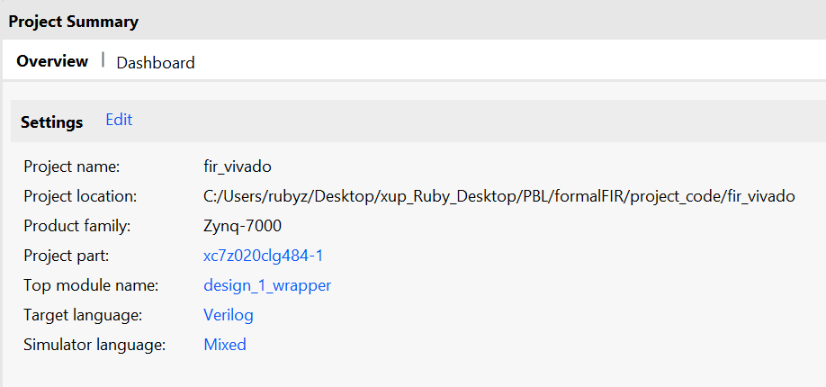
2.1 Create a New Vivado Project
Project name
Project path
Board type

Slide 17
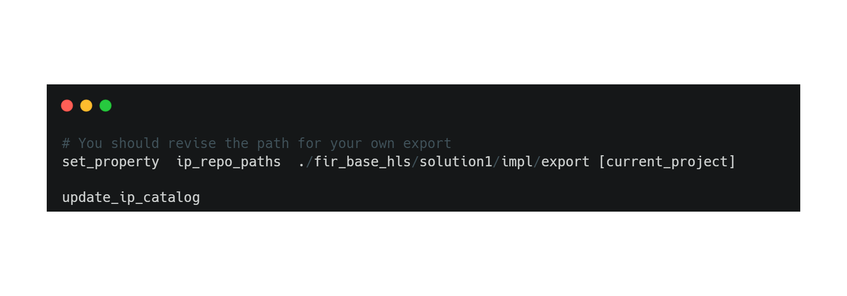
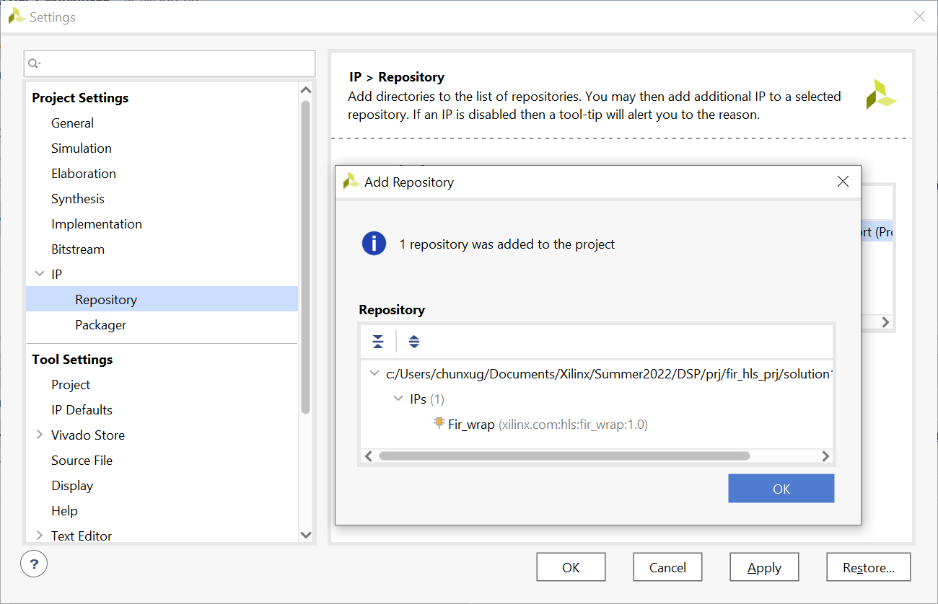
2.2 Import IP
You can change it to your IP path.
You should extract the export.zip file generated by HLS to the path you want in advance.

Slide 18
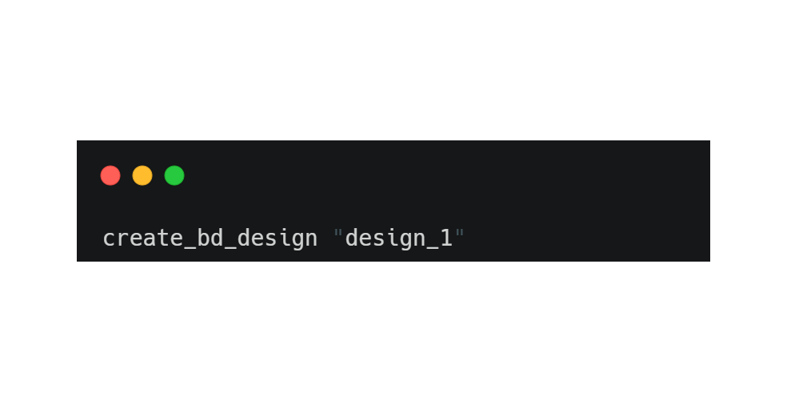
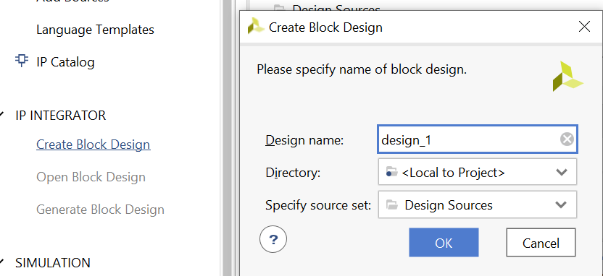
2.3 Create a Block Design
Generate a block design

Slide 19
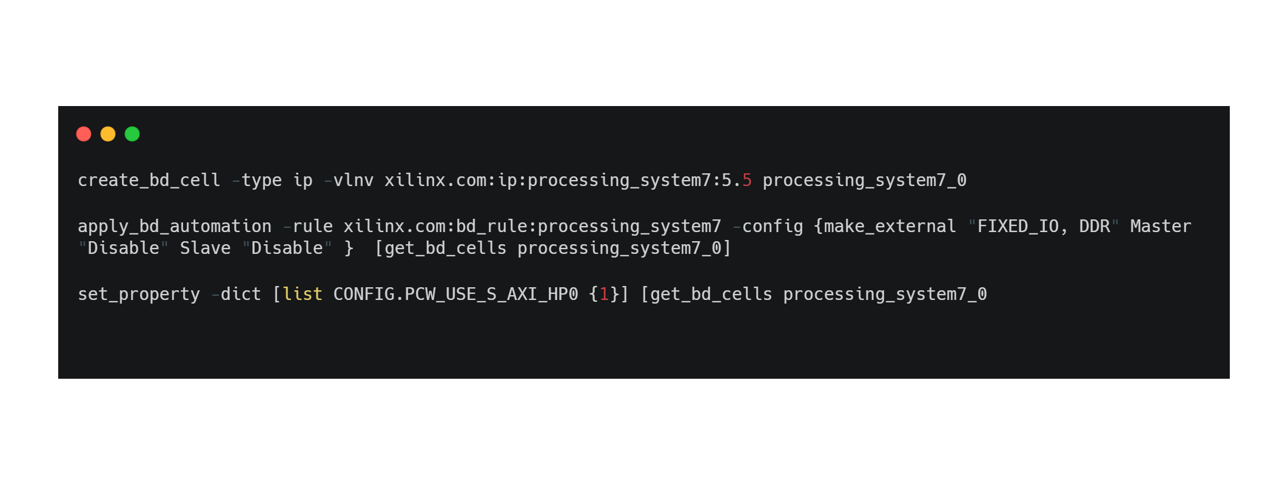
2.3 Create a Block Design
Add ZYNQ7 processing system
Run block automation
Add an HP port
Add and configure ZYNQ7 Processing System

Slide 20
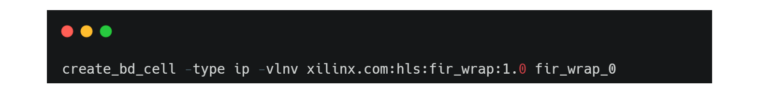
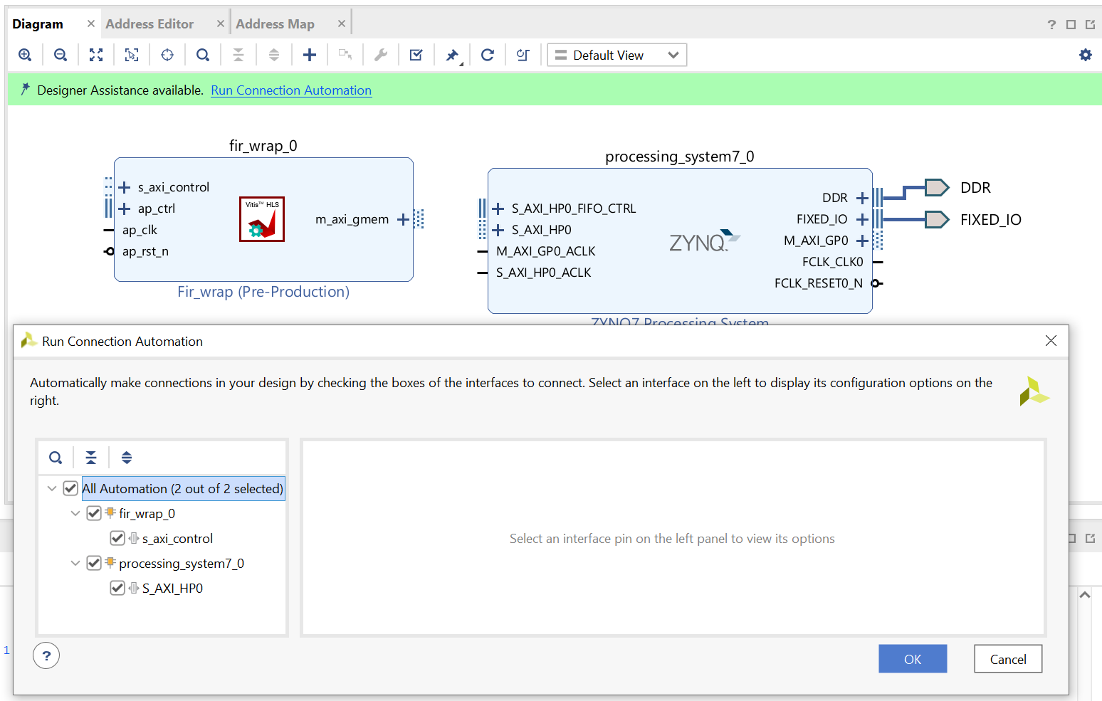
2.3 Create a Block Design
Add fir_wrap IP to the design

Slide 21
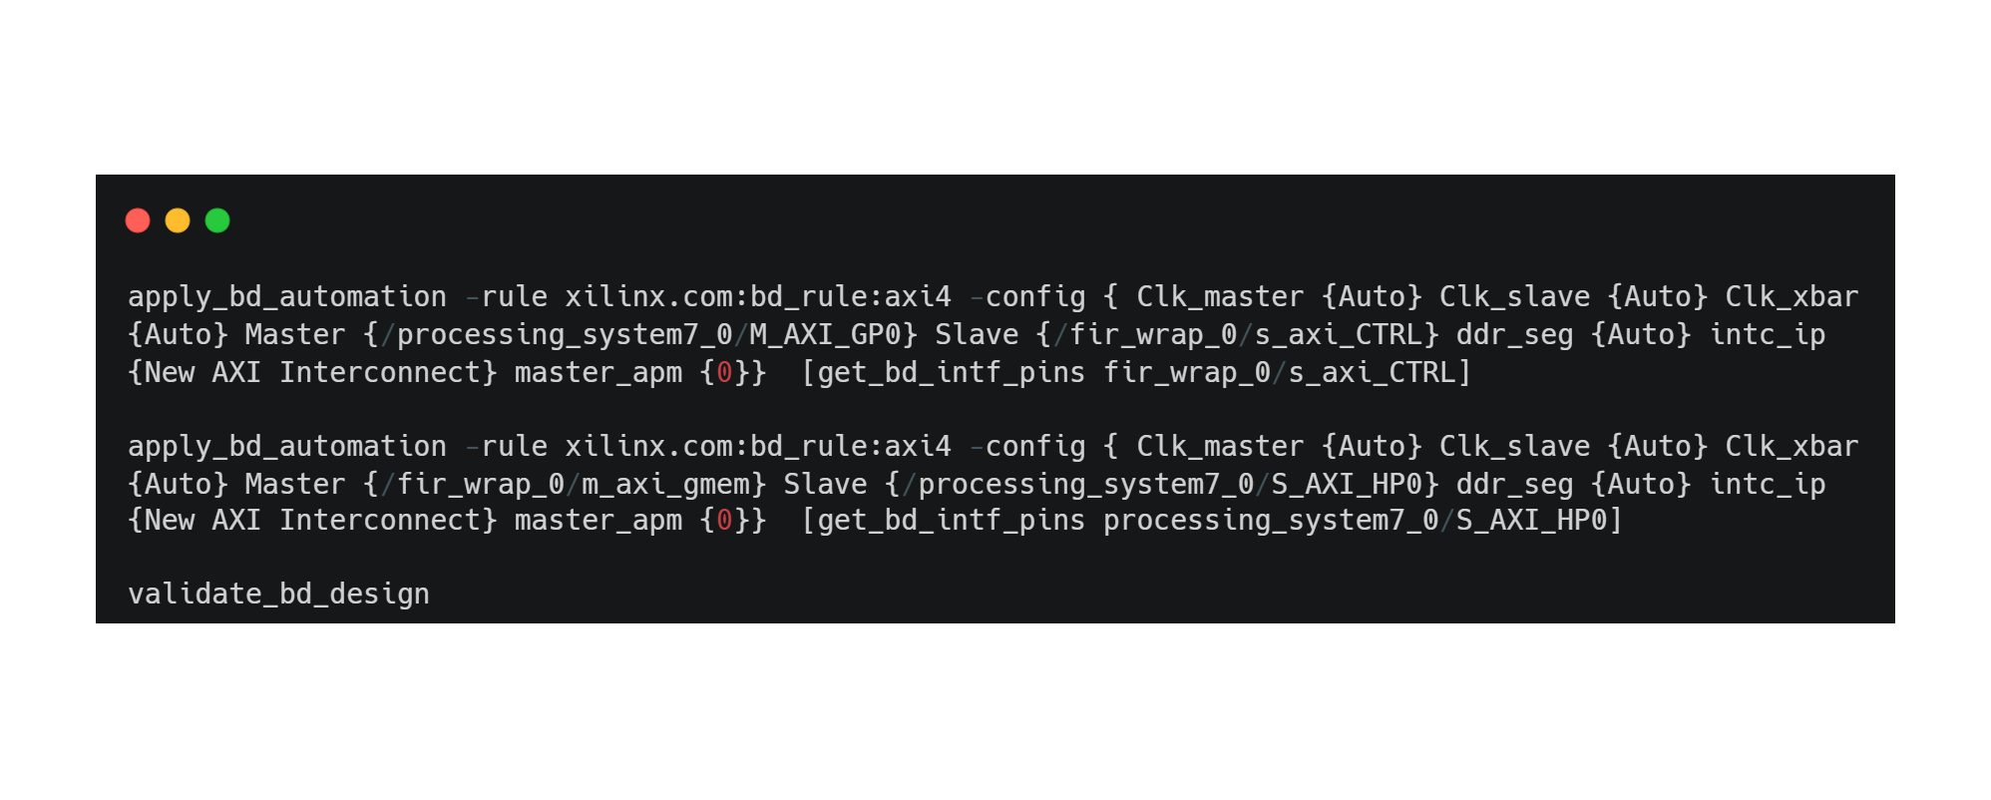
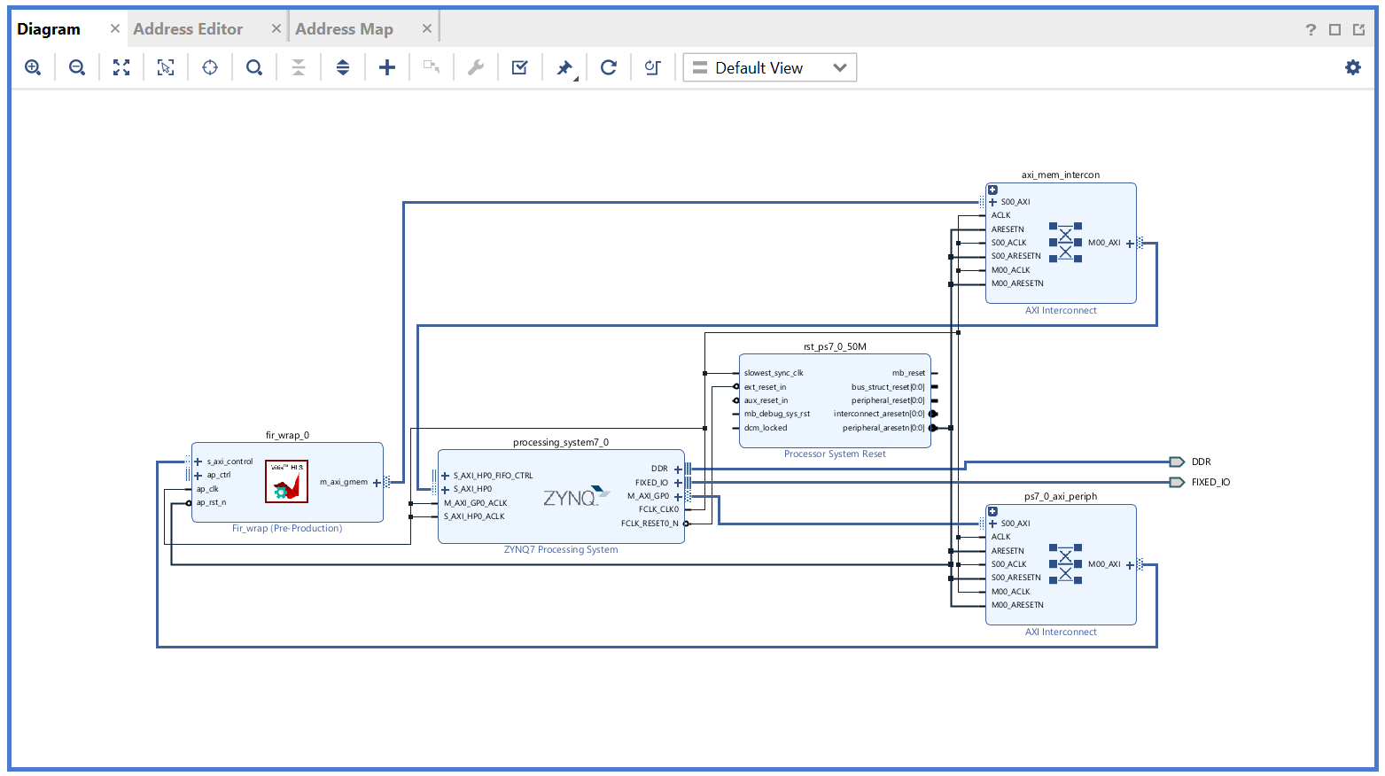
2.3 Create a Block Design
Run connection automation
validate
Run Connection Automation and validate

Slide 22
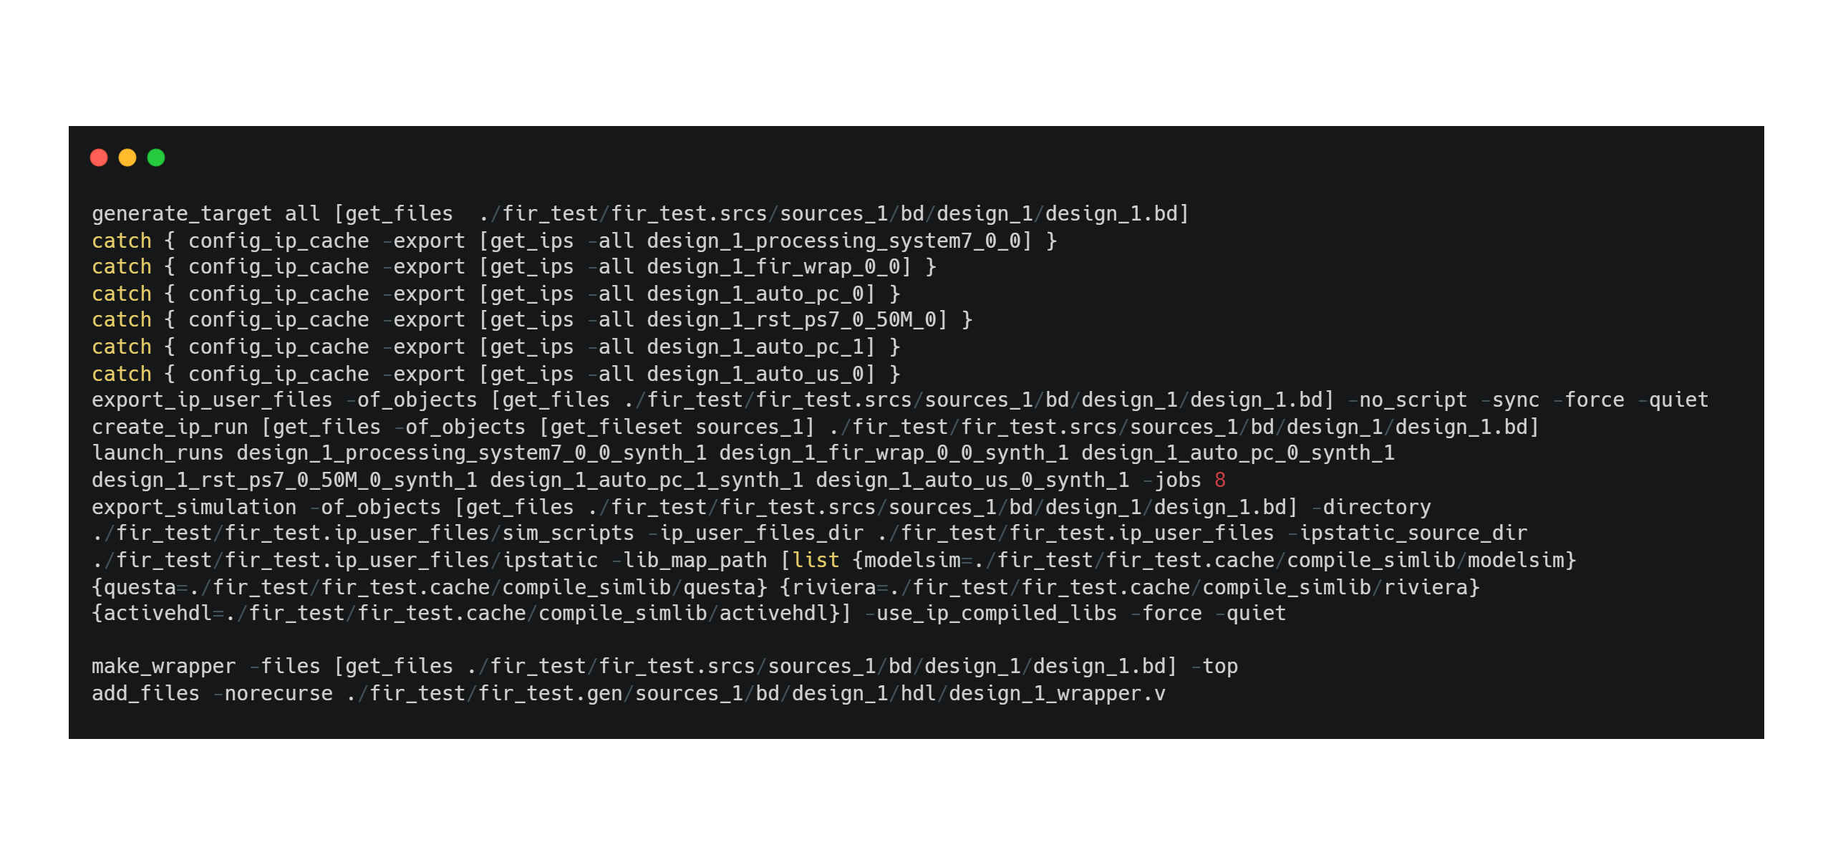
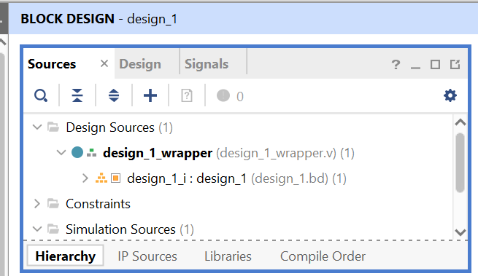
2.3 Create a Block Design
Generate Output Products and Create HDL Wrapper

Slide 23
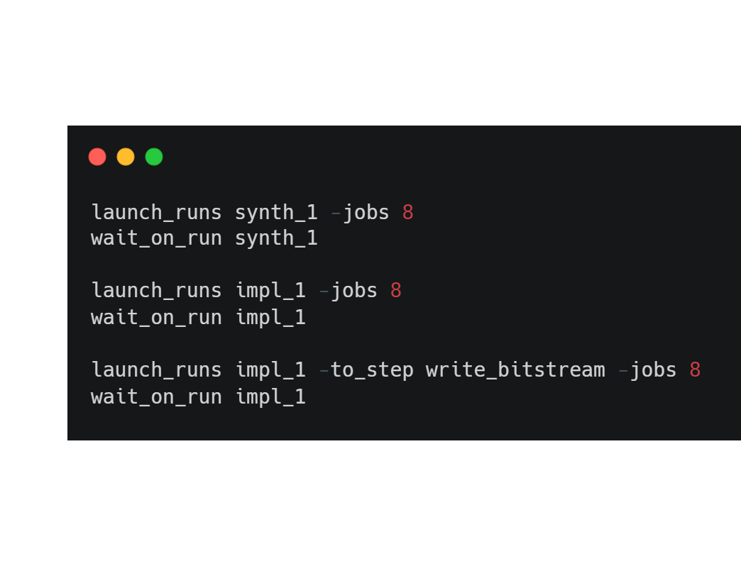
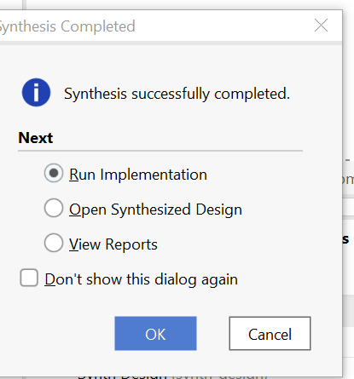
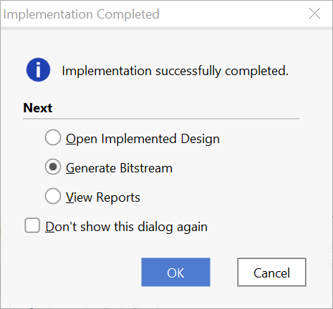
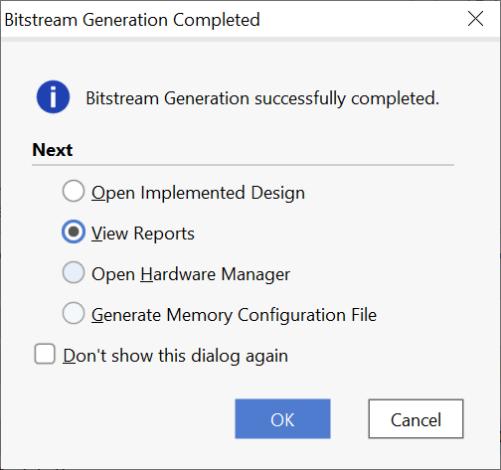
2.4 Synthesis and Generation of Bitstreams
Run Synthesis, Implementation and generate bitstream

Slide 24
Hardware Testing
Extract bit and hwh files
Visit Jupyter by anaconda
Deploy and run overlay

Slide 25
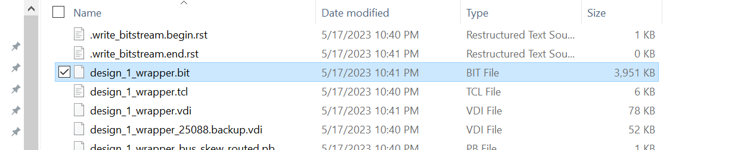
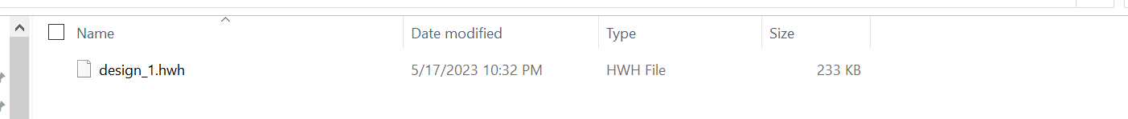
Extract bit and hwh Files
Visit the \fir_vivado_prj\fir_vivado_prj.runs\impl_1 directory in the file manager, the design_1_wrapper.bit file in that directory is the generated bitstream file, copy it to your own folder to save it and rename it to fir.bit
In the file manager, access the \fir_vivado_prj\fir_vivado_prj.gen\sources_1\bd\design_1\hw_handoff directory, where design_1.hwh is the hardware handoff file we need Copy it to your own folder and rename it to fir.hwh.

Slide 26
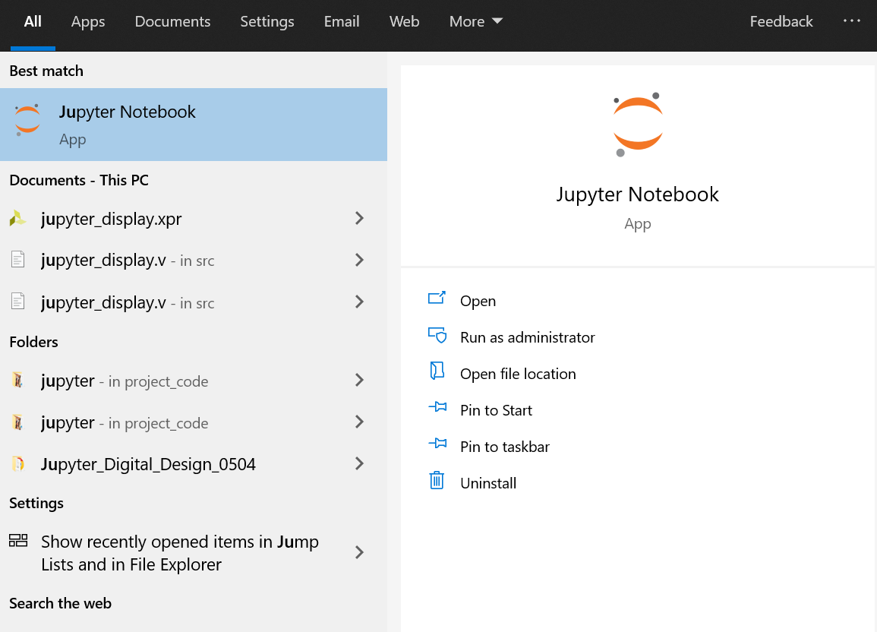
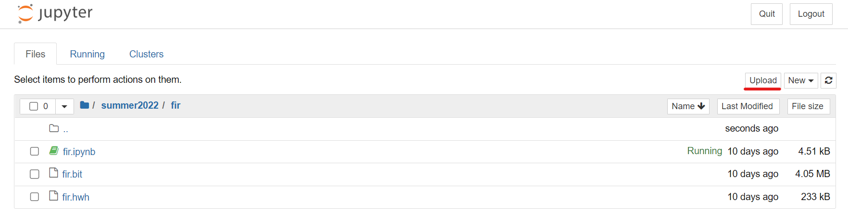
Visit Jupyter by Anaconda
Notes:
Open jupyter notebook and enter your file address.

Slide 27
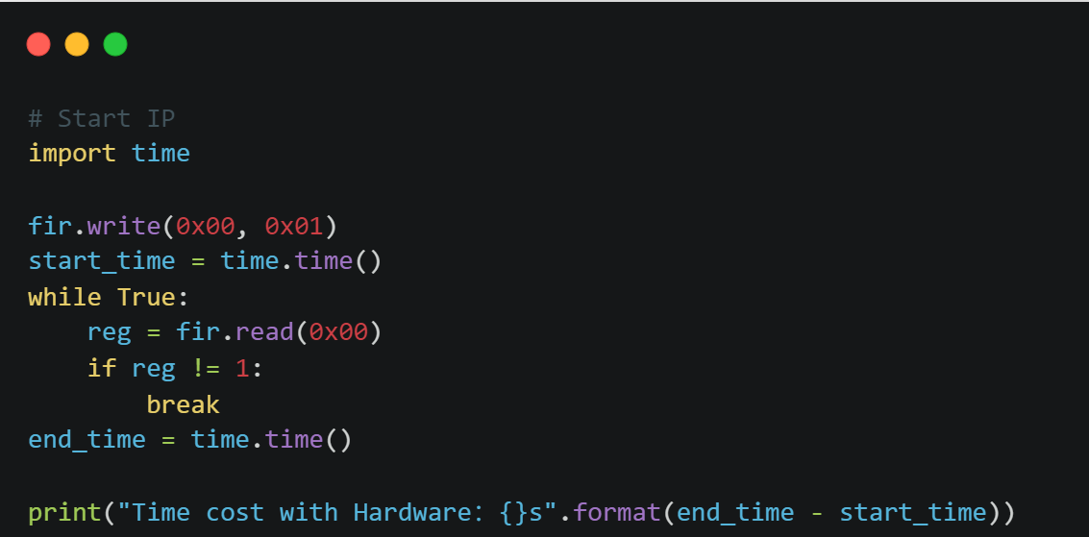
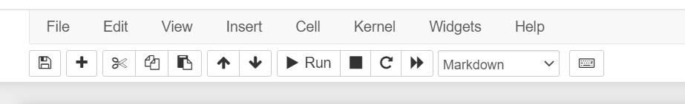
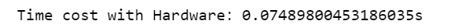
Deploy and Run Overlay
Question: What is the purpose of each operation in jupyter notebook?
Click the Run button on the top side of the window, Jupyter Notebook will execute the current Cell and automatically switch to the next Cell at the same time
Notes:
Run the ipynb file and you can get the result fo 0.07s.
For each step in ipynb, you can consider it and we will introduce it carefully in module 3.

Slide 28
Deploy and Run Overlay
Click the Run button on the top side of the window, Jupyter Notebook will execute the current Cell and automatically switch to the next Cell at the same time
YOU HAVE DONE IT!

