Slide 1
AI-Based Customer Segmentation
Personalized Marketing Recommendation System
using Machine Learning
Nigilan | 145731105
BE CSE AI | Sathyabama university
Academic year: 2026-2027
Guide: [Guide name - not assigned]
1
Notes:
Editable title slide. Details supplied by the student; no guide or approval is invented. Synthetic demonstration data.

Slide 2
Introduction
Customer behavior varies beyond income and spending score.
Purchase recency, frequency and monetary value add useful context.
This system combines unsupervised learning with transparent marketing rules.
The demonstration uses synthetic records and makes no claim of real campaign lift.
2
Notes:
Explain the distinction between learned groups and designed recommendation rules. Source: project README and src modules.

Slide 3
Problem statement
How can an analyst turn customer and purchase records into interpretable customer groups?
Compare alternative clustering assumptions using a consistent feature space.
Explain new-customer assignments and propose actions without claiming ground-truth customer labels.
3

Slide 4
Objectives
1. Derive and reconcile RFM from transaction records.
2. Compare four models using three internal metrics and coverage.
3. Explain customer assignments and segment-based marketing rules.
4. Deliver authenticated analytics, saved models and SQLite history.
4

Slide 5
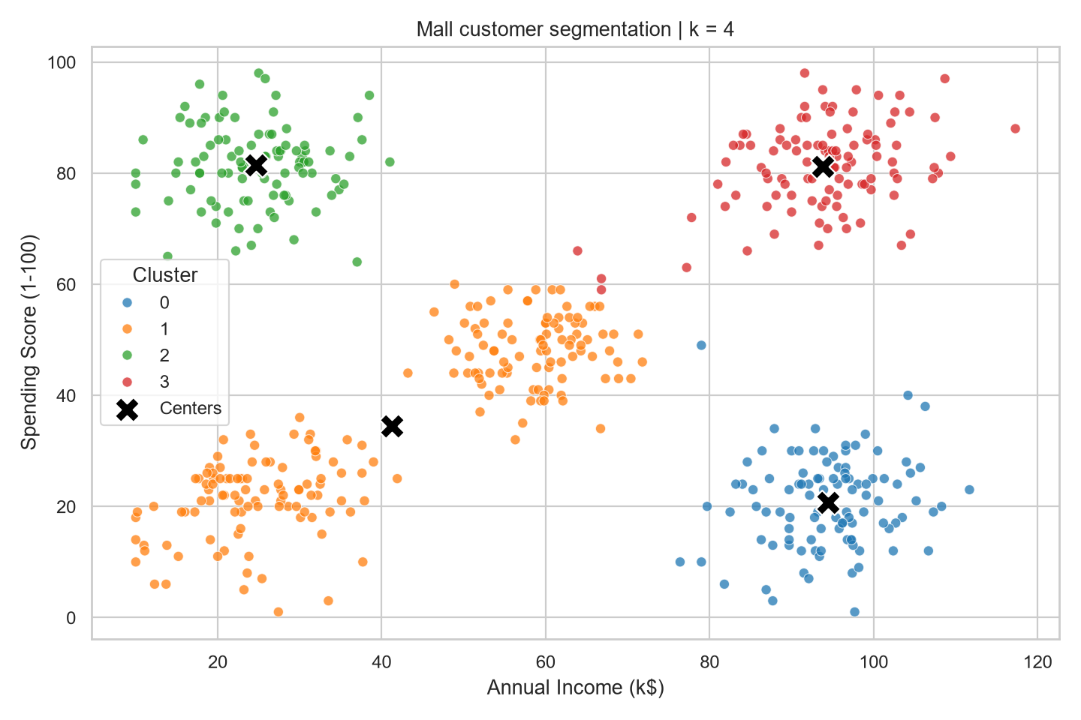
Existing system
Original baseline
500 synthetic customers
Income + spending score
K-Means and elbow analysis
Single-page Streamlit app
5
Notes:
Image is the original project output, preserved under legacy. The final application retains classic mode and legacy files.

Slide 6
Proposed system
2,000 customers and 32,800 purchases with transaction-derived RFM.
Four clustering algorithms, comparison scores and explained assignments.
Administrator login, six protected views and local analysis history.
Segment profiles produce campaign suggestions that users can inspect and export.
6

Slide 7
System architecture
Admin login
Protected dashboard
CSV + RFM
Profiles + marketing
Four ML models
SQLite snapshot
Local files and saved model bundles support reproducible analysis.
7

Slide 8
Dataset
Component | Size / unit | Purpose
Customers | 2,000 records | Synthetic customer profiles
Transactions | 32,800 purchases | Auditable RFM aggregation
Income / monetary | Thousands USD / USD | Explicit unit distinction
Analysis date | 2026-09-25 | Reproducible recency
Window | 365 days, inclusive boundaries | Comparable observation period
Gender and satisfaction are descriptive; IDs never enter model distances.
8

Slide 9
RFM analysis
Measure | Definition | Worked example
Recency | Days since latest purchase | 5 days
Frequency | Number of in-window purchases | 3 purchases
Monetary | Sum of in-window amounts | $300
Example: $120 + $80 + $100, latest purchase 20 September, reference date 25 September.
9
Notes:
Worked example is illustrative, not a claim about a particular dataset row. No-purchase customers use frequency/value 0 and recency sentinel 366.

Slide 10
Machine learning algorithms
Model | Training idea | New-customer assignment
K-Means | Nearest mean, squared distance | Native prediction
Ward hierarchy | Merge by variance increase | Nearest-centroid proxy
DBSCAN | Density and noise | Core-sample radius extension
Gaussian Mixture | Probabilistic components | Native posterior assignment
Shared preprocessing: median imputation, log1p(RFM), standard scaling.
10
Notes:
Sources: https://scikit-learn.org/stable/modules/clustering.html and https://scikit-learn.org/stable/modules/mixture.html. The extension rules are project implementation choices.

Slide 11
Model comparison
Model | Groups | Coverage | Silhouette | DBI | CH
K-Means | 4 | 100.0% | 0.373 | 1.006 | 1330.1
Agglomerative | 4 | 100.0% | 0.369 | 0.980 | 1237.7
DBSCAN | 3 | 84.8% | 0.342 | 1.002 | 880.6
Gaussian Mixture | 4 | 100.0% | 0.355 | 1.059 | 1246.7
Recommended: K-Means
Ward leads DBI; DBSCAN excludes 304 customers. Scores are not accuracy.
11
Notes:
Measured source: outputs/model_comparison.csv. Higher silhouette/CH and lower DBI are preferred. Rank averages include a coverage penalty and require 80% coverage.

Slide 12
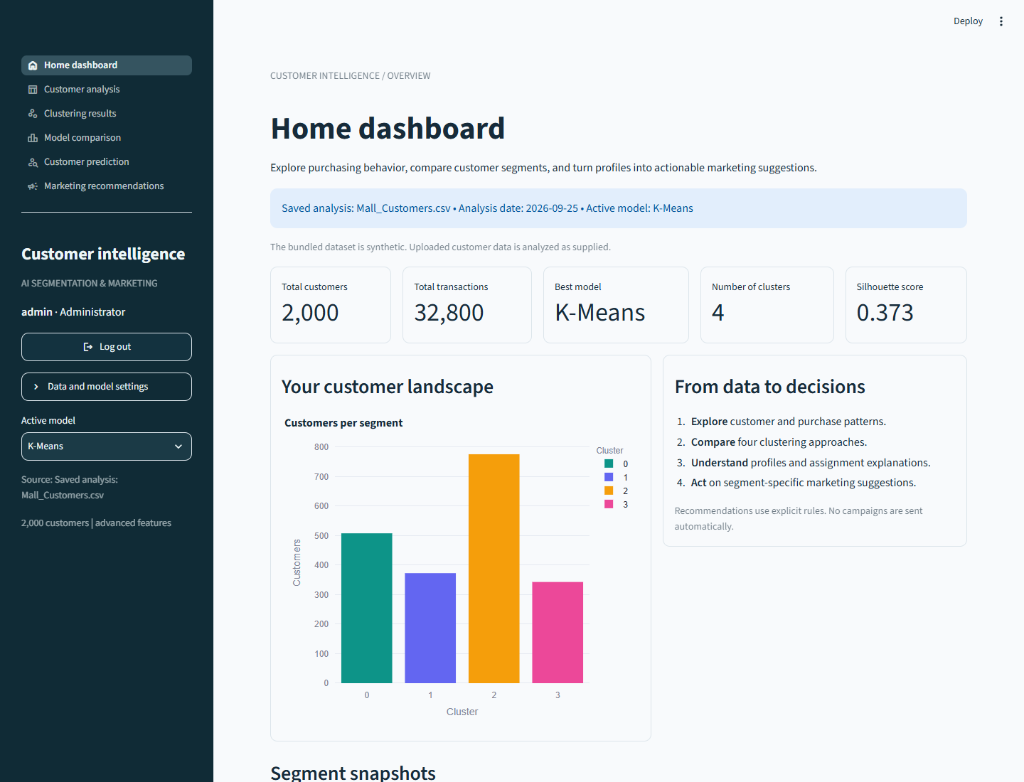
Dashboard demonstration
1. Sign in as administrator.
2. Inspect customer analysis.
3. Compare fitted models.
4. Predict and explain a profile.
5. Export recommendations.
12
Notes:
Actual dashboard screenshot. Demo account admin/admin123 is for local college use. The original legacy app is a separate historical demo.

Slide 13
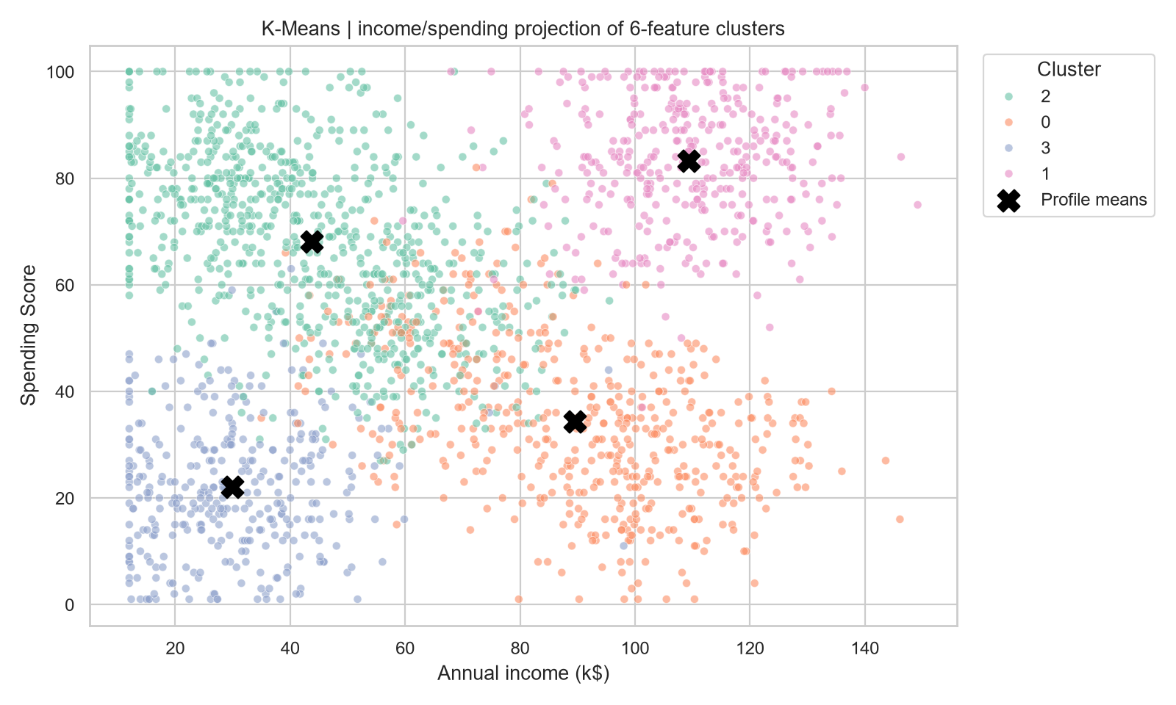
Results
4 K-Means groups
0.373 silhouette
VIP, growth, value-focused and at-risk engagement profiles
Synthetic evidence; no revenue claim
13
Notes:
Measured project outputs. Plot is an income/spending projection of six-feature clusters. Cluster IDs are arbitrary.

Slide 14
Future scope
Validate on representative customer data and audit feature choices.
Study stability across samples, time windows and parameter settings.
Evaluate campaigns with controlled experiments.
Add managed identity, retention controls and monitored deployment.
14

Slide 15
Conclusion
A complete, reproducible customer analytics workflow is implemented.
RFM and multiple algorithms extend the original K-Means baseline.
Profiles and explanations make outputs easier to inspect and discuss.
The next step is real-data and business-outcome validation.
15
Notes:
Do not claim accuracy, causal explanations or proven campaign success. Invite questions about assumptions, DBSCAN coverage and prediction extensions.

