Slide 1





Addis Ababa University
Intelligent AI and Data Engineering
Used Car Price Prediction
Presenter : Nigus Admas
Date:8/3/2026G.c
YOUR LOGO
PRESENTATION

Slide 2

CONTENTS
Background and Problem Statement
Project Objectives
Dataset Description
Data Preprocessing
Exploratory Data Analysis
Feature Engineering
Machine Learning Models
Model Evaluation
Web Application Development
Results and Discussion
Conclusion and Future Work

Slide 3
YOUR LOGO
Background significance
The used car market has expanded rapidly due to increasing demand for affordable transportation. However, determining the correct selling price of a used vehicle remains challenging because many factors such as vehicle age, mileage, fuel type, transmission, engine capacity, and brand influence its value.
Traditional pricing methods rely heavily on personal experience and manual comparison, which often produce inconsistent and inaccurate estimates. Machine Learning offers an intelligent alternative by learning patterns from historical sales data to predict vehicle prices with greater accuracy and consistency.
Graduate Thesis Defense PPT Template
PRESENTATION

Slide 4
Problem Statement
Pricing a used vehicle accurately is difficult because every car has unique characteristics. Buyers often overpay, while sellers may undervalue their vehicles due to limited market knowledge.
The absence of an intelligent pricing system leads to inconsistent pricing decisions and reduced market efficiency.
This project addresses the problem by developing a Machine Learning model capable of estimating a vehicle's selling price based on its features.

Slide 5


Project Objectives
Specific Objective
Understand and analyze the used car dataset.
Clean and preprocess the collected data.
Perform exploratory data analysis to identify trends and relationships.
Create meaningful features to improve prediction accuracy.
Train and compare multiple regression algorithms.
Develop an interactive Streamlit web application for real-time price prediction.
General Objective
To develop an intelligent Machine Learning model that accurately predicts the selling price of used cars.

Slide 6
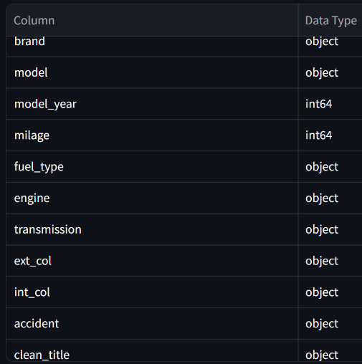
Dataset Description
Important Features
Total Records: 4,009
Target Variable: Selling Price
Column
Rows
12
4,009

Slide 7
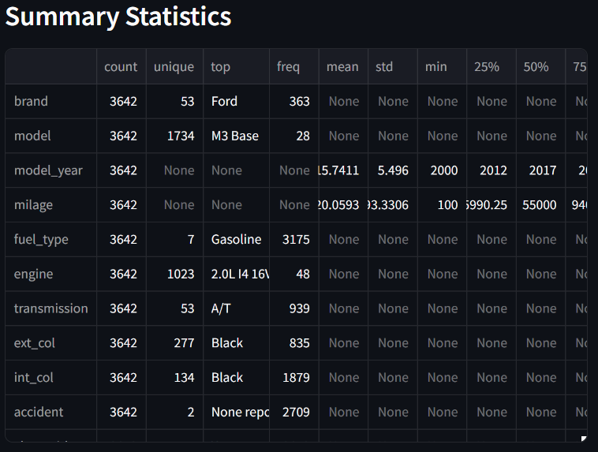
Data Preprocessing
Handling missing values
Removing duplicate records
Detecting and treating outliers
Encoding categorical variables
Scaling numerical variables where necessary
Splitting the dataset into training and testing sets

Slide 8
Exploratory Data Analysis
Major observations include:
Luxury brands generally have higher average selling prices.
Newer vehicles tend to sell for more than older vehicles.
Vehicles with lower mileage generally have higher prices.
Accident history negatively affects resale value.
Brand is one of the strongest predictors of price.
Model year has a positive relationship with price.
Mileage has a negative relationship with price.
Most cars in the dataset are manufactured after 2015.

Slide 9
Feature Engineering
Additional features were created to improve the predictive capability of the Machine Learning models.
The newly engineered features include:
Vehicle Age
Mileage per Year
Luxury Brand Indicator
Vehicle Age Category
These engineered features capture hidden relationships within the dataset and significantly improve prediction accuracy.

Slide 10
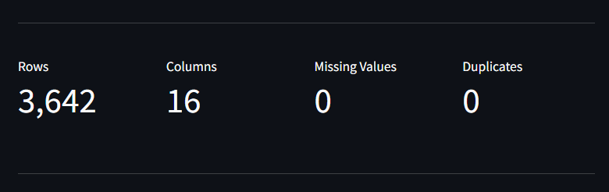
After performing Feature Engineerung, the dataset was cleaned and prepared for machine learning. Data quality issues were identified and resolved to improve model performance.

Slide 11
Machine Learning Models
Several regression algorithms were trained and evaluated to identify the most suitable prediction model.
The models include:
Linear Regression
Ridge Regression
Lasso Regression
Decision Tree Regressor
Random Forest Regressor
Gradient Boosting Regressor
Extra Trees Regressor
Each model was trained using the same processed dataset and evaluated using identical performance metrics to ensure a fair comparison.

Slide 12
Model Evaluation
The trained models were evaluated using widely accepted regression performance metrics.
The metrics include:
Mean Absolute Error (MAE):-Measures the average prediction error
Root Mean Square Error (RMSE):-Measures prediction accuracy while giving greater weight to large errors.
R² Score:-Measures how well the model explains the variation in selling prices.
etc.
The Ridge Regression achieved the highest prediction accuracy and demonstrated superior generalization performance compared to the other algorithms.

Slide 13
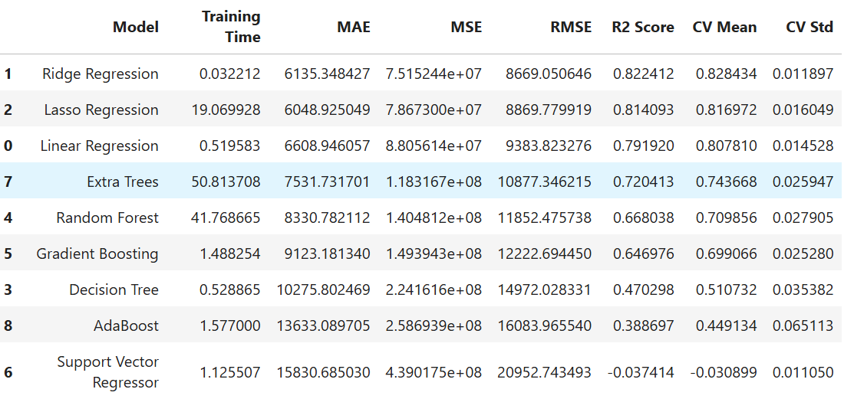
Model Evaluation

Slide 14
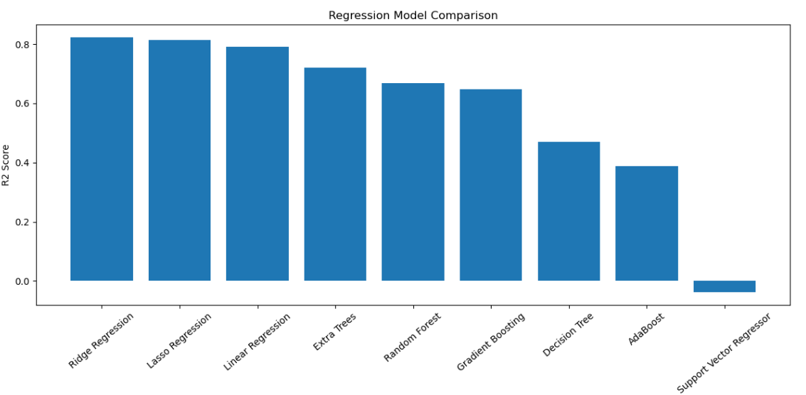
Model Evaluation

Slide 15
Model Evaluation
After comparing all regression algorithms, the Random Forest Regressor was selected as the final prediction model.
Reasons for selection:
Strong generalization capability
Mean Absolute Error (MAE):-Lowest prediction error.
Hieghest R² Score:-Highest prediction accuracy.
etc.
The trained model was saved using Joblib and integrated into the Streamlit application for real-time predictions.

Slide 16
Web Application
01
Interactive user interface
02
Easy vehicle information input form
03
Instant selling price prediction
04
Enough Information/
05
Download prediction results

Slide 17
Results and Discussion
The developed Machine Learning system successfully predicts used car
prices with high accuracy.
Major achievements include:
Successful data preprocessing
Effective feature engineering.
Comparison of multiple regression models
Selection of Random Forest as the best-performing model.
Development of a fully functional Streamlit prediction application
The project demonstrates the practical application of Machine Learning in solving real-world business problems.

Slide 18
Conclusion
This project successfully developed an intelligent Machine Learning system capable of predicting used car prices using historical vehicle data.
The Ridge Regression model produced the best overall performance and was integrated into an interactive Streamlit application, enabling users to obtain accurate price predictions quickly and efficiently.
The project highlights how data-driven techniques can support better decision-making in the used vehicle market.

Slide 19
Future Work
Future improvements may include:
Collecting a larger and more diverse dataset
Incorporating real-time market information
Using advanced ensemble and deep learning models
Deploying the application on cloud platforms
Developing a mobile version of the prediction system
Integrating image-based vehicle condition analysis

Slide 20
02
Thank you For Your Attention!!
PRESENTATION

