Slide 1
Introduction to NLP for biomedical text analysis
Mark Benson & V. Keith Hughitt
NIH BYOB
Aug 13, 2020

Slide 2

What is Natural Language Processing (NLP)?
“Natural Language Processing or NLP is a field of Artificial Intelligence that gives the machines the ability to read, understand and derive meaning from human languages.” (KDnuggets)
Involves processing large amount of unstructured data.
First steps often involve the syntactic and semantic analysis of text -- understanding the structure and meaning of that text.
Unstructured text is often processed into vector representations that capture important semantic or contextual information and allows for mathematical operations (cosine similarity, etc.) to be used for comparisons.
Benefited from recent advances in deep learning (RNNs, and more recently, transformer architecture..)
https://thetechnomaniac.com/what-is-natural-language-processing/
Notes:
Attention
-For every word in a sentence, can have a attention vector: weights indicating how relevant other words in the sentence are to the current word.
-So a sentence of 10 words, you end up with a 10x10 attention “matrix”.

Slide 3
NLP is a rapidly growing field...

Slide 4
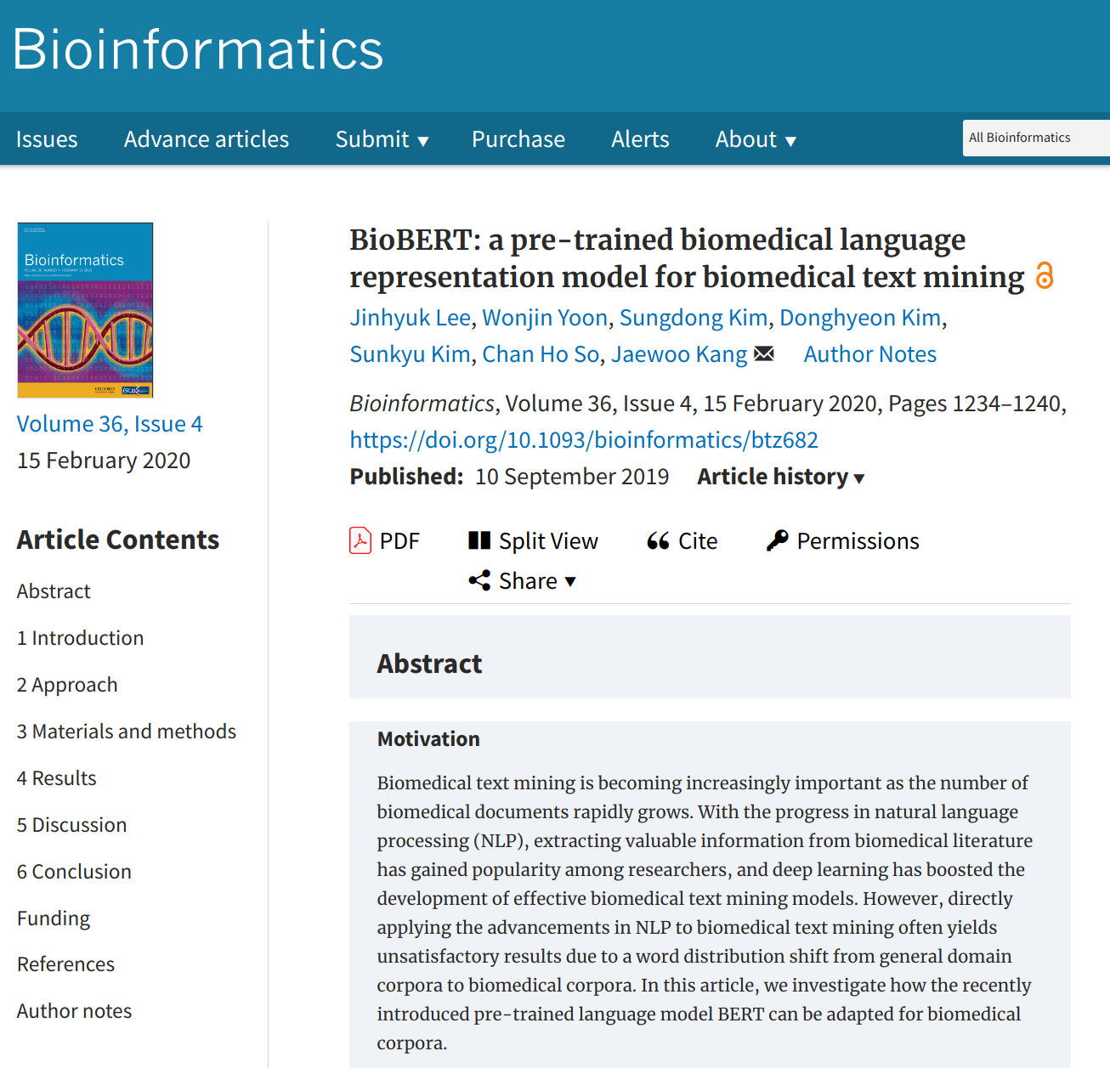
Adaptation of Google’s BERT pre-trained language model to biomedical texts..

Slide 5
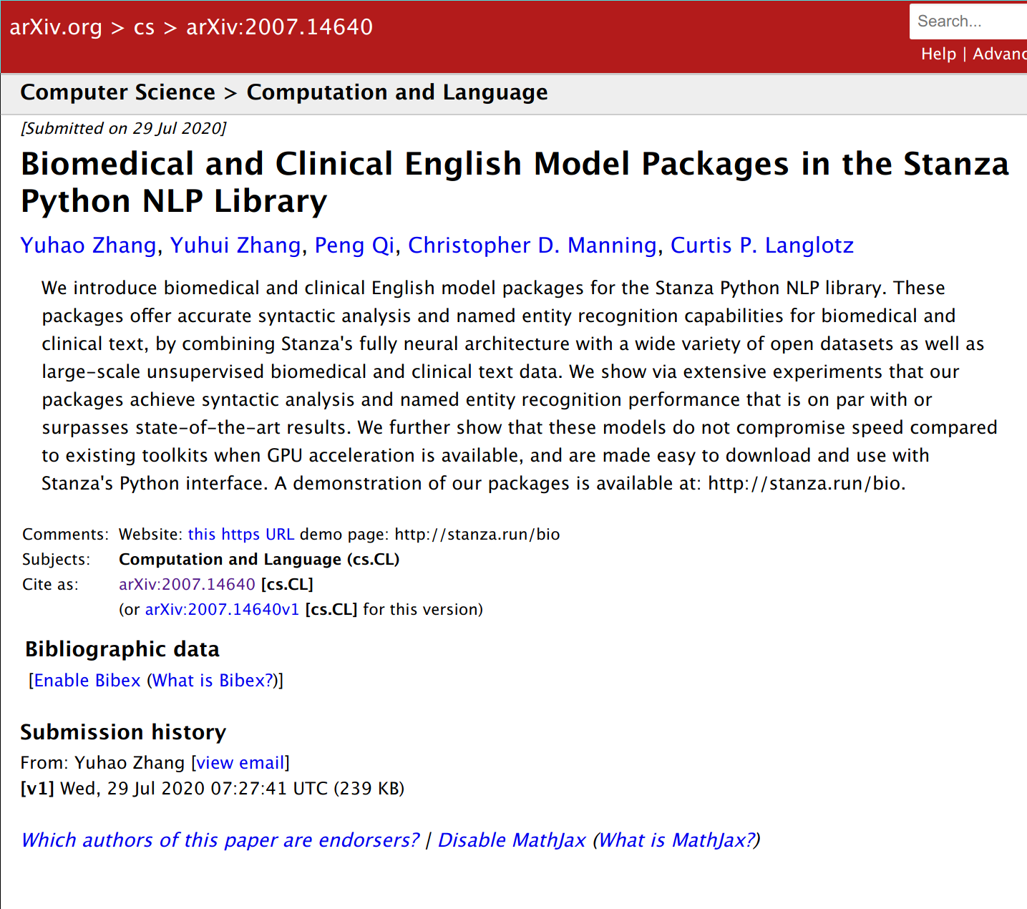

Slide 6
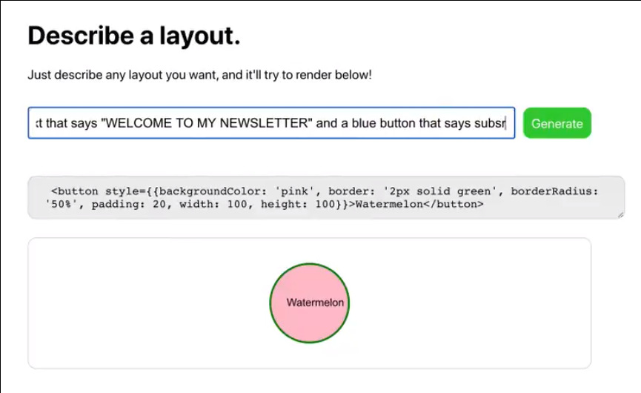
Generative Pre-trained Transformer 3 (GPT-3)
A pre-trained generative text model released in July 2020.
Can be used as a generalized “autocomplete” engine.
Built using deep learning model trained on a massive text corpus..
The entirety of Wikipedia makes up only ~ 0.6% of the training set.
Example uses in the wild:
Question answer search engine
Code generation
Text style transfer
https://tinyurl.com/gpt3layout
Notes:
A fun non-bio example..
GPT: 117m params (2018)
GPT-2: 1.5b params (2019)
GPT-3: 175b params (2020)
Training Set: All of Wikipedia + ??? (Wikipedia makes up about 0.5% of it’s training set)
More examples of GPT-3 in the wild: https://analyticsindiamag.com/openai-gpt-3-model-machine-learning-products/

Slide 7
NLP Basics

Slide 8
Text pre-processing
In order to make it easier and more efficient to analyze and compare text, there are a few operations that are commonly applied at the start of many NLP pipelines..
“c-Myc is regulated by HIF-2α in chronic hypoxia”
(raw sentence)
The first step in processing often involves removing uninformative stop words.
“c-Myc is regulated by HIF-2α in chronic hypoxia”
“c-Myc regulat HIF-2α chronic hypoxia”
Removal of suffixes is referred to as “stemming”
Lemmatization is similar, but instead reduces words to their valid root words, e.g. “sang”, “sung”, and “sing” all become “sing”.
“c-Myc regulate HIF-2α chronic hypoxia”
Named Entity Recognition involves annotating different types of proper nouns, in this case: genes and diseases.
“c-Myc regulate HIF-2α chronic hypoxia”
*Example sentence taken from the title of an Onctotarget article by Wang et al. (2016).
Notes:
Few other common tasks
Tokenization
semantic analysis / part-of-speech detection
universal dependency (UD) characterization

Slide 9
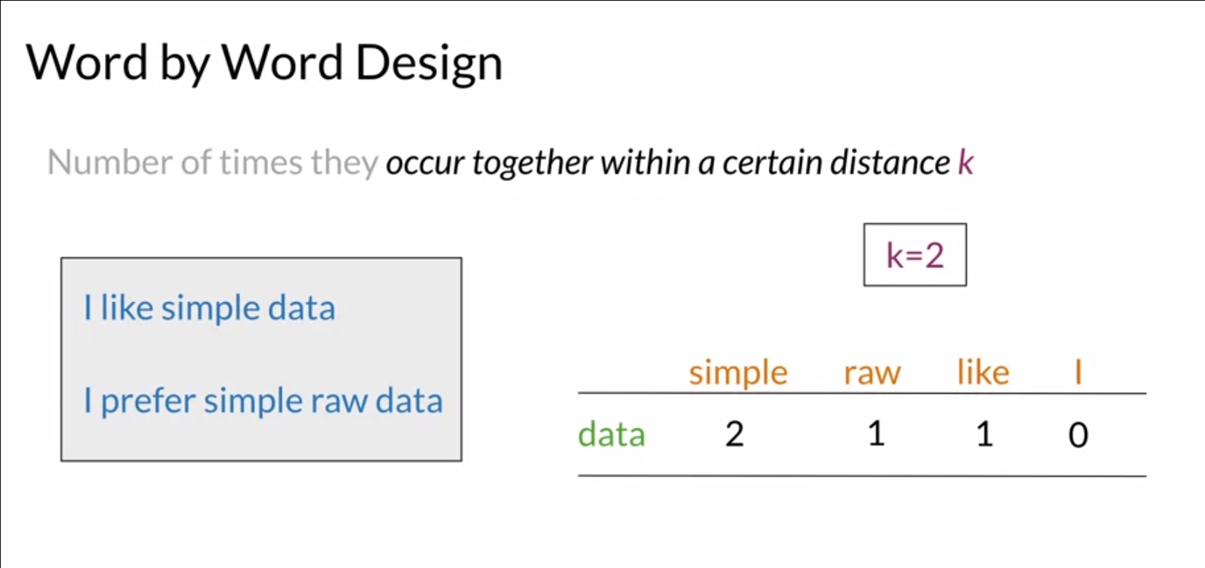
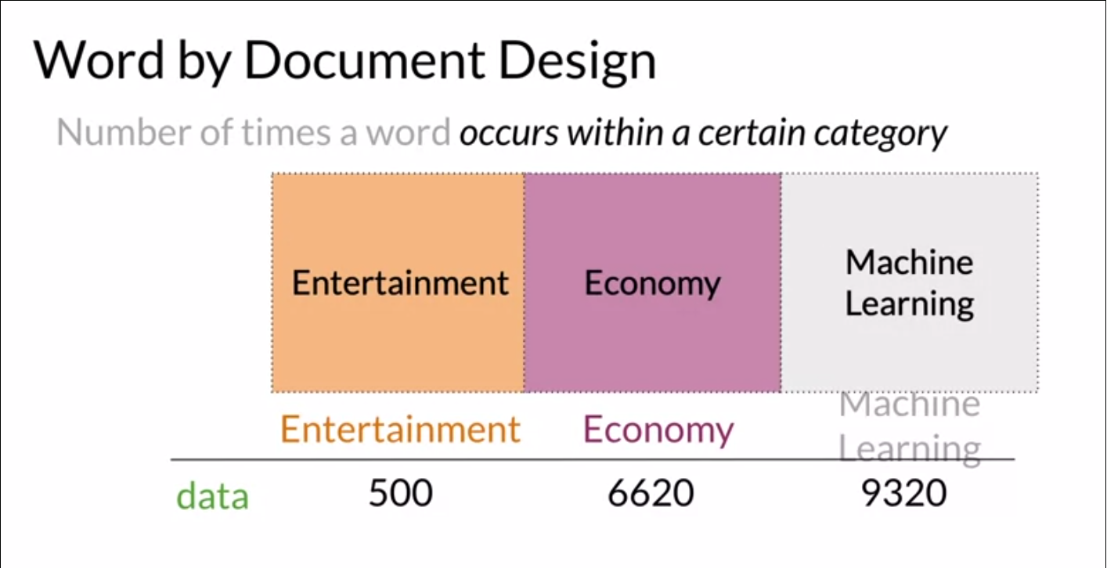
Word embedding
Word embedding or vectorization is the process of converting text into numeric vector representations.
This allows us to do things like:
Similarity searches
Transformations
Translations
Basic approaches often make use of sentence or document-level co-occurrence matrices:
Within a specified distance within sentences (“word by word”)
Within a collection of related documents (“word by document”)
(Source: deeplearning.ai | coursera)

Slide 10
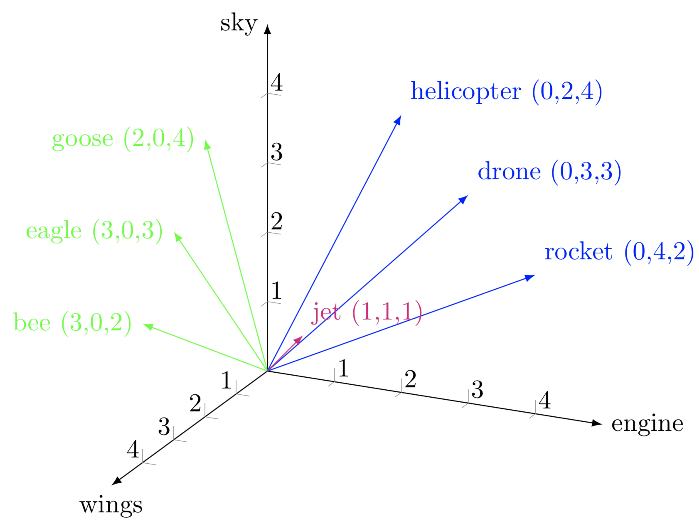
Word embedding
Once we have a vector representation of a word (or sentence, or document..), we can can apply the usual vector math operations (e.g. cosine similarity) on them!
Important assumption:
Similar words are near each other in the projected vector space.
(Related: locality-sensitive hashing)
Source: https://corpling.hypotheses.org/495
Notes:
Embedding spaces
(Numeric) vector spaces words can be projected to such that proximal words are similar in meaning.
Positional encoders in transformer models can be used to help deal with the fact that a word’s meaning (and thus where it should projected to) is context-dependent.

Slide 11
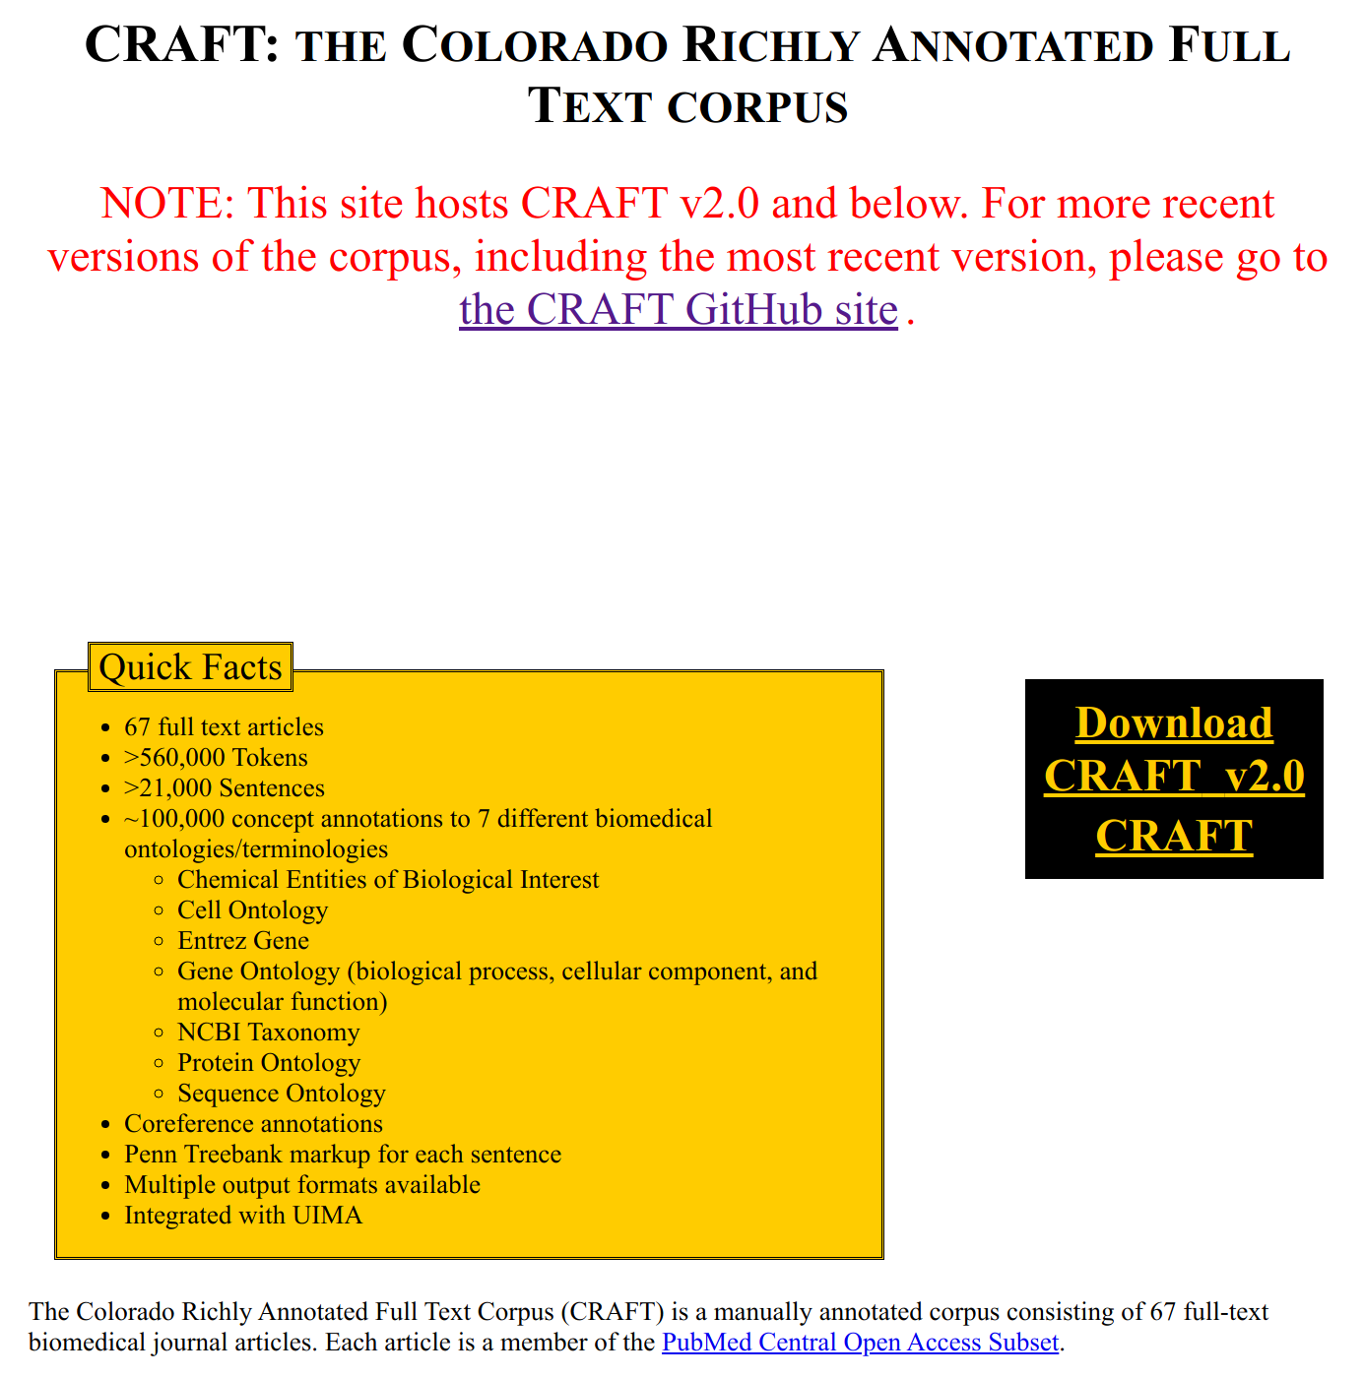
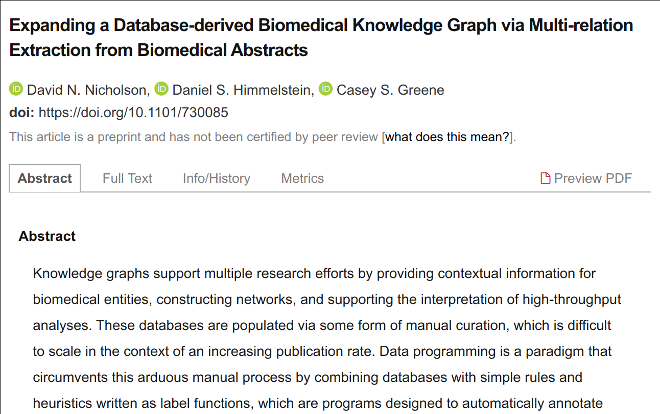
Text Corpora
Training of NLP methods often make use of large Text corpuses (large collections of structured text) and treebanks (parsed corpuses with annotated syntactic and semantic elements).
One advantage NLP has over other subfields of ML: there is massive amounts of free text sources on the internet..
For supervised methods, however, the annotation process can still be extremely time-consuming.
Some recent efforts (e.g. Snorkeling) attempt to speed up the process up the process by applying a transfer learning approach to relationship extraction.
Notes:
LDA - “In natural language processing, the latent Dirichlet allocation (LDA) is a generative statistical model that allows sets of observations to be explained by unobserved groups that explain why some parts of the data are similar.”
In the context of population genetics, LDA was proposed by J. K. Pritchard, M. Stephens and P. Donnelly in 2000.^{[1][2]} LDA was applied in machine learning by David Blei, Andrew Ng and Michael I. Jordan in 2003.^{[3]} (wikipedia)

Slide 12
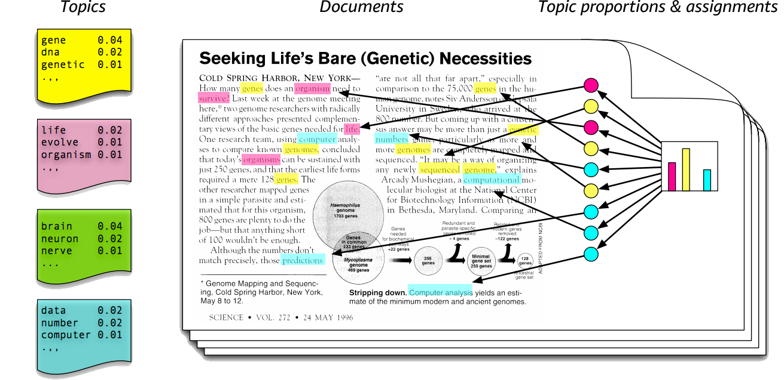
Unsupervised vs. supervised methods in NLP
Similar to other ML subfields, there are both supervised and unsupervised NLP methods.
Unsupervised methods attempt to extract relationships and detect latent features in unannotated text corpuses.
Latent Dirichlet Allocation (LDA) used for topic modeling, for example, is a generative statistical model that assumes that documents can be modeled as mixtures of some small number of “topics”, each with their own distributions of word frequencies.
Supervised methods rely on labeled training sets to build predictors.
Text classification
Predicting semantic relationships between named entities (e.g. drug-gene pairs)
Topic modeling using LDA
(https://medium.com/batteries-included/topic-modeling-using-lda-algorithm-nlp-part-2-b86d2646a2b)
Notes:
LDA - “In natural language processing, the latent Dirichlet allocation (LDA) is a generative statistical model that allows sets of observations to be explained by unobserved groups that explain why some parts of the data are similar.”
In the context of population genetics, LDA was proposed by J. K. Pritchard, M. Stephens and P. Donnelly in 2000.^{[1][2]} LDA was applied in machine learning by David Blei, Andrew Ng and Michael I. Jordan in 2003.^{[3]} (wikipedia)

Slide 13
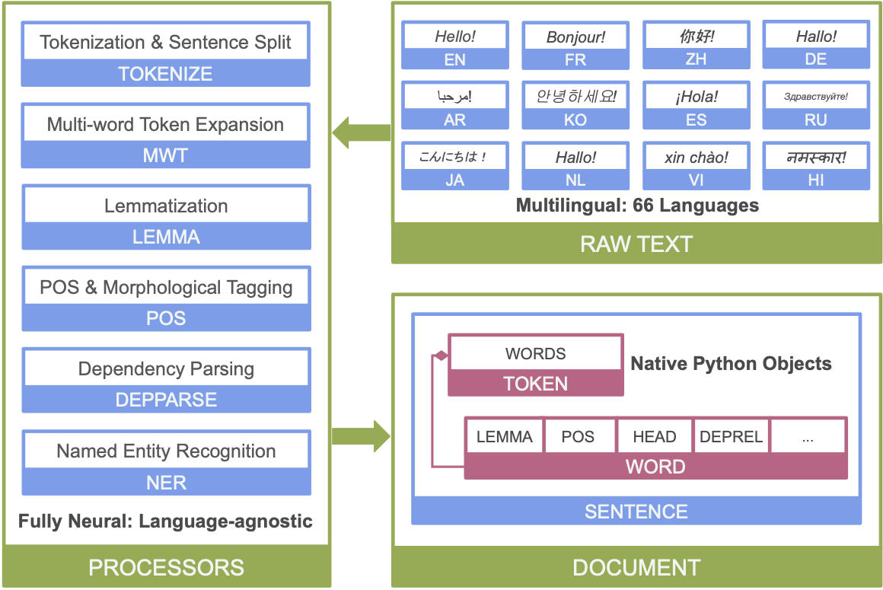
NLP Frameworks
NLP frameworks provide collections of methods for analyzing text and assist in constructing computational pipelines.
NLPTK, spaCy, and Stanza are a few of the popular ones often used for biomedical analysis.
Stanza (from the Stanford NLP group) uses PyTorch under the hood for fast GPU-based model training and predictions.
Stanza also provides pre-trained biomedical and clinical syntactic and NER models which can be downloaded using the Python library.
Overview of Stanza’s neural network NLP pipeline
(https://stanfordnlp.github.io/stanza/)
Notes:
http://stanza.run/bio
https://www.ncbi.nlm.nih.gov/research/pubtator/?view=publication&pmid=27793037

Slide 14
More Information
Learning
A Simple Introduction to Natural Language Processing (becominghuman.ai)
Your Guide to Natural Language Processing (KDnuggets)
2019 — Year of BERT and Transformer (Towards data science)
A no-frills guide to most Natural Language Processing Models — The Transformer (XL) Era (Towards Data Science)
Coursera - NLP with Classification and Vector Spaces
Foundations of Statistical Natural Language Processing
Literature
Lee, J., Yoon, W., Kim, S., Kim, D., Kim, S., So, C. H., & Kang, J. (2020). BioBERT: a pre-trained biomedical language representation model for biomedical text mining. Bioinformatics , 36(4), 1234–1240.
Qi, P., Zhang, Y., Zhang, Y., Bolton, J., & Manning, C. D. (2020). Stanza: A Python Natural Language Processing Toolkit for Many Human Languages. In arXiv [cs.CL]. arXiv. http://arxiv.org/abs/2003.07082
Vaswani, A., Shazeer, N., Parmar, N., Uszkoreit, J., Jones, L., Gomez, A. N., Kaiser, L., & Polosukhin, I. (2017). Attention Is All You Need. In arXiv [cs.CL]. arXiv. http://arxiv.org/abs/1706.03762
Wei, C.-H., Allot, A., Leaman, R., & Lu, Z. (2019). PubTator central: automated concept annotation for biomedical full text articles. Nucleic Acids Research, 47(W1), W587–W593.
Zhang, Y., Zhang, Y., Qi, P., Manning, C. D., & Langlotz, C. P. (2020). Biomedical and Clinical English Model Packages in the Stanza Python NLP Library. In arXiv [cs.CL]. arXiv. http://arxiv.org/abs/2007.14640

Slide 15
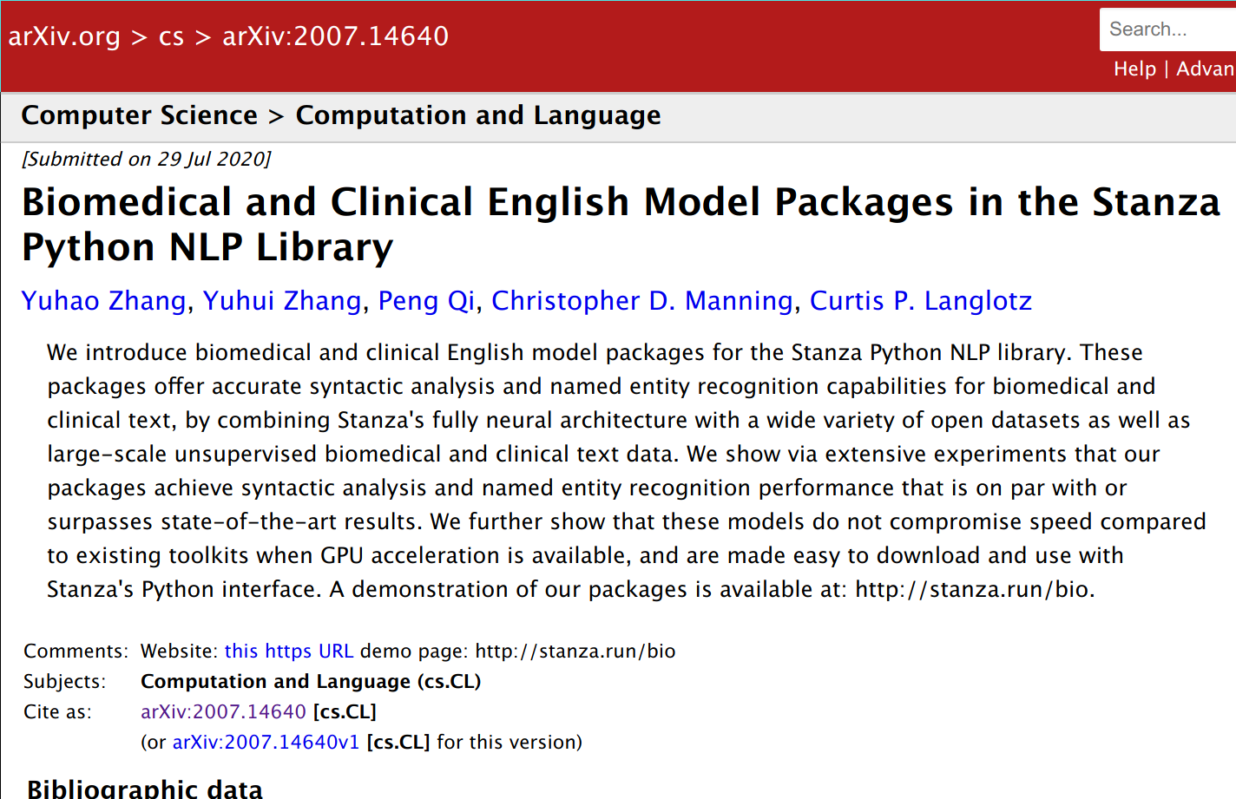
(Stanza Jupyter demo..)

