Slide 1
Introduction to NLP for biomedical text analysis
Mark Benson & V. Keith Hughitt
NIH BYOB
Aug 13, 2020

Slide 2
What can NLP Do for me?
Information Extraction
* Organize, structure into computable format
* Produce a structured representation (concepts and relationships), of relevant information
Name Entity Recognition
* find and classify names
Classification
Is document spam; does it talk about desired concept X or Y
Classify intent of document? (helpbot detects What does user want? – direct to technical support, vs billing)
Sentiment Analysis
Clinical Trials and EHR
Biocuration
Precision Medicine Support
Pubmed and Literature-ome
* PubTator Central, Text Mining Tools
https://www.ncbi.nlm.nih.gov/research/pubtator/ https://www.ncbi.nlm.nih.gov/research/bionlp/tools/
Notes:
What can NLP Do for me?
Tasks and Applications

Slide 3
“What’s in a name?”
Q: How many trials in have looked at BRAF V600E or EGFR mutations as an Eligibility Inclusion criterion?
B-Raf
v-Raf murine sarcoma viral oncogene homolog B
BRAF Val600Glu
BRAF V600 mutation
BRAF V600 wt
BRAF wt Allele
BRAF V600E negative
BRAF V600E mutation
BRAF NP_004324.2:V600M
BRAF negative
BRAF gene mutation
Inactivating BRAF mutation
bRaf/cRaf Dimer
(b-RAF1; NS7; RAFB1)
Epidermal Growth Factor Receptor
EGFR Gene
EGFR Gene Mutation
EGFR Activating Mutation
T790M EGFR Gene Mutation
EGFR exon 21 L858R mutation
EGFR Gene Exon Deletion Mutation Nineteen
EGFR variant III
EGFR NP_005219.2:p.L861Q
EGFR NP_005219.2:p.G719X
EGFR-TKI Sensitizing Mutation
EGFR wt Allele
EGFR Gene Exon Insertion Mutation Twenty
EGFR Positive
EGFR T790M Mutation Negative
Activating EGFR Gene Mutation Negative
(ERBB; HER1; epidermal growth factor receptor)
Notes:
Why do I need Named Entity Recognition? - biomarker edition
What's in a name? That which we call a rose By any other name would smell as sweet;
- Juliet (Romeo and Juliet, Act II, Scene II)
Lots of ways, nomenclature to say 1 things (or variations of name) –
Include old names (alias)
HGVS versus other systems
Plain English descriptions

Slide 4
Clinical Informatics and Clinical Trials
Example
Matching patients to Clinical Trials
DOI: 10.1038/d41586-019-02871-3
Example
Diagnosis of genetic diseases in seriously ill children by rapid whole-genome sequencing and automated phenotyping and interpretation
Science Translational Medicine 24 Apr 2019: Vol. 11, Issue 489, eaat6177 DOI: 10.1126/scitranslmed.aat6177
Notes:
Using NLP on EHR is major area

Slide 5

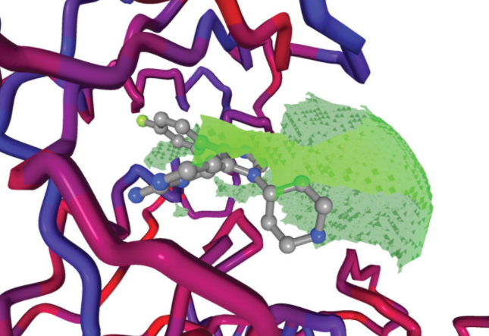
Biocuration and Knowledge Extraction
Example
BindingMOAD.org (PDBbind)
32,727 Protein Structures
12,098 binding data
Example
Biomarker Identification
Identification of biomarkers from clinical protocol documents
harmonized and annotated into datastore
Used by rules engine
doi.org/10.1093/nar/gkm911
Notes:
https://academic.oup.com/view-large/figure/42728290/gkm911f4.jpeg
IR and NER – does not have to “replace” curators, but as a tool !

Slide 6
Precision Medicine Support
New model for addressing cancer
Clinical Trials
NCI-MATCH
PRECISE
Key Scenario: Molecular Tumor Board
Organizing evidence from literature
(in addition to computational)
What genes and mutations are important?
Notes:
Driver versus Passenger Mutations: They have come along for the ride (passenger mutations)
Goal is to distinguish drivers (mutations that cause and accelerate cancers) from passengers (mutations that are byproducts of cancer’s growth)
Need to be able to scale – and overcome issues with cut-and-paste one-off approaches

Slide 7
Project Goal: Support Precision Medicine Trials
Context:
NCI-MATCH (matching patients to clinical trials)
For Future Precision Medicine Trials:
Extract biomarkers from Clinical trial protocol documents
Classify biomarkers (inclusionary, exclusionary, neutral)
Annotate and harmonize biomarkers
Load biomarkers into rules engine
Notes:
Assist and improve accuracy through automation the protocol abstraction team in the identification and classification of eligibility criteria from subprotocol documents so that eligibility criteria can be easily consumed by the clinical trial report program, finding clinical trials for cancer patients program, precision medicine trials, and others.

Slide 8

Training and Testing the NLP Pipeline
“The missense variant p.Q546H in PIK3CA (NM_006218.3) has been reported to ClinVar as Likely Pathogenic with a status of (0 stars) no assertion criteria provided...”
P.Q546H ProteinMutation p|SUB|Q|546|H
dbSNP: rs1057519940y
NLP Pipeline
Q: Which set of documents?
AdultMATCH Internal
Subprotocols Variant Reviews
Q: Which NLP Tools?
tmVar2
SETH
nala
spaCy
AWS Comprehend
Compare Answers
Manually review all output and compare to expected results
or
Notes:
Read and parse break the document down into smaller pieces
Check for variants in each piece
3. Determine the intent
is it inclusionary or exclusionary

Slide 9
Workflow Breakout
External data
External data
tmVar2
Gather docs,
metadata
parse output, link (id), datastore
Seth
Biomarkers
✅
✅
✅
.pdf .docx
Parse (ascii),
Split (⁋)
Integrate with external data
pdf
pdf
Track (id),
datastore
Analysis
spaCY
Tagged Output with Standardized, Harmonized Biomarkers
Create input files (pubtator format)
Run Reports
AWS
Post-processing
Pre-processing
Named-entity recognition
Notes:
Three basic steps in workflow
Pre-processing
Tagging (aka named-entity recognition)
Post-processing
Integrate tools from the National Library of Medicine (NLM) to identify and categorize key biological terms.
Output is structured data that contains the term, the category, and the body of text where it was found.
https://www.ncbi.nlm.nih.gov/research/pubtator/index.html https://www.ncbi.nlm.nih.gov/research/bionlp/Tools/

Slide 10
Example: Clear Variant Identification
1000003|t|MVAR-22
1000003|a|The missense variant p.Q546H in PIK3CA (NM_006218.3) has been reported to ClinVar as Likely Pathogenic with a status of (0 stars) no assertion criteria provided (Variation ID 376491 as of 2018-06-07). (PP5 - Supporting) The p.Q546H variant is novel (not in any individuals) in gnomAD Exomes and is novel (not in any individuals) in 1000 Genomes. (PM2 - Moderate) The gene PIK3CA has a low rate of benign missense variation as indicated by a high missense variants Z-Score of 5.42. The gene PIK3CA contains 19 pathogenic missense variants, indicating that missense variants are a common mechanism of disease in this gene. (PP2 - Supporting) 3 variants within 6 amino acid positions of the variant p.Q546H have been shown to be pathogenic, while none have been shown to be benign. (PM1 - Moderate) COSMIC reports this variant mutation in 17 different samples
1000003 29 36 P.Q546H ProteinMutation p|SUB|Q|546|H
dbSNP: rs1057519940
1000003 234 241 P.Q546H ProteinMutation p|SUB|Q|546|H
dbSNP: rs1057519940
1000003 710 717 p.Q546H ProteinMutation p|SUB|Q|546|H
dbSNP: rs1057519940

Slide 11


Which NLP Tool Did Best?
Very Good Out-of-the-Box Results
SETH
tmVar2
Poor Out-of-the-Box Results
AWS Comprehend Medical
nala
spaCy
Great success with
SNV
Indel
Issues with some variant types
Fusions
Copy Number
Splice-site
Notes:
Value of having domain-specific / domain-trained tools
HGVS syntax for SNV, Indel
Less specific for Fusions, copy number, splice-site

Slide 12
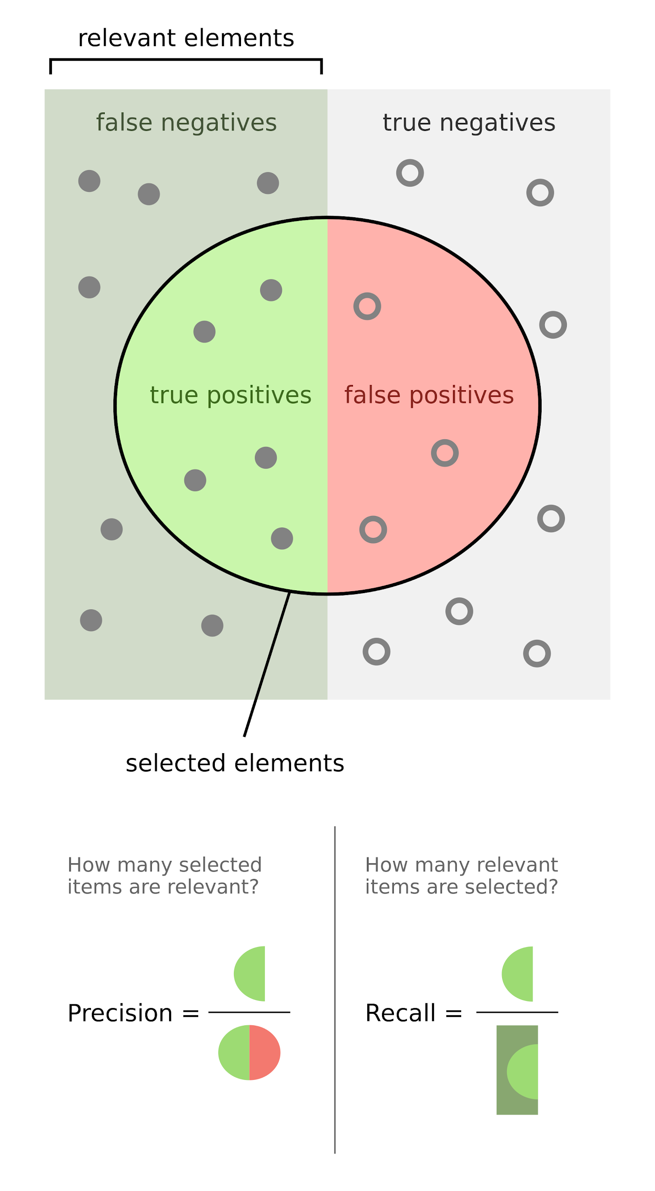
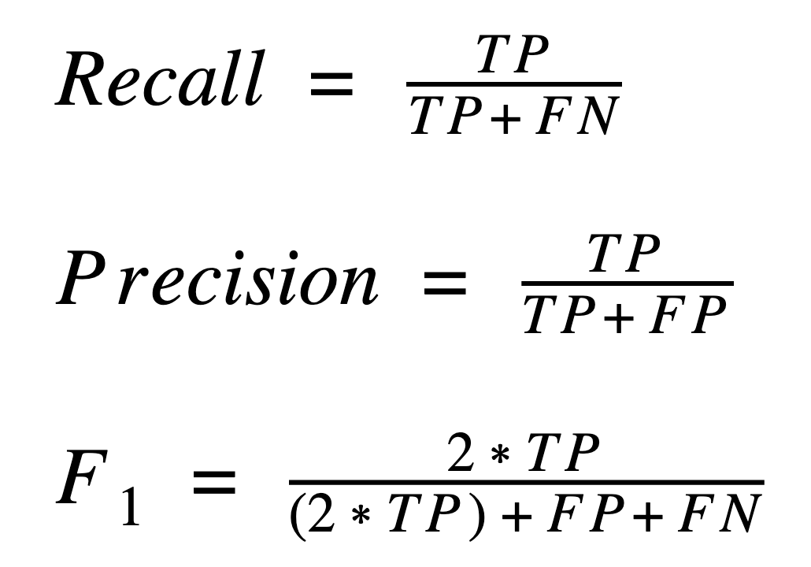
Metrics
 |  | Actual
 |  | Pos | Neg
 | Pos | TP | FP
 | Neg | FN | TN
Expected
Metric values range: 0.0 → 1.0
(worst) (perfect)

Slide 13
Initial Results 90% Success Identifying Variants
First pass
SETH
tmVar2
METRICS
0.0 (worst) -->1.0 (perfect)
Actual
Actual
 | SETH | tmVar2
Recall | 0.90 | 0.90
Precision | 0.90 | 0.98
F1 | 0.90 | 0.94
Pos
Neg
Pos
Neg
985 TP | 112 FP
108 FN | 23 TN
959 TP | 22 FP
110 FN | 23 TN
Pos
Pos
Novel aMOI Review
Predicted
Predicted
Neg
Neg
119 docs
Actual
Actual
Pos
Neg
Pos
Neg
 | SETH | tmVar2
Recall | 0.84 | 0.77
Precision | 0.98 | 0.86
F1 | 0.90 | 0.77
47 TP | 1 FP
9 FN | 31 TN
24 TP | 4 FP
0 FN | 3 TN
Pos
Pos
AdultMATCH Subprotocol
Predicted
Predicted
Neg
Neg
38 docs
Notes:
Between SETH and tmVar, Required the data to match Exactly

Slide 14
Improved Results, >97% Success
With Updated Training
SETH
tmVar2
Actual
Actual
Actual
Actual
 | SETH | tmVar2
Recall | 0.97 | 0.97
Precision | 1.00 | 0.98
F1 | 0.99 | 0.97
Pos
Neg
Pos
Neg
985 TP | 0 FP
27 FN | 23 TN
959 TP | 22 FP
29 FN | 23 TN
Pos
Pos
Novel aMOI Review
Predicted
Predicted
Predicted
Neg
Neg
119 docs
Actual
Actual
Pos
Neg
Pos
Neg
 | SETH | tmVar2
Recall | 1.00 | 0.96
Precision | 1.00 | 1.00
F1 | 1.00 | 0.98
1622 TP | 1 FP
2 FN | 31 TN
1599 TP | 4 FP
0 FN | 3 TN
Pos
Pos
AdultMATCH Subprotocol
Predicted
Predicted
Predicted
Neg
Neg
38 docs

Slide 15
How Well Can We Classify Eligibility Criteria ?
Examples
When it comes to eligibility criteria, is the variant inclusionary or exclusionary?
86% Accuracy
“Patients must have a BRAF V600E or, V600K, V600R or V600D mutation, or another aberration, as identified via the MATCH Master Protocol and described in Appendix IV”
“Patients must not have activating KRAS mutations.”

Slide 16
Technical Bits
System Setup
Individual developer machines
No emailing data (Huddle)
Document/Text Tools
NLP Code
Project Organization
github.com/drivendata/cookiecutter-data-science
Data: text files over database
snakemake (pipeline)

Slide 17
Recommendations and Lessons
Know your data and system
Iterate quickly
Identify bottlenecks and limits
Use right tools
Be aware of encoding (Unicode, ascii, etc) and formatting issues
Organize data and code (versioning)
github.com/drivendata/cookiecutter-data-science
snakemake, entr (airflow, luigi, knime)
Communication, coordination
Notes:
Know your data and system
* spent lots of time classifying documents, extracting True Hits, reviewing results

Slide 18
Acknowledgements
Brent Coffey
Anjan Purkayastha
Mark Benson
Qing Yu
Alex Sickler

Slide 20
Reference Material

Slide 21
Example tmVar2 Output
1000003|t|MVAR-22
1000003|a|The missense variant p.Q546H in PIK3CA (NM_006218.3) has been reported to ClinVar as Likely Pathogenic with a status of (0 stars) no assertion criteria provided (Variation ID 376491 as of 2018-06-07). (PP5 - Supporting) The p.Q546H variant is novel (not in any individuals) in gnomAD Exomes and is novel (not in any individuals) in 1000 Genomes. (PM2 - Moderate) The gene PIK3CA has a low rate of benign missense variation as indicated by a high missense variants Z-Score of 5.42. The gene PIK3CA contains 19 pathogenic missense variants, indicating that missense variants are a common mechanism of disease in this gene. (PP2 - Supporting) 3 variants within 6 amino acid positions of the variant p.Q546H have been shown to be pathogenic, while none have been shown to be benign. (PM1 - Moderate) COSMIC reports this variant mutation in 17 different samples
1000003 29 36 p.Q546H ProteinMutation p|SUB|Q|546|H
1000003 234 241 p.Q546H ProteinMutation p|SUB|Q|546|H
1000003 710 717 p.Q546H ProteinMutation p|SUB|Q|546|H

Slide 22
Example Classification Output
"Patients must have a mutation in mTOR as determined by the MATCH screening 'assessment. See Appendix II for a list of the targeted mutations and corresponding Levels of Evidence."
“Patients with history of RAS mutation-positive tumors are not eligible regardless of interval from the current study.”
'pos'
0.9999999999988229
'neg'
0.9974689734852946

Slide 23
