Slide 1
Introduction to Linear Systems and Gauss-Jordan Elimination

Slide 2

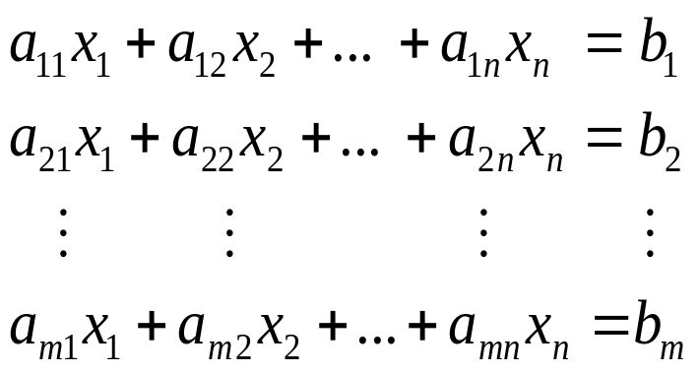

Linear Systems
A finite set of linear equations in the variables
is called a system of linear equations or a linear system .
A sequence of numbers
that satisfies the system of equations is called a solution of the system.
A system that has no solution is said to be inconsistent ; if there is at least one solution of the system, it is called consistent.
An arbitrary system of m linear equations in n unknowns

Slide 3
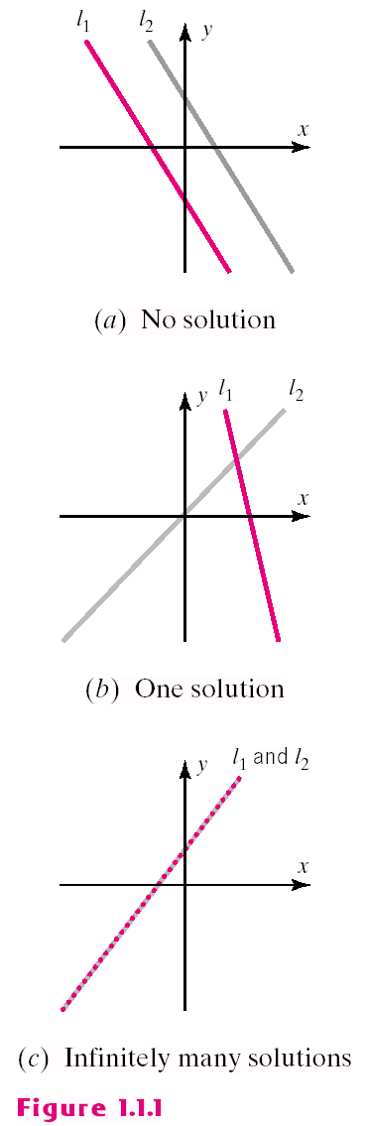
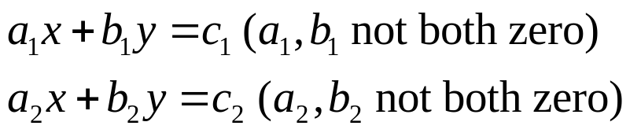
Solutions
Every system of linear equations has either no solutions, exactly one solution, or infinitely many solutions.
A general system of two linear equations: (Figure1.1.1)
  Two lines may be parallel -> no solution
  Two lines may intersect at only one point
  -> one solution
  Two lines may coincide
  -> infinitely many solution

Slide 4
Systems of Linear Equations
Systems of linear algebraic equations may represent too much, or too little or just the right amount of information to determine values of the variables constituting solutions.
Using Gauss-Jordan elimination we can determine whether the system has many solutions, a unique solution or none at all.

Slide 5
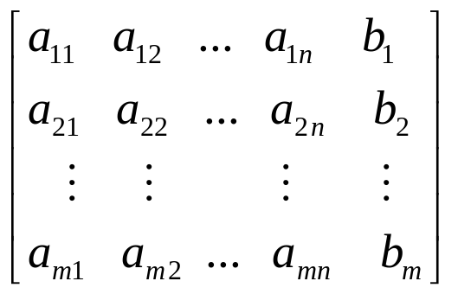
Augmented Matrices
The location of the +’s, the x’s, and the =‘s can be abbreviated by writing only the rectangular array of numbers.
This is called the augmented matrix for the system.
Note: must be written in the same order in each equation as the unknowns and the constants must be on the right.

Slide 6
Elementary Row Operations
The basic method for solving a system of linear equations is to replace the given system by a new system that has the same solution set but which is easier to solve.
Since the rows of an augmented matrix correspond to the equations in the associated system, the new systems is generally obtained in a series of steps by applying the following three types of operations to eliminate unknowns systematically. These are called elementary row operations.
1. Multiply an equation through by an nonzero constant.
2. Interchange two equations.
3. Add a multiple of one equation to another.

Slide 7
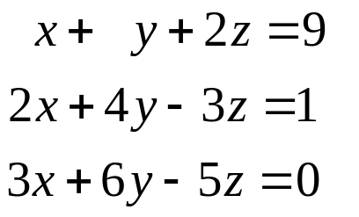
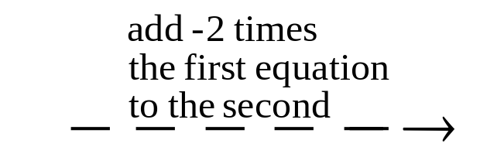
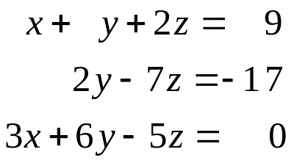
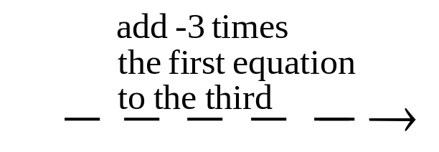
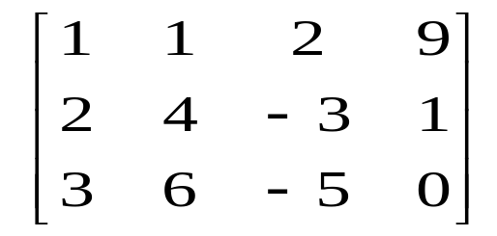
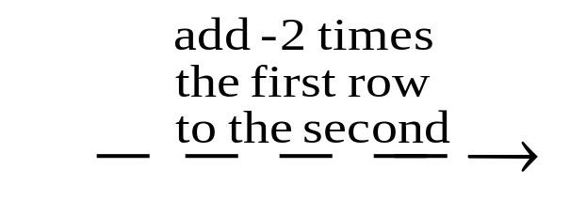
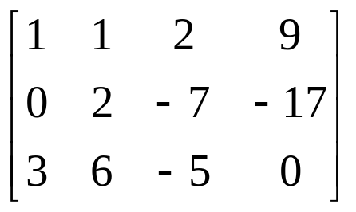
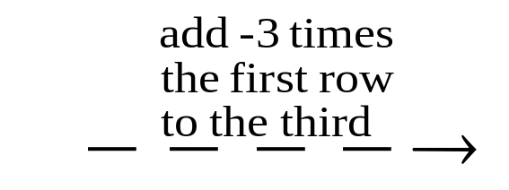
Example 1
Using Elementary row Operations(1/4)

Slide 8
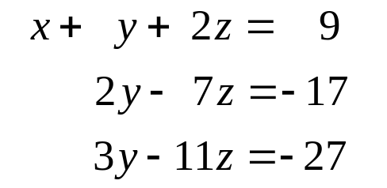
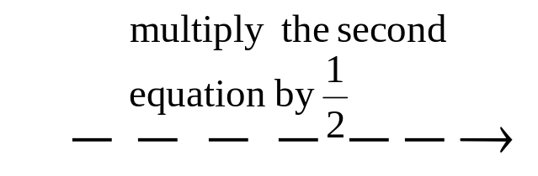
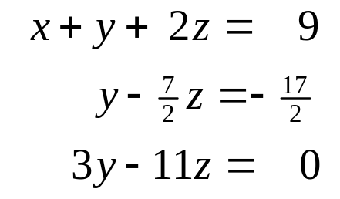
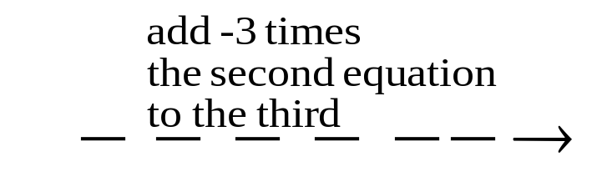
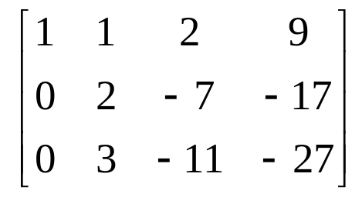
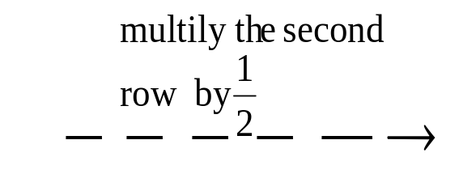
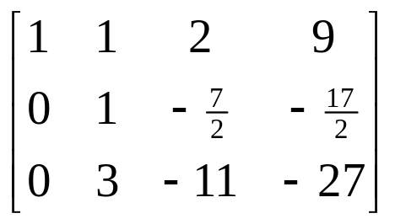
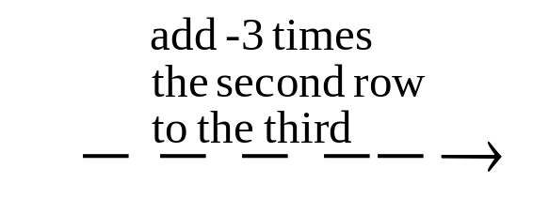
Example 1
Using Elementary row Operations(2/4)

Slide 9
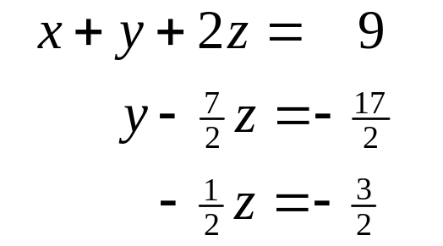
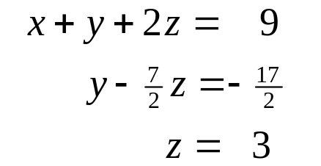
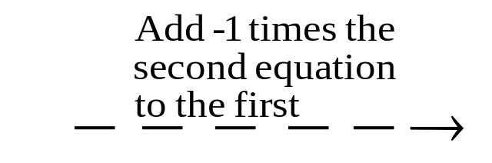
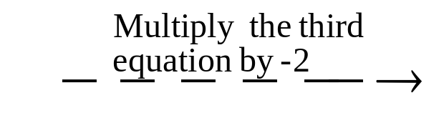
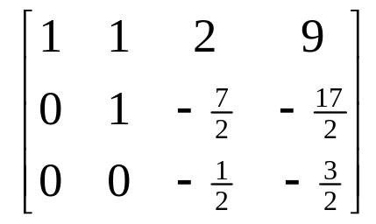
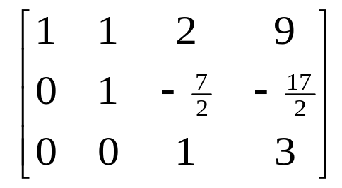
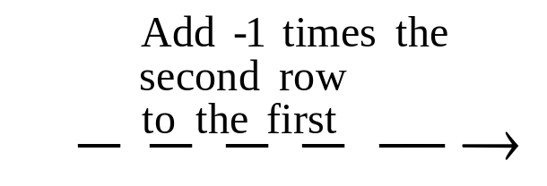
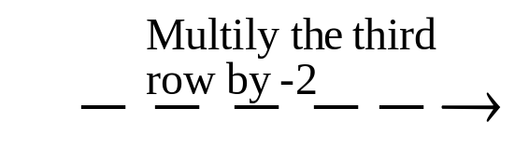
Example 1
Using Elementary row Operations(3/4)

Slide 10
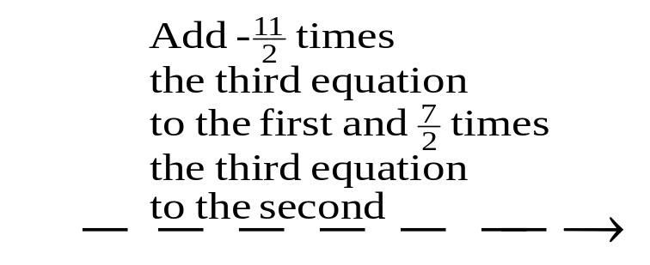
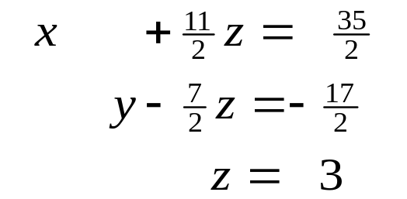
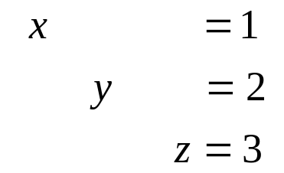
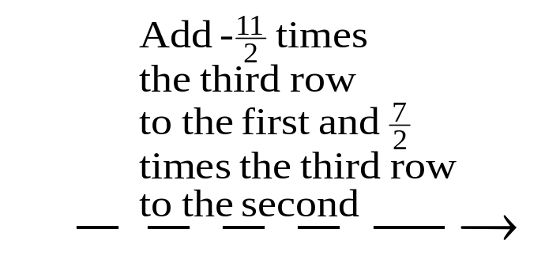
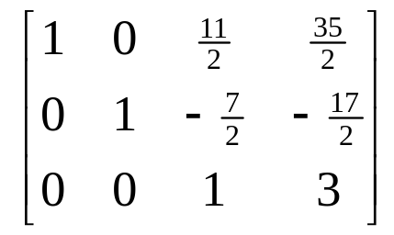
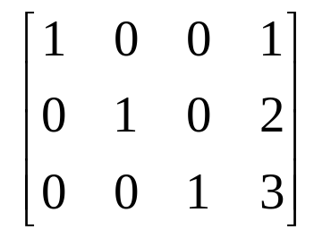
Example 1
Using Elementary row Operations(4/4)
The solution x=1,y=2,z=3 is now evident.

Slide 11
Echelon Forms
A matrix with the following properties is in reduced row-echelon form, (RREF).
1. If a row does not consist entirely of zeros, then the first nonzero number in the row, called its pivot, equals 1.
2. If there are any rows that consist entirely of zeros, then they are grouped together at the bottom of the matrix.
3. In any two successive rows that do not consist entirely of zeros, the pivot in the lower row occurs farther to the right than the pivot in the higher row.
4. Each column that contains a pivot has zeros everywhere else.
A matrix that has the first three properties is said to be in row-echelon form.
A matrix in reduced row-echelon form is of necessity in row-echelon form, but not conversely.

Slide 12
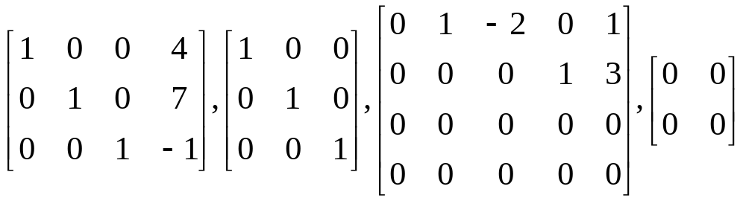
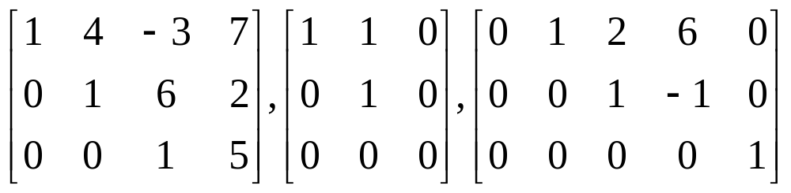
Row-Echelon & Reduced Row-Echelon form
reduced row-echelon form:
row-echelon form:

Slide 13
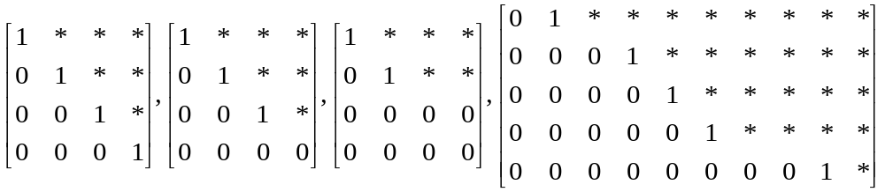
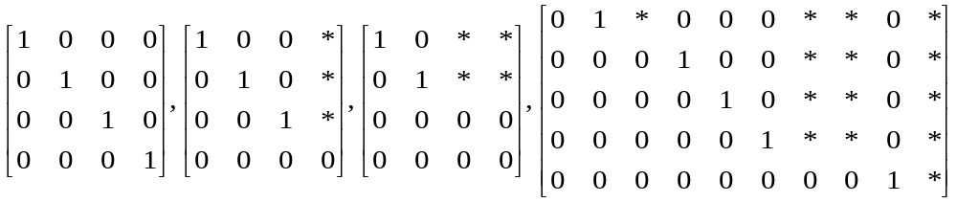
More on Row-Echelon and Reduced Row-Echelon form
All matrices of the following types are in row-echelon form ( any real numbers substituted for the *’s. ) :
All matrices of the following types are in reduced row-echelon form ( any real numbers substituted for the *’s. ) :

Slide 14
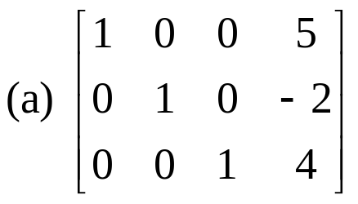
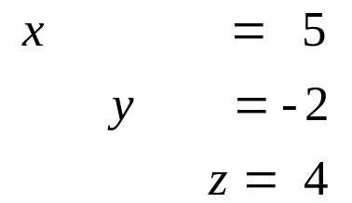
Example 2(a)
Suppose that the augmented matrix for a system of linear equations have been reduced by row operations to the given reduced row-echelon form. Solve the system.
Solution
the corresponding system of equations is :

Slide 15
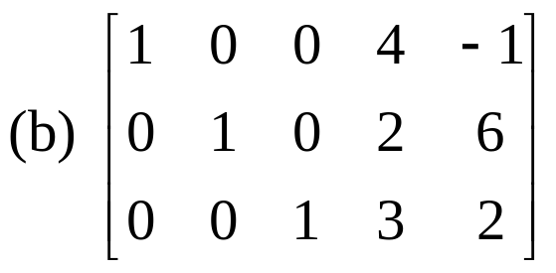
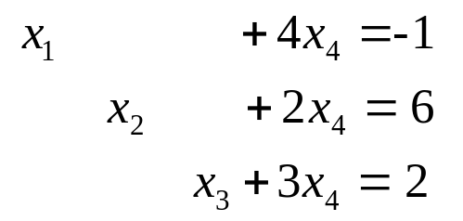
Example 2 (b1)
Solution
1. The corresponding system of equations is :
free variables
leading variables

Slide 16
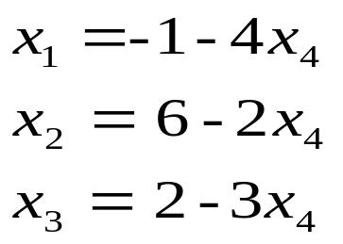
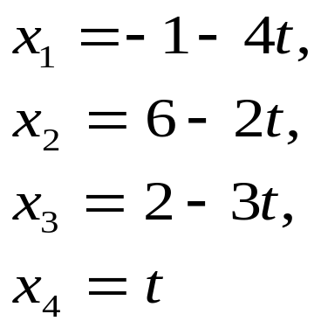
Example 2 (b2)
2. We see that the free variable can be assigned an arbitrary value, say t, which then determines values of the leading variables.
3. There are infinitely many solutions, and the general solution is given by the formulas

Slide 17
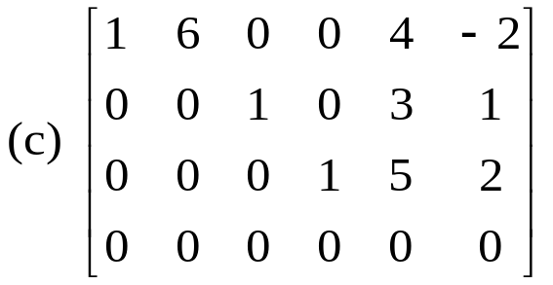
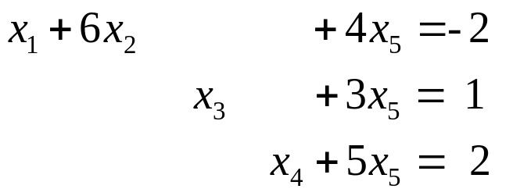
Example 2 (c1)
Solution
The 4th row of zeros leads to the equation places no restrictions on the solutions (why?). Thus, we can omit this equation.

Slide 18
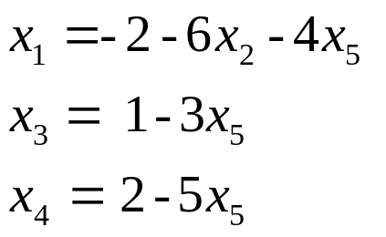
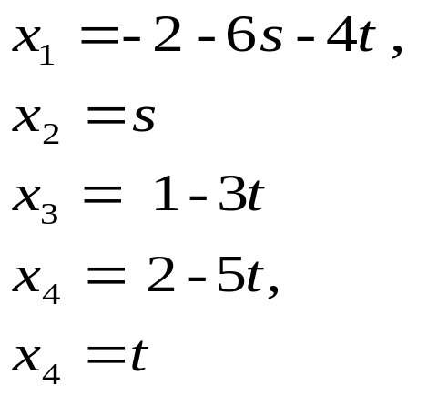
Example 2 (c2)
Solution
Solving for the leading variables in terms of the free variables:
3. The free variable can be assigned an arbitrary value,there are infinitely many solutions, and the general solution is given by the formulas.

Slide 19
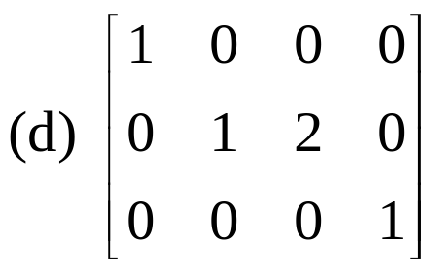

Example 2 (d)
Solution
the last equation in the corresponding system of equation is
Since this equation cannot be satisfied, there is no solution to the system.

Slide 20
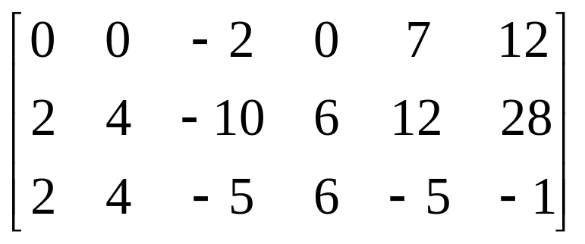
Elimination Methods (1/7)
We shall give a step-by-step elimination procedure that can be used to reduce any matrix to reduced row-echelon form.

Slide 21

Elimination Methods (2/7)
Step1. Locate the leftmost column that does not consist entirely of zeros.
Step2. Interchange the top row with another row, to bring a nonzero entry to top of the column found in Step1.
Leftmost nonzero column
The 1st and 2nd rows in the preceding matrix were interchanged.

Slide 22


Elimination Methods (3/7)
Step3. If the entry that is now at the top of the column found in Step1 is a, multiply the first row by 1/a in order to introduce a pivot 1.
Step4. Add suitable multiples of the top row to the rows below so that all entries below the pivot 1 become zeros.
The 1st row of the preceding matrix was multiplied by 1/2.
-2 times the 1st row of the preceding matrix was added to the 3rd row.

Slide 23


Elimination Methods (4/7)
Step5. Now cover the top row in the matrix and begin again with Step1 applied to the sub-matrix that remains. Continue in this way until the entire matrix is in row-echelon form.
Leftmost nonzero column in the submatrix
The 1st row in the sub-matrix was multiplied by -1/2 to introduce a pivot 1.

Slide 24


Elimination Methods (5/7)
Step5 (cont.)
-5 times the 1st row of the sub-matrix was added to the 2nd row of the sub-matrix to introduce a zero below the pivot 1.
The top row in the sub-matrix was covered, and we returned again Step1.
Leftmost nonzero column in the new sub-matrix
The first (and only) row in the new sub-matrix was multiplied by 2 to introduce a pivot 1.
The entire matrix is now in row-echelon form.

Slide 25



Elimination Methods (6/7)
Step6. Beginning with last nonzero row and working upward, add suitable multiples of each row to the rows above to introduce zeros above the pivot 1’s.
7/2 times the 3rd row of the preceding matrix was added to the 2nd row.
-6 times the 3rd row was added to the 1st row.
5 times the 2nd row was added to the 1st row.
The last matrix is in reduced row-echelon form.

Slide 26
Elimination Methods (7/7)
Step1~Step5: the above procedure produces a row-echelon form and is called Gaussian elimination.
Step1~Step6: the above procedure produces a reduced row-echelon form and is called Gaussian-Jordan elimination.
Every matrix has a unique reduced row-echelon form but a row-echelon form of a given matrix is not unique.

Slide 27


Example 4
Gauss-Jordan Elimination(1/4)
Solve by Gauss-Jordan Elimination
Solution:
The augmented matrix for the system is

Slide 28


Example 4
Gauss-Jordan Elimination(2/4)
Adding -2 times the 1st row to the 2nd and 4th rows gives
Multiplying the 2nd row by -1 and then adding -5 times the new 2nd row to the 3rd row and -4 times the new 2nd row to the 4th row gives

Slide 29


Example 4
Gauss-Jordan Elimination(3/4)
Interchanging the 3rd and 4th rows and then multiplying the 3rd row of the resulting matrix by 1/6 gives the row-echelon form.
Adding -3 times the 3rd row to the 2nd row and then adding 2 times the 2nd row of the resulting matrix to the 1st row yields the reduced row-echelon form.

Slide 30


Example 4
Gauss-Jordan Elimination(4/4)
The corresponding system of equations is
Solving for the leading variables in terms of the free variables
We assign the free variables, and the general solution is given by the formulas:

Slide 31
Back-Substitution
It is sometimes preferable to solve a system of linear equations by using Gaussian elimination to bring the augmented matrix into row-echelon form without continuing all the way to the reduced row-echelon form.
When this is done, the corresponding system of equations can be solved by by a technique called back-substitution.
Example 5

Slide 32

Example 5
Ex4 solved by Back-substitution(1/2)
From the computations in Example 4, a row-echelon form from the augmented matrix is
To solve the corresponding system of equations
Step1. Solve the equations for the leading variables.

Slide 33

Example5
Ex4 solved by Back-substitution(2/2)
Step2. Beginning with the bottom equation and working upward, successively substitute each equation into all the equations above it.
  Substituting x6=1/3 into the 2nd equation
  Substituting x3=-2 x4 into the 1st equation
Step3. Assign free variables, the general solution is given by the formulas.

Slide 34
Example 6
Gaussian elimination(1/2)
Solve by Gaussian elimination and
back-substitution.
Solution
  We convert the augmented matrix
  to the row-echelon form
  The system corresponding to this matrix is

Slide 35



Example 6
Gaussian elimination(2/2)
Solution
  Solving for the leading variables
  Substituting the bottom equation into those above
  Substituting the 2nd equation into the top

