Slide 1
Floating Point Numbers

Slide 2
Floating vs. fixed point
Floating point refers to a binary decimal representation where there is not a fixed number of digits before and after the decimal place (contrast “fixed point”).
The decimal is said to be allowed to “float”
Virtually all general purpose modern processors are based on ieee-754 floating point standard
Allows representation of much greater range of numbers at cost of greater overhead relative to fixed point.

Slide 3
Parts of a Floating Point Number
Exponent
-0.9876 x 10⁻³
Sign of
exponent
Sign of
mantissa
Location of
decimal point
Mantissa
Base
p. 123

Slide 4
IEEE 754 Standard
Most common standard for representing floating point numbers
Single precision: 32 bits, consisting of...
  Sign bit (1 bit)
  Exponent (8 bits)
  Mantissa (23 bits)
Double precision: 64 bits, consisting of…
  Sign bit (1 bit)
  Exponent (11 bits)
  Mantissa (52 bits)
p. 133

Slide 5
Single Precision Format
32 bits
Mantissa (23 bits)
Exponent (8 bits)
Sign of mantissa (1 bit)

Slide 6
Normalization
The mantissa is normalized
Has an implied decimal place on left
Has an implied “1” on left of the decimal place
E.g.,
  Mantissa →
  Represents…
10100000000000000000000
1.101₂ = 1.625₁₀

Slide 7
Excess Notation
To include + and – exponents, “excess” notation is used
Single precision: excess 127
Double precision: excess 1023
The value of the exponent stored is larger than the actual exponent
E.g., excess 127,
  Exponent →
  Represents…
10000111
135 – 127 = 8

Slide 8
Example
Single precision
0 10000010 11000000000000000000000
1.11₂
130 – 127 = 3
0 = positive mantissa
+1.11₂ x 2³ = 1110.0₂ = 14.0₁₀

Slide 9
Hexadecimal
It is convenient and common to represent the original floating point number in hexadecimal
The preceding example…
0 10000010 11000000000000000000000
4
1
6
0
0
0
0
0

Slide 10
Converting from Floating Point
E.g., What decimal value is represented by the following 32-bit floating point number?
C17B0000₁₆

Slide 11
Step 1
  Express in binary and find S, E, and M
C17B0000₁₆ =
1 10000010 11110110000000000000000₂
S
E
M
1 = negative
0 = positive

Slide 12
Step 2
  Find “real” exponent, n
  n = E – 127
  = 10000010₂ – 127
  = 130 – 127
  = 3

Slide 13
Step 3
  Put S, M, and n together to form binary result
  (Don’t forget the implied “1.” on the left of the mantissa.)
-1.1111011₂ x 2^{n} =
-1.1111011₂ x 2³ =
-1111.1011₂

Slide 14
Step 4
  Express result in decimal
-1111.1011₂
-15
2⁻¹ = 0.5
2⁻³ = 0.125
2⁻⁴ = 0.0625
0.6875
Answer: -15.6875

Slide 15
Converting to Floating Point
E.g., Express 36.5625₁₀ as a 32-bit floating point number (in hexadecimal)

Slide 16
Step 1
  Express original value in binary
36.5625₁₀ =
100100.1001₂

Slide 17
Step 2
  Normalize
100100.1001₂ =
1.001001001₂ x 2⁵

Slide 18
Step 3
  Determine S, E, and M
+1.001001001₂ x 2⁵
n
E = n + 127
= 5 + 127
= 132
= 10000100₂
S
M
S = 0 (because the value is positive)

Slide 19
Step 4
  Put S, E, and M together to form 32-bit binary result
0 10000100 00100100100000000000000₂
S
E
M

Slide 20
Step 5
  Express in hexadecimal
0 10000100 00100100100000000000000₂ =
0100 0010 0001 0010 0100 0000 0000 0000₂ =
4 2 1 2 4 0 0 0₁₆
Answer: 42124000₁₆

Slide 21
Floating point operations
Addition, subtraction very simple
  Match exponents by shifting decimal place
  Perform regular bitwise addition
  Renormalize
Note that this process is in general not exact. Rounding and loss of precision inevitable.

Slide 22
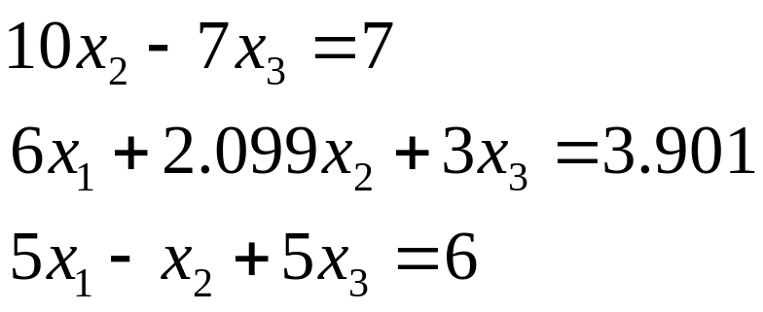
Pivoting in GE
Two Potential Pitfalls of “naïve” algorithm
Division by zero: May occur in the forward elimination steps.
Consider the set of equations:
- Round-off error: Prone to round-off errors.

Slide 23
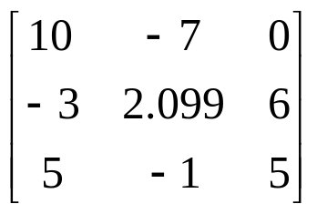
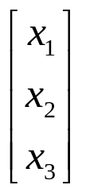
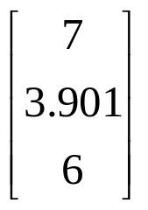
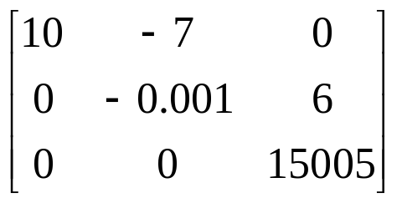

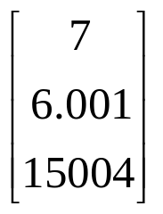
Pitfalls: Example
Consider the system of equations:
Use five significant figures with chopping
=
At the end of Forward Elimination
=

Slide 24
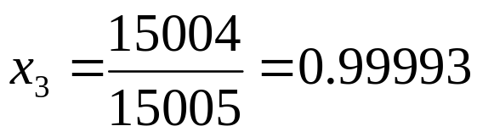
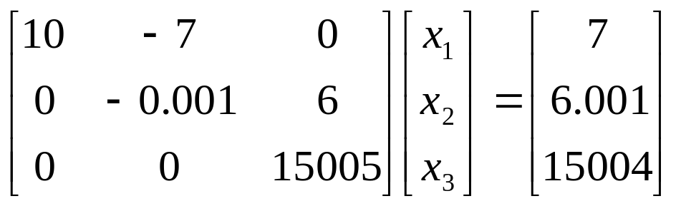
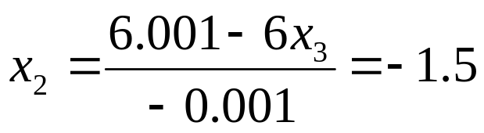
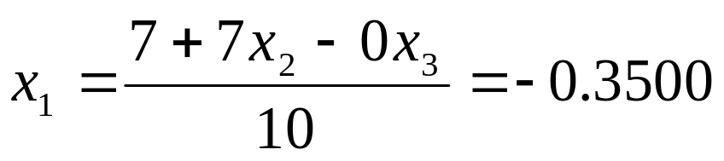
Pitfalls: Example
Back Substitution

Slide 25
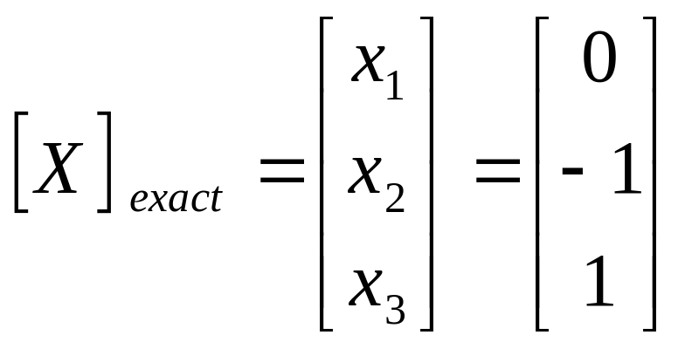
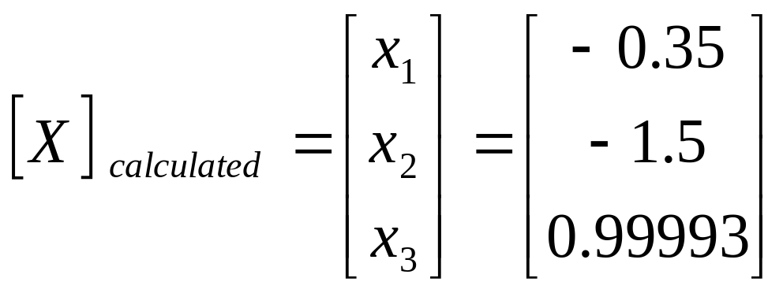
Pitfalls: Example
Compare the calculated values with the exact solution

Slide 26
Improvements
Increase the number of significant digits
Decreases round off error
Does not avoid division by zero
Gaussian Elimination with Partial Pivoting
Avoids division by zero
Reduces round off error

Slide 27
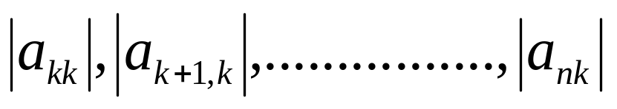
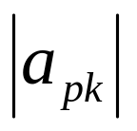

Partial Pivoting
Gaussian Elimination with partial pivoting applies row switching to normal Gaussian Elimination.
How?
At the beginning of the k^{th} step of forward elimination, find the maximum of
If the maximum of the values is
In the p^{th} row,
then switch rows p and k.

Slide 28
Partial Pivoting
What does it Mean?
Gaussian Elimination with Partial Pivoting ensures that each step of Forward Elimination is performed with the pivoting element |a_{kk}| having the largest absolute value.

Slide 29
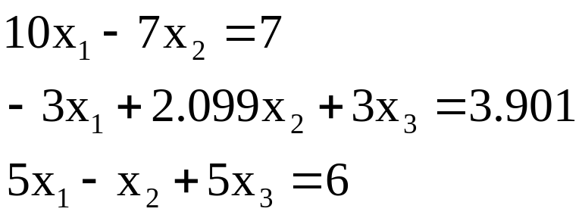
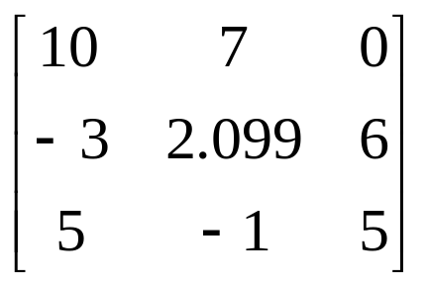
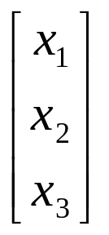

Partial Pivoting: Example
Consider the system of equations
In matrix form
=
Solve using Gaussian Elimination with Partial Pivoting using five significant digits with chopping

Slide 30
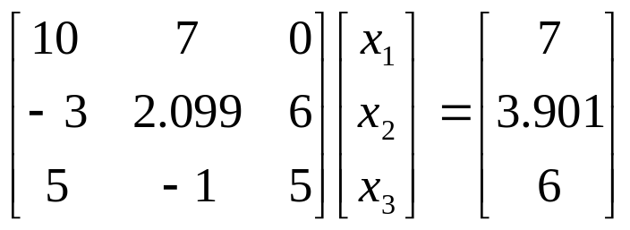
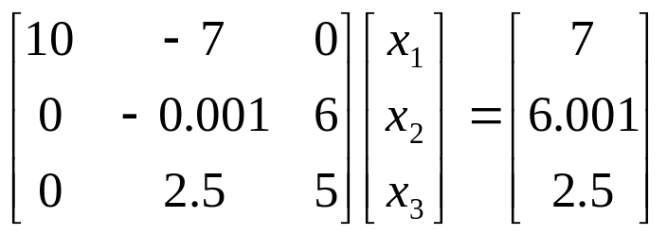

Partial Pivoting: Example
Forward Elimination: Step 1
Examining the values of the first column
|10|, |-3|, and |5| or 10, 3, and 5
The largest absolute value is 10, which means, to follow the rules of Partial Pivoting, we switch row1 with row1.
Performing Forward Elimination

Slide 31
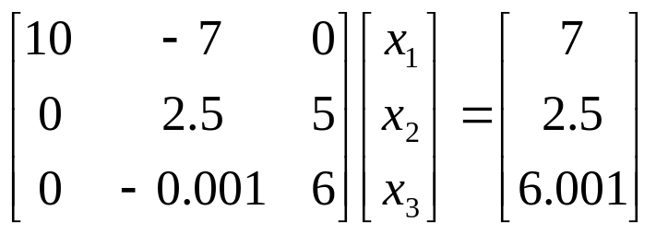
Partial Pivoting: Example
Forward Elimination: Step 2
Examining the values of the first column
|-0.001| and |2.5| or 0.0001 and 2.5
The largest absolute value is 2.5, so row 2 is switched with row 3
Performing the row swap

Slide 32
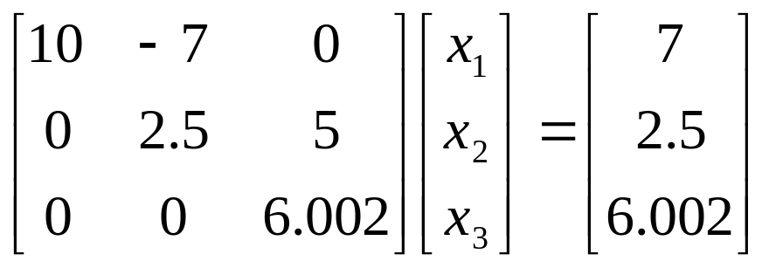
Partial Pivoting: Example
Forward Elimination: Step 2
Performing the Forward Elimination results in:

Slide 33
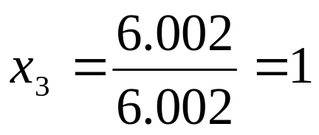
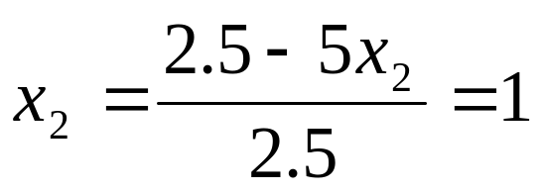
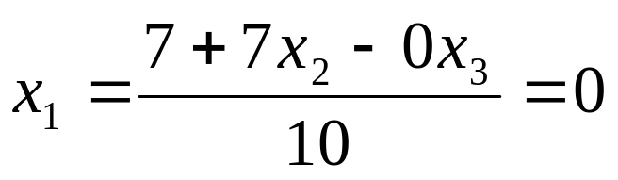
Partial Pivoting: Example
Back Substitution
Solving the equations through back substitution

Slide 34
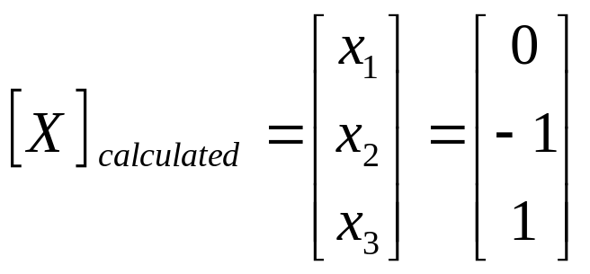

Partial Pivoting: Example
Compare the calculated and exact solution
The fact that they are equal is coincidence, but it does illustrate the advantage of Partial Pivoting

