Slide 1

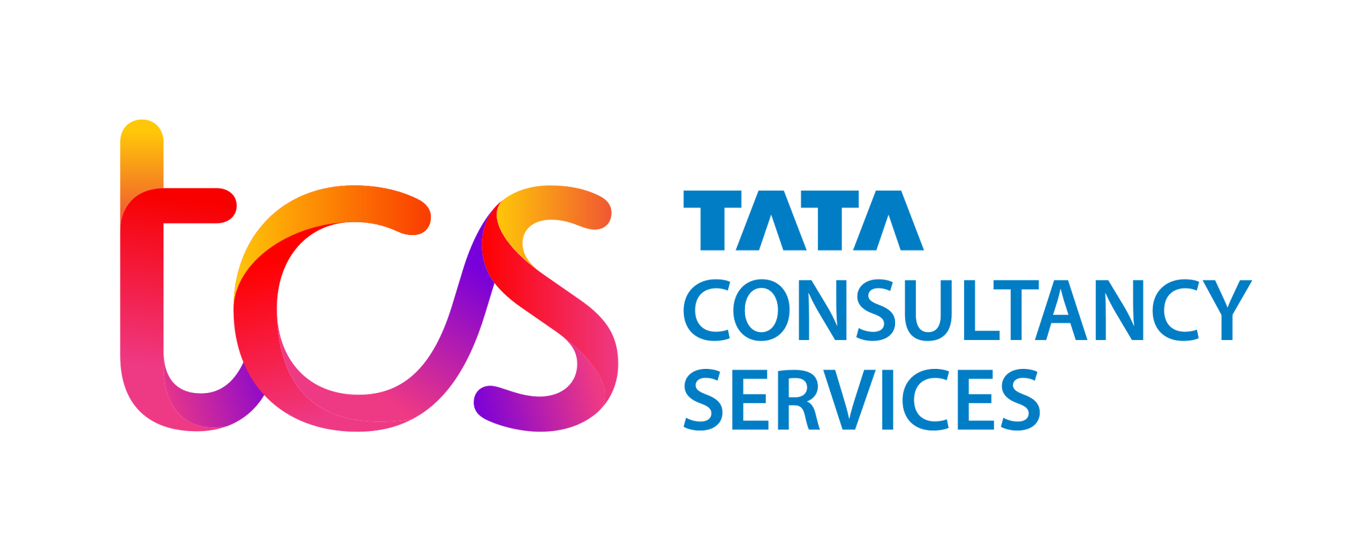
Comprehensive Implementation Plan for TechCorp's IAM Platform
This presentation outlines a detailed plan for implementing an Identity and Access Management (IAM) platform for TechCorp, addressing key challenges and ensuring alignment with business goals.

Slide 2
Detailed Implementation Roadmap
Assessment Phase (Month 1)
1
Evaluate existing infrastructure and requirements. Identify critical assets, users, and access levels. Define success criteria.
2
Design Phase (Month 2)
Architect IAM platform structure. Define roles, policies, and permissions. Select tools (e.g., Okta, Azure AD, Ping Identity).
Development Phase (Months 3-4)
3
Set up IAM modules (authentication, SSO, MFA, access control). Customize for TechCorp's requirements.
4
Integration Phase (Months 5-6)
Integrate with legacy systems, cloud services, and third-party apps. Test connections and functionality.
Testing & Deployment (Month 7)
5
Conduct user acceptance testing (UAT). Address feedback and fine-tune the system. Deploy in a phased manner.
6
Maintenance & Monitoring (Ongoing)
Set up continuous monitoring tools. Conduct regular audits and updates.

Slide 3
Integration Challenges and Solutions
Challenges
Solutions
Legacy Systems: Incompatibility with older software.
Use middleware for legacy system compatibility.
Third-Party Applications: Ensuring seamless connectivity.
Leverage APIs for third-party app integration.
Employ hybrid IAM models for multi-cloud access.
Cloud Integration: Handling multi-cloud environments.
Conduct rigorous pre-deployment testing.

Slide 4
Alignment with TechCorp's Business Goals
Enhanced Cybersecurity
Streamlined Operations
Cost Efficiency
Optimized resource usage with role-based access. Integration with existing cloud platforms.
Centralized access control to reduce unauthorized access. Implementation of MFA for secure logins.
Simplified user provisioning and deprovisioning. Reduced IT workload through automated workflows.

