Slide 1

Topological Ring Detection for Market Manipulation
Persistent homology on directed transaction graphs
School of Computer Science and Engineering
Project Guide: Dr Merin Thomas
Associate Professor
School of Computer Science and Engineering
RV University, Bangalore
Team members
USN1RUA25CSE0348 - Priyadarshini Prasad
USN 1RUA25CSE0292 - Niharika KP
USN 1RUA25CSE0297 - Nischita M
USN 1RUA25CSE0291 - Nidhi Santosh Nayak

Slide 2
Outline
SL NO. | TOPIC
1. | INTRODUCTION
2. | LITERATURE SURVEY
3. | PROBLEM STATEMENT
4. | OBJECTIVES AND EXPECTED OUTCOMES
5. | SYSTEM REQUIREMENT SPECIFICATION
6. | PROPOSED METHODOLOGY
7. | ARCHITECTURE DIAGRAM
8. | RESULTS
9. | GANTT CHART
10. | LIMITATIONS & FUTURE WORK
11. | REFERENCES

Slide 3
Introduction
Wash trading and money-laundering rings fake market activity by circulating value among a small group of colluding accounts.
Each single trade looks ordinary. The loop in the who-paid-whom graph does not.
Goal: from a stream of timestamped transactions, find these rings, score how suspicious each is, group them by type, and keep the alarm threshold accurate as tactics drift.
Why it is hard
Rare: positives are 1.7% of candidate rings on IBM HI-Small
Hard negatives look alike: market makers, arbitrage bots, exchange hot wallets
Rings are sparse, so density and community detectors miss them
Cycle listing is yes/no: no strength, no type
Tactics drift and confirmed labels arrive late
A
B
Value leaves A and returns to A.
Members net to about zero; trades run on a bot-like cadence.
C

Slide 4
Literature Survey (1/2)
Paper Details | Objective of Paper, Techniques/Methods | Key Contribution | Research Gap
E. Altman et al., "Realistic Synthetic Financial Transactions for Anti-Money Laundering Models," NeurIPS Datasets & Benchmarks, 2023. | Generate realistic labelled AML data: agent-based simulation of individuals, companies and banks with injected laundering patterns. | Public AMLworld datasets (HI/LI, Small to Large) with complete ground truth; baseline models benchmarked. | Labels are per transaction; no ring-level localisation or circulation strength. Used here as the test bed.
M. Weber et al., "Anti-Money Laundering in Bitcoin: Experimenting with Graph Convolutional Networks for Financial Forensics," KDD Workshop, 2019. | Classify illicit Bitcoin transactions; compares logistic regression, random forest and graph convolutional networks. | Elliptic dataset; shows graph structure helps and that random forest is a strong baseline. | Node-level scores only; does not name the colluding accounts of a ring; deep models are hard to explain.
D. Lütgehetmann, D. Govc, J. Smith, R. Levi, "Computing Persistent Homology of Directed Flag Complexes," Algorithms, 2020. | Efficient persistent homology of directed flag complexes built from directed graphs. | flagser: fast, scalable software for directed-complex persistence. | Not applied to transaction graphs or wash-trading rings.

Slide 5
Literature Survey (2/2)
Paper Details | Objective of Paper, Techniques/Methods | Key Contribution | Research Gap
F. Victor, A. M. Weintraud, "Detecting and Quantifying Wash Trading on Decentralized Cryptocurrency Exchanges," WWW, 2021. | Detect wash trading on decentralized exchanges from trade graphs of closed groups of traders. | Quantifies wash-trading volume on real exchanges. | Binary detection; no continuous ring strength; fixed rules, no adaptation to drift.
L. W. Cong, X. Li, K. Tang, Y. Yang, "Crypto Wash Trading," Management Science, 2023. | Statistical tests of trade data (e.g. Benford's law, trade-size clustering) to detect fake volume. | Evidence of widespread wash trading on unregulated crypto exchanges. | Exchange-level verdicts; does not identify the accounts in a ring.
M. Gidea, Y. Katz, "Topological Data Analysis of Financial Time Series: Landscapes of Crashes," Physica A, 2018. | Persistence landscapes of multivariate market return time series. | Topological early-warning signal before market crashes. | Global market signal; not account-level, not on transaction graphs.

Slide 6
Existing Solutions & Gaps
Capability | Density / community | Cycle enumeration | GNN | Global blockchain TDA | This project
Finds sparse rings | No | Yes | Partly | No | Yes
Names the accounts in a ring | Partly | Yes | Partly | No | Yes (exact)
Continuous ring strength | No | No | Score only | No | Yes (birth, persistence)
Circulation vs one-way flow | No | Not by itself | Learned | No | Yes (directed complex)
Uses behaviour along edges | Partly | No | Yes | Partly | Yes (edge weights)
Adapts threshold to drift | No | No | No | No | Yes
Classical and interpretable | Yes | Yes | No | Yes | Yes
Gap: density methods miss sparse loops; cycle methods give only a yes/no answer; global TDA flags that the network changed but not which accounts.

Slide 7
Problem Statement
Problem
Existing system limits
Novelty of our work
Wash-trading and laundering rings circulate value among a few colluding accounts.
Given timestamped transactions, find each ring, name its accounts and score how suspicious it is.
Keep the alarm threshold accurate as tactics drift and labels arrive late.
Density and community detectors miss sparse rings.
Cycle enumeration gives only yes/no: no strength, no type.
GNNs score nodes, not rings, and are hard to explain.
Global TDA flags that the network changed, not which accounts.
Fixed thresholds decay under drift.
Directed flag persistence on each localised ring: continuous strength.
Exact ring localisation: SCCs plus bounded cycle enumeration.
Behaviour edge weights learned by projected gradient descent.
Drift-adaptive alarm threshold.

Slide 8
USP / Novelty
1
Directed topology for rings
2
Continuous ring strength
3
Exact localization
A directed flag complex keeps circular flow open and fills one-way flow, so a 3-party ring stays visible.
Filtration birth and persistence replace a yes/no cycle check.
SCC + bounded cycle enumeration names the exact accounts, edges and transactions.
4
Learned behaviour weights
5
Drift-adaptive threshold
6
Honest evaluation
Equal weights cannot push a multi-party ring below 1/3. Learned weights lift ring-birth AP from 0.57 to 0.9997 (synthetic).
Online gradient ascent keeps 97% of the hindsight-oracle reward; a fixed threshold keeps 24%.
Grouped CV, grouped-bootstrap CIs, ring birth credited to D not T, negative results reported.

Slide 9
Objectives and Expected Outcomes
Objectives
Expected outcomes / deliverables
1. Build a synthetic generator with planted rings, hard negatives, drift knobs and exact ground truth.
2. Localise candidate rings in 5-day windows (SCCs, cycles of length 2 to 6).
3. Describe each ring with baseline (B), direction (D) and topological (T) features.
4. Test whether topology adds lift over B+D, with grouped CV and bootstrap CIs.
5. Learn edge weights and adapt the alarm threshold under drift.
Tested Python package src/ringtda (222 automated tests).
Ring-level classification on IBM AML HI-Small and LI-Small with 95% CIs.
Learned weights: ring-birth AP 0.57 to 0.9997 (synthetic).
Adaptive threshold: 97% of hindsight-oracle reward vs 24% fixed.
Paper write-up and presentation.

Slide 10
System Requirement Specification
Python 3.11
NetworkX
Online resources
Project repository: github.com/niha4527/topological-ring-detection
IBM AML dataset (Kaggle): kaggle.com/datasets/ealtman2019/ibm-transactions-for-anti-money-laundering-aml
flagser: github.com/luetge/flagser
GUDHI: gudhi.inria.fr
Demo: demo/ folder in the repository (runs locally)
Report: paper/ieee/ in the repository
pyflagser / flagser
GUDHI
scikit-learn
NumPy, SciPy, pandas
Matplotlib
pytest (222 tests)

Slide 11
Proposed Methodology
1
Window & weight
5-day windows, one directed edge per account pair. Edge weight from reciprocity, flow balance and timing regularity (low = suspicious).
2
Localize rings
Keep the most suspicious edges, split into strongly connected components, enumerate simple directed cycles of length 2 to 6.
3
Describe each ring
Baseline graph features (B), direction and behaviour features (D, incl. ring birth), topological features (T) from directed flag persistence.
4
Classify
Logistic regression, random forest, RBF-SVM. Grouped cross-validation. Primary test: B+D+T vs B+D with bootstrap CIs.
5
Adapt
Learn edge weights by projected gradient descent on the simplex. Track the alarm threshold online under drift.

Slide 12
Core Idea: Directed Topology
Cyclic triangle
Transitive triangle
Filled by a 4th account
C
C
C
D
A
B
A
B
A
B
Never filled. The loop persists: bar (b, ∞).
Filled the moment its last edge enters: zero persistence.
D feeds A, B, C. The loop dies when D's edges enter: bar (0.1, 0.6).
Sublevel-set filtration: low-weight (suspicious) edges enter first; a triangle enters at the largest weight of its edges.

Slide 13
Dataset
IBM AML (AMLworld) | HI-Small | LI-Small
Transactions (self-loops dropped) | 4,487,133 | 6,119,572
Windows (5 days, stride 1 day) | 13 | 12
Candidate rings | 8,074 | 10,206
Positive rings (primary) | 131 | 38
Positive groups | 14 | 10
Ambiguous (excluded) | 519 | 486
Synthetic generator
Planted wash rings: 2-, 3-, 5-party; dense neighbourhoods; chorded rings
Topology-sensitive negatives: transitive triangles, shortcut-filled loops
Hard negatives: market makers, arbitrage bots, hot wallets
Evasion and drift knobs: decoy trades, timing jitter, amount noise
Exact ground truth for every ring
Ring label: positive if 80% or more of its edges are backed by one laundering attempt; negative if none; ambiguous otherwise.

Slide 14
Features, Models & Optimization
B Baseline graph
D Direction & behaviour
T Topological
Degree, betweenness, clustering coefficient, edge-weight variance, neighbourhood density
Ring birth, ring length, in/out imbalance, reciprocity, node balance, volume and timing stats
Persistence landscapes of the ring's neighbourhood and the window, infinite-bar count, entropy
Models
Optimization
Logistic regression (L2, class-balanced)
Random forest (300 trees)
RBF-SVM
Ward clustering; ridge / RF / gradient-boosting regression
A: convex logistic loss by gradient descent, step 1/L
B: edge weights α by projected GD on the simplex: α = (0.00, 0.21, 0.79)
C: alarm threshold by online gradient ascent with 2-window label delay

Slide 15
Architecture Diagram
1. Data ingestion
2. Graph construction
3. Candidate rings
4. Persistence
IBM AML loader, synthetic generator
Windows, pair aggregation, edge weights
Sparsify, SCCs, cycles length 2-6
Directed flag complex (flagser), landscapes
src/ringtda/data/
src/ringtda/graph/
src/ringtda/topology/candidates
src/ringtda/topology/persistence
8. Evaluation
7. Adaptive threshold
6. Models
5. Features
Labels, grouped CV, bootstrap CIs
Gradient ascent, D-UCB, SW-Thompson
Classify, cluster, severity regression
B baseline, D direction, T topology
src/ringtda/eval/
src/ringtda/threshold/
src/ringtda/models/
src/ringtda/features.py
Highlighted: the topology core. Pipeline logic lives in src/ringtda/; 222 automated tests guard correctness.

Slide 16
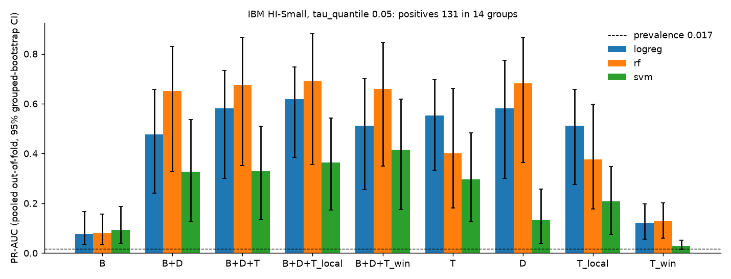
Results: Classification
Behaviour helps: B+D beats B, CI excludes 0 for all three models.
No detectable lift on IBM HI-Small: B+D+T minus B+D = +0.104 [−0.002, +0.171] (logistic regression).
Synthetic data: small topological lift, CI above 0 in 7 of 12 cells.
HI-Medium (87 positive groups): logistic regression +0.108 [+0.049, +0.174]; random forest −0.014 [−0.036, +0.001]. Topology helps the linear model, not the best model.
Pooled out-of-fold PR-AUC with 95% grouped-bootstrap CIs; prevalence 0.017.

Slide 17
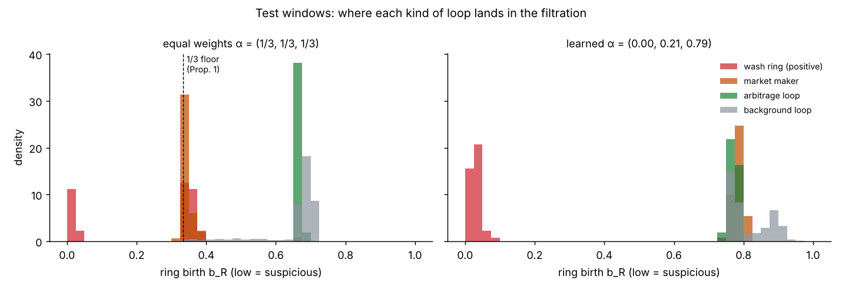
Results: Learned Edge Weights
0.57
ring-birth AP, equal weights
0.9997
ring-birth AP, learned weights
Equal weights cannot push a multi-party ring below 1/3, so wash rings sit next to market makers.
Learned weights (timing regularity 0.79, balance 0.21) separate wash rings from every legitimate loop (synthetic data; IBM runs use equal weights).

Slide 18
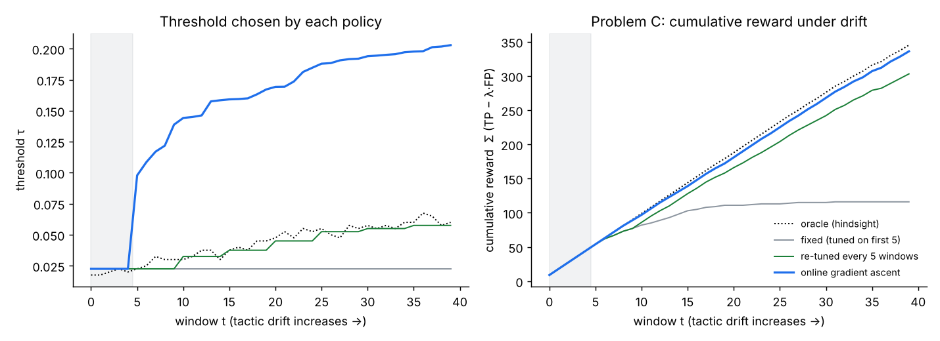
Results: Adaptive Threshold
97%
online gradient ascent
86%
re-tuned every 5 windows
24%
Drift: wash timing jitter 0.05 to 0.60, amount noise 0.01 to 0.16 over 40 windows.
Bandits (discounted UCB, sliding-window Thompson) lose to periodic re-tuning at the primary setting.
fixed threshold
share of hindsight-oracle reward

Slide 19
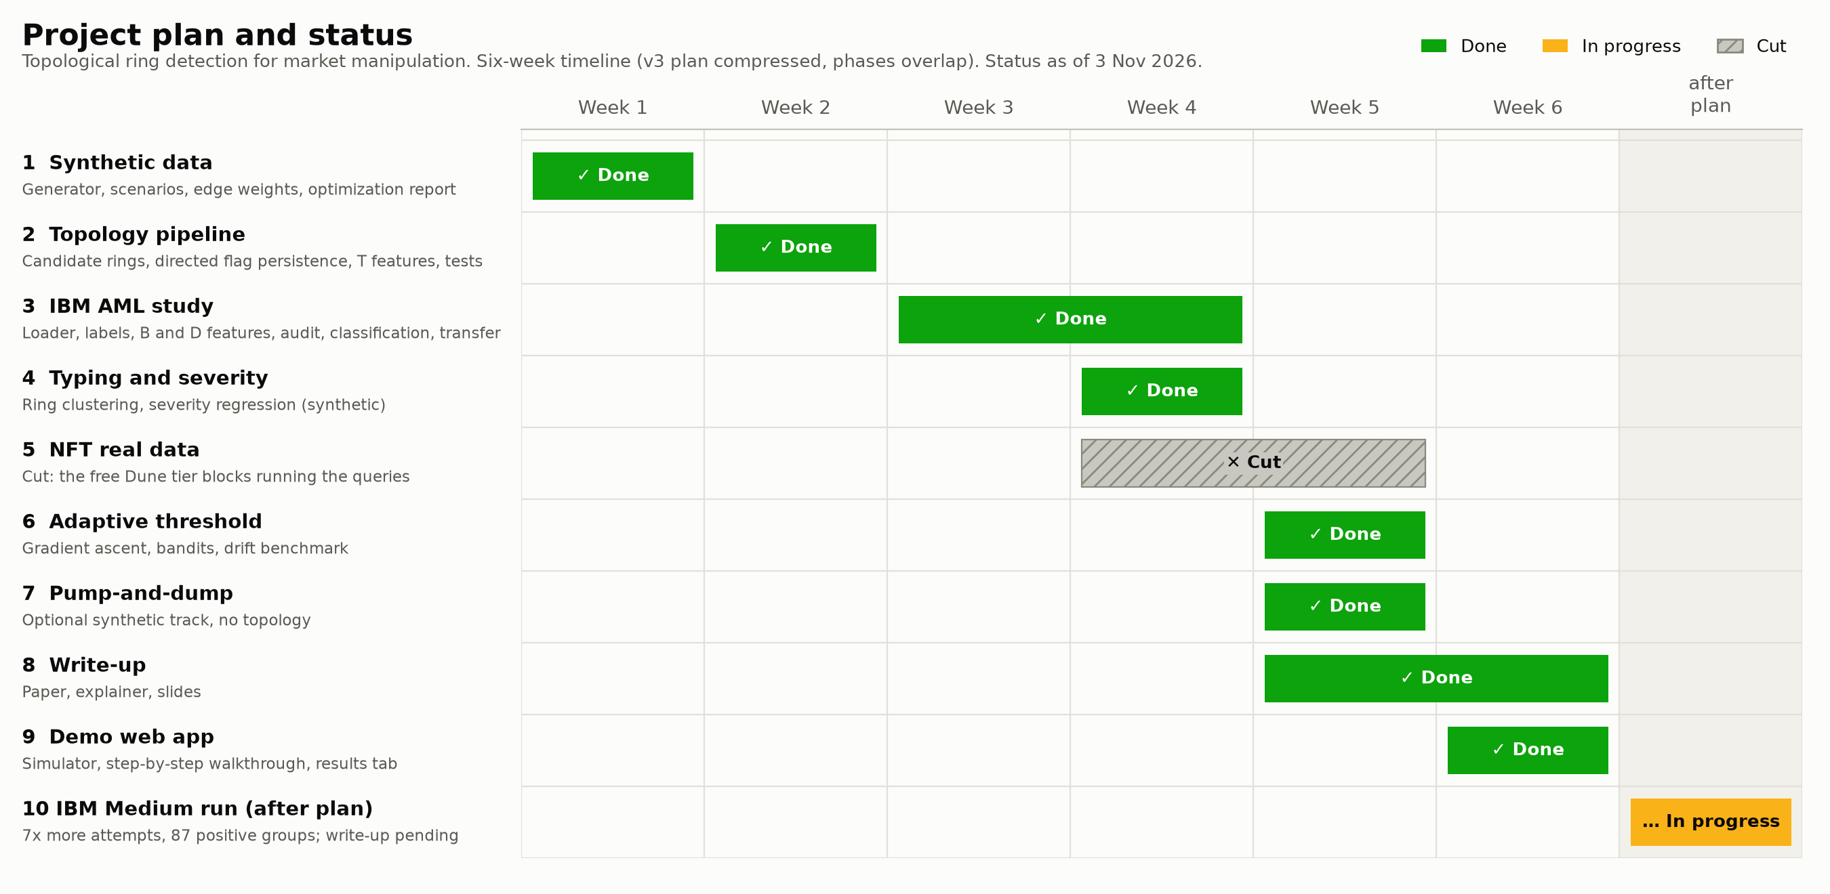
Gantt Chart

Slide 20
Limitations & Future Work
Limitations
Future work
Rings longer than 6 accounts are missed by design
IBM AML is itself synthetic; 14 positive groups on HI-Small (87 on HI-Medium), so CIs stay wide
NFT real-data study not run (Dune free tier)
Adaptive threshold evaluated offline only
Hard negatives are modelled, not observed
Real exchange / NFT data with confirmed labels
Live deployment with delayed feedback
Undirected-complex and persistence-image ablations
Longer rings via local re-sparsification
Multi-parameter filtrations

Slide 21
References
[1] E. Altman et al., "Realistic Synthetic Financial Transactions for Anti-Money Laundering Models," NeurIPS Datasets & Benchmarks, 2023.
[2] M. Weber et al., "Anti-Money Laundering in Bitcoin: Experimenting with Graph Convolutional Networks for Financial Forensics," KDD Workshop, 2019.
[3] D. Lütgehetmann, D. Govc, J. Smith, R. Levi, "Computing Persistent Homology of Directed Flag Complexes," Algorithms, 2020.
[4] H. Edelsbrunner, J. Harer, Computational Topology: An Introduction, AMS, 2010.
[5] P. Bubenik, "Statistical Topological Data Analysis using Persistence Landscapes," JMLR, 2015.
[6] M. Gidea, Y. Katz, "Topological Data Analysis of Financial Time Series: Landscapes of Crashes," Physica A, 2018.
[7] L. W. Cong, X. Li, K. Tang, Y. Yang, "Crypto Wash Trading," Management Science, 2023.
[8] F. Victor, A. M. Weintraud, "Detecting and Quantifying Wash Trading on Decentralized Cryptocurrency Exchanges," WWW, 2021.
[9] V. von Wachter et al., "NFT Wash Trading: Quantifying Suspicious Behaviour in NFT Markets," FC Workshops, 2022.
[10] D. B. Johnson, "Finding All the Elementary Circuits of a Directed Graph," SIAM J. Computing, 1975.
[11] R. Tarjan, "Depth-First Search and Linear Graph Algorithms," SIAM J. Computing, 1972.
[12] A. Garivier, E. Moulines, "On Upper-Confidence Bound Policies for Switching Bandit Problems," ALT, 2011.
[13] J. Duchi et al., "Efficient Projections onto the l1-Ball for Learning in High Dimensions," ICML, 2008.

Slide 22
Thank You

