Slide 1
Linux Device Driver
Nihad jifri KP

Slide 2
INTRODUCTION

Slide 3
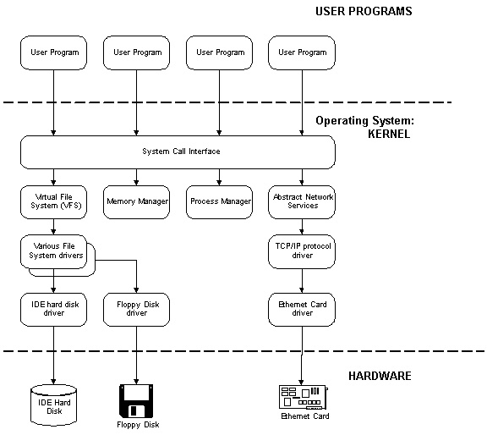
What is driver?
Device driver is a software which gives a device its behavior.
Device driver is a piece of software which gives intelligence to hardware to make work as it should

Slide 4
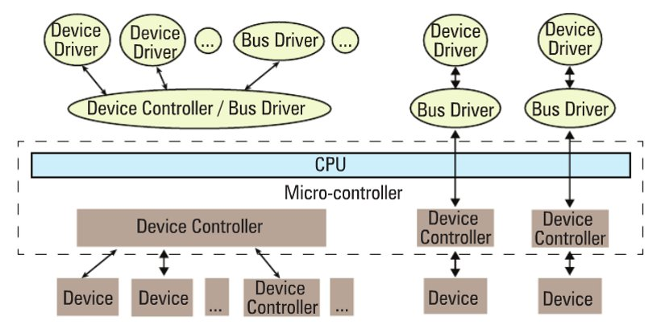
Device and driver interaction

Slide 5
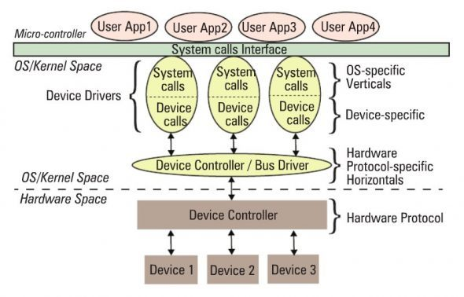

Slide 6
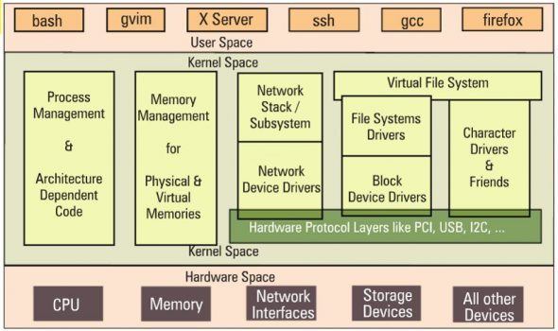

Slide 7
Why should we need a driver?

Slide 8
Advantages of device driver:

Slide 9
Features of linux kernel
Does not have access to C library.
Kernel stack is fixed
Kernel cannot easily use floating point
No memory protection in kernel space

Slide 10
Types of Drivers:
Statically linked driver: whose object code is linked with the kernel. The code of such device driver is physically contained in the kernel and therefore loaded in memory when the system boots.
Dynamically linked driver: whose object code is NOT linked with the kernel. The code of such device driver is NOT contained in the kernel, and the device driver is loaded and unloaded as and when required

Slide 11
Kernel versioning:
Stable kernels : these are production level releases suitable for widespread
deployment
Ex: 3.10.18
3 is Major version no.
10 is minor version no.
Changed only when there drastic changes to kernel i.e from 3.9 to 3.10
18 is first release
These are releases with bugfixes.
Development kernels: these undergo rapid change where anything goes, often
drastic changes to the kernel are made
Ex: 3.9.18

Slide 12
Modules and classes:
Character devices
Block devices
Network devices
Pseudo device drivers

Slide 13
When is a device driver called ?
Autoconfiguration
The kernel calls a device driver at autoconfiguration time to determine what devices are available & to initialize them.
I/O operations
The kernel calls a device driver to perform I/O operations on the device. These operations include opening the device to perform reads & writes & closing the device.
Interrupt handling
The kernel calls a device driver to handle interrupts from devices capable of generating them.
The kernel calls a device driver to handle special requests through ioctl calls
Reinitialisation
The kernel calls the device driver to reinitialize the driver, the device, or both when the bus is reset.

Slide 14
Security issues:

Slide 15
First device Driver:

Slide 16
Building and running modules:

Slide 17
Module parameters:

Slide 18
Debugging techniques:
Priority (high to low) | Description
KERN_EMERG <0> | Used for emergency messages, usually those that precede a crash.
KERN_ALERT <1> | A situation requiring immediate action.
KERN_CRIT <2> | Critical conditions, often related to serious hardware or software failures.
KERN_ERR <3> | Used to report error conditions; device drivers often use KERN_ERR to report hardware difficulties.
KERN_WARNING <4> | Warnings about problematic situations that do not, in themselves, create serious problems with the system.
KERN_NOTICE <5> | Situations that are normal, but still worthy of note. A number of security-related conditions are reported at this level.
KERN_INFO <6> | Informational messages. Many drivers print information about the hardware they find at startup time at this level.
KERN_DEBUG <7> | Used for debugging messages.

Slide 19
Data types in kernel:

Slide 20
Kernel c extras in linux device driver

Slide 21
Procfs

Slide 22
sysfs

Slide 23
Module Interractions

Slide 24
Writing the kernel module
Compiling and loading modules
Proc and sysfs

Slide 25
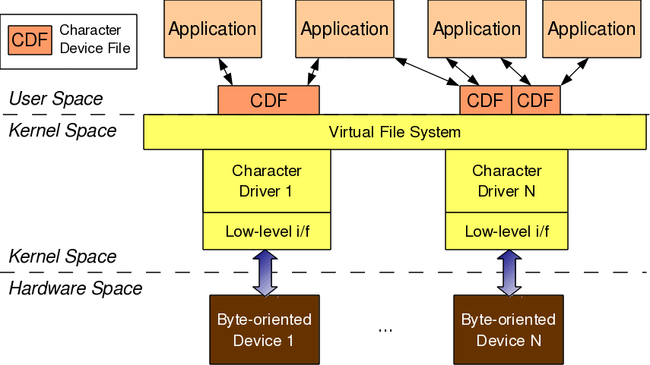
CHARACTER DRIVERS
Application
Open()
Character Device File
Register(), linking device file opps
Character Device Driver
Operations()
Character Device

Slide 26
The connection between the application and the device file is based on the name of the device file. However, the connection between the device file and the device driver is based on the number of the device file:
Type (defined in kernel header linux/types.h):
dev_t contains both major and minor numbers
Macros (defined in kernel header linux/kdev_t.h):
MAJOR(dev_t dev) extracts the major number from dev
MINOR(dev_t dev) extracts the minor number from dev
MKDEV(int major, int minor) creates the dev from major and minor.

Slide 27
Connecting the device file with the device driver involves two steps:
Registering for the <major, minor> range of device files.
Linking the device file operations to the device driver functions.
The first step is achieved using either of the following two APIs, defined in the kernel header linux/fs.h:
Registering:
int register_chrdev_region(dev_t first, unsigned int cnt, char *name);
int alloc_chrdev_region(dev_t *first, unsigned int firstminor, unsigned int cnt, char *name);

Slide 28
Creation of Device file (Auto)
Linking file operations structure:
Reading to device
Writing from device

Slide 29
Allocation of major number-register_chrdev_region, alloc_chrdev_region.
Creating a device file
Char device registration – cdev_alloc, cdev_init, cdev_add, cdev_del
Class – udev auto creation of device files while inserting module
Freeing the device – unregister_chrdev_region

Slide 30
Char device file creation

Slide 31
Cdev structure and file operations

Slide 32
ADVANCED CHARACTER DRIVER OPERATIONS
Lseek
ioctl

Slide 33
FLOW OF TIME

Slide 34
HARDWARE MANAGEMENT

Slide 35
INTERRUPT HANDLING

Slide 36
CONCORRENCY AND RICE CONDITION

Slide 37
USB DEVICES

Slide 38
BLOCK DEVICES

Slide 39
PCI INTERFACE

Slide 40
LINUX DEVICE MODEL

Slide 41
LINUX KERNEL BUILD AND STATIC LINKING

Slide 42
SERIAL PORT

Slide 43
PARALLEL PORT

Slide 44
BEAGLE BONE BLACK

