Slide 1
Linux Device Driver
Nihad jifri KP

Slide 2
INTRODUCTION

Slide 3
What is driver?

Slide 4
Why should we need a driver?

Slide 5
Advantages of device driver:

Slide 6
Types of Drivers:

Slide 7
Kernel versioning:

Slide 8
Modules and classes:

Slide 9
Security issues:

Slide 10
First device Driver:

Slide 11
Building and running modules:

Slide 12
Module parameters:

Slide 13
Debugging techniques:

Slide 14
Data types in kernel:

Slide 15
Kernel c extras in linux device driver

Slide 16
Procfs

Slide 17
sysfs

Slide 18
Module Interractions

Slide 19
Writing the kernel module
Compiling and loading modules
Proc and sysfs

Slide 20
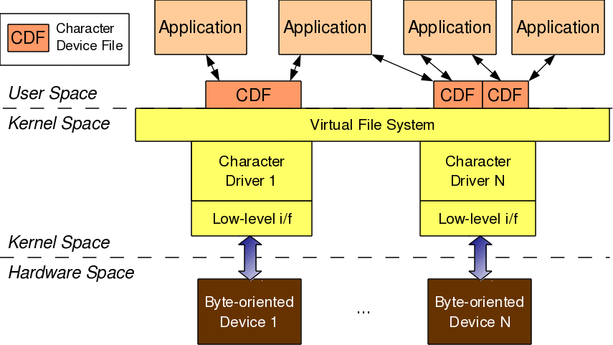
CHARACTER DRIVERS
Application
Open()
Character Device File
Register(), linking device file opps
Character Device Driver
Operations()
Character Device

Slide 21
The connection between the application and the device file is based on the name of the device file. However, the connection between the device file and the device driver is based on the number of the device file:
Type (defined in kernel header linux/types.h):
dev_t contains both major and minor numbers
Macros (defined in kernel header linux/kdev_t.h):
MAJOR(dev_t dev) extracts the major number from dev
MINOR(dev_t dev) extracts the minor number from dev
MKDEV(int major, int minor) creates the dev from major and minor.

Slide 22
Connecting the device file with the device driver involves two steps:
Registering for the <major, minor> range of device files.
Linking the device file operations to the device driver functions.
The first step is achieved using either of the following two APIs, defined in the kernel header linux/fs.h:
Registering:
int register_chrdev_region(dev_t first, unsigned int cnt, char *name);
int alloc_chrdev_region(dev_t *first, unsigned int firstminor, unsigned int cnt, char *name);

Slide 23
Creation of Device file (Auto)
Linking file operations structure:
Reading to device
Writing from device

Slide 24
Allocation of major number-register_chrdev_region, alloc_chrdev_region.
Creating a device file
Char device registration – cdev_alloc, cdev_init, cdev_add, cdev_del
Class – udev auto creation of device files while inserting module
Freeing the device – unregister_chrdev_region

Slide 25
Char device file creation

Slide 26
Cdev structure and file operations

Slide 27
ADVANCED CHARACTER DRIVER OPERATIONS
Lseek
ioctl

Slide 28
FLOW OF TIME

Slide 29
HARDWARE MANAGEMENT

Slide 30
INTERRUPT HANDLING

Slide 31
CONCORRENCY AND RICE CONDITION

Slide 32
USB DEVICES

Slide 33
BLOCK DEVICES

Slide 34
PCI INTERFACE

Slide 35
LINUX DEVICE MODEL

Slide 36
LINUX KERNEL BUILD AND STATIC LINKING

Slide 37
SERIAL PORT

Slide 38
PARALLEL PORT

Slide 39
BEAGLE BONE BLACK

