Slide 1


VR Siddhartha Engineering College Department of Information Technology
Multimodal Fake Disaster News Detection on Social Media Using Deep Learning
B. Tech in Information Technology
20IT8551: MAJOR PROJECT
BATCH-20
Presented by
Shaik Nihajasmine (228W1A12i9)
Chinni Bhanu Prakash (228W1A12E5)
Under the guidance of
Dr. T. Anuradha, Professor

Slide 2
Agenda
Introduction and Problem Statement
Objectives and Outcomes of the project
Literature Review and Summary
Dataset and requirement specifications
Algorithms used in the Project
Architecture diagram
Implementation steps and Execution
Results obtained
Result analysis with charts
Conclusion and future work
References

Slide 3
Introduction
During disaster situations, timely and reliable information is critical for emergency response and public safety.
The rapid spread of fake or misleading disaster-related tweets can cause panic, misguide rescue operations, and reduce trust in genuine information.
An automated system capable of filtering fake disaster tweets can support faster decision-making and improve the reliability of social media as an information source during emergencies.

Slide 4
Problem Statement
The rapid spread of misinformation during disaster events on social media platforms creates confusion, panic, and challenges for emergency response efforts.
Disaster-related tweets often circulate without verification, making it difficult to distinguish between genuine information and false claims in real time.
Existing manual monitoring and verification methods are not scalable or efficient for handling the large volume of disaster-related social media data.

Slide 5
OBJECTIVES
To develop a multimodal framework for detecting fake disaster-related tweets using from textual information and disaster information visual information.
To fine-tune pre-trained RoBERTa for contextual textual feature extraction and ResNet-50 for visual feature extraction from tweet-associated images.
To implement a decision-level fusion strategy to combine text and image predictions for final classification.
OUTCOMES
A functional multimodal system capable of classifying disaster-related tweets as Fake or Real.
Individually fine-tuned text and image models capable of extracting meaningful semantic and visual features relevant to disaster misinformation.
A unified prediction mechanism using decision-level fusion, with evaluated performance comparison against unimodal (text-only and image-only) models.

Slide 6
Literature Survey
Title-Journal | Objective | Methodology | Algorithms used | Dataset/Study area | Limitations | Conclusion
Fake News Detection With Credibility Scoring on Turkish Twitter Data Author: ÖA Fidan, E Öztürk, H Kantarci Journal: IEEE Access Year: 2025 | To improve fake news detection on Turkish Twitter by combining deep learning models with credibility scoring. | Collected 5,169 Turkish tweets from 38 news accounts. Calculated credibility score using text, user, and social features. Fine-tuned Llama-2-7B and Phi-3-mini models. Compared performance with and without credibility features. Conducted binary and multiclass experiments. | Llama-2-7B (fine-tuned) Phi-3-mini-4k Logistic Regression (baseline) SHAP (feature importance) | Turkish Twitter dataset (5169 tweets) | Requires high computational resources. Lower performance in multiclass setting. Language-specific (Turkish only). | Credibility-based modeling significantly improves fake news detection, with near-perfect binary F1 performance.
Emotions-Based Disaster Tweets Classification: Real or Fake Author: Marco Alfonse, Mariam Gawich Journal: WSEAS Transactions on Information Science and Applications Year: 2023 | To distinguish between fake disaster tweets and real ones and to evaluate the impact of emotion (sentiment) extraction on classification performance | Dataset selection (Kaggle disaster tweets dataset). Preprocessing (removal of NaN values, lemmatization, regex cleaning, noun phrase detection). Emotion extraction using Syuzhet (R package) to compute tweet polarity. Feature extraction using: TF-IDF, Count Vectorizer Classification using multiple ML algorithms. | Multinomial Naive Bayes (MNB) Logistic Regression (LR) Linear SVC KNN Decision Tree Random Forest Gradient Boosting SGD MLP Bagging Classifier | Kaggle Disaster Tweets Dataset | Does not process emoticons. Performance improvement from emotion feature is modest. Model is text-only. | The inclusion of emotion extraction (tweet polarity) improves disaster fake tweet classification performance, achieving 89.39% accuracy, outperforming previous compared models

Slide 7
Title-Journal | Objective | Methodology | Algorithms used | Dataset/Study area | Limitations | Conclusion
A BERT-Based Multimodal Framework for Enhanced Fake News Detection Using Text and Image Data Fusion Authors: Mohammed Al-alshaqi, Danda B. Rawat, Chunmei Liu Journal: Computers (ISSN 2073-431X) Year: 2025 | To improve fake news detection by combining textual and visual information using multimodal deep learning with cross-attention fusion | Collected multimodal fake news datasets. Applied OCR to extract embedded image text. Used BERT_base_uncased for text features. Used CNN for image feature extraction. Applied cross-attention feature-level fusion. Classified news as fake or real. | BERT_base_uncased OCR CNN for image features Cross-attention fusion Deep learning classifier | ISOT WELFake TruthSeeker (Social media fake news datasets) | Requires large multimodal datasets. Computationally expensive. Performance sensitive to OCR quality. | Feature-level multimodal fusion using cross-attention significantly improves fake news detection accuracy and generalization compared to unimodal approaches. Reported Accuracy ≈ 99.97%
ContCommRTD: A Distributed Content-Based Misinformation-Aware Community Detection System for Real-Time Disaster Reporting Author: Elena-Simona Apostol et al. Journal: IEEE Transaction Year: 2023 | To build a distributed real-time system that detects disaster-related communities on Twitter while filtering misinformation. | Collected geolocated Twitter data using a meta-knowledge dictionary. Constructed social graph (retweets + replies). Applied misinformation detection before community formation. Used OLDA for topic modeling. Applied DBSCAN for geolocation-based community detection. Implemented distributed system using Kafka + MongoDB. | FN-BERT-TFIDF (BiLSTM + CNN + BERT + TF-IDF) Online LDA (OLDA) DBSCAN Named Entity Recognition (NER) | Hydrological hazards: 356,483 tweets COVID-19 hazards: 50,230 tweets Fake detection tested on: LIAR dataset COVID-19 rumor dataset | Depends on geolocation availability or NER extraction Moderate fake detection accuracy on LIAR dataset Computationally heavy distributed architecture | The system successfully integrates misinformation detection with real-time disaster community detection. FN-BERT-TFIDF improves performance over single-input models, and DBSCAN produces highly separated communities (Accuracy-87%).

Slide 8
Literature Summary
Recent studies in fake news detection show a shift from traditional machine learning to deep learning and multimodal approaches. Early methods using sentiment and text-based features improve performance but remain limited to textual analysis.
Recent works incorporate credibility features and large language models, improving detection accuracy, though they are computationally expensive and dataset-specific. Multimodal frameworks combining text and image data further enhance performance by capturing complementary information, but require large datasets and complex processing.
System-level approaches focus on real-time detection and community analysis, improving scalability but lacking deep content understanding. Overall, while multimodal and deep learning methods are effective, challenges remain in fusion efficiency, generalization, and unified detection of disaster relevance and misinformation.

Slide 9
Datasets Used
PHEME Dataset
Used for Real vs Fake classification
Disaster-related Tweet Datasets
Used for Disaster vs Non-Disaster classification
Includes tweets from floods, earthquakes, wildfires, accidents
Disaster Image Datasets
Used for Disaster Type Classification
Categories: flood, fire, earthquake, cyclone, etc.
Helps model learn visual patterns of disasters

Slide 10
Requirement Specifications
Hardware Requirements
Processor: Intel i5 or higher
RAM: Minimum 8 GB (16 GB recommended)
GPU: Required for deep learning training
Storage: ≥ 10 GB
Software Requirements
Operating System: Windows / Linux
Programming Language: Python
Development Tools: Jupyter Notebook / VS Code
Tools & Technologies
PyTorch: used for Model training
Hugging Face Transformers: used for RoBERTa implementation
Scikit-learn: used for Evaluation metrics
NumPy & Pandas: used for Data preprocessing
OpenCV: used for Image processing
Interface:
Flask : used for Backend API
React (Vite): used for Frontend dashboard
MySQL: used for Data storage
Leaflet + OpenStreetMap : used for Map visualization

Slide 11
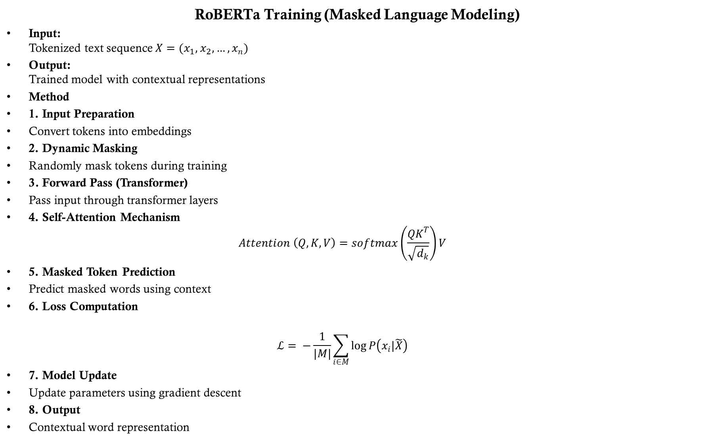
RoBERTa Training (Masked Language Modeling)
Input: Tokenized text sequence $X=(x_{1},x_{2},…, x_{n})$
Output: Trained model with contextual representations
Method
1. Input Preparation
Convert tokens into embeddings
2. Dynamic Masking
Randomly mask tokens during training
3. Forward Pass (Transformer)
Pass input through transformer layers
4. Self-Attention Mechanism
$$Attention \left(Q, K, V\right)=softmax\left(\frac{QK^{T}}{\sqrt{d_{k}}}\right)V$$
5. Masked Token Prediction
Predict masked words using context
6. Loss Computation
$$ℒ= −\frac{1}{|M|}\sum_{i∈M}{\log{P\left(x_{i}|\tilde{X}\right)}}$$
7. Model Update
Update parameters using gradient descent
8. Output
Contextual word representation

Slide 12
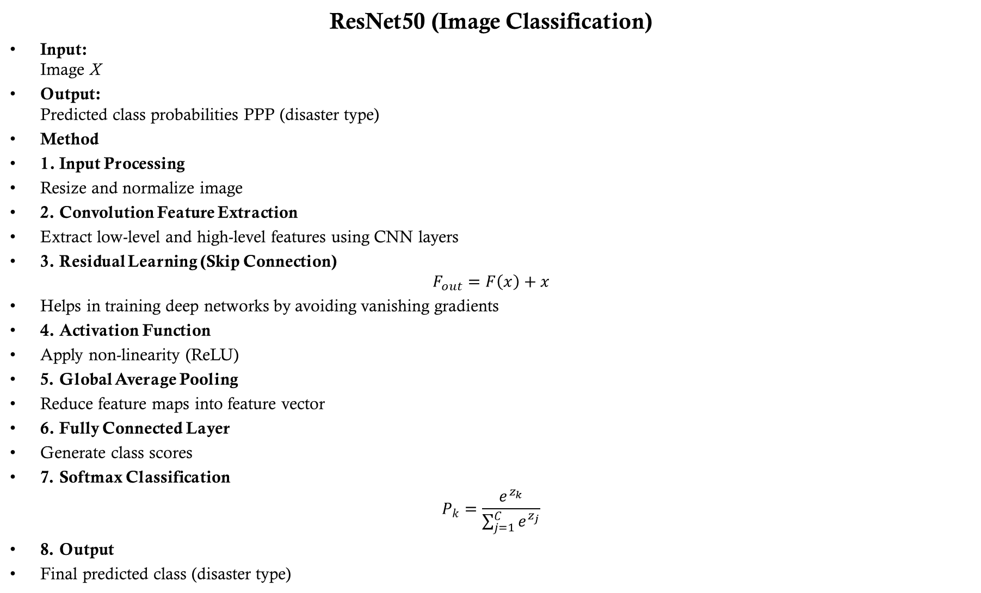
ResNet50 (Image Classification)
Input: Image X
Output: Predicted class probabilities PPP (disaster type)
Method
1. Input Processing
Resize and normalize image
2. Convolution Feature Extraction
Extract low-level and high-level features using CNN layers
3. Residual Learning (Skip Connection)
$$F_{out}=F\left(x\right)+x$$
Helps in training deep networks by avoiding vanishing gradients
4. Activation Function
Apply non-linearity (ReLU)
5. Global Average Pooling
Reduce feature maps into feature vector
6. Fully Connected Layer
Generate class scores
7. Softmax Classification
$$P_{k}=\frac{e^{z_{k}}}{\sum_{j=1}^{C}{e^{z_{j}}}}$$
8. Output
Final predicted class (disaster type)

Slide 13
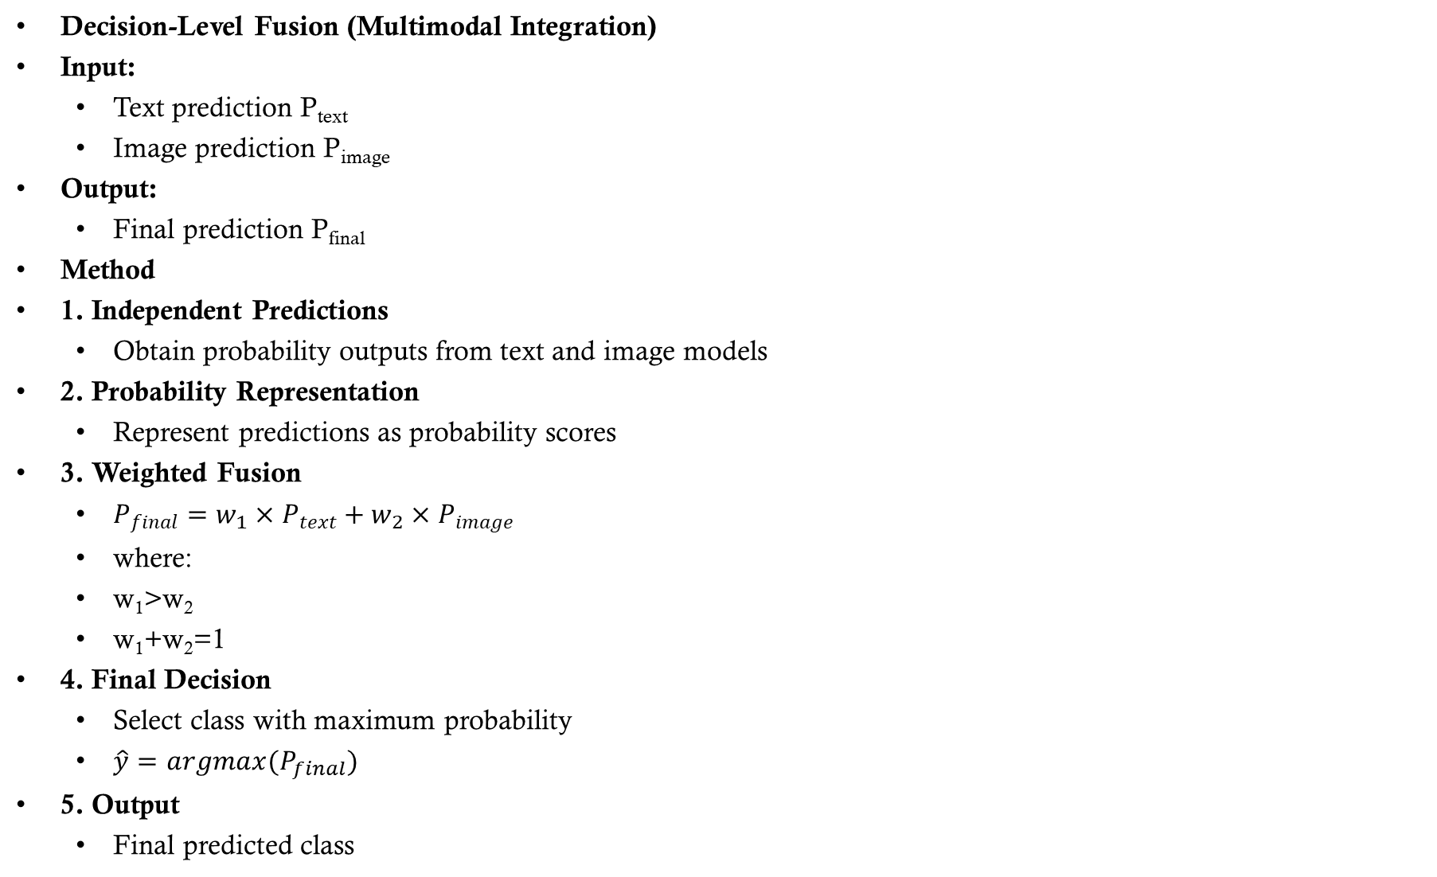
Decision-Level Fusion (Multimodal Integration)
Input:
Text prediction P_{text}​
Image prediction P_{image}​
Output:
Final prediction P_{final}​
Method
1. Independent Predictions
Obtain probability outputs from text and image models
2. Probability Representation
Represent predictions as probability scores
3. Weighted Fusion
$P_{final}=w_{1}×P_{text}+w_{2}×P_{image}$
where:
w₁​>w₂​
w₁+w₂=1
4. Final Decision
Select class with maximum probability
$\hat{y}=argmax(P_{final})$
5. Output
Final predicted class

Slide 14
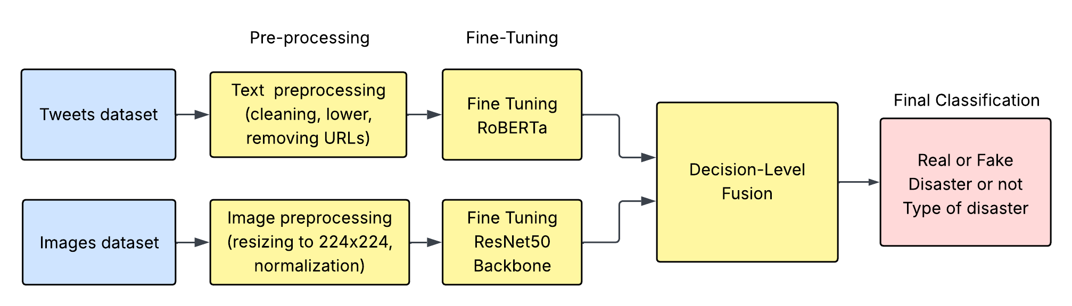
Architecture diagram

Slide 15
Implementation steps
Step 1: Dataset The PHEME dataset is used for real/fake classification. Multiple disaster-related tweet datasets are combined for disaster/non-disaster classification, and multiple image datasets are integrated for disaster type classification.
Step 2: Data Preprocessing Clean and tokenize text for transformer input, and resize/normalize images for ResNet50 processing.
Step 3: Multitask Text Model (RoBERTa) Fine-tune RoBERTa with dual classification heads for disaster detection and fake/real classification.
Step 4: Image Model (ResNet50) Fine-tune ResNet50 to classify disaster types from images.
Step 5: Decision-Level Fusion Combine outputs from both models, assigning higher weight to text predictions.
Step 6: Final Output Generation Generate predictions for disaster presence, authenticity, and disaster type.

Slide 16
Execution
Step 1: Input Acquisition Tweet data is either fetched from the Twitter API or manually entered through the system interface.
Step 2: Preprocessing The input text is cleaned and tokenized, while the associated image is resized and normalized.
Step 3: Text Model Inference (RoBERTa) The multitask RoBERTa model predicts:
Disaster / Non-Disaster
Real / Fake
Step 4: Image Model Inference (ResNet50) The ResNet50 model analyzes the image and predicts the disaster type.
Step 5: Context Extraction
Named Entity Recognition extracts location, Nominatim for identifying coordinates
Sentiment analysis determines urgency level
Step 6: Decision-Level Fusion Text and image predictions are combined, giving higher priority to textual output.
Step 7: Filtering and Storage Only tweets satisfying: Disaster = TRUE AND Real = TRUE are stored in the database.
Step 8: Visualization Validated results are displayed on the dashboard with location, urgency, and disaster type.

Slide 17
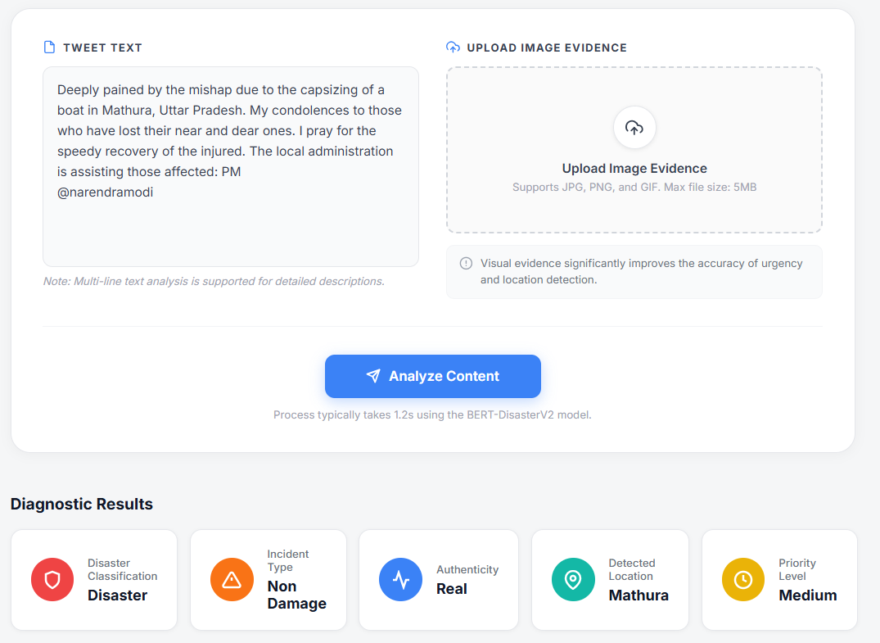
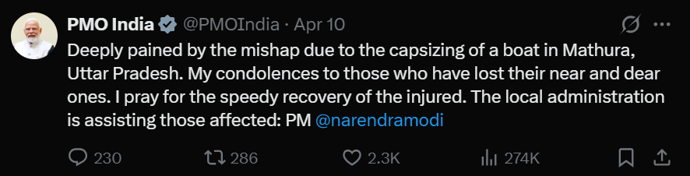
Results obtained

Slide 18
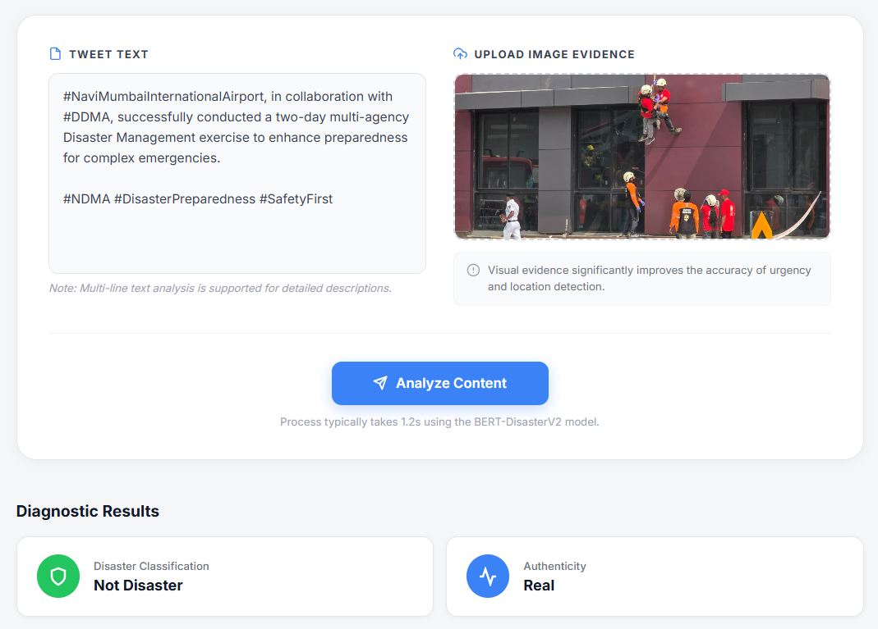
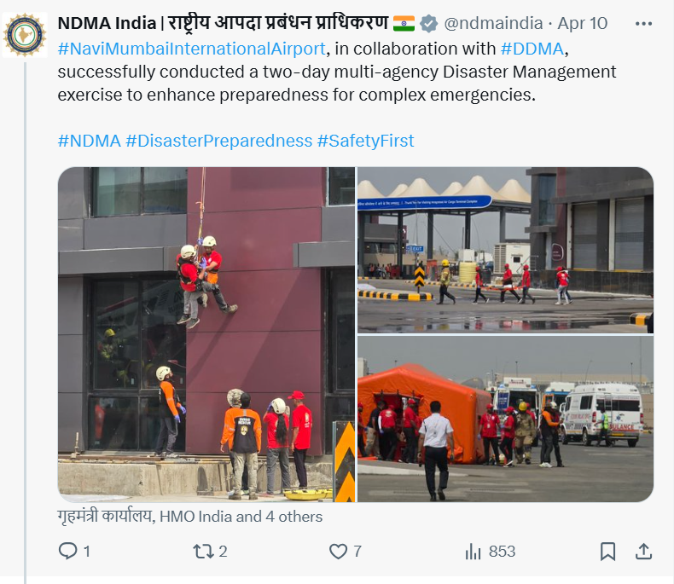

Slide 19
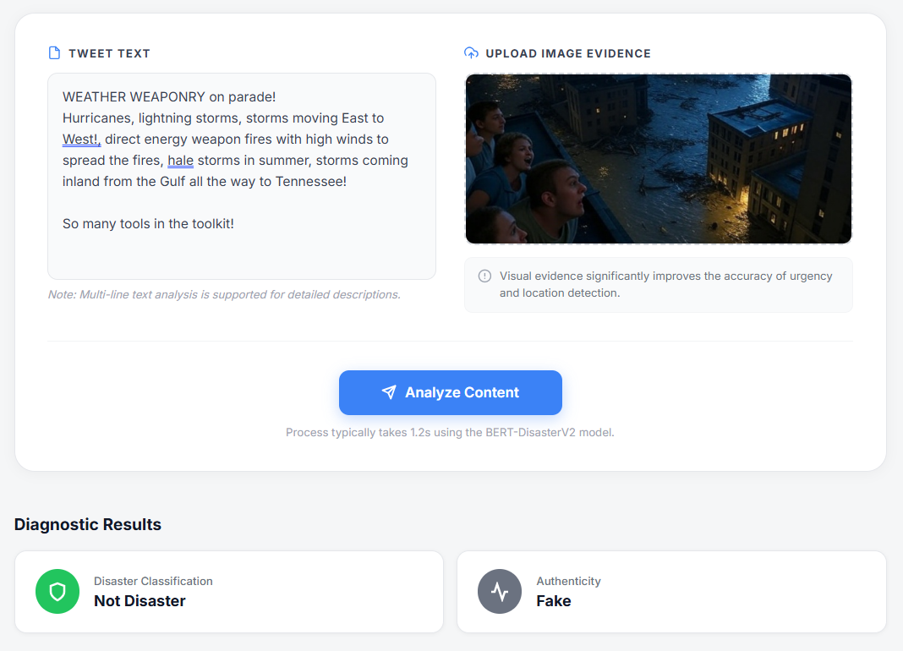
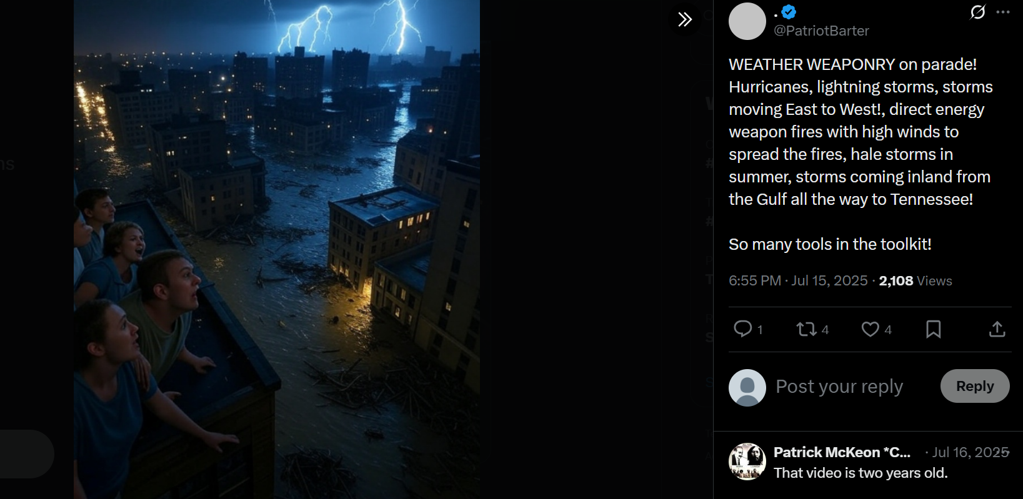

Slide 20
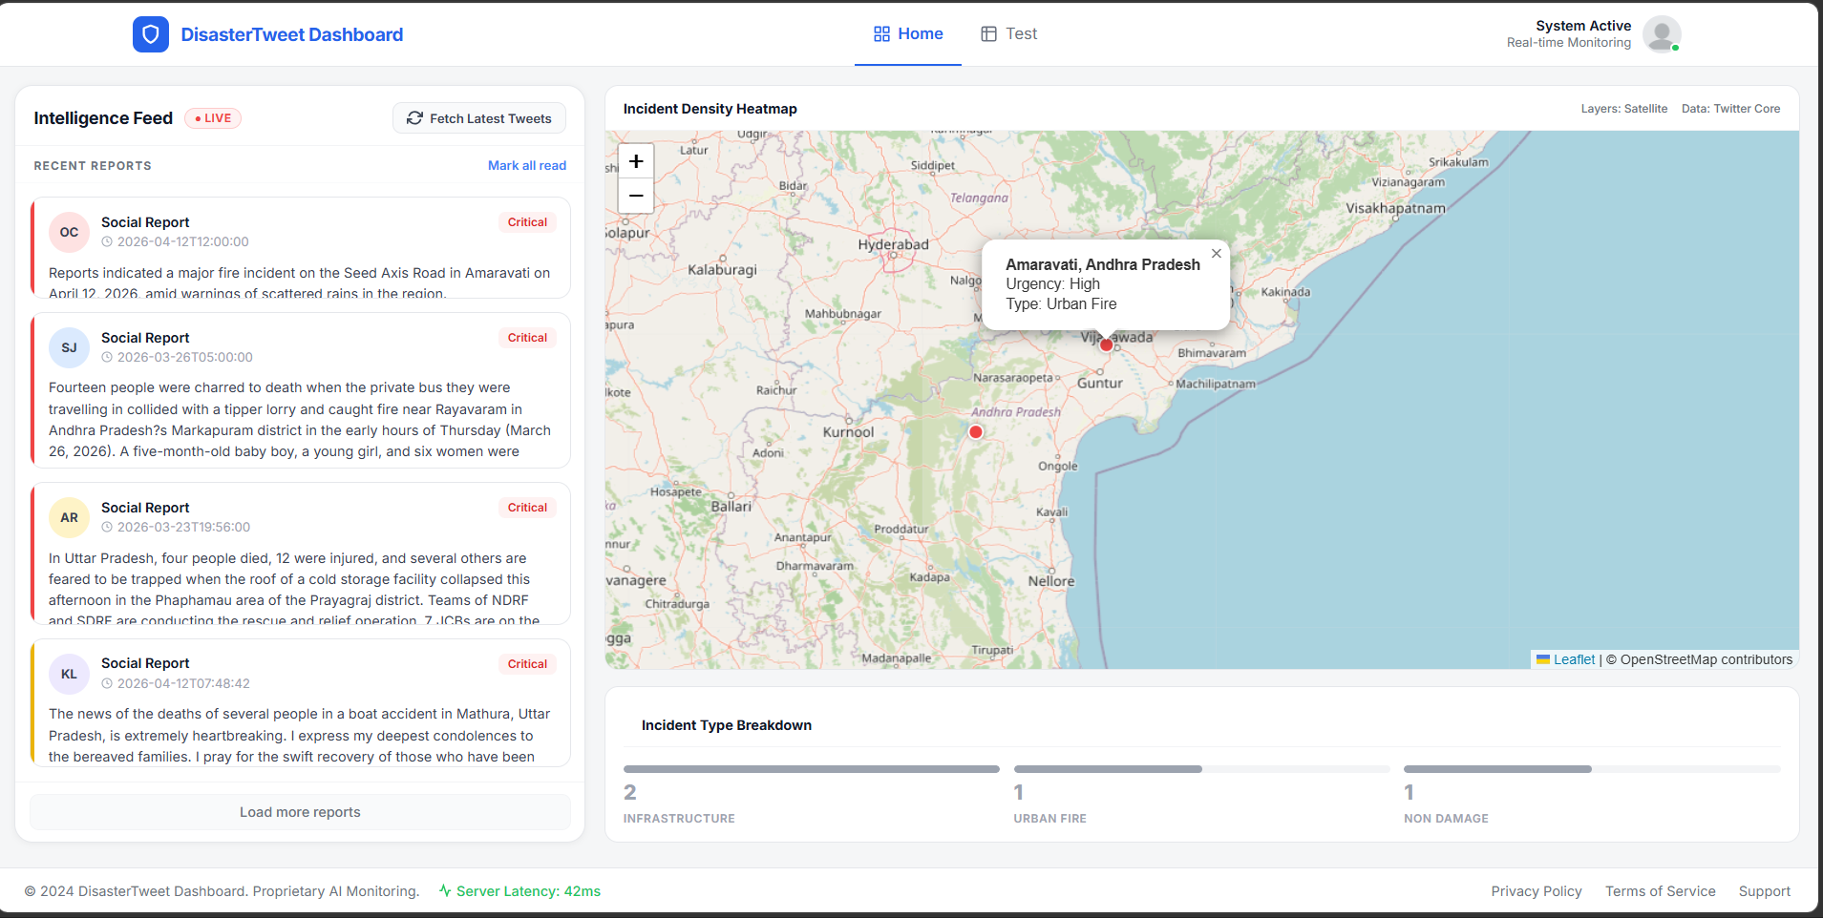
Interface Results

Slide 21
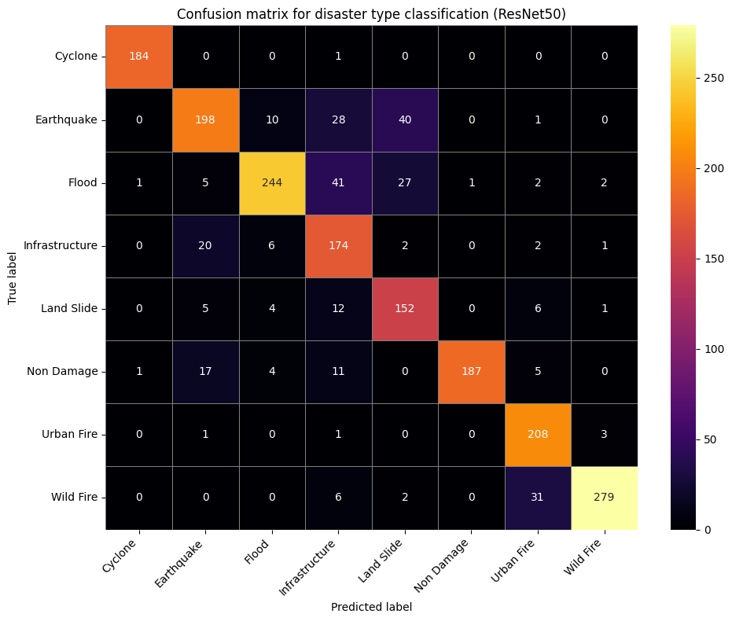
Result analysis with charts
ResNet50 Results

Slide 22
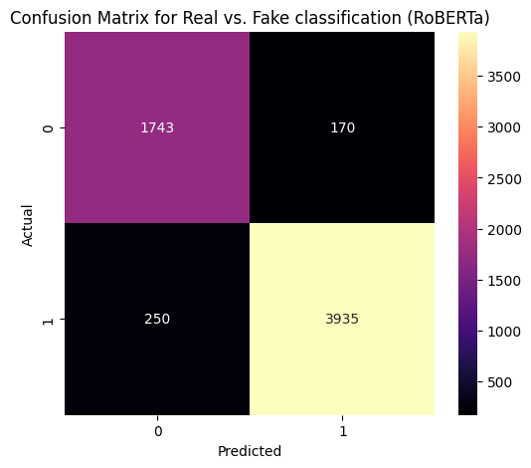
RoBERTa (Real/Fake) Detection

Slide 23
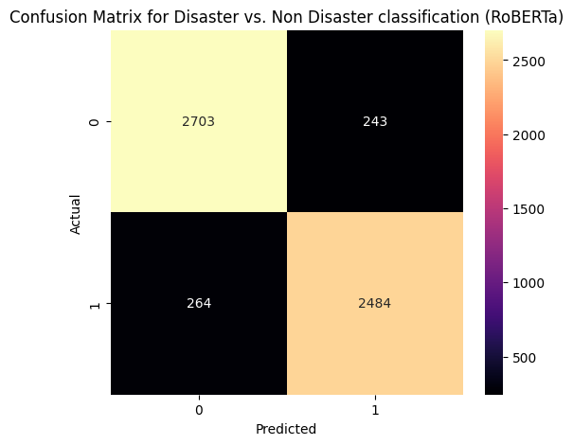
Roberta (Disaster/Not) Detection

Slide 24
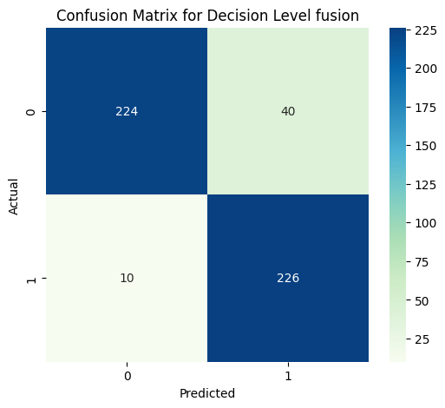
Decision fusion and Quantitative comparison
Model | Task | Accuracy
ResNet50 | Disaster Image | 0.85
RoBERTa | Disaster Text (Proposed) | 0.8820
RoBERTa | Real/Fake Text (Proposed) | 0.8442
Fusion | Text+Image (Proposed System) | 0.9050

Slide 25
CONCLUSION
The proposed system develops a multimodal framework for detecting disaster-related and fake social media content using RoBERTa for text analysis and ResNet50 for image classification. Decision-level fusion improves prediction reliability by reducing ambiguity compared to unimodal approaches. The integration of location and urgency extraction further enhances its practical usefulness for real-time disaster monitoring and misinformation detection.
FUTURE WORK
Extend the system to work on real-time Twitter data for live disaster monitoring
Improve fusion using advanced methods like attention-based techniques
Use larger and more diverse datasets to improve accuracy and generalization
Add support for video and audio data for better understanding of events
Include explainable AI to make model predictions more transparent

Slide 26
References
[1] Fidan, Ö. A., Öztürk, E., & Kantarci, H. (2025). Fake News Detection With Credibility Scoring on Turkish Twitter Data. IEEE Access.
[2] Alfonse, M. A. R. C. O., & Gawich, M. (2023). Emotions-based disaster tweets classification: real or fake. WSEAS Transactions on Information Science and Applications, 20, 313-321.
[3] Al-alshaqi, M., Rawat, D. B., & Liu, C. (2025). A BERT-Based Multimodal Framework for Enhanced Fake News Detection Using Text and Image Data Fusion. Computers, 14(6), 237.
[4] Apostol, E. S., Truică, C. O., & Paschke, A. (2024). ContCommRTD: A distributed content-based misinformation-aware community detection system for real-time disaster reporting. IEEE Transactions on Knowledge and Data Engineering, 36(11), 5811-5822.
[5] Song, G., & Huang, D. (2021). A sentiment-aware contextual model for real-time disaster prediction using twitter data. Future Internet, 13(7), 163.
[6]NicoleMichelle. (n.d.). PHEME dataset for rumour detection [Data set]. Kaggle. https://www.kaggle.com/datasets/nicolemichelle/pheme-dataset-for-rumour-detection
[7] Imolu, M. (2020). Disaster tweets dataset [Data set]. Kaggle. https://www.kaggle.com/datasets/aslemimolu/disaster-tweets-dataset
[8] Bhute, S. (2021). Hackathon disaster tweet dataset [Data set]. Kaggle. https://www.kaggle.com/datasets/sanjanabhute03/hackathon-disaste-tweet
[9]Roy, R. (2021). Cyclone, wildfire, flood & earthquake image database [Data set]. Kaggle. https://www.kaggle.com/datasets/rupakroy/cyclone-wildfire-flood-earthquake-database
[10] Varpit, V. (2020). Disaster images dataset (Comprehensive Disaster Dataset) [Data set]. Kaggle. https://www.kaggle.com/datasets/varpit94/disaster-images-dataset
[11] Babula, M. (2021). Disaster images dataset for CNN-based disaster detection [Data set]. Kaggle. https://www.kaggle.com/datasets/mikolajbabula/disaster-images-dataset-cnn-model
[12] Kabeer, M. (2022). Flood images for training disaster detection models [Data set]. Kaggle. https://www.kaggle.com/datasets/kabeer2004/flood-images-for-training disaster-detection-model

