Slide 1
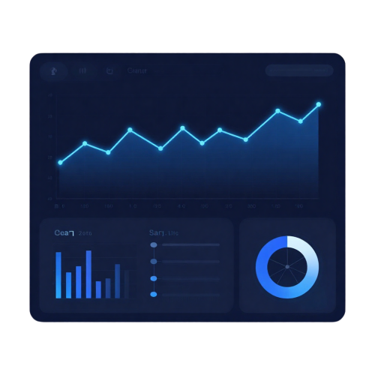
Retail Sales Analytics Dashboard
Data Analytics Internship Project
Presented By: Nihal Muhammed V
Role: Junior Data Analyst Intern
Organization: ProDevInfo Solutions
Mentor: Abdul Vahab P

Slide 2
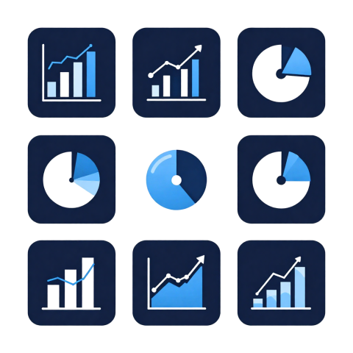
Project Overview
This project analyzes retail sales data from 2021–2024 to identify business trends, calculate KPIs, and build an interactive dashboard for decision-making.
Tools Used
Python
Pandas
NumPy
Plotly
Streamlit
Jupyter Notebook

Slide 3

Problem Statement
Data Challenges
Missing Values
Duplicate Records
Inconsistent Formats
Data Quality Issues
Objective
Clean the data, perform analysis, generate business insights, and develop an interactive dashboard.

Slide 4
Project Workflow
Raw Dataset
Data Cleaning
Exploratory Data Analysis
KPI Calculation
Dashboard Development
Business Insights & Recommendations

Slide 5
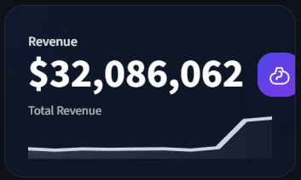
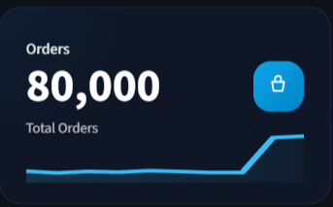
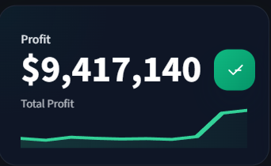
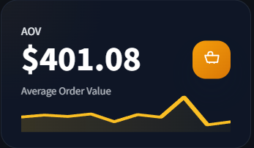
KPI Overview
Key Performance Indicators (KPIs)
Total Revenue
Total Profit
Total Orders
Avg Order Value
Purpose
KPIs provide a quick overview of business performance and help monitor sales growth and profitability.

Slide 6
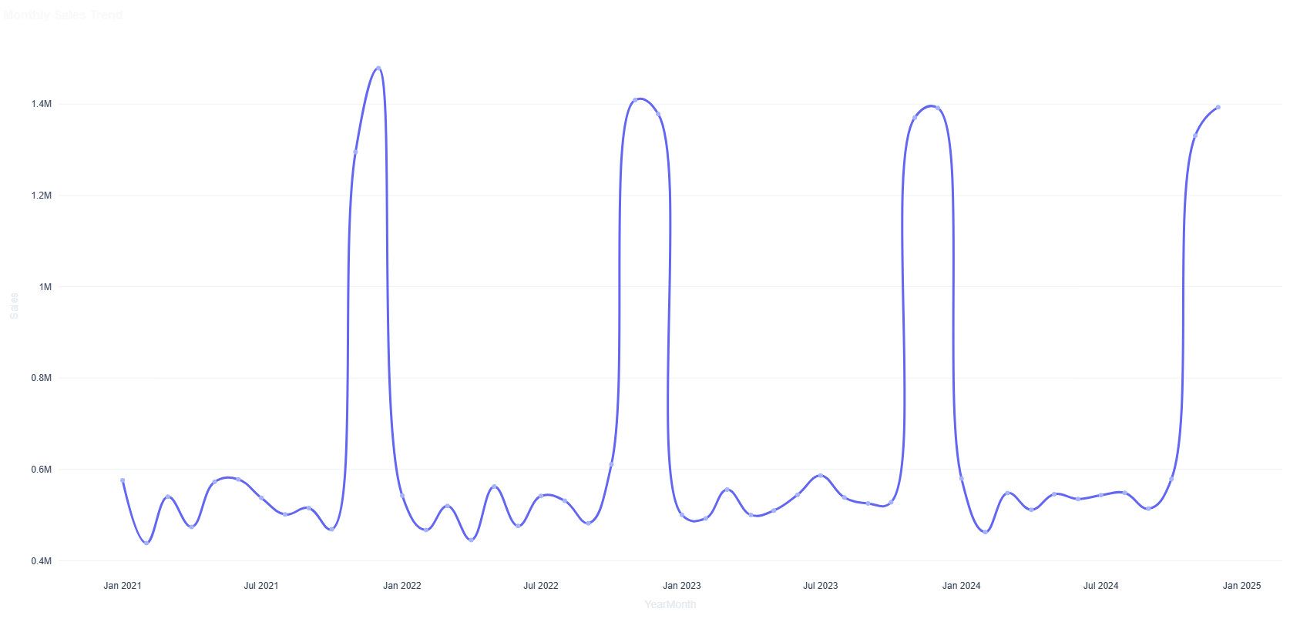
Monthly Sales Trend
Objective
Analyze monthly sales performance and identify seasonal patterns.
Observations
• Sales fluctuate throughout the year.
• Seasonal peaks indicate higher customer demand.
• Trend analysis supports inventory and sales planning.

Slide 7
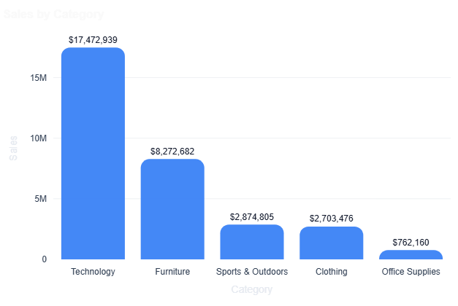
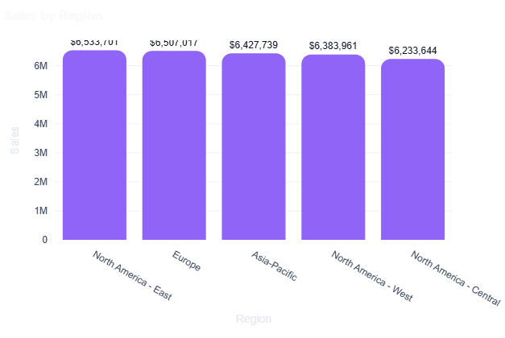
Sales by Category and Region
Objective
Compare sales performance across product categories and regions.
Observations
• Technology category generates the highest revenue.
• Regional performance varies across markets.
• Growth opportunities exist in lower-performing regions.

Slide 8
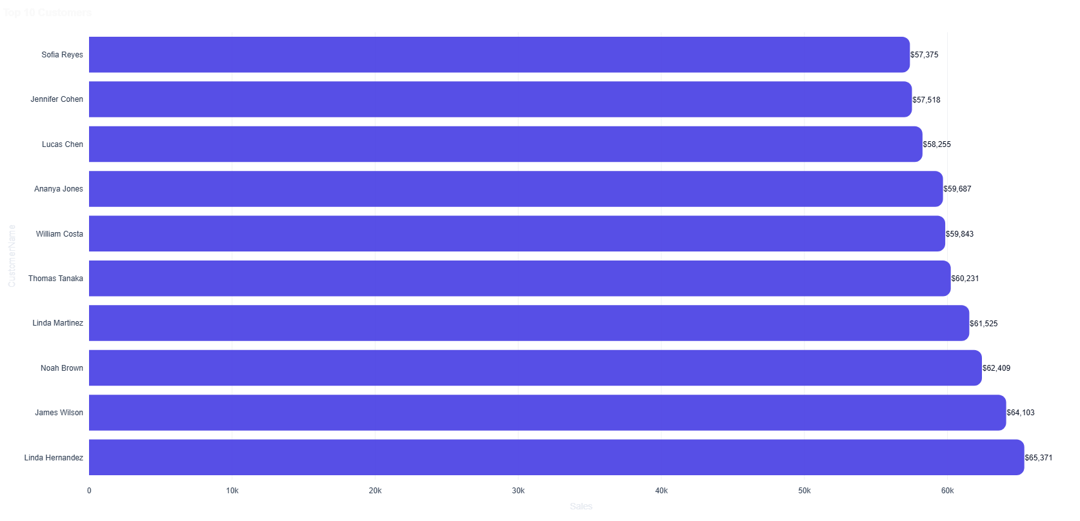
Top 10 Customers
Objective
Identify customers contributing the highest sales revenue.
Observations
• Top customers contribute a significant share of revenue.
• Customer retention improves profitability.
• High-value customers should be prioritized.

Slide 9
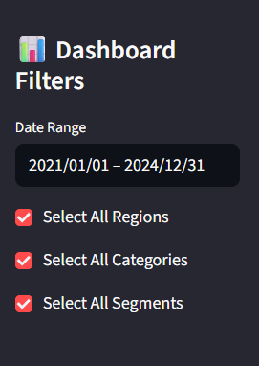
Interactive Dashboard Filters
Available Filters
• Date Range
• Region
• Category
• Segment
Benefits
• Real-time data exploration
• Customized business analysis
• Faster decision-making
• Improved user experience

Slide 10
Key Business Insights
1
Technology category generates the highest sales revenue.
2
Monthly sales trends reveal seasonal demand patterns.
3
Top customers contribute a significant share of total revenue.
4
Regional performance varies across different markets.
5
Year-over-year growth indicates positive business performance.

Slide 11
Business Recommendations
1
Focus on high-performing product categories.
2
Strengthen customer retention programs.
3
Improve sales performance in lower-performing regions.
4
Optimize inventory planning based on seasonal demand.
5
Monitor return rates and profitability regularly.

Slide 12
Conclusion
• Successfully cleaned and analyzed retail sales data.
• Performed exploratory data analysis and KPI calculations.
• Generated actionable business insights.
• Developed an interactive Streamlit dashboard for business decision-making.
Thank You
Questions & Answers
Presented By:
Nihal Muhammed V
Role:
Junior Data Analyst Intern

