Slide 1
Design And Analysis of Algorithms HI-Q Game
2010030361- T Venkata sai sathvik
2010030374 - Jaideep Sharma
2010030413- Nihal Agarwal
2010030153 – Shaik Abdul Shaan

Slide 2
PROBLEM STATEMENT
A HI-Q game also known as Peg Solitaire, is a board game for one player which involves movement of pegs/ marbles on a board with holes. The game is known as solitaire in Britain and as peg solitaire in US, solitaire is commonly known as patience. It is called as Brainvita in India. For solving this game there are many solutions available given by different people in different methods. The standard game fills the entire board with pegs except for the central hole. The objective is, making valid moves, to empty the entire board except for a solitary peg in the central hole.
keywords: HI-Q, Solitaire, patience, Brainvita, central hole.

Slide 3
PROBLEM STATEMENT
HI-Q game is one of the application for ‘minimum jumps to reach the end’ algorithm. The user wants to know number of optimal jumps and the path to reach the end faster than the person he is competing with. Peg solitaire is a board game for one player. It is played on a board which has positions in a geometric arrangement. Each position can be either free or occupied. Usually the positions are marked by indentations that can be occupied by a peg or a marble. We need to first describe the initial state of the board, then define the desired state of the board and pegs, try to find out conditions that initially fill the whole board according to the conditions and then apply an algorithm that apply transformation until desired state is reached.

Slide 4

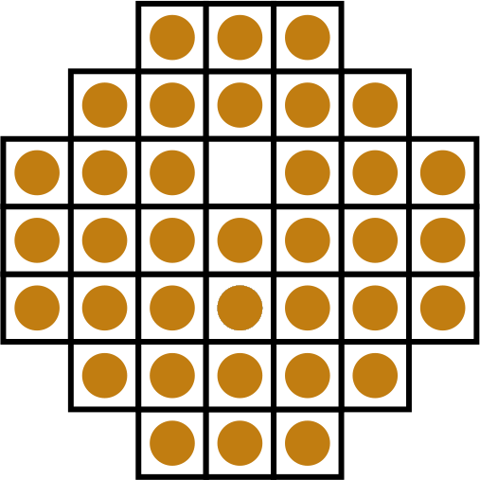
PEG SOLATAIRE

Slide 5
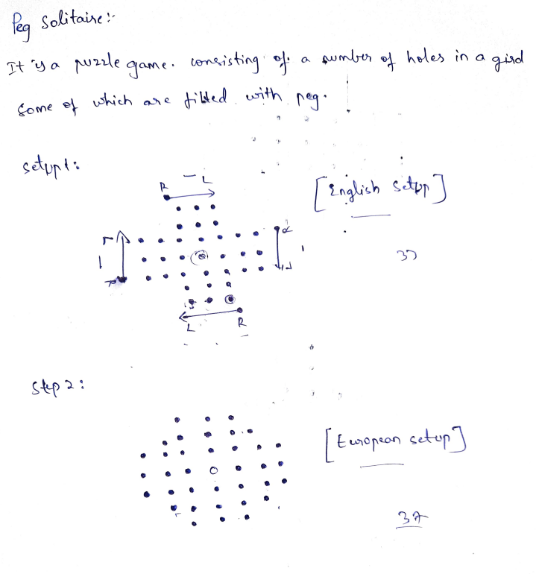
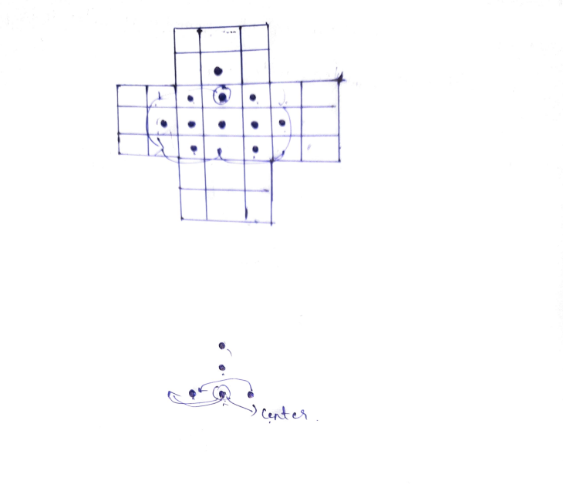
EXPLANATION

Slide 6
EXISTING SOLUTIONS
To solve this problem, there are Depth first Search(DFS) and breadth first Search(BFS) solutions existing for optimal condition reaching by leaving one peg to the other end on the board.
We can also iterate through the whole board by looping the conditions given as rules for the game and get the desired condition of board we want to make it look.
We can also use brute force with recursion or a bottom up approach using dynamic programming.
We can also use the queue data structure to deal with strategy.

Slide 7

PROPOSED ALGORITHM DESIGN TECHNIQUE- SOLUTION STRATEGY
We are implementing our program for problem solving using java programming using dynamic programming approach under memotization and tabulation methods. It uses different Collection methods for different readymade predefined classes and objects to use it for easier accessibility.
It uses the dynamic programming in which one input calls the other external output as implicit cases and verifies the answer for the recently machined algorithm to get the optimal and accurate answer out of it.

Slide 8

ALGORITHM USED
Algorithm pegSolataire{
if there is only n=1 peg left,
if it is in center, return indicating we found a solution, otherwise, we did not;
if this board is flagged as congruent to one that has been determined to not lead a solution,
return indicating we did not find one, otherwise,
for each possible jump,
modify the board to account
for the jump, and call the backtracking algorithm recursively using memotization technique,
where if the algorithm indicates success, record the jump and
return indicating we found a solution,
otherwise, reset the board to the state it was in prior to making a jump; and the loop will only finish
if none of the possible jumps led to a solution, so flag that
this board has been found not to find a solution and
return indicating we did not find one.
}

Slide 9
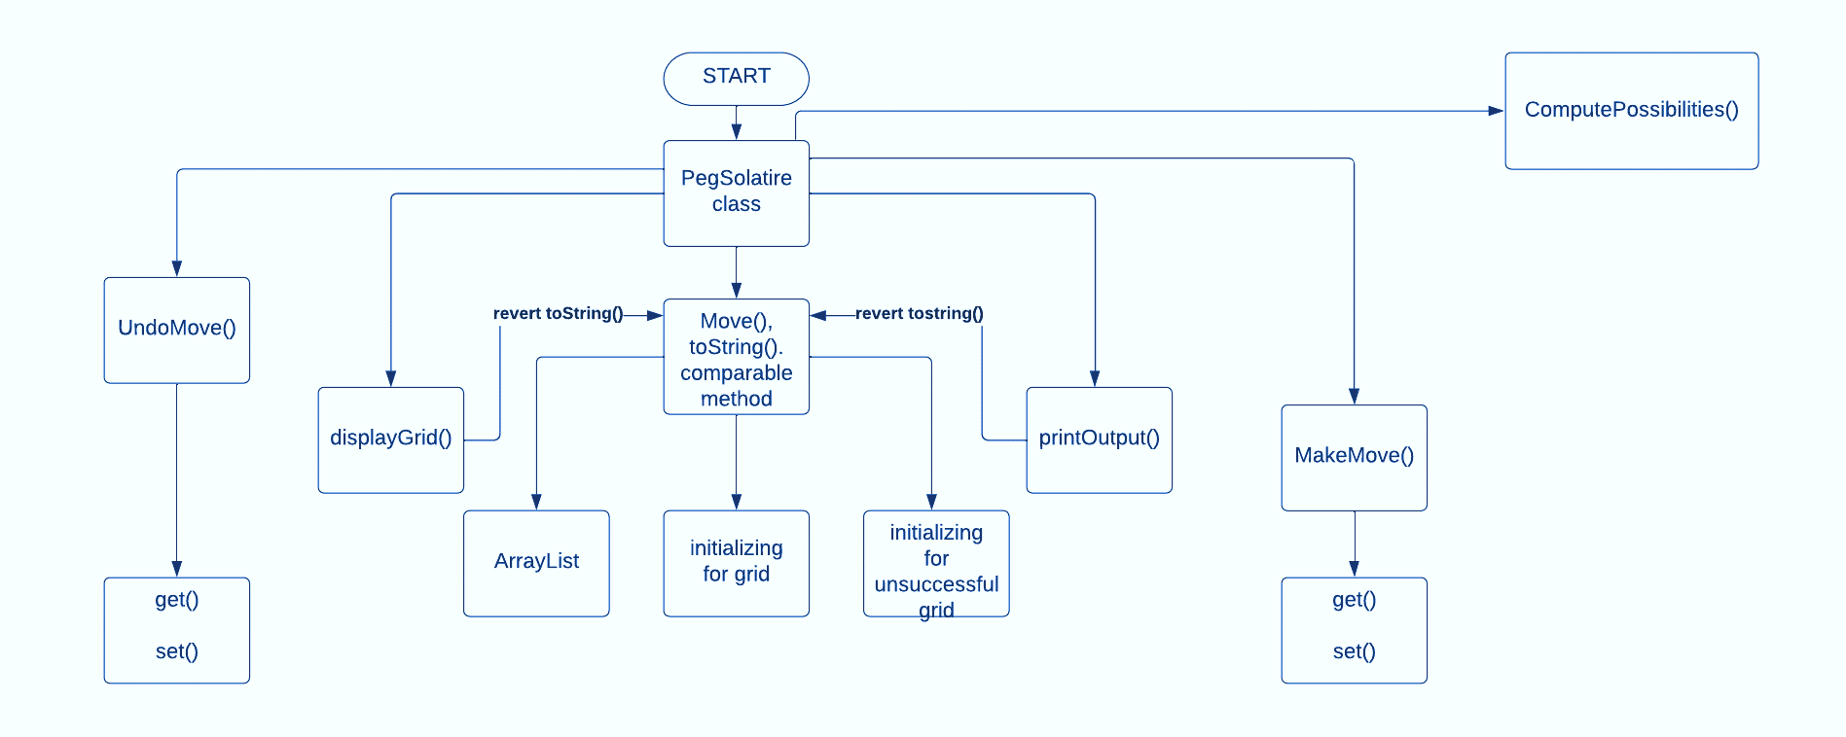
FLOW CHART

Slide 10
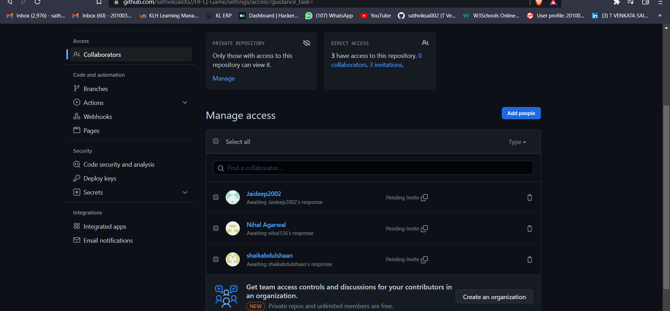
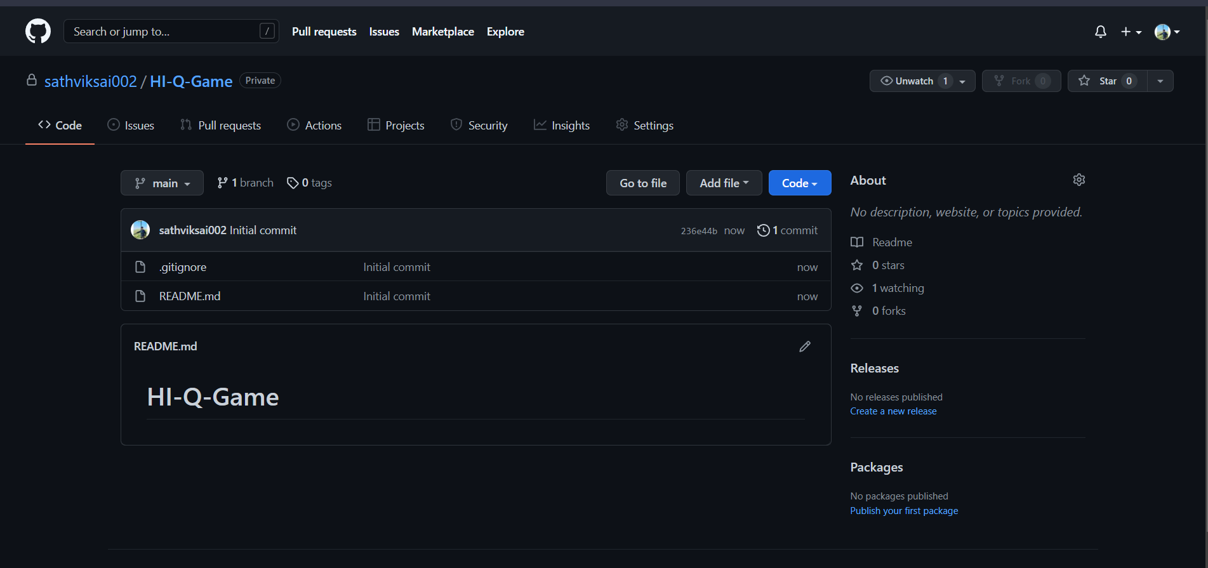
GITHUB SETUP

Slide 11
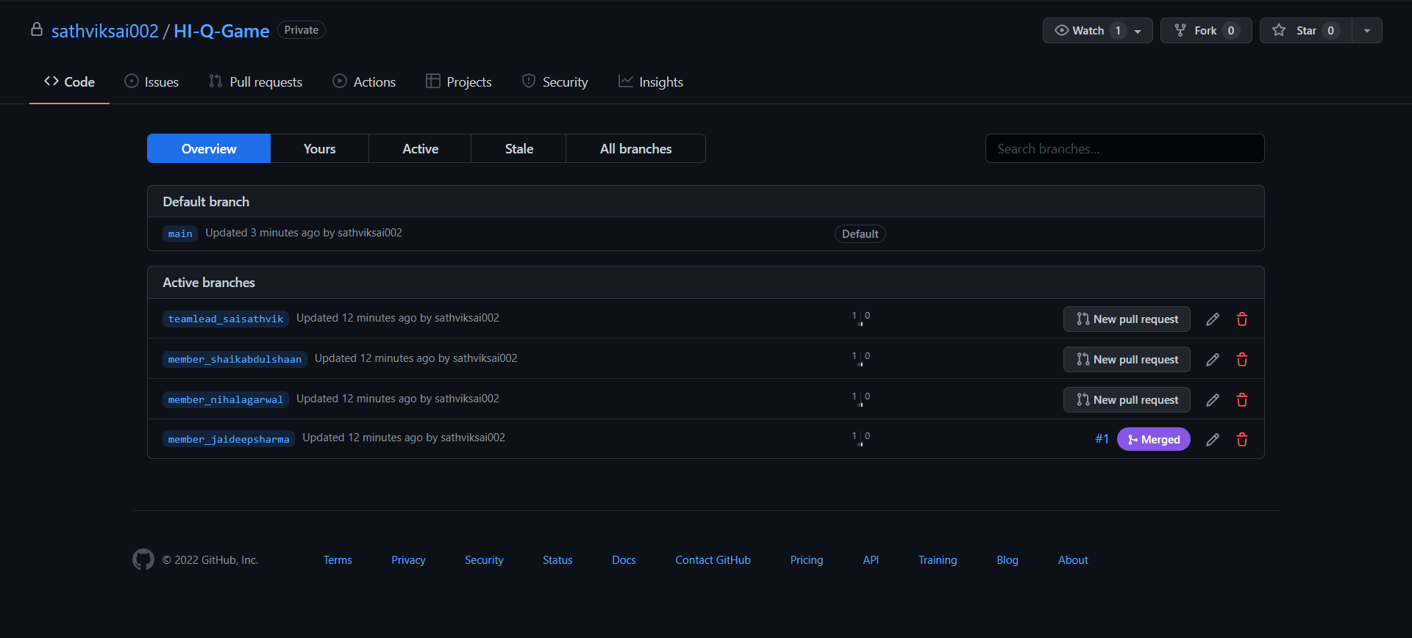
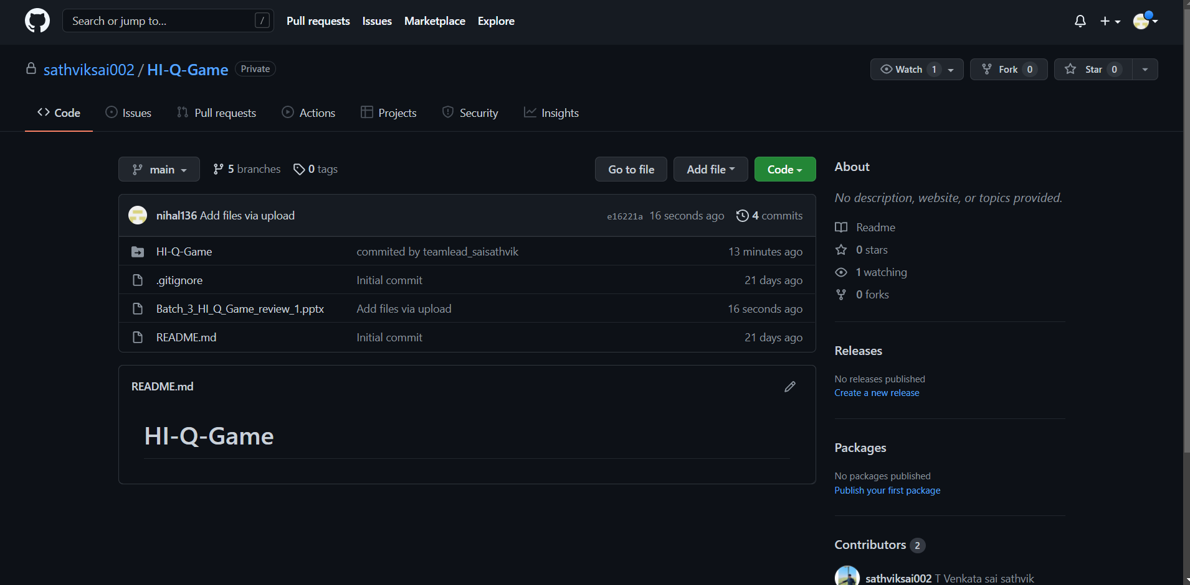
GITHUB COMMITS

Slide 12
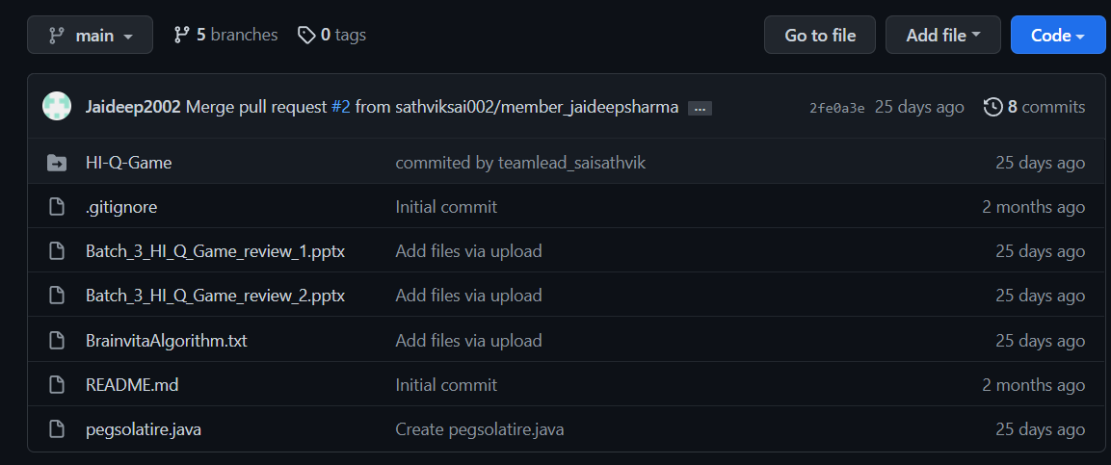
GITHUB COMMITS

Slide 13
HARDWARE AND SOFTWARE USED
Hardware requirements:
1. Intel(R) Core(TM) i5-10300H CPU @ 2.50GHz 2.50 GHz
2. 8.00 GB RAM or higher.
3. 64 Bit operating system or higher.
4. 1 TB Hard free drive space.
Software requirements:
1. Operating System: Windows 10
2. Web Browser: Brave/ Google Chrome
3. Java programming language
4. Eclipse for java programming.

Slide 14
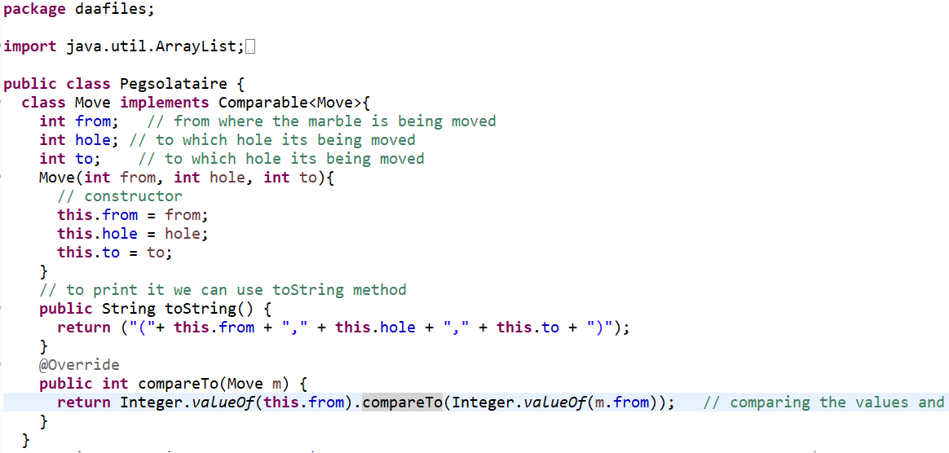
IMPLEMENTATION

Slide 15
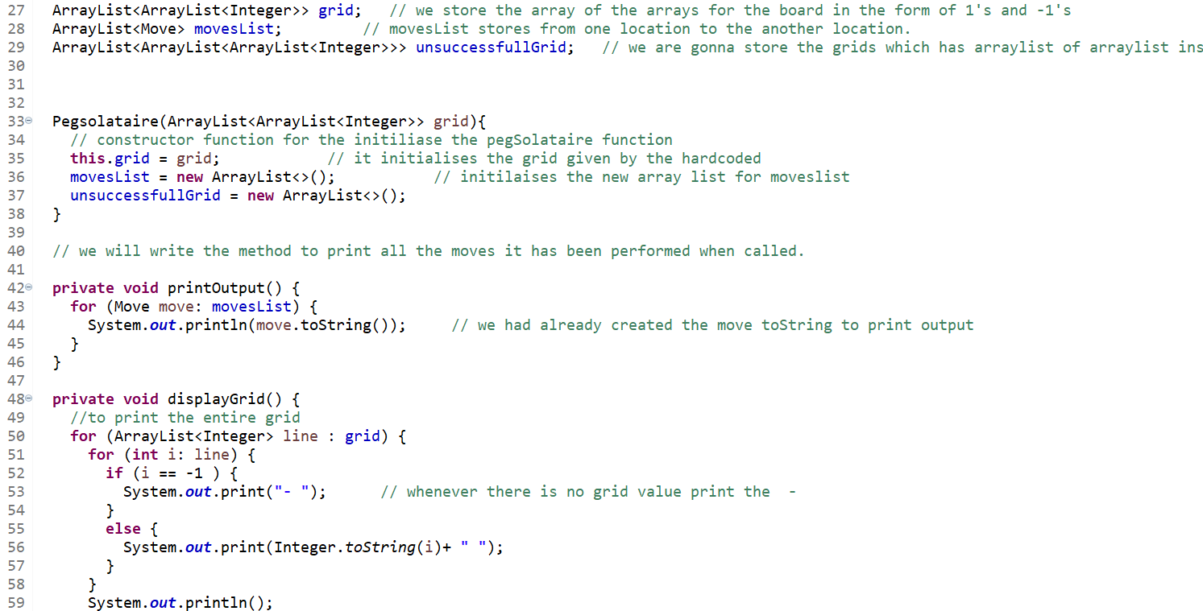
IMPLEMENTATION

Slide 16
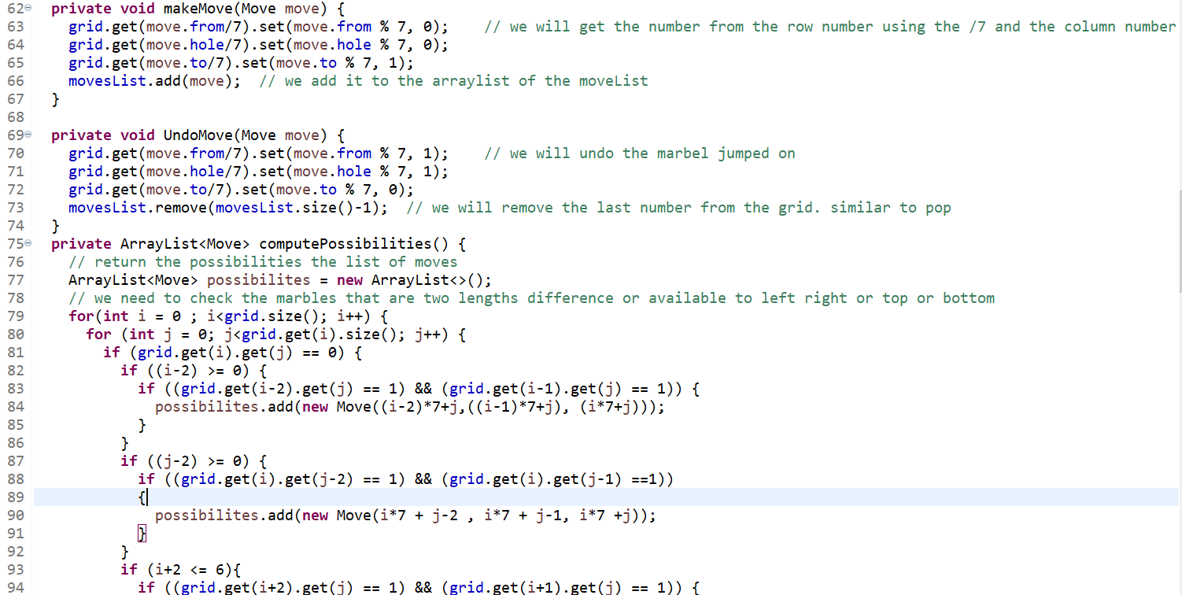
IMPLEMENTATION

Slide 17
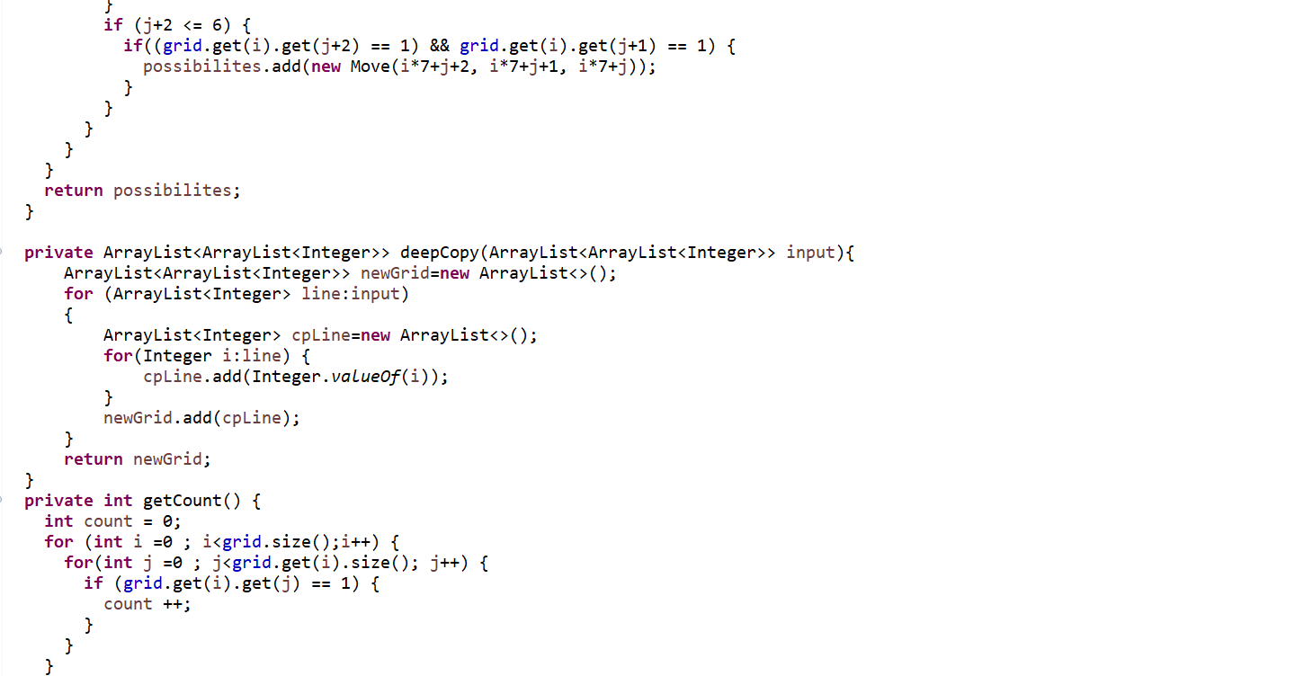
IMPLEMENTATION

Slide 18
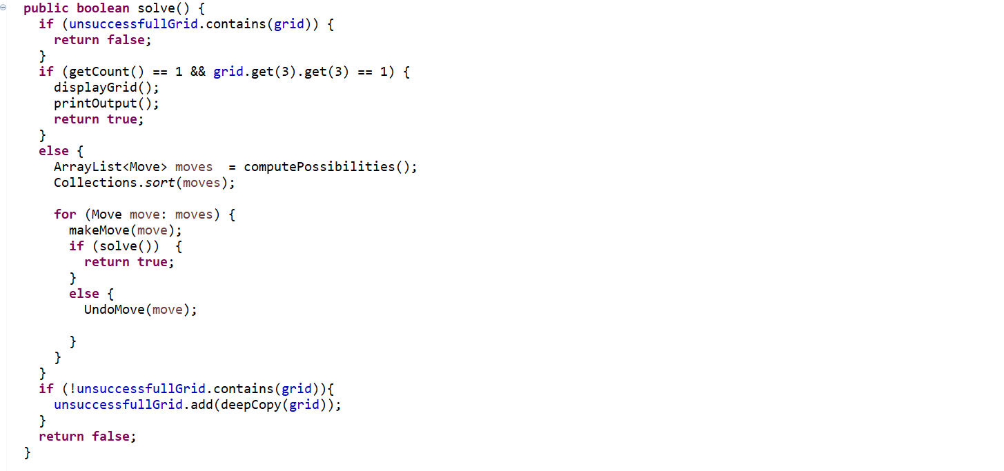
IMPLEMENTATION

Slide 19
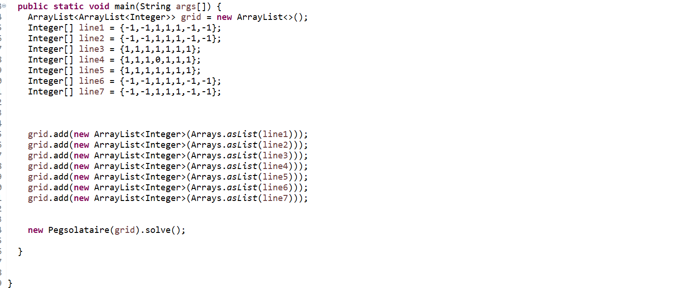
IMPLEMENTATION

Slide 20
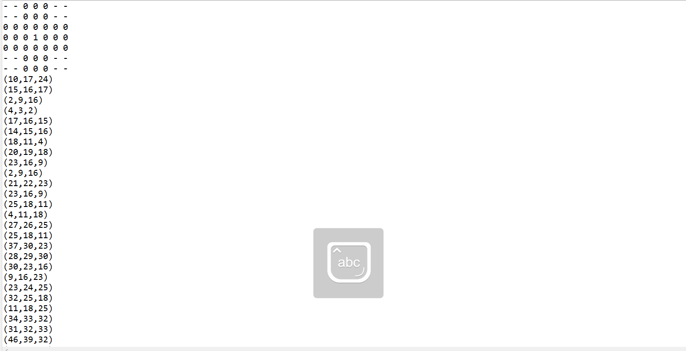
RESULT

Slide 21
FUTURE SCOPE OF IMPROVEMENT
The future scope of this project can be a GUI ( graphic user interface) for the brain Vita Game or HI-Q Game using c++ graphics user interface mode of programming.
The GUI won’t be able to solve the game or giving the optimal path for the user but allows us to play the game on it by giving us minimum number of moves and informs us whether the game is passed or failed.

Slide 22
WORK DIVISION
Name | WORK DONE
1. T Venkata Sai Sathvik | Working and analysing the different methods we can use and data structures we can implement this project with.
2. Jaideep Sharma | Understanding and providing inputs and information on what actually the game is and how does it vary with origin to origin.
3. Nihal Agarwal | Working on the GitHub repositories and collecting the journal papers related to it, and the analysis part.
4. Shaik Abdul Shaan | Relating the problem statement with the domain and connecting the PY charm with the GitHub initially.

Slide 23
THANK YOU

