Slide 1
Design And Analysis of Algorithms HI-Q Game
2010030361- T Venkata sai sathvik
2010030374 - Jaideep Sharma
2010030413- Nihal Agarwal
2010030153 – Shaik Abdul Shaan

Slide 2
PROBLEM STATEMENT
HI-Q game is one of the application for ‘minimum jumps to reach the end’ algorithm. The user wants to know number of optimal jumps and the path to reach the end faster than the person he is competing with. Peg solitaire is a board game for one player. It is played on a board which has positions in a geometric arrangement. Each position can be either free or occupied. Usually the positions are marked by indentations that can be occupied by a peg or a marble. We need to first describe the initial state of the board, then define the desired state of the board and pegs, try to find out conditions that initially fill the whole board according to the conditions and then apply an algorithm that apply transformation until desired state is reached.

Slide 3

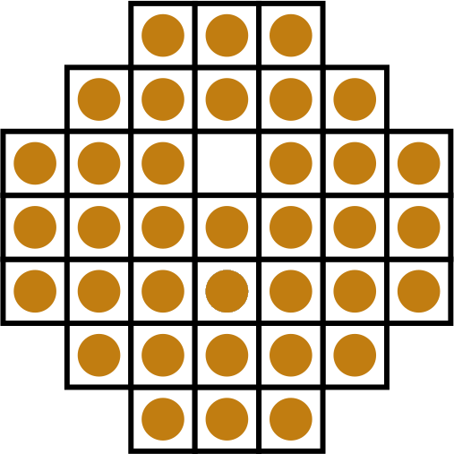
PEG SOLATAIRE

Slide 4
EXISTING SOLUTIONS
To solve this problem, there are Depth first Search(DFS) and breadth first Search(BFS) solutions existing for optimal condition reaching by leaving one peg to the other end on the board.
We can also iterate through the whole board by looping the conditions given as rules for the game and get the desired condition of board we want to make it look.
We can also use brute force with recursion or a bottom up approach using dynamic programming.
We can also use the queue data structure to deal with strategy.

Slide 5

PROPOSED ALGORITHM DESIGN TECHNIQUE
We are implementing our program for problem solving using java programming using dynamic programming approach under memotization and tabulation methods. It uses different Collection methods for different readymade predefined classes and objects to use it for easier accessibility.

Slide 6

ALGORITHM USED
Algorithm pegSolataire{
if there is only n=1 peg left,
if it is in center, return indicating we found a solution,otherwise, we did not;
if this board is flagged as congruent to one that has been determined to not lead a solution,
return indicating we did not find one, otherwise,
for each possible jump,
modify the board to account
for the jump, and call the backtracking algorithm recursively using memotization techinique,
where if the algorithm indicates success, record the jump and
return indicating we found a solution,
otherwise, reset the board to the state it was in prior to making a jump; and the loop will only finish
if none of the possible jumps led to a solution, so flag that
this board has been found not to find a solution and
return indicating we did not find one.
}

Slide 7
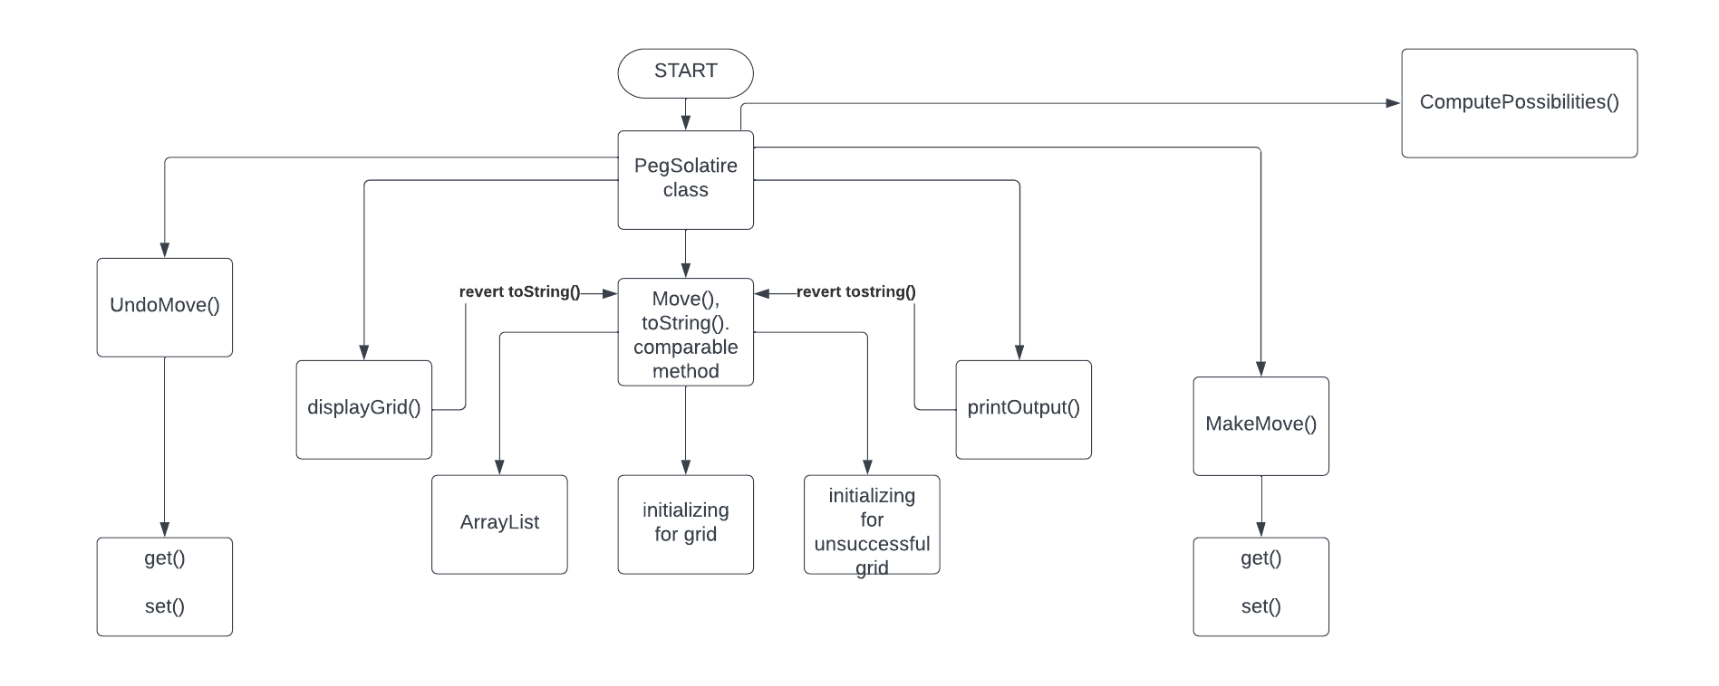
FLOW CHART

Slide 8
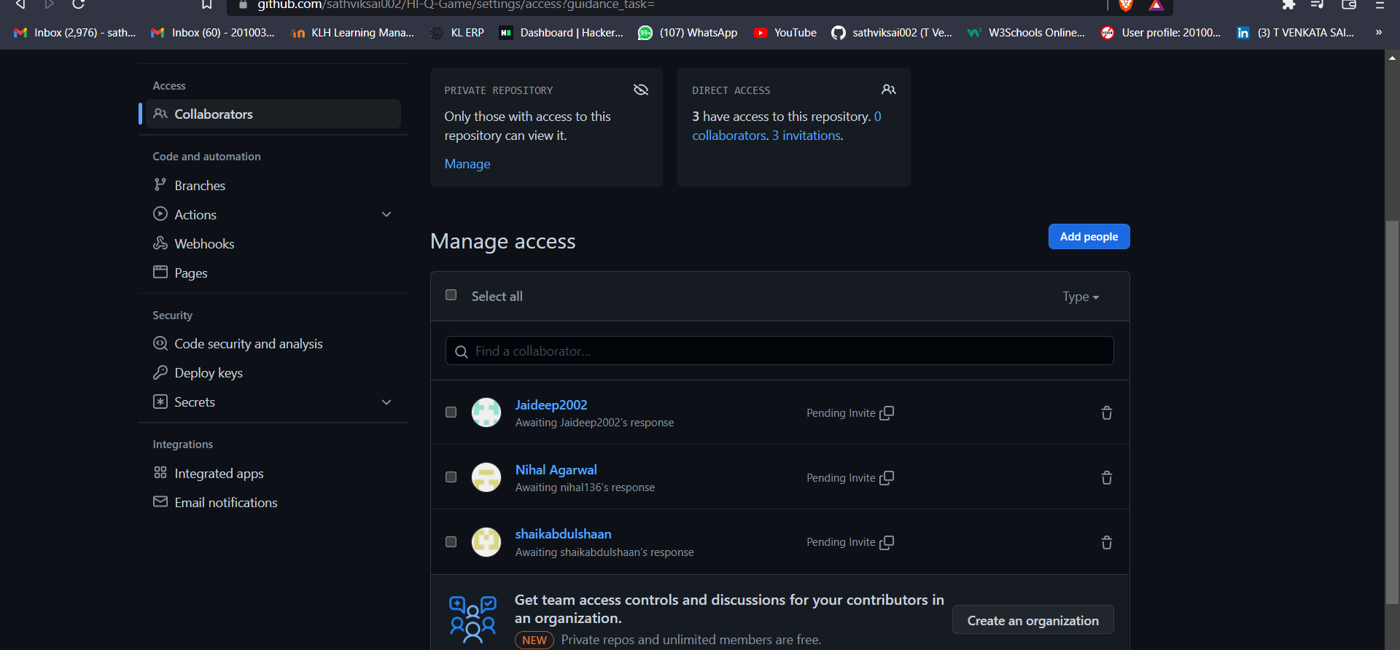
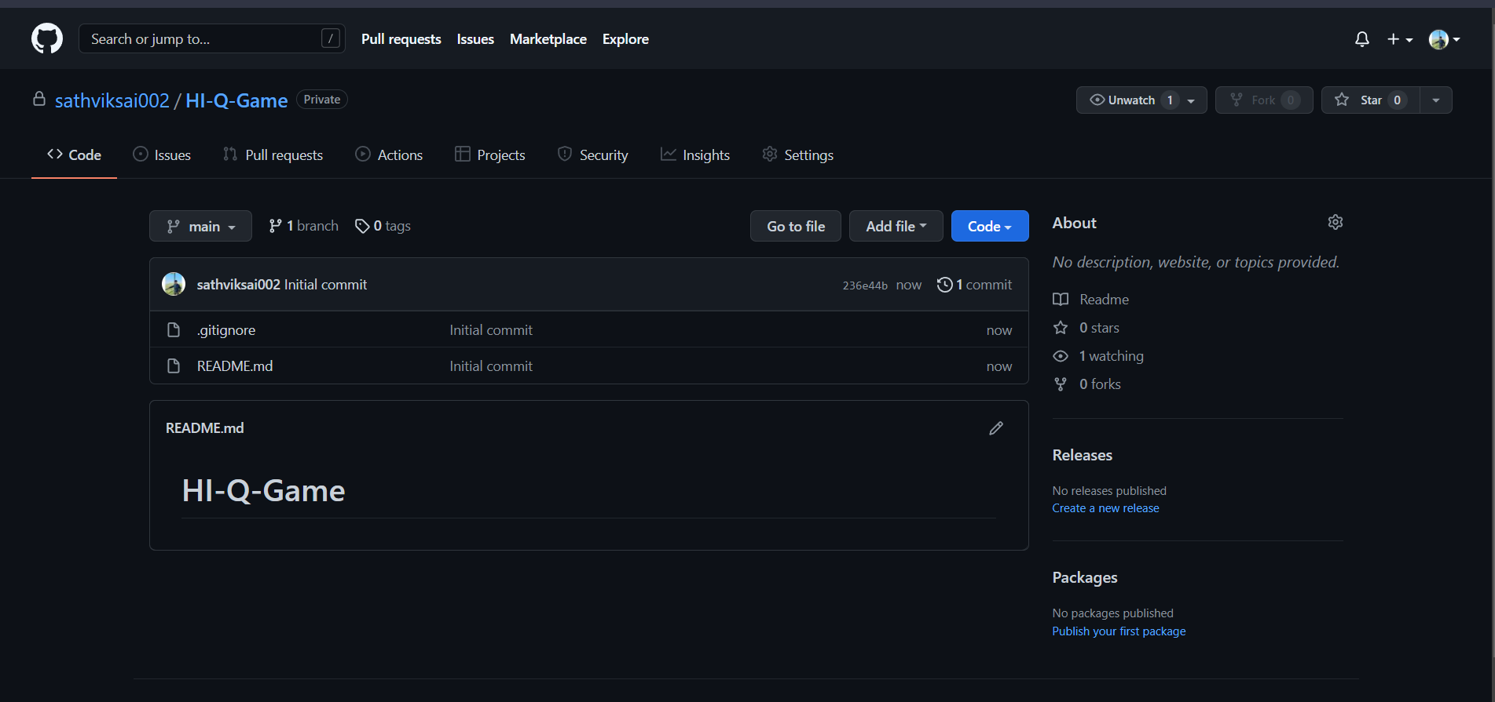
GITHUB SETUP

Slide 9
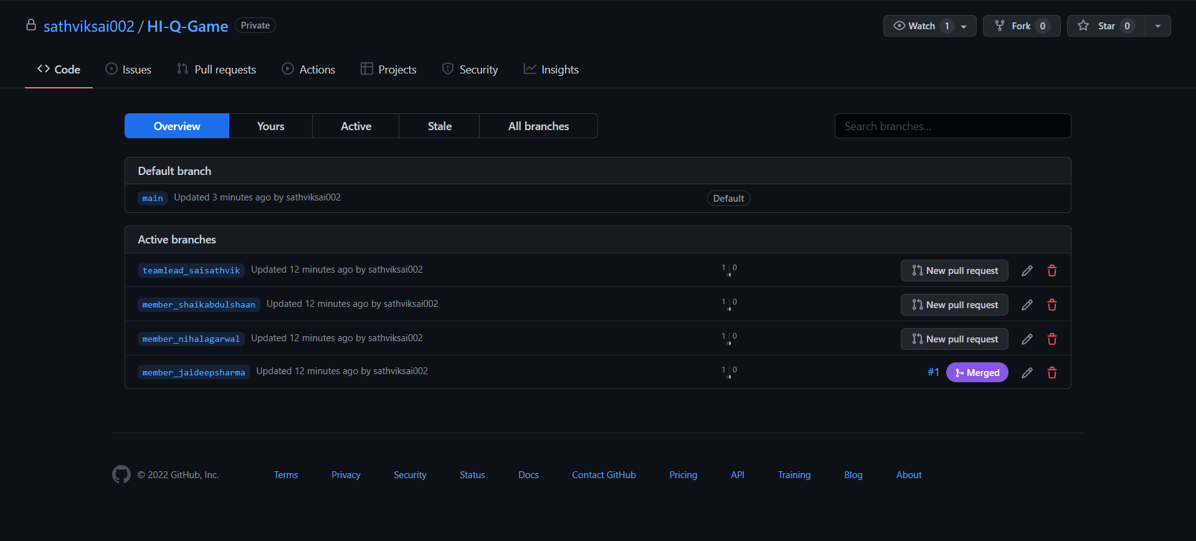
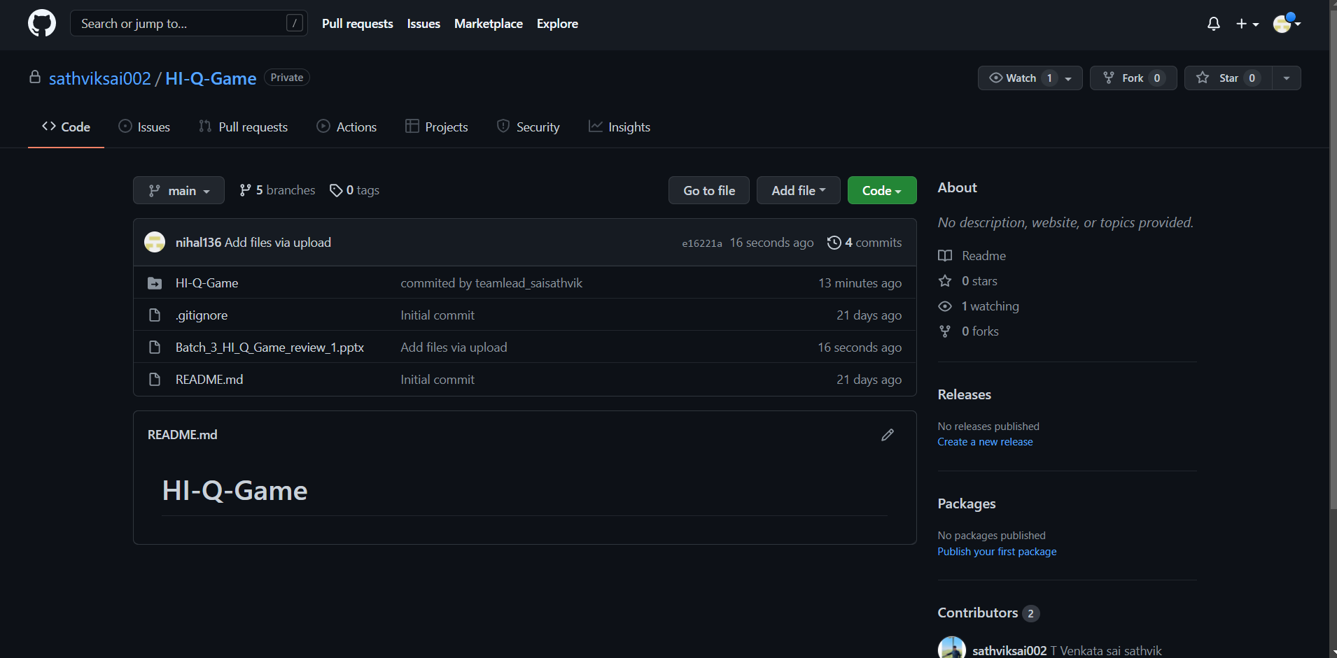
GITHUB COMMITS

Slide 10
WORK DIVISION
Name | WORK DONE
1. T Venkata Sai Sathvik | Working and analysing the different methods we can use and data structures we can implement this project with.
2. Jaideep Sharma | Understanding and providing inputs and information on what actually the game is and how does it vary with origin to origin.
3. Nihal Agarwal | Working on the GitHub repositories and collecting the journal papers related to it, and the analysis part.
4. Shaik Abdul Shaan | Relating the problem statement with the domain and connecting the PY charm with the GitHub initially.

Slide 11
THANK YOU

