Slide 1
Design And Analysis of Algorithms HI-Q Game
By
2010030361- T Venkata sai sathvik
2010030374 - Jaideep Sharma
2010030413- Nihal Agarwal
2010030153 – Shaik Abdul Shaan

Slide 2
Problem statement and domain
HI-Q game is one of the application for ‘minimum jumps to reach the end’ algorithm. The user wants to know number of optimal jumps and the path to reach the end faster than the person he is competing with. Peg solitaire is a board game for one player. It is played on a board which has positions in a geometric arrangement. Each position can be either free or occupied. Usually the positions are marked by indentations that can be occupied by a peg or a marble. We need to first describe the initial state of the board, then define the desired state of the board and pegs, try to find out conditions that initially fill the whole board according to the conditions and then apply an algorithm that apply transformation until desired state is reached.

Slide 3
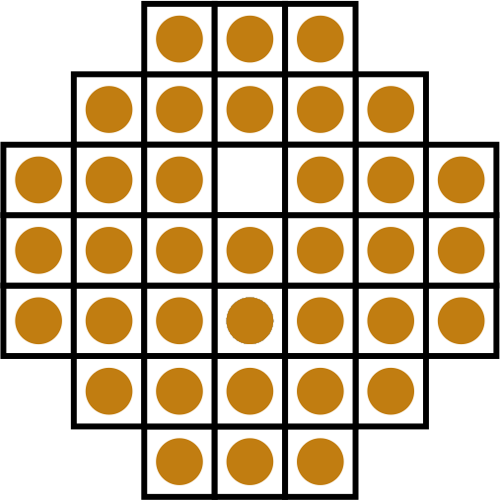

PEG SOLATAIRE.

Slide 4
Existing solutions/ Naïve solutions
To solve this problem, there are Depth first Search(DFS) and breadth first Search(BFS) solutions existing for optimal condition reaching by leaving one peg to the other end on the board.
We can also iterate through the whole board by looping the conditions given as rules for the game and get the desired condition of board we want to make it look.
We can also use brute force with recursion or a bottom up approach using dynamic programming.
We can also use the queue data structure to deal with strategy.

Slide 5
Proposed Algorithm Design Technique
We want to use Depth First Search algorithm to solve the HI-Q game which is used to find the optimal path to make the peg reach to the other end leaving one peg on the same end. The Depth-First search finds the one potential solution for our problem until it reaches the end. At the point it reaches the end or the solution it backtracks until there is another option available in the same route for the end. So on and so forth until all the holes have been explored.
Depth first search algorithm works on tree or graph data where it starts at the root node and explores as far as possible with each branch before backtracking.

Slide 6
Data Structures needed
The data structures needed for the program is:
Dictionary
List
Print function
Depth first Search
Tuples
Queue

Slide 7
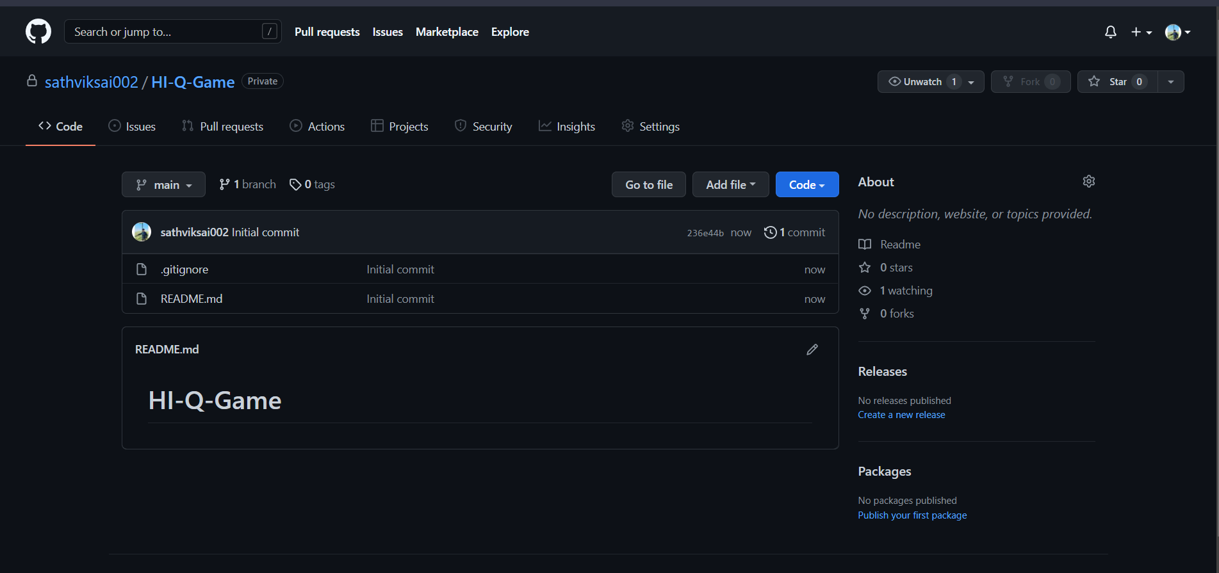

Github setup

Slide 8
Division of work among the group members
Name | WORK DIVIDED
1. T Venkata Sai Sathvik | Working and analysing the different methods we can use and data structures we can implement this project with.
2. Jaideep Sharma | Understanding and providing inputs and information on what actually the game is and how does it vary with origin to origin.
3. Nihal Agarwal | Working on the GitHub repositories and collecting the journal papers related to it, and the analysis part.
4. Shaik Abdul Shaan | Relating the problem statement with the domain and connecting the PY charm with the GitHub initially.

Slide 9
Thankyou.

