Slide 1

TREND OF TECHNOLOGY
ANALYSIS
Nihal Navin Thampy 26/10/2023

Slide 2

OUTLINE
Executive Summary
Introduction
Methodology
Results
Visualization – Charts
Dashboard
Discussion
Findings & Implications
Conclusion
Appendix

Slide 3

EXECUTIVE SUMMARY
Current Technology Usage Trend
Language
Database
Platform
Web frame
Future Technology Trend
Language
Database
Platform
Web frame
Demographics Survey
Country & Gender Difference

Slide 4

INTRODUCTION
Analyze technology trend in software and web development among developers around the world
Purpose of this Analysis
Identify the top programming languages, database, platform and web frame skills in demand
Identify skill requirements for future
Identify human resource gap in the industry
Audience for this Presentation
Programmers
IT industry leaders
Computer science students

Slide 5

METHODOLOGY
Data Collection (Sources)
Stack overflow developer 2019 survey
GitHub job postings
Programming languages annual salary
Data Wrangling
Data Exploration
Data Cleaning
Data Visualization
Python matplotlib & turtle
IBM Cognos
Presentation

Slide 6
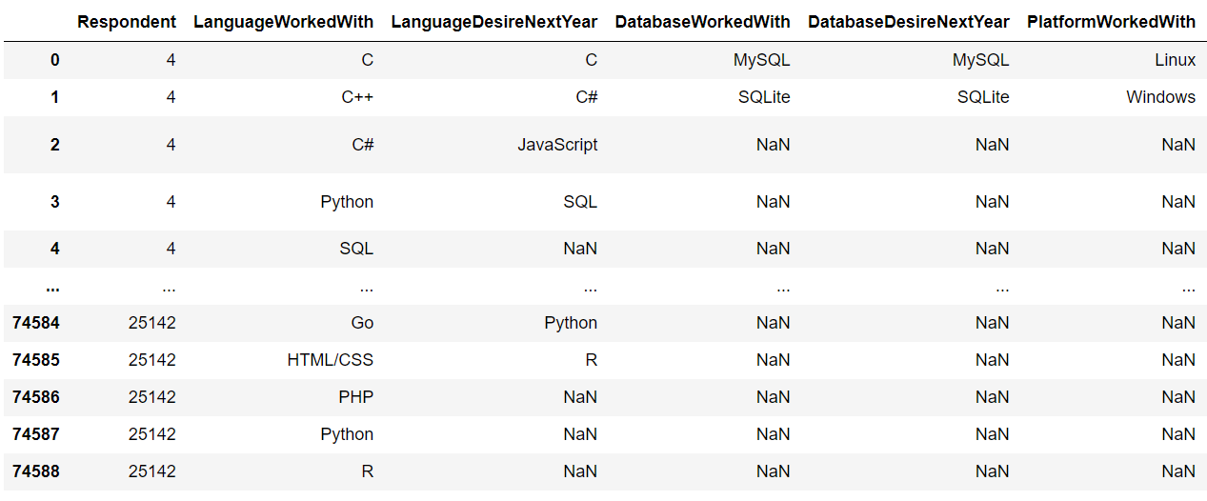
RESULTS

Slide 7
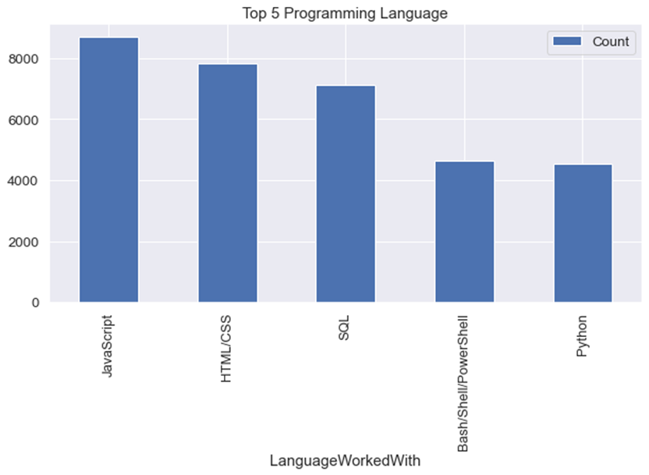
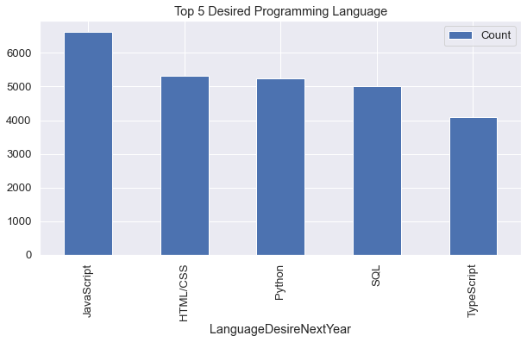
PROGRAMMING LANGUAGE TRENDS IN TECHNOLOGY
Current Year
Next Year

Slide 8
PROGRAMMING LANGUAGE TRENDS - FINDINGS & IMPLICATIONS
Implications
Findings
JavaScript leads the programming language trends globally.
Python and TypeScript are steadily gaining popularity across various applications.
Web development and developers are in continuous high demand due to the need for digital solutions and online experiences.
JavaScript and TypeScript proficiency is essential for modern web development and application creation.
Python is emerging as a trending language, particularly in the field of artificial intelligence, powering innovation and advancements.

Slide 9
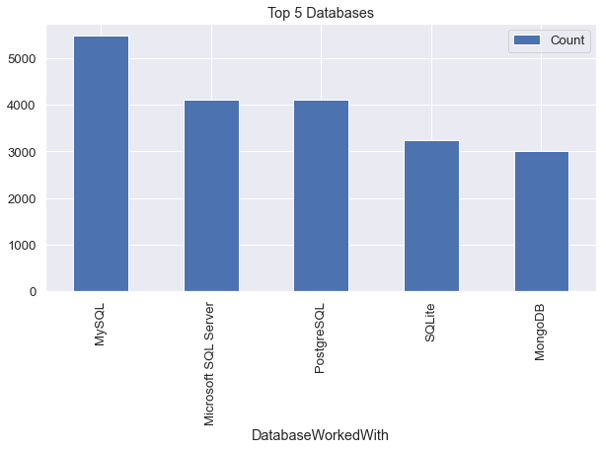
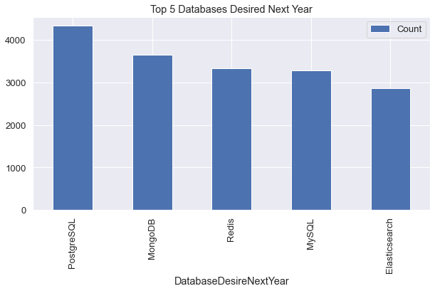
DATABASE TRENDS
Current Year
Next Year

Slide 10
DATABASE TRENDS - FINDINGS & IMPLICATIONS
Findings
MySQL is the widely favored database system in various industries.
Microsoft SQL Server remains a reliable choice for data management in many businesses.
MongoDB and Redis lead the NoSQL category, preferred for flexible and scalable data storage.
Implications
Open-source databases like MySQL are still popular choices.
SQL remains crucial in software development and Big Data.
NoSQL databases are set to transform the relational database landscape.

Slide 11

DASHBOARD
The permanent link of the read-only view of the Cognos dashboard:
https://github.com/nihal2329/Capstone-story-project/blob/34be1404959e81aba922e68a82e0f891a95a68fb/A%20dashboard%20with%20Cognos%20Dashboard%20Embedded%20(CDE).json

Slide 12
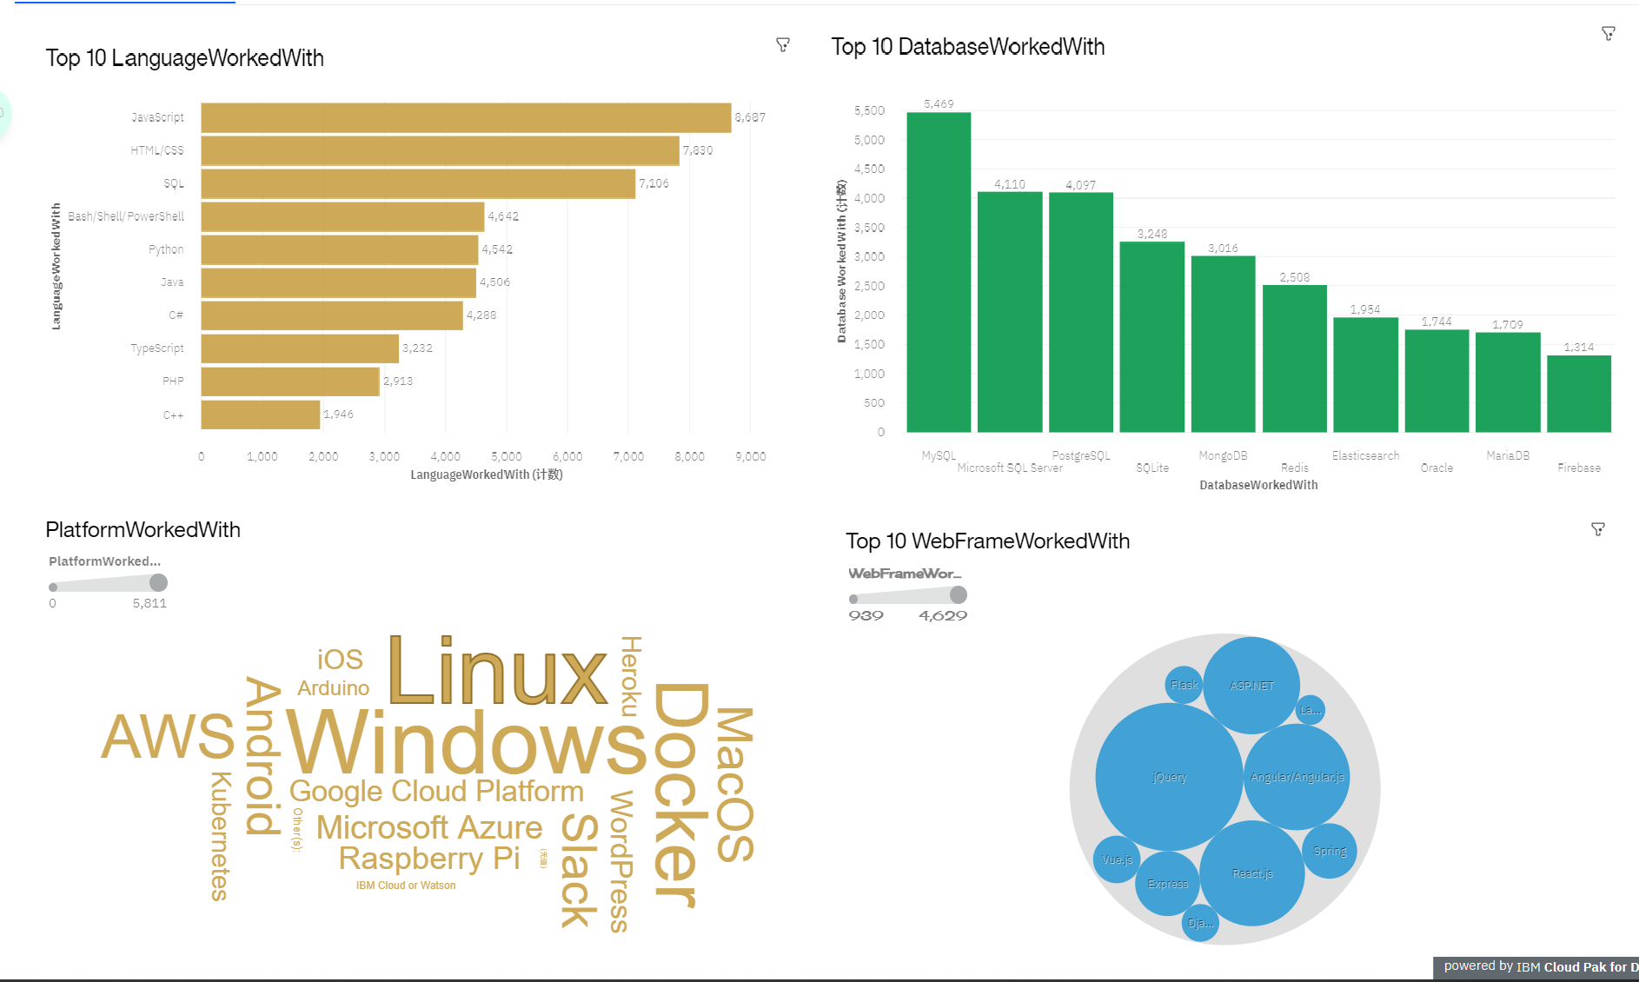
CURRENT TECHNOLOGY USAGE

Slide 13
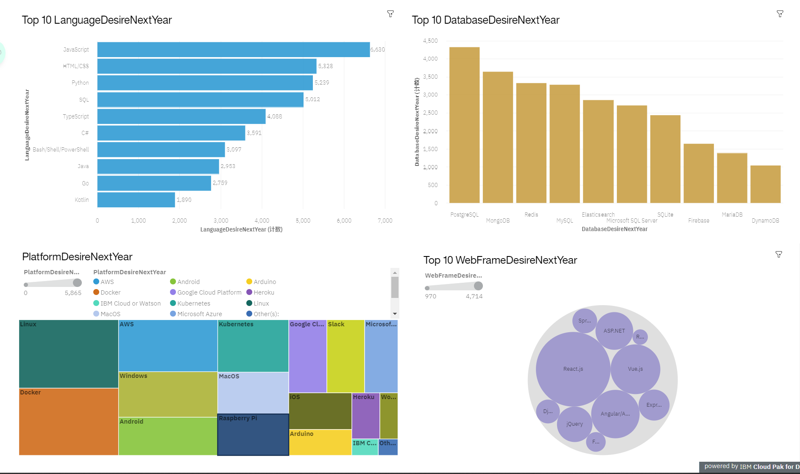
FUTURE TECHNOLOGY TREND

Slide 14
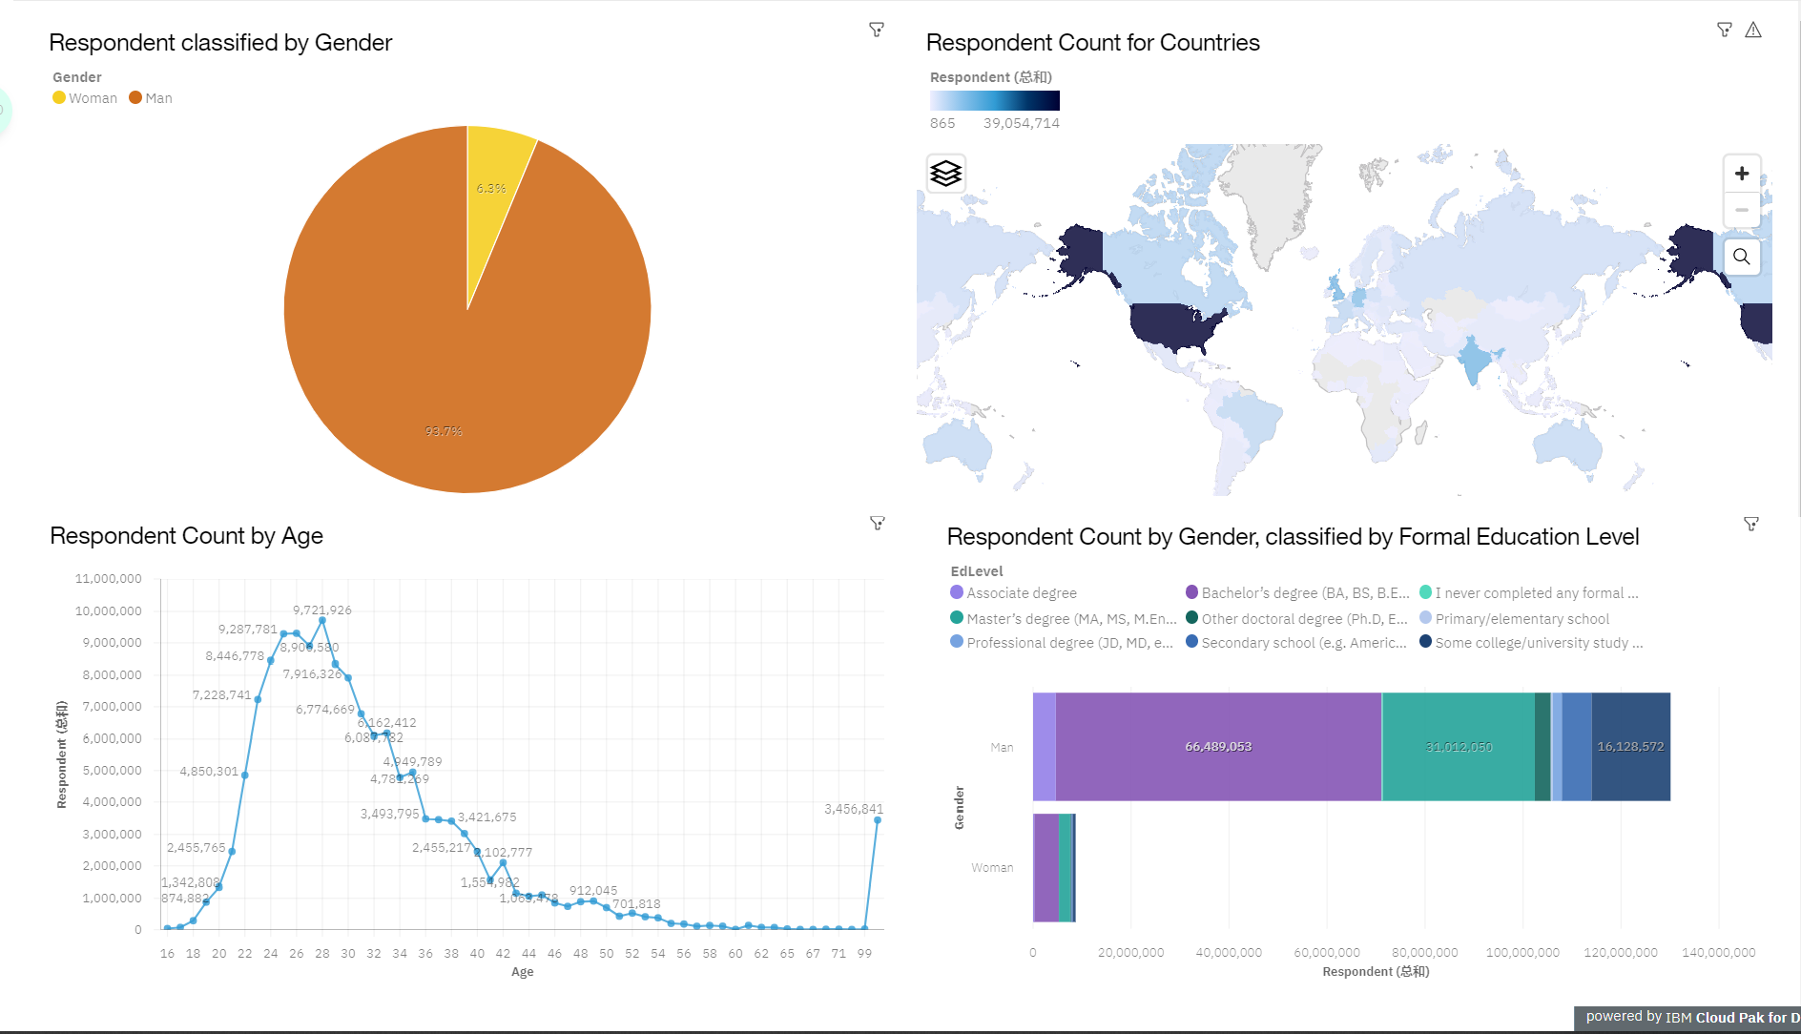
DEMOGRAPHICS

Slide 15
DISCUSSION
Technology Usage Trends: Present and Future
Disparities in the IT Industry: Gender, Age, and Education Bias.

Slide 16
OVERALL FINDINGS & IMPLICATIONS
Findings
Implications
Yearly Tech Trend Changes
USA's Role in Tech Leadership
Gender and Age Bias in Tech
Docker and AWS Platform Dominance
Keeping Current: Programmers Must Embrace Technology Trends
Equal Tech Exposure: Bridging the Global Gap

Slide 17

CONCLUSION
Tech Trends: Languages, Databases, Platforms, Frameworks
Demographics: Gender, Education
Language Trends vs. Salaries

Slide 18

APPENDIX
IBM Cognos Dashboard Embedded: AI-Powered Business Intelligence
Supports Full Data Analytics Cycle
User-Friendly Data Exploration
No Formal Training Needed for Interactive Dashboards

Slide 19
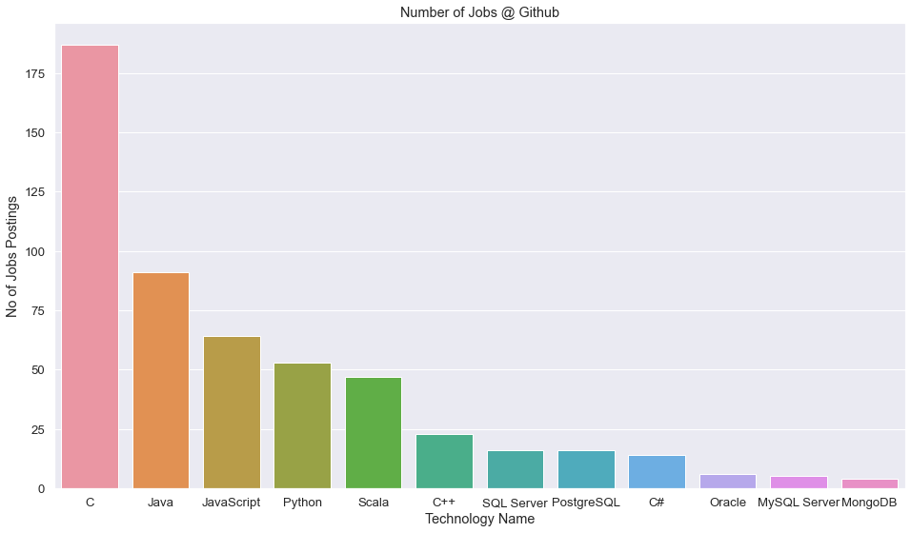
GITHUB JOB POSTINGS

Slide 20
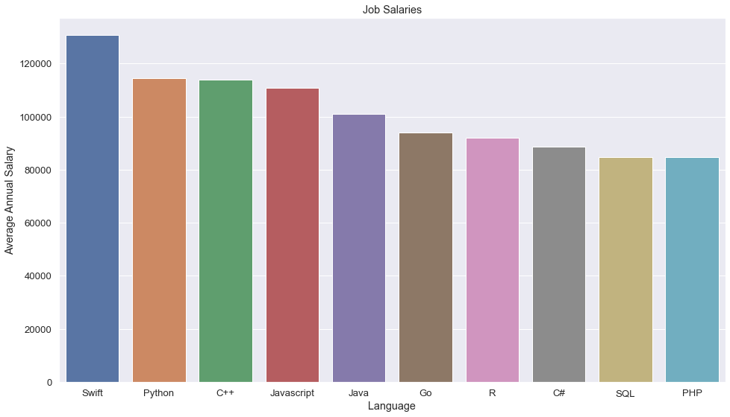
POPULAR LANGUAGES

