Slide 1

TREND OF TECHNOLOGY
ANALYSIS
Nihal Navin Thampy 26/10/2023

Slide 2

OUTLINE
Executive Summary
Introduction
Methodology
Results
Visualization – Charts
Dashboard
Discussion
Findings & Implications
Conclusion
Appendix

Slide 3

EXECUTIVE SUMMARY
Current Technology Usage Trend
Language
Database
Platform
Web frame
Future Technology Trend
Language
Database
Platform
Web frame
Demographics Survey
Country & Gender Difference

Slide 4

INTRODUCTION
Analyze technology trend in software and web development among developers around the world
Purpose of this Analysis
Identify the top programming languages, database, platform and web frame skills in demand
Identify skill requirements for future
Identify human resource gap in the industry
Audience for this Presentation
Programmers
IT industry leaders
Computer science students

Slide 5

METHODOLOGY
Data Collection (Sources)
Stack overflow developer 2019 survey
GitHub job postings
Programming languages annual salary
Data Wrangling
Data Exploration
Data Cleaning
Data Visualization
Python matplotlib & turtle
IBM Cognos
Presentation

Slide 6
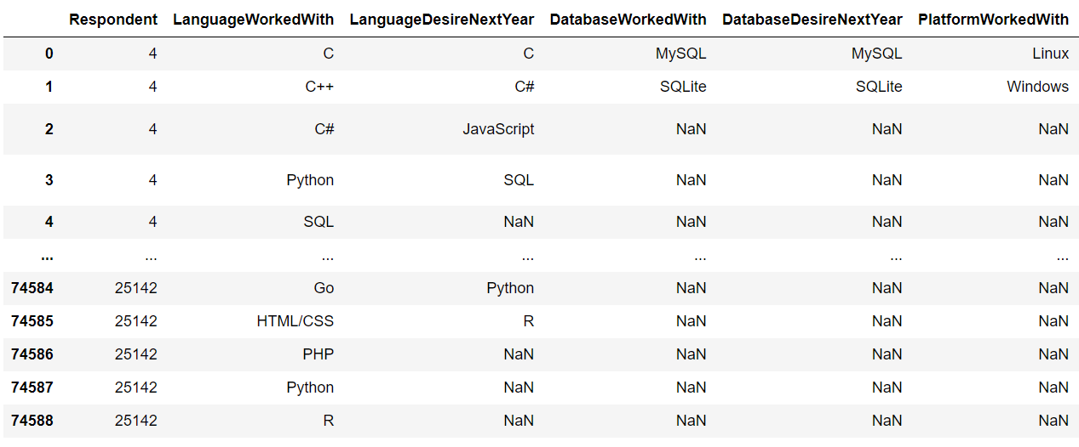
RESULTS

Slide 7
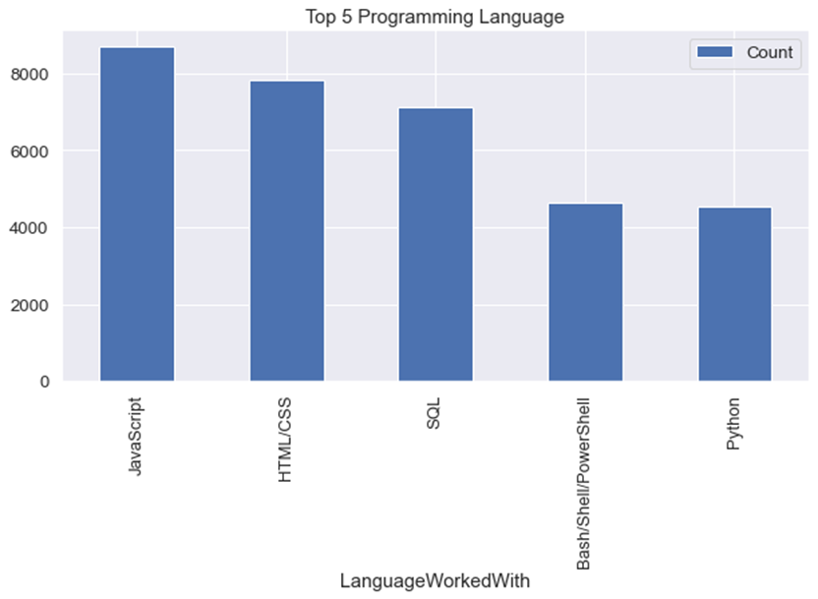
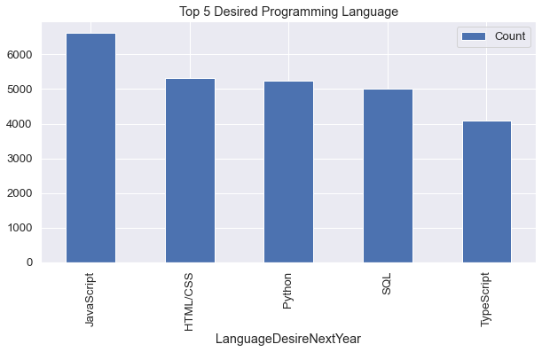
PROGRAMMING LANGUAGE TRENDS IN TECHNOLOGY
Current Year
Next Year

Slide 8
PROGRAMMING LANGUAGE TRENDS - FINDINGS & IMPLICATIONS
Findings
JavaScript stands out as the current frontrunner in the world of programming languages, enjoying the status of being the most sought-after and trending choice among developers.
Python and TypeScript are steadily on the rise, with their popularity growing consistently. They're gradually becoming the languages of choice for a broad range of applications and projects.
Notably, HTML/CSS and SQL continue to occupy a substantial share in the overall language usage trends, underscoring their enduring significance in the realms of web development and database management.
Implications
The demand for web development and web developers remains consistently high, reflecting the persistent need for digital solutions and online experiences.
Proficiency in JavaScript and TypeScript is increasingly seen as essential for developers, given their pivotal roles in modern web development and application creation.
Python is currently making waves as a trending programming language, finding particular popularity in the domain of artificial intelligence, where it's driving innovation and breakthroughs.

Slide 9
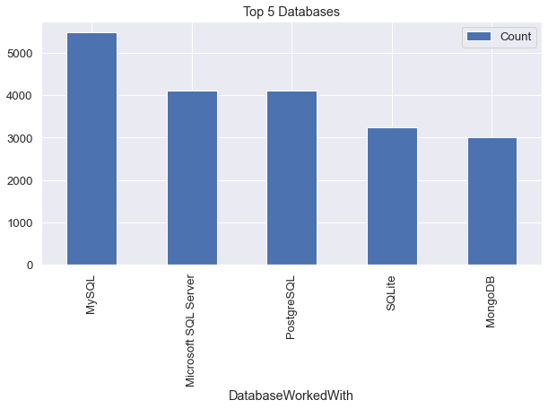
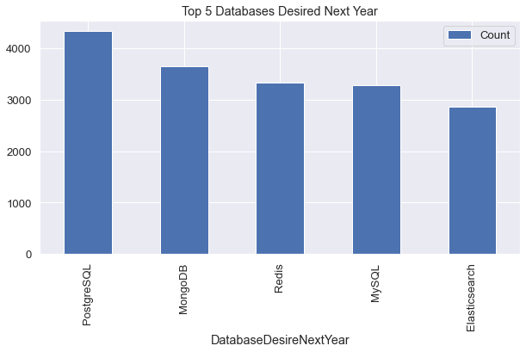
DATABASE TRENDS
Current Year
Next Year

Slide 10
DATABASE TRENDS - FINDINGS & IMPLICATIONS
Findings
MySQL holds the distinction of being the most widely used and favored database system across various industries and applications.
Many businesses continue to rely on Microsoft SQL Server, demonstrating its enduring presence as a preferred choice for managing and processing data.
MongoDB and Redis have emerged as the top contenders in the realm of NoSQL databases, garnering significant favor among developers and organizations seeking flexible and scalable data storage solutions.
Implications
MySQL and other open-source databases remain the top choice for many.
SQL continues to be essential in software development and Big Data technology.
NoSQL databases are poised to disrupt the world of relational databases.

Slide 11

DASHBOARD
The permanent link of the read-only view of the Cognos dashboard:
https://github.com/nihal2329/Capstone-story-project/blob/34be1404959e81aba922e68a82e0f891a95a68fb/A%20dashboard%20with%20Cognos%20Dashboard%20Embedded%20(CDE).json

Slide 12
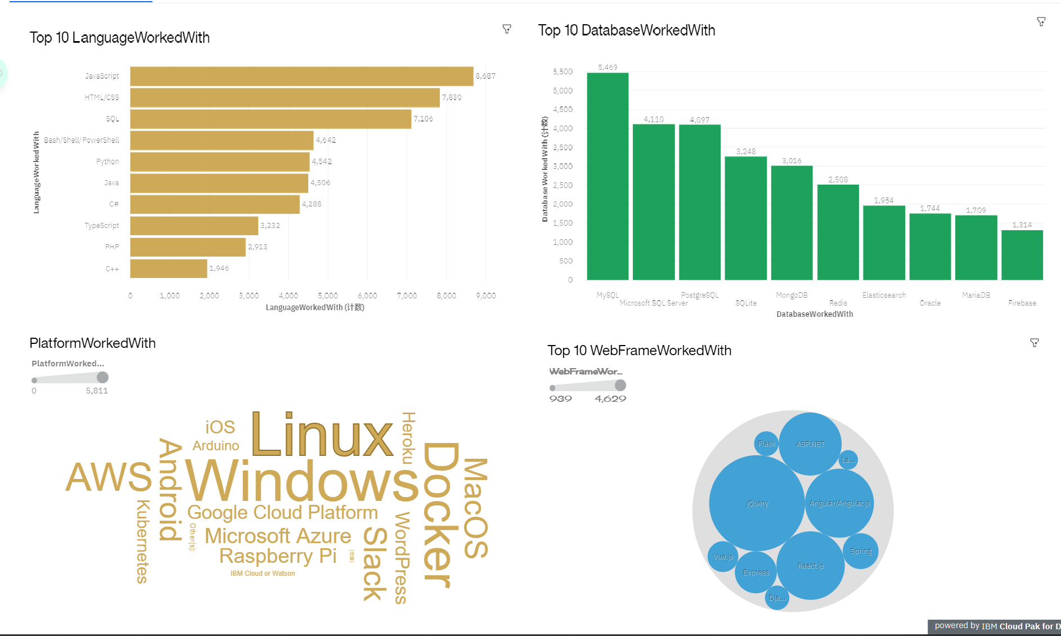
CURRENT TECHNOLOGY USAGE

Slide 13
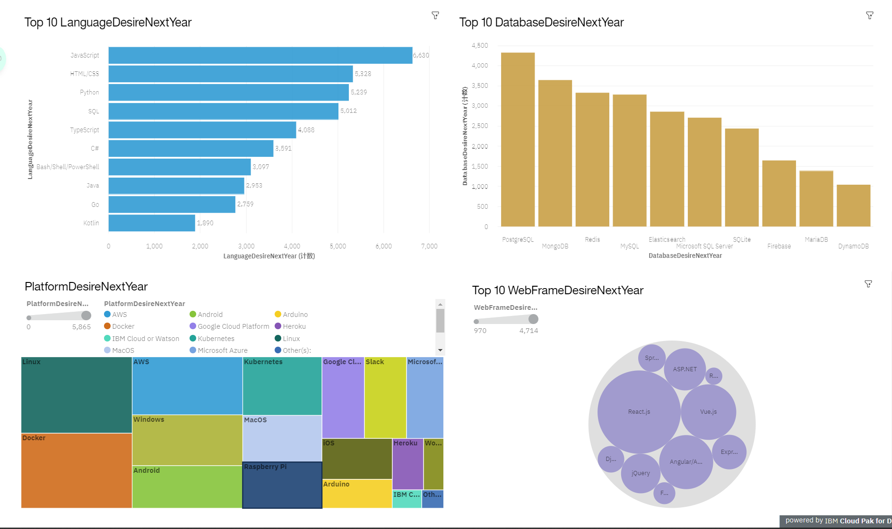
FUTURE TECHNOLOGY TREND

Slide 14
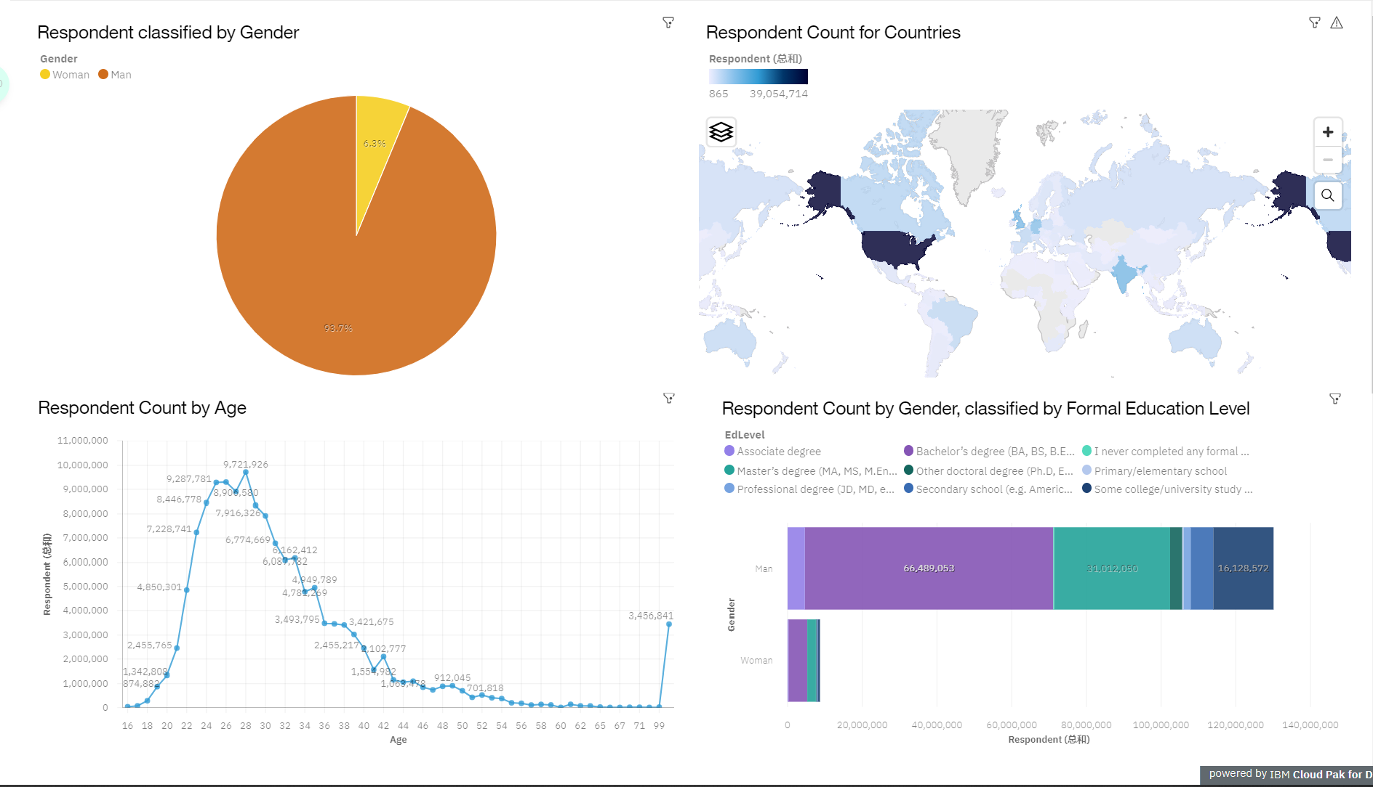
DEMOGRAPHICS

Slide 15
DISCUSSION
Current and Future Technology Usage Trends
Inequities in the IT Industry: Gender, Age, and Education Discrimination

Slide 16
OVERALL FINDINGS & IMPLICATIONS
Findings
Implications
Annual Evolution of Technology Trends
Leading the Tech Frontier: The USA's Prominence
Struggles with Gender and Age Discrimination
Dominance of Docker and AWS Platforms
Staying Updated: The Imperative for Programmers to Embrace Current Technology Trends
Expanding Access: Promoting Equal Technology Exposure Across Nations

Slide 17

CONCLUSION
Evolving Technology Trends: Programming Languages, Databases, Platforms, and Web Frameworks
Shifting Demographics: Exploring Gender and Education
Correlation Between Programming Language Trends and Salary Patterns

Slide 18

APPENDIX
IBM Cognos Dashboard Embedded (CDE) is an AI-driven business intelligence service.
It supports the entire data analytics process, from data discovery to operationalization.
Users can visually explore and interact with data to uncover valuable insights.
It allows users to create interactive dashboards without requiring formal training.

Slide 19
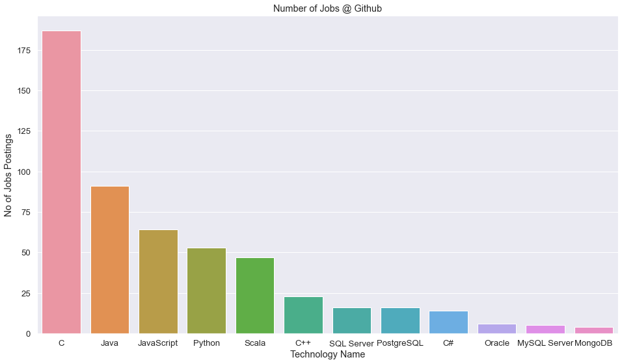
GITHUB JOB POSTINGS

Slide 20
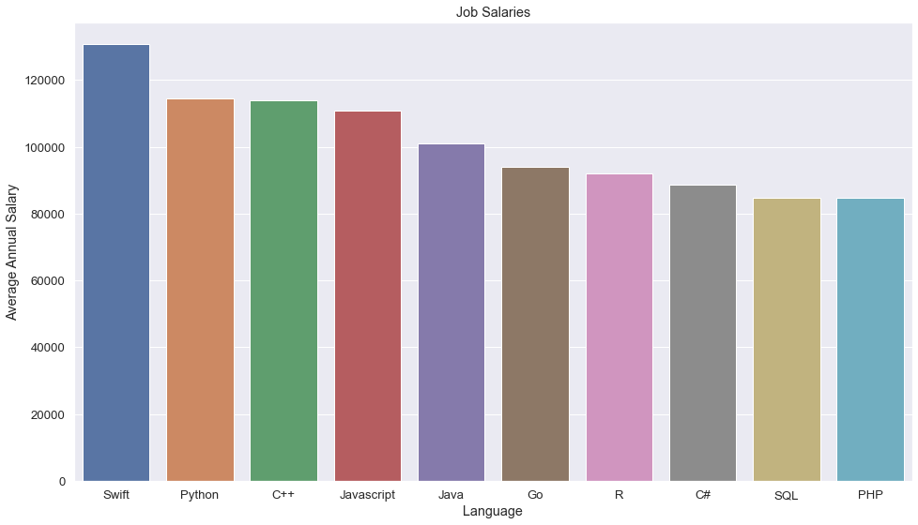
POPULAR LANGUAGES

