Slide 1

Quantum Technology
Presented by
S. M. Nihal Ahmed
ID : 232-35-002

Slide 2
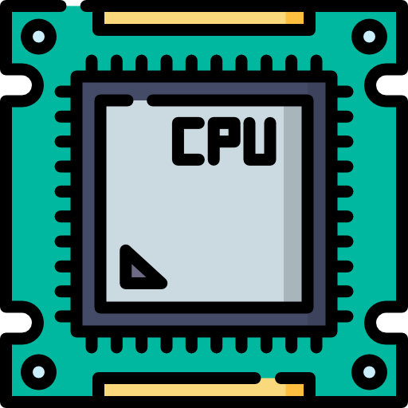

Traditional Computer and Quantum Computer
Traditional CPU
Quantum CPU
1
0
0
1

Slide 3
Physics Behind Quantum Computer
e
Atom with one electron

Slide 4
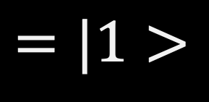

Physics Behind Quantum Computer
e
$$=|0>$$
e
e
e
$$=|1>$$
Atom with one electron
Electron in active shell

Slide 5
Quantum Supur Position
e
Using same amount of energy in less time

Slide 6
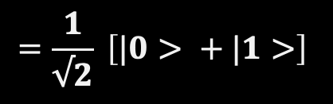
Quantum Supur Position
e
e
e
e
$$=\frac{1}{√2} \left[|0> + |1>\right]$$
Using same amount of energy in less time
Electron moving so fast

Slide 7
Measurement
e1
S
e1
N
e2
e2
Measurement Machine

Slide 8

Now Main Diffrence

Slide 9

Electron Entanglement
e
e
e
e
e
Particle form of a Quantum object
Wave form of a Quantum object
Wave form of two entangled electrons

Slide 10

Quantum Teliportaion Netwrok

Slide 11
Thank You

