Slide 1
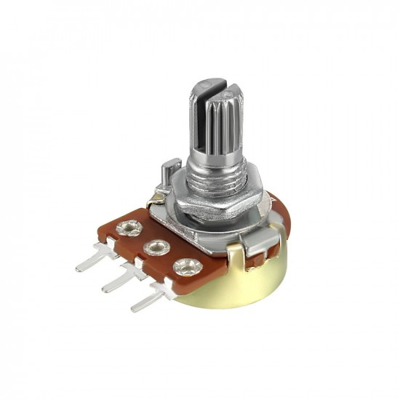
Potentiometer
VCC
OUTPUT
GND

Slide 2
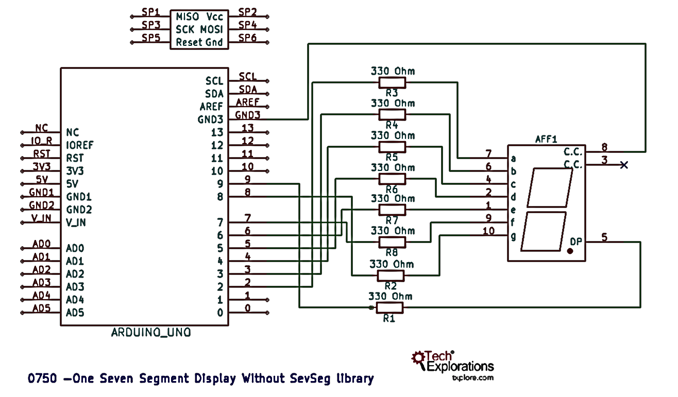
Potentiometer
VCC
OUTPUT
GND

Slide 3
Potentiometer
VCC
OUTPUT
GND

Slide 4
Potentiometer
VCC
OUTPUT
GND

Slide 5
void setup()
{
Serial.begin(9600); //fire up serial monitor
pinMode(A0,INPUT);
}
void loop()
{
int x;
x = analogRead(A0);
Serial.println(x); //analog pin number
}

Slide 6
void setup()
{
Serial.begin(9600); //fire up serial monitor
pinMode(A0,INPUT);
}
void loop()
{
Serial.println(analogRead(A0));
}

Slide 7
Analog Input Range
0
1
2
3
4
5
6
7
8
9
0
1
2
3
4
5
6
7
8
9
0
1
2
3
4
5
6
7
8
9
0
1
2
3
4
5
6
7
8
9

Slide 8
Analog OUTPUT Range
0
1
2
3
4
5
6
7
8
9
0
1
2
3
4
5
6
7
8
9
0
1
2
3
4
5
6
7
8
9

Slide 9

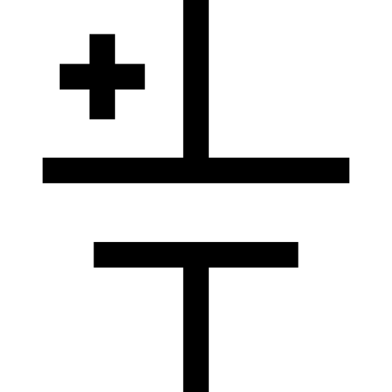

Potentiometer
VCC
OUTPUT
GND

Slide 10
Potentiometer
VCC
OUTPUT
GND

Slide 11

Potentiometer
VCC
OUTPUT
GND

Slide 12
void setup()
{
Serial.begin(9600); //fire up serial monitor
pinMode(A0,INPUT);
pinMode(3,OUTPUT);
}
void loop()
{
int x;
x = analogRead(A0);
analogWrite(3,x);
}

Slide 13
void setup()
{
Serial.begin(9600); //fire up serial monitor
pinMode(A0,INPUT);
pinMode(3,OUTPUT);
}
void loop()
{
int x;
x = analogRead(A0);
int y = map(x,0,1023,0,255);
analogWrite(3,y);
}

Slide 14
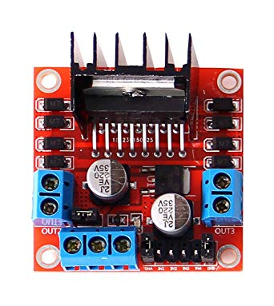
POWER!!!!!!!!!!!
Voltage regulator jumper
Vout 1
Vout 4
Vout 2
Vout 3
12V
GND
IN1
IN4
ENB
5V
ENA
IN2
IN3
(Regulated
voltage)
Lipo Battery

Slide 15
void setup()
{
pinMode(6,OUTPUT);
pinMode(7,OUTPUT);
pinMode(8,OUTPUT);
pinMode(9,OUTPUT);
pinMode(5,OUTPUT); //ENB Pin
pinMode(10,OUTPUT); //ENA Pin
}
void loop()
{
digitalWrite(6,HIGH);
digitalWrite(7,LOW);
analogWrite(10,120);
digitalWrite(8,HIGH);
digitalWrite(9,LOW);
analogWrite(5,120);
}

Slide 16
VCC
OUTPUT
GND

Slide 17
#2
Arduino Circuit diagram

Slide 18
In the end…..
Show them robotics does matter

Slide 19
Made For
RoboSUST
Created By : Mirza Nihal Baig

