Slide 1
#1
How to make basic circuit using breadboard

Slide 2
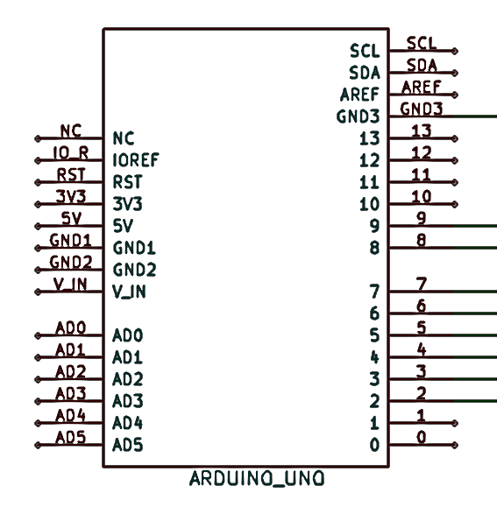
#2
Arduino Circuit diagram

Slide 3
In the end…..
Show them robotics does matter

