Slide 1

Bangladesh Army University of
Science and Technology
(BAUST)
Department of Computer Science and Engineering
Course Code: CSE4140
Title: Machine Learning Sessional
Teacher: Engr. Rohul Amin
Designation: Lecturer
Teacher: Nadim Reza
Designation: Lecturer
Name : Md. Ariful Islam
Id: 220201010
Multi-Class Android Ransomware Detection Based
on Behavioural Analysis for Smarter Mobile Security
25 Nov 2025

Slide 2

Contents
Introduction
Objective
Dataset
Methodology
Result
XAI
Conclusion
Fig. 1. Screenshot of Android mobile ransomware ransom note. [Online].
Available: https://www.bankinfosecurity.com/mobile-ransomware-targets-android-users-through-sms-a-12864
Multi-Class Android Ransomware Detection
Page 1

Slide 3
Introduction
Android phones are often attacked by different types of ransomware.
Most of the Research only tell if an app is good or bad, but they cannot tell which type of ransomware it is.
So, we created a model that can detect five different types of ransomware, not just one.
Our model works well, and some algorithms reached very high accuracy for identifying ransomware types.
Multi-Class Android Ransomware Detection
Page 2

Slide 4
Objective
To detect different types of Android ransomware, not just “malicious or not.”
To build a model that can classify five ransomware categories.
To compare different machine learning algorithms to find the best one.
To help improve mobile security by giving more detailed and useful ransomware information.
Multi-Class Android Ransomware Detection
Page 3

Slide 5
Related Work
Table 01: Related Work
Study | Method Used | Target / Focus | Type | Key Findings
Arp et al., 2014 [1] | Static analysis (permissions, API calls) | General Android malware | Binary | High accuracy (~98%), but cannot detect ransomware types.
Narudin et al., 2015 [2] | Machine learning with static features | Malware detection | Binary | Good performance, but limited behavioural understanding.
Slates, 2019 [3] | Dynamic behaviour analysis | Locker ransomware | Binary | Very accurate for locker malware, but only one ransomware type.
Yerima et al., 2016 [4] | Multi-class ML | Malware families | Multi-class | 65–72% accuracy; multi-class is harder due to similar behaviours.
Our Work, 2025 | Behaviour-based ML | Android ransomware (5 types) | Five-class | 99.73% accuracy; gives detailed ransomware type information.
Multi-Class Android Ransomware Detection
Page 4

Slide 6
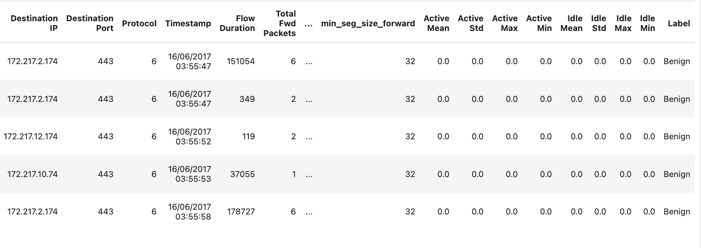
Dataset
Our dataset has 203,556 rows and 85 columns.
It includes 10 types of Android ransomware and benign (normal) traffic.
Each ransomware type has a different number of records.
Here is the data distribution:
SVpeng: 54,161 records
PornDroid: 46,082 records
Koler: 44,555 records
Benign: 43,091 records
RansomBO: 39,859 records
Charger: 39,551 records
Simplocker: 36,340 records
WannaLocker: 32,701 records
Jisut: 25,672 records
Lockerpin: 25,307 records
Pletor: 4,715 records
Fig. 2: Dataset of Android Ransomware
Multi-Class Android Ransomware Detection
Page 5

Slide 7
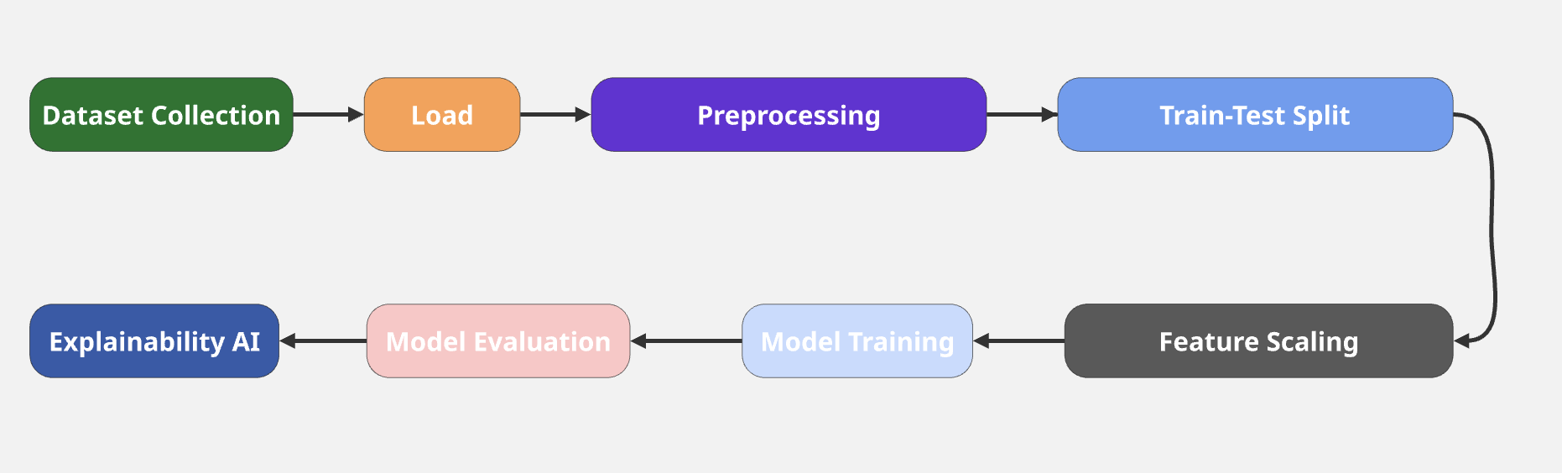

Methodology
Fig. 3: Methodolgy of Android Ransomware
Multi-Class Android Ransomware Detection
Page 6

Slide 8
Result
Table 01: Five-Class Model Results
Algorithm | Accuracy | Precision | Recall | F1-Score
Logistic Regression | 71% | 71% | 70% | 70%
K-Nearest Neighbors (KNN) | 84% | 84% | 84% | 84%
Random Forest | 98% | 98% | 98% | 98%
XGBoost | 99.76% | 99.7% | 99.7% | 99.7%
LightGBM | 99.78% (Best) | 99.8% | 99.8% | 99.8%
CatBoost | 99.56% | 99.6% | 99.6% | 99.6%
Multi-Class Android Ransomware Detection
Page 7

Slide 9
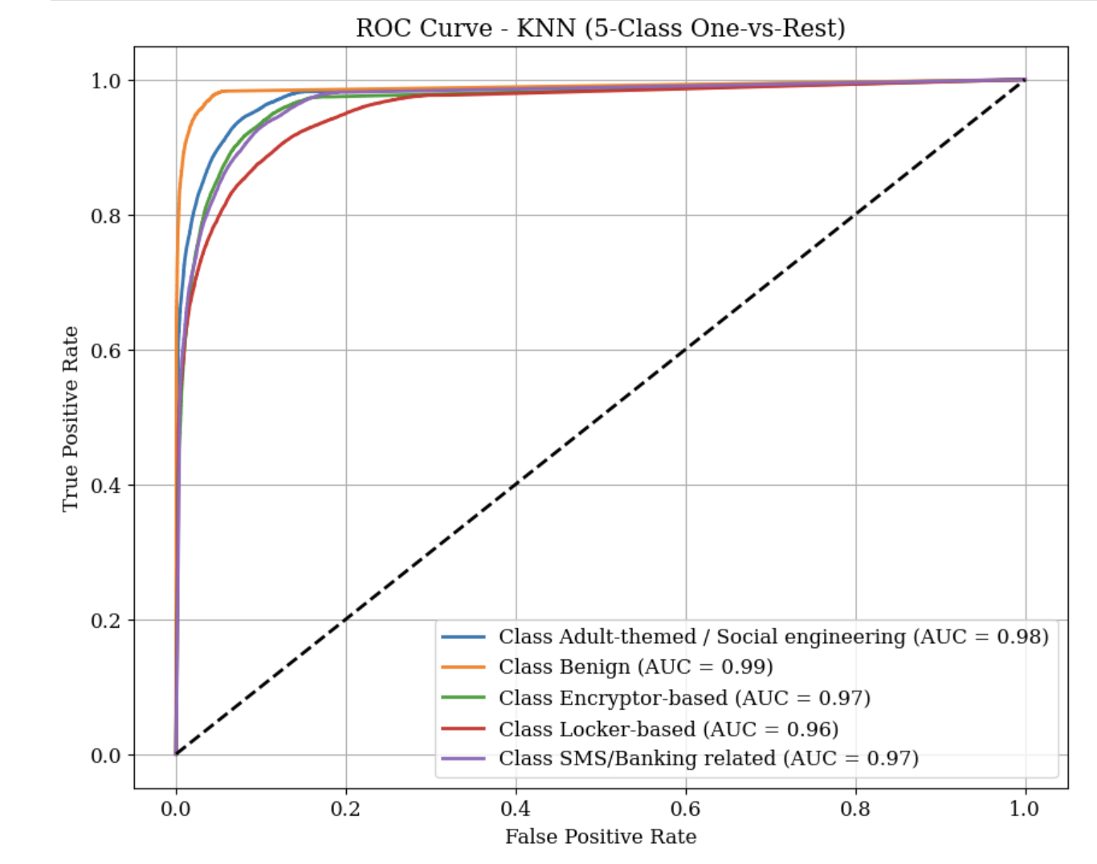
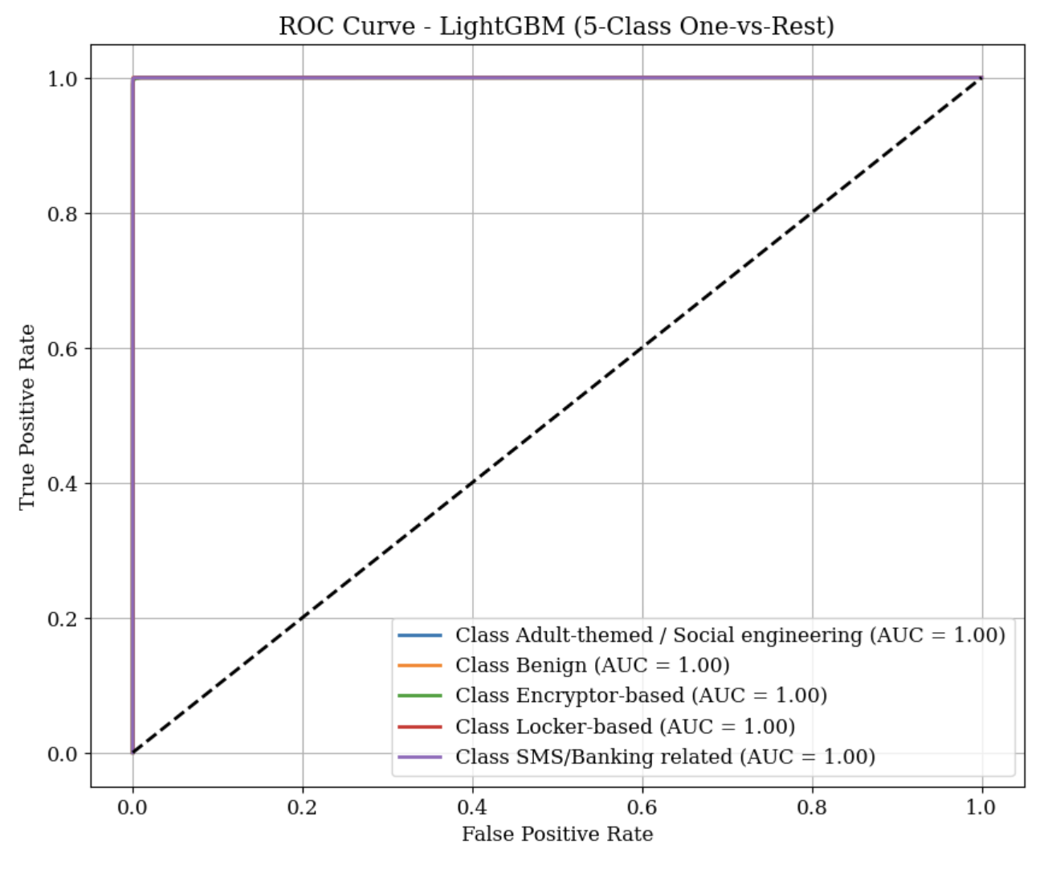
Result
Fig. 4: ROC Curve of KNN Model
Fig. 5: ROC Curve of LightGBM Model
Multi-Class Android Ransomware Detection
Page 8

Slide 10
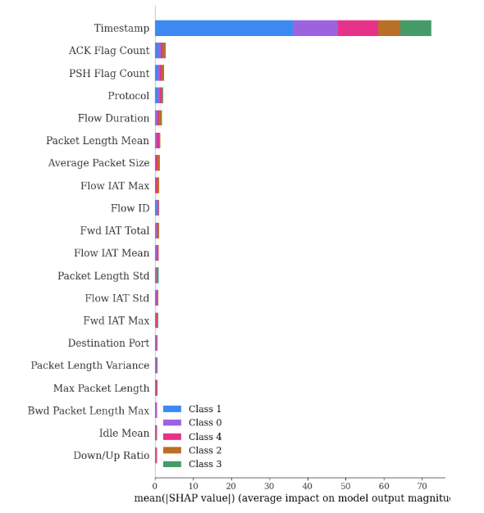
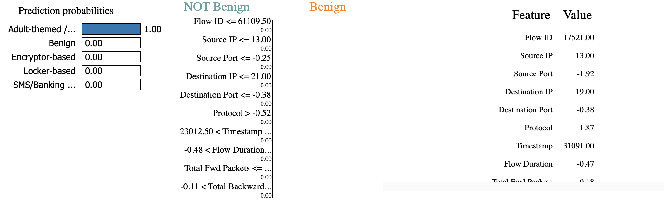
Explainable AI
Fig. 6: LIME of LightGBM Model
Fig. 7: SHAP of LightGBM Model
Multi-Class Android Ransomware Detection
Page 9

Slide 11
Conclusion
Android ransomware is becoming more advanced, and different types behave in different ways.
Most existing research only detect whether an app is malicious, but they cannot identify the ransomware type.
Our work provides a five-class model that can detect and separate different ransomware behaviours.
Advanced algorithms like LightGBM and XGBoost gave very high accuracy in multi-class detection.
This approach can help improve mobile security by giving more detailed and useful information for real-world protection.
Multi-Class Android Ransomware Detection
Page 10

Slide 12
References
Arp, D. et al. (2014) – “Drebin: Efficient Android Malware Detection Using Static Analysis.”
Narudin, N. et al. (2015) – “Evaluation of Machine Learning Classifiers for Mobile Malware Detection.”
Slates, R. (2019) – “Dynamic Analysis of Android Locker Ransomware.”
Yerima, S. et al. (2016) – “High-Accuracy Android Malware Detection Using Multi-Class Machine Learning.”
Koler / Simplocker Dataset Studies – Android ransomware behavioural research.
Svpeng Banking Malware Analysis – Financial data–stealing ransomware behaviour.
PornDroid / Adult-Themed Malware Reports – Social-engineering–based ransomware families.
Kaggle Dataset (2025) – “Android Ransomware Detection Dataset.”
(https://www.kaggle.com/datasets/subhajournal/android-ransomware-detection)
Multi-Class Android Ransomware Detection
Page 11

Slide 13

Do you have any questions?
Thank You
University Management System

