Slide 1



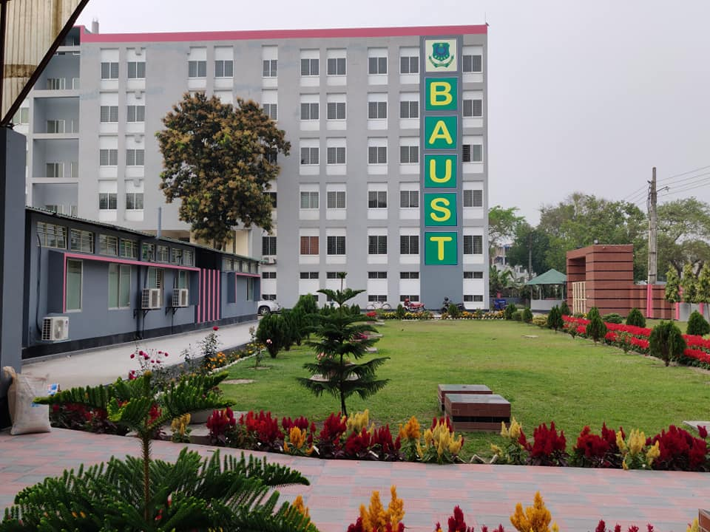

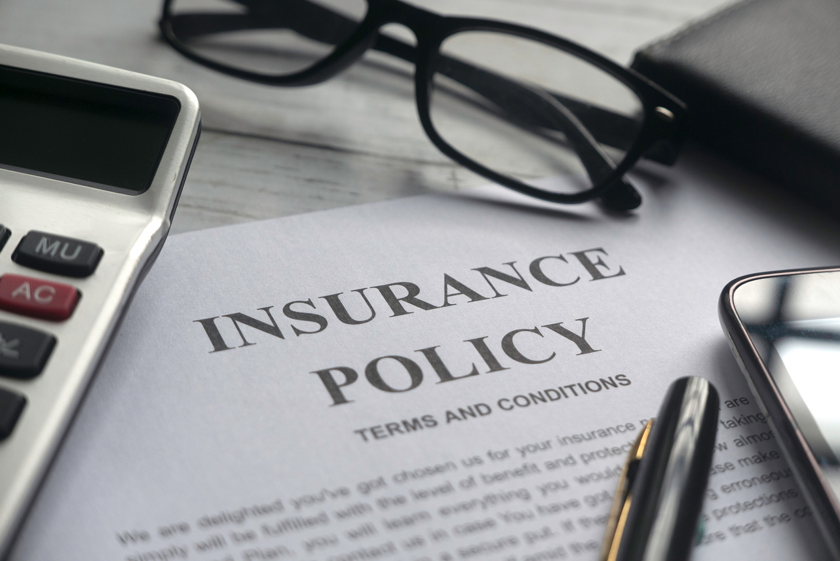




Bangladesh Army University of Science and Technology (BAUST)
Department of Computer Science and Engineering (CSE)
Course Code: CSE 4140
Course Title: Machine Learning Sessional
Project Title
Medical Insurance Cost Prediction Using Machine Learning
Presented By:
Presented To:
Name: Swapnil Sett
ID: 220201011
Engr. Rohul Amin
Lecturer of CSE, BAUST
Nadim Reza
Lecturer of CSE, BAUST
Date: 24 September, 2025

Slide 2


Introduction
Medical insurance costs are rising globally
Costs are influenced by key demographic and health factors
Machine Learning can analyze large datasets and uncover patterns that determine medical expenses.
Page: 02
Medical Insurance Cost Prediction Using Machine Learning

Slide 3

Objectives
Analyze key factors affecting medical insurance costs.
Build a Linear Regression model for cost prediction.
Evaluate model performance using accuracy metrics
Page: 03
Medical Insurance Cost Prediction Using Machine Learning

Slide 4
Dataset
Source: Kaggle – Medical Insurance Cost Dataset
Total Records: 1,338 entries
Features: 7 attributes
Page: 03
Medical Insurance Cost Prediction Using Machine Learning

Slide 5
Methodology
Dataset Collection
Data Preprocessing
Train Test Split
Handling Missing Values
Encoding Categorical Variables
Feature Scaling
Model Selection:
Linear Regression Model
performance analysis
Model Training
Page: 04
Medical Insurance Cost Prediction Using Machine Learning

Slide 6
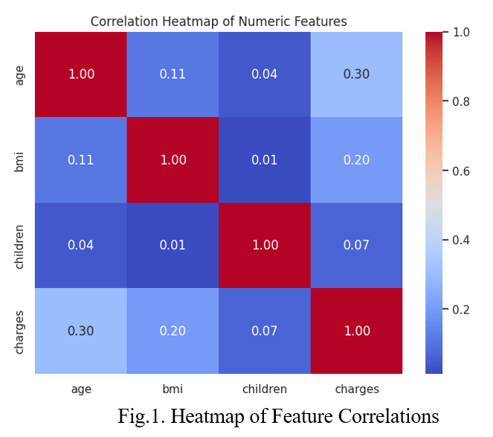
Model Training
Data Preparation
  Split dataset into Training (80%) and Testing (20%) sets
  Applied encoding for categorical features (sex, smoker, region)
  Ensured data quality after preprocessing
Model Selection
  Chosen algorithm: Linear Regression
  Reason: Simple, interpretable, effective for continuous value prediction
Page: 05
Medical Insurance Cost Prediction Using Machine Learning

Slide 7

Result Analysis
The Linear Regression model achieved a 78% R² score
Page: 06
Medical Insurance Cost Prediction Using Machine Learning

Slide 8
Future improvement
1.Hyperparameter tuning
2.Using ensemble methods
3.Trying non-linear regression models
Page: 06
Medical Insurance Cost Prediction Using Machine Learning

Slide 9
Thank you
Page: 06
Medical Insurance Cost Prediction Using Machine Learning

