Slide 1

Bangladesh Army University of Science and Technology (BAUST)
Department of Computer Science and Engineering (CSE)
Course Code: CSE 4140
Course Title: Machine Learning Sessional
Project Name:Heart Disease Prediction Using Machine Learning
Date: 25-11-2025
Presented To:
COURSE TEACHER : Rohul Amin , Nadim Reza
DESIGNATION : Lecturer
Presented By:
Mst. Eshrat Jahan Esha
ID: 220201038

Slide 2
WHY HEART DISEASE PREDICTION?
Heart disease is one of the top causes of death globally.
Early detection greatly improves chances of survival.
Many symptoms appear late, so early risk prediction is crucial.
Machine learning can analyze patient data more efficiently than manual methods.
Helps doctors identify high-risk patients quickly.

Slide 3
INTRODUCTION
Heart disease is a leading global health problem.
Early prediction helps reduce complications.
Machine Learning can identify patterns in medical data.
This project uses Logistic Regression and TabNet.

Slide 4
OBJECTIVES
Preprocess heart disease dataset
Extract useful numerical & categorical features
Train and Test ML models
Compare performance between LR and TabNet
Identify the best-performing model

Slide 5
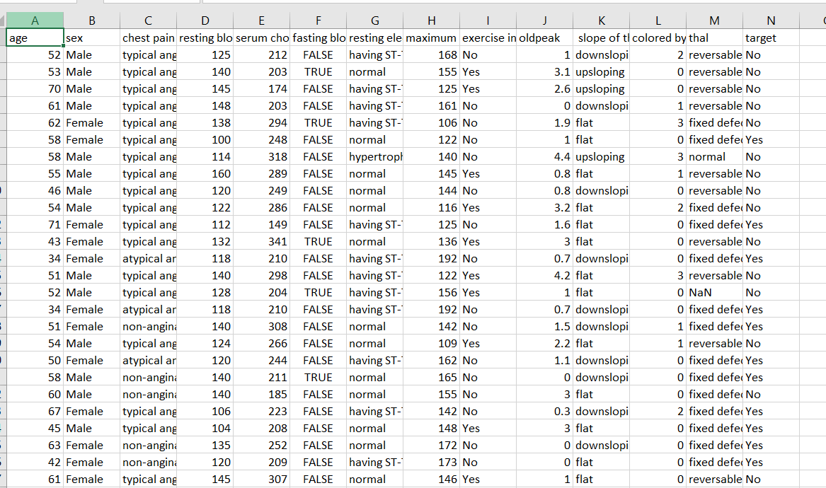
DATASET
The dataset consists of 1026 samples

Slide 6
DATA PREPROCESSING
Removed missing and inconsistent values
Standardized all numerical medical features (BP, Cholesterol, MaxHR)
Applied One-Hot Encoding to all categorical features
Converted the entire dataset into numeric format

Slide 7
MODEL
Logistic Regression
TabNet Classifier

Slide 8
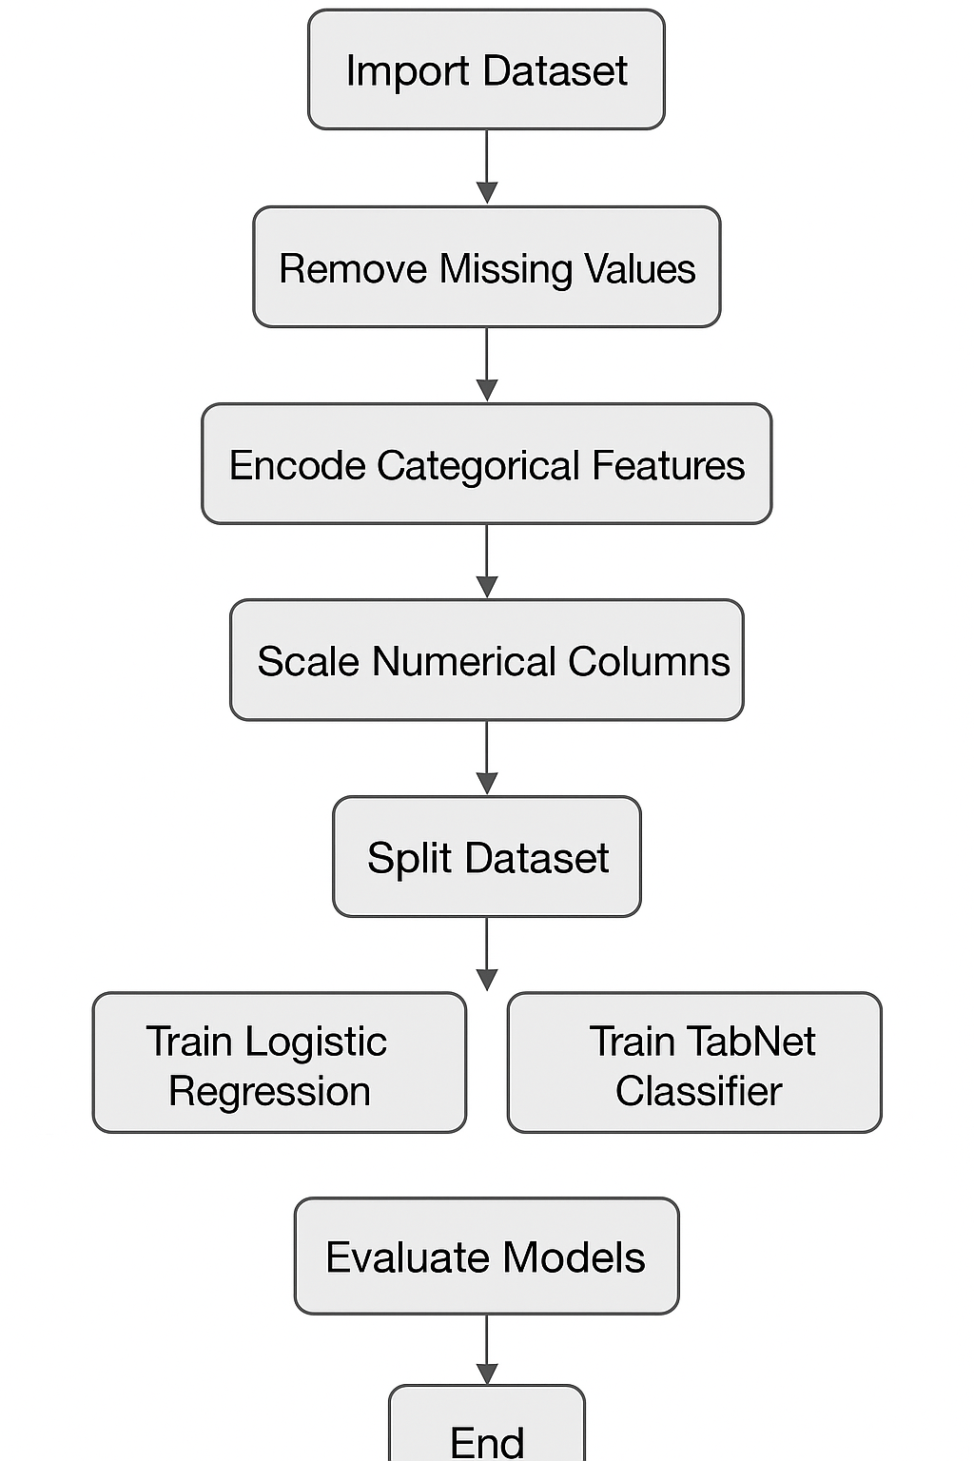
METHODOLOGY

Slide 9
RESULT ANALYSIS
Training Accuracy:
LR: 90%
TabNet: 96%
Validation Accuracy:
LR: Lower
TabNet: More stable
Test Accuracy:
LR: 80%
TabNet: 94%

Slide 10
FUTURE WORK
Use larger and more diverse datasets to make the model more robust
Integrate additional features such as lifestyle, genetics, diet, exercise, and stress levels.
Use real-time data from wearable devices for early detection.
Periodically retrain and monitor the model to adapt to new data.

Slide 11
CONCLUSION
ML improves heart disease prediction accuracy
Statistical feature selection boosts performance
TabNet outperformed Logistic Regression

Slide 12
SUMMARY OF RELATED WORK
Paper | Dataset Used | Class Type | Methodology
Paper 1: Logistic Regression for Heart Disease Classification | Heart Disease Dataset | Heart Disease / No Heart Disease | Basic preprocessing, Logistic Regression
Paper 2: Decision Tree-Based Heart Disease Detection | UCI Heart Disease Dataset | Heart Disease / No Heart Disease | Decision Tree
Paper 3: Machine Learning Algorithms for Heart Disease Detection | Kaggle Heart Disease Dataset | Heart Disease / No Heart Disease | KNN, Logistic Regression, SVM
Paper 4: Random Forest for Heart Disease Prediction | Heart Disease Dataset | Heart Disease / No Heart Disease | Random Forest
Paper 5: XGBoost in Medical Data Classification | Engineered Cardiac Features | Heart Disease / No Heart Disease | XGBoost

Slide 13
REFERENCE
[1] M. A. Haq, S. S. Islam, and M. Rahman, “K-Nearest Neighbors based diagnosis of heart disease using clinical features,” Biomedical Research Journal, vol. 28, no. 4, pp. 236–244, 2017.
[2] D. Kumar and R. Goel, “Heart disease prediction using Random Forest classifier,” Procedia Computer Science, vol. 132, pp. 1253–1262, 2019.
[3] R. Gupta, P. Sinha, and A. Verma, “Efficient cardiovascular risk prediction using XGBoost,” IEEE Access, vol. 8, pp. 153238–153247, 2020.
[4] D. W. Aha and M. K. Tan, “Analyzing the Cleveland Heart Disease Dataset using Logistic Regression,” International Journal of Medical Informatics, vol. 115, pp. 45–52, 2018.
[5] P. Sharma, K. Gupta, and S. Singh, “Statistical feature selection for medical datasets using Chi-square, ANOVA, and Mutual Information,” Journal of Health Informatics, vol. 12, no. 2, pp. 112–120, 2016.
pp. 321–357, 2002.

Slide 14


