Slide 1

Bangladesh Army University of Science and Technology (BAUST) Saidpur Cantonment, Nilphamari
Department of Computer Science and Engineering (CSE)
Course Code: CSE 4140
Course Title: Machine Learning Sessional
Title:
Automated ECG Classification Using Hearbeat Image Based on RESNET50
Presented By
Md Nafsun Kabir, 220201049
Prepared for:
Engr. Rohul Amin
Lecturer, CSE, BAUST
Nadim Reza
Lecturer, CSE, BAUST
1

Slide 2
Presentation Outline
Introduction
Objectives
Proposed Methodology
Dataset
Result
Comparison
Future Scope
Conclusion
References
2

Slide 3
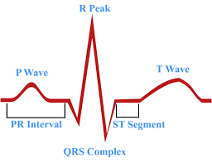
Introduction
Finds heart problems from ECG images.
    Normal
    History of MI,
    Heart Attack (MI),
    and Abnormal Heatbeat
3

Slide 4
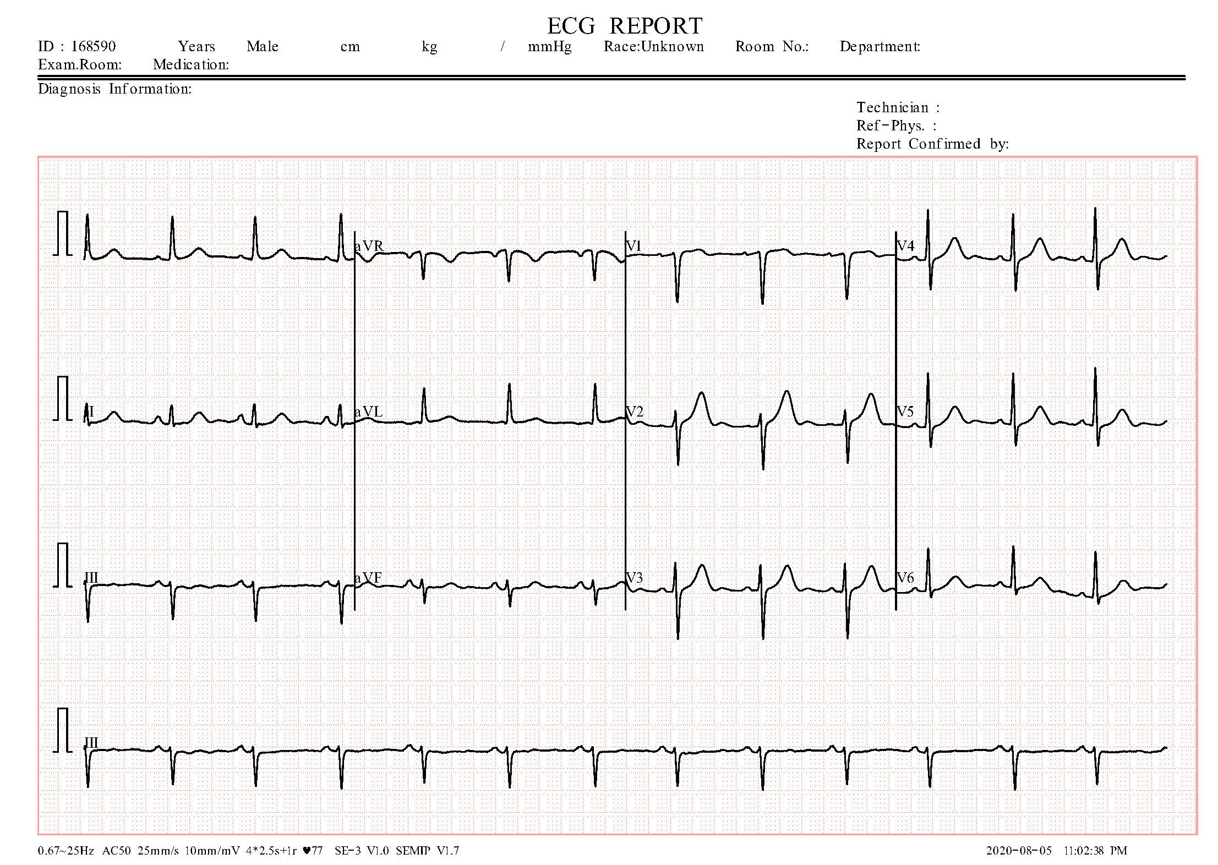
Dataset
Use public ECG image sets from Kaggle
    Divide into 4 classes: Normal ,History of MI, Heart Attack (MI),and Abnormal Heatbeat
Fig1:Normal ECG DATA

Slide 5
Objectives
To automatically classify ECG images into 4 heart conditions
To use deep learning (ResNet50) Model for accurate diagnosis
To test the model on real ECG images, not just signals

Slide 6
Methodology
    Build a deep learning model(RESNET50) to classify ECG images into Normal, History of MI, Heart Attack (MI),and Abnormal Heatbeat
1. Data
  Kaggle datasets
2. Data Preprocessing
  Resize image (224×224)
  Data Augmentation.

Slide 7
Proposed Methodology (Cont.)
3. Model
  RESNET50
4. Training & Evaluation
  Split : Train data 80%(train 80% and validation 20%)
  Test data 20%.
  Metrics: Accuracy ,Precision
  Recall ,F1-score

Slide 8
Proposed Methodology (Diagram)
Data Preprocessing
resize image (224×224)
normalize,
augmentation
Data
Kaggle ECG datasets
Model
RESNET50
Dropout
Training & Evaluation
Split: 80% / 20%.
Metrics: Accuracy, Precision, Recall, F1-score
Output

Slide 9
Related Works
Research Paper | Authors & Publisher | Methodology | Challenges & Gap
A Lightweight DNN for ECG Image Classification | Authors: A. E. Youssef, A. M. Hemeida, A. I. Taloba, A. Atwan Publisher: IEEE | combining CNN with other classification layers with MIT-BIH Arrhythmia Database (ECG signals) | Performance may drop on real-world data outside MIT-BIH. Only 80.3% accuracy
Arrhythmia Classification Using ECG Image Dataset Using Machine Learning Approach on DenseNet121 Model | Authors: Kanwarpartap Singh Gill; Vatsala Anand; Rupesh Gupta Publisher: IEEE | transfer learning with the DenseNet121 model to classify arrhythmia from ECG images Feature selection to highlight informative ECG patterns. | Only 80% accuracy Performance on different datasets / real-world hospital data is not validated.

Slide 10
Related Works (Cont.)
Research Paper | Authors & Publisher | Methodology | Challenges & Gap
 |  | ECG signals transformed into images combine images, then classify with CNN | Dependency on Signal to Image Transformation Loss of temporal details during signal to image conversion.
 | Authors:Ganeshkumar M., Vinayakumar Ravi,Sowmya V., E. A. Gopalakrishnan, Soman K. P. Publisher: IEEE Transactions on Engineering Management, | Used about 6,300 ECG records with 8 abnormal classes + normal. removed noise and converted signals to 2-D ECG matrices. | No plan for a doctor-friendly app or dashboard. No demo on live or streaming ECG data
ECG Heartbeat Classification Using Multimodal Fusion
Authors: Zeeshan Ahmad; Anika Tabassum; Ling Guan; Naimul Mefraz Khan
Publisher: IEEE
Explainable Deep Learning-Based Approach for Multilabel Classification of Electrocardiogram

Slide 11
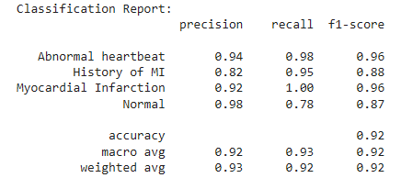
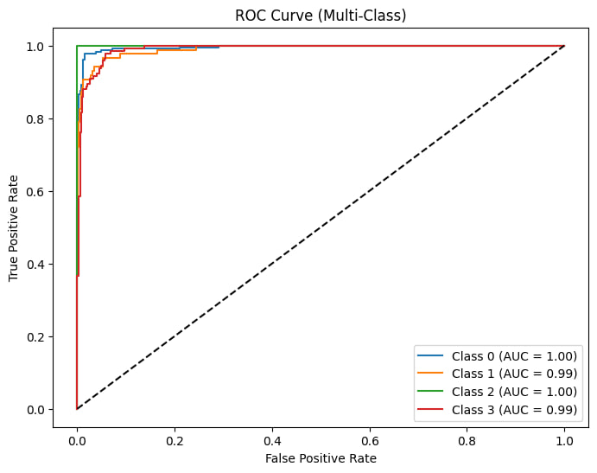
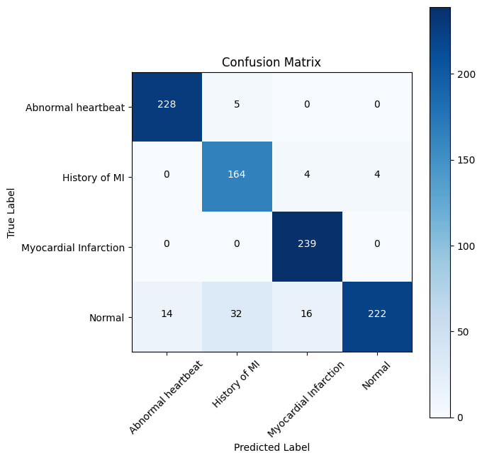
Result

Slide 12
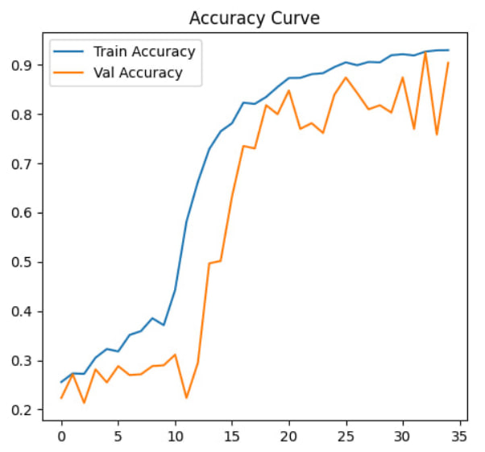
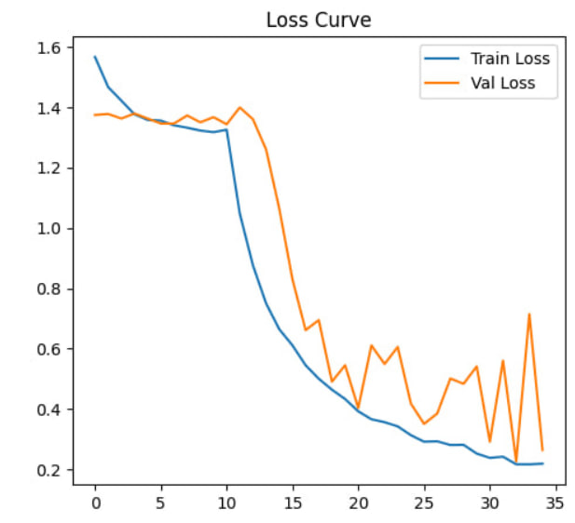
Result

Slide 13
Future Scope
Add more types of heart conditions to classify
Add more data for better performance
Make the system usable on mobile phones
Add explainable AI to show which part of ECG the model focuses on

Slide 14
Conclusion
We used a ResNet50 model to classify ECG images into 4 types of heart conditions.
The model achieved 91.91% accuracy on test data.
Image preprocessing and transfer learning helped get good results.
This method works well for automated heart disease detection.

Slide 15
References
Rana, Amrita, and Kyung Ki Kim. "A lightweight dnn for ecg image classification." 2020 International SoC Design Conference (ISOCC). IEEE, 2020.
Gill, Kanwarpartap Singh, Vatsala Anand, and Rupesh Gupta. "Arrhythmia classification using ecg image dataset using machine learning approach on densenet121 model." 2023 14th International Conference on Computing Communication and Networking Technologies (ICCCNT). IEEE, 2023.
Ahmad, Zeeshan, et al. "ECG heartbeat classification using multimodal fusion." IEEE Access 9 (2021): 100615-100626.
Gill, Kanwarpartap Singh, Vatsala Anand, and Rupesh Gupta. "Arrhythmia classification using ecg image dataset using machine learning approach on densenet121 model." 2023 14th International Conference on Computing Communication and Networking Technologies (ICCCNT). IEEE, 2023.

Slide 16
Thank You!
Any Question?

