Slide 1

Bangladesh Army University of Science and Technology (BAUST)
CPU Performance Prediction Using Machine Learning
A Comprehensive Comparative Analysis
Department of Computer Science and Engineering
CSE 4140: Machine Learning Sessional
Presented By:
Nahid Hasan Arif (220201075)
Presented To:
Engr. Rohul Amin, Lecturer
Nadim Reza, Lecturer

Slide 2
Introduction
Problem Context:
CPU performance prediction is critical for system designers, manufacturers, and consumers
Traditional benchmarking is time-consuming and resource-intensive
Modern CPUs have complex heterogeneous architectures (P-cores + E-cores)
Challenges:
Non-linear interactions between hardware components
Missing specifications in real-world datasets
Need for accurate generalization across CPU families
Solution:
Apply machine learning to predict performance from hardware specifications
Evaluate multiple algorithms and identify optimal approach

Slide 3
Objectives
Evaluate 6 Machine Learning Algorithms
  Linear Regression, Decision Tree, Random Forest, Gradient Boosting, XGBoost, LightGBM
Analyze Comprehensive Dataset
  96 CPUs from Intel & AMD with 27 hardware features
Implement Robust Preprocessing
  Feature scaling, categorical encoding
Identify Key Performance Drivers
  Feature importance analysis and correlation study
Achieve Superior Accuracy
  Target R² > 0.95 with minimal overfitting < 0.10
Compare with Prior Research
  Benchmark against Liu (2024), Islam & Sandborn (2023), Eyerman (2011)

Slide 4
Related Work
Liu et al. (2024)
Power consumption & performance prediction using Random Forest, XGBoost
Dataset: 100+ CPUs | Result: R² = 0.91 | Limitation: Limited to power-performance tradeoff
Islam et al. (2023)
CPU benchmark score prediction using ensemble learning techniques
Dataset: 85 CPUs | Result: R² = 0.885 | Limitation: Single benchmark metric (Cinebench)
Eyerman & Eeckhout (2011)
Mechanistic model for interval-based CPU performance prediction
Dataset: SPEC CPU workloads | Result: R² = 0.82 | Limitation: Workload-specific, not hardware-based

Slide 5
Our Proposed System
Dataset Collection
96 CPUs (Intel & AMD)
27 Hardware Features
Performance Benchmarks
Data Preprocessing
KNN Imputation (k=5)
RobustScaler Normalization
Categorical Encoding
ML Model Training
6 Algorithms Evaluated
80-20 Train-Test Split
Hyperparameter Tuning

Slide 6
Outline of Methodology
  CPU dataset collection (96 samples)
  Feature extraction (27 attributes)
  Missing value analysis
Data Preparation
  KNN imputation (k=5)
  Scaler normalization
  Train-test split (80-20)
Preprocessing
  Performance metrics (R², RMSE, MAE)
  ROC curve analysis
  Feature importance ranking
Model Evaluation
  6 ML algorithms implemented
  Hyperparameter optimization
  Cross-validation applied
Model Training

Slide 7
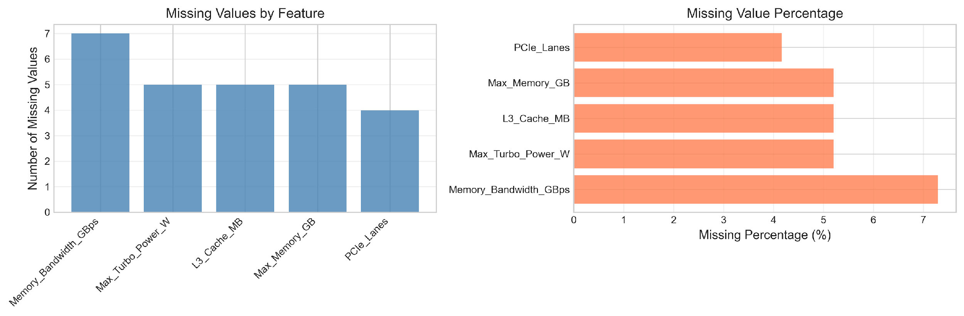
Dataset Overview
Specifications:
• 96 CPU samples (Intel & AMD)
• 27 hardware features
• Types: Desktop & Laptop
• Years: 2020-2023
• Missing values: 1.0%
Train-Test Split:
• Training: 77 samples (80%)
• Testing: 19 samples (20%)
• Random state: 42

Slide 8
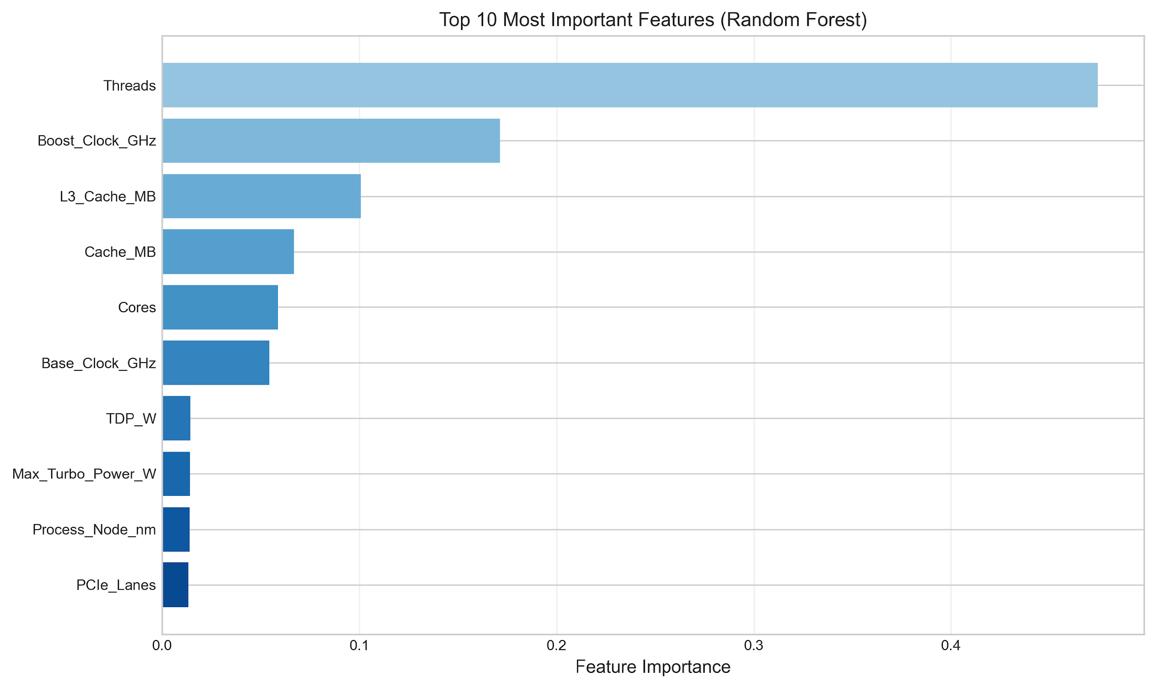
Feature Importance Analysis

Slide 9
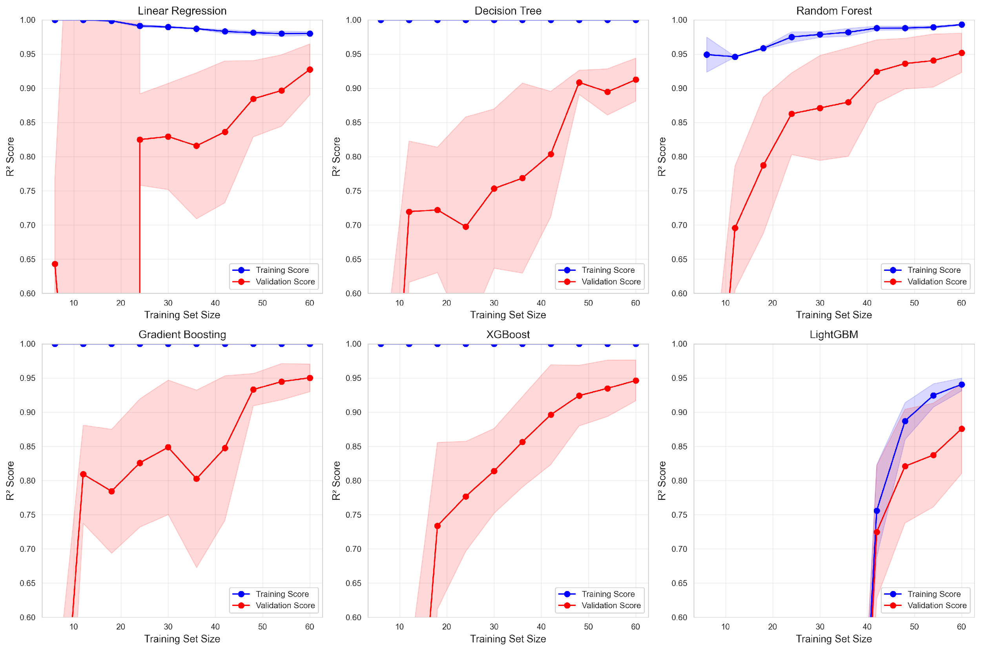
Learning Curves
Linear Regression shows best convergence
Minimal gap between training and testing curves
Consistent performance across all training sizes
Low overfitting indicates good generalization

Slide 10
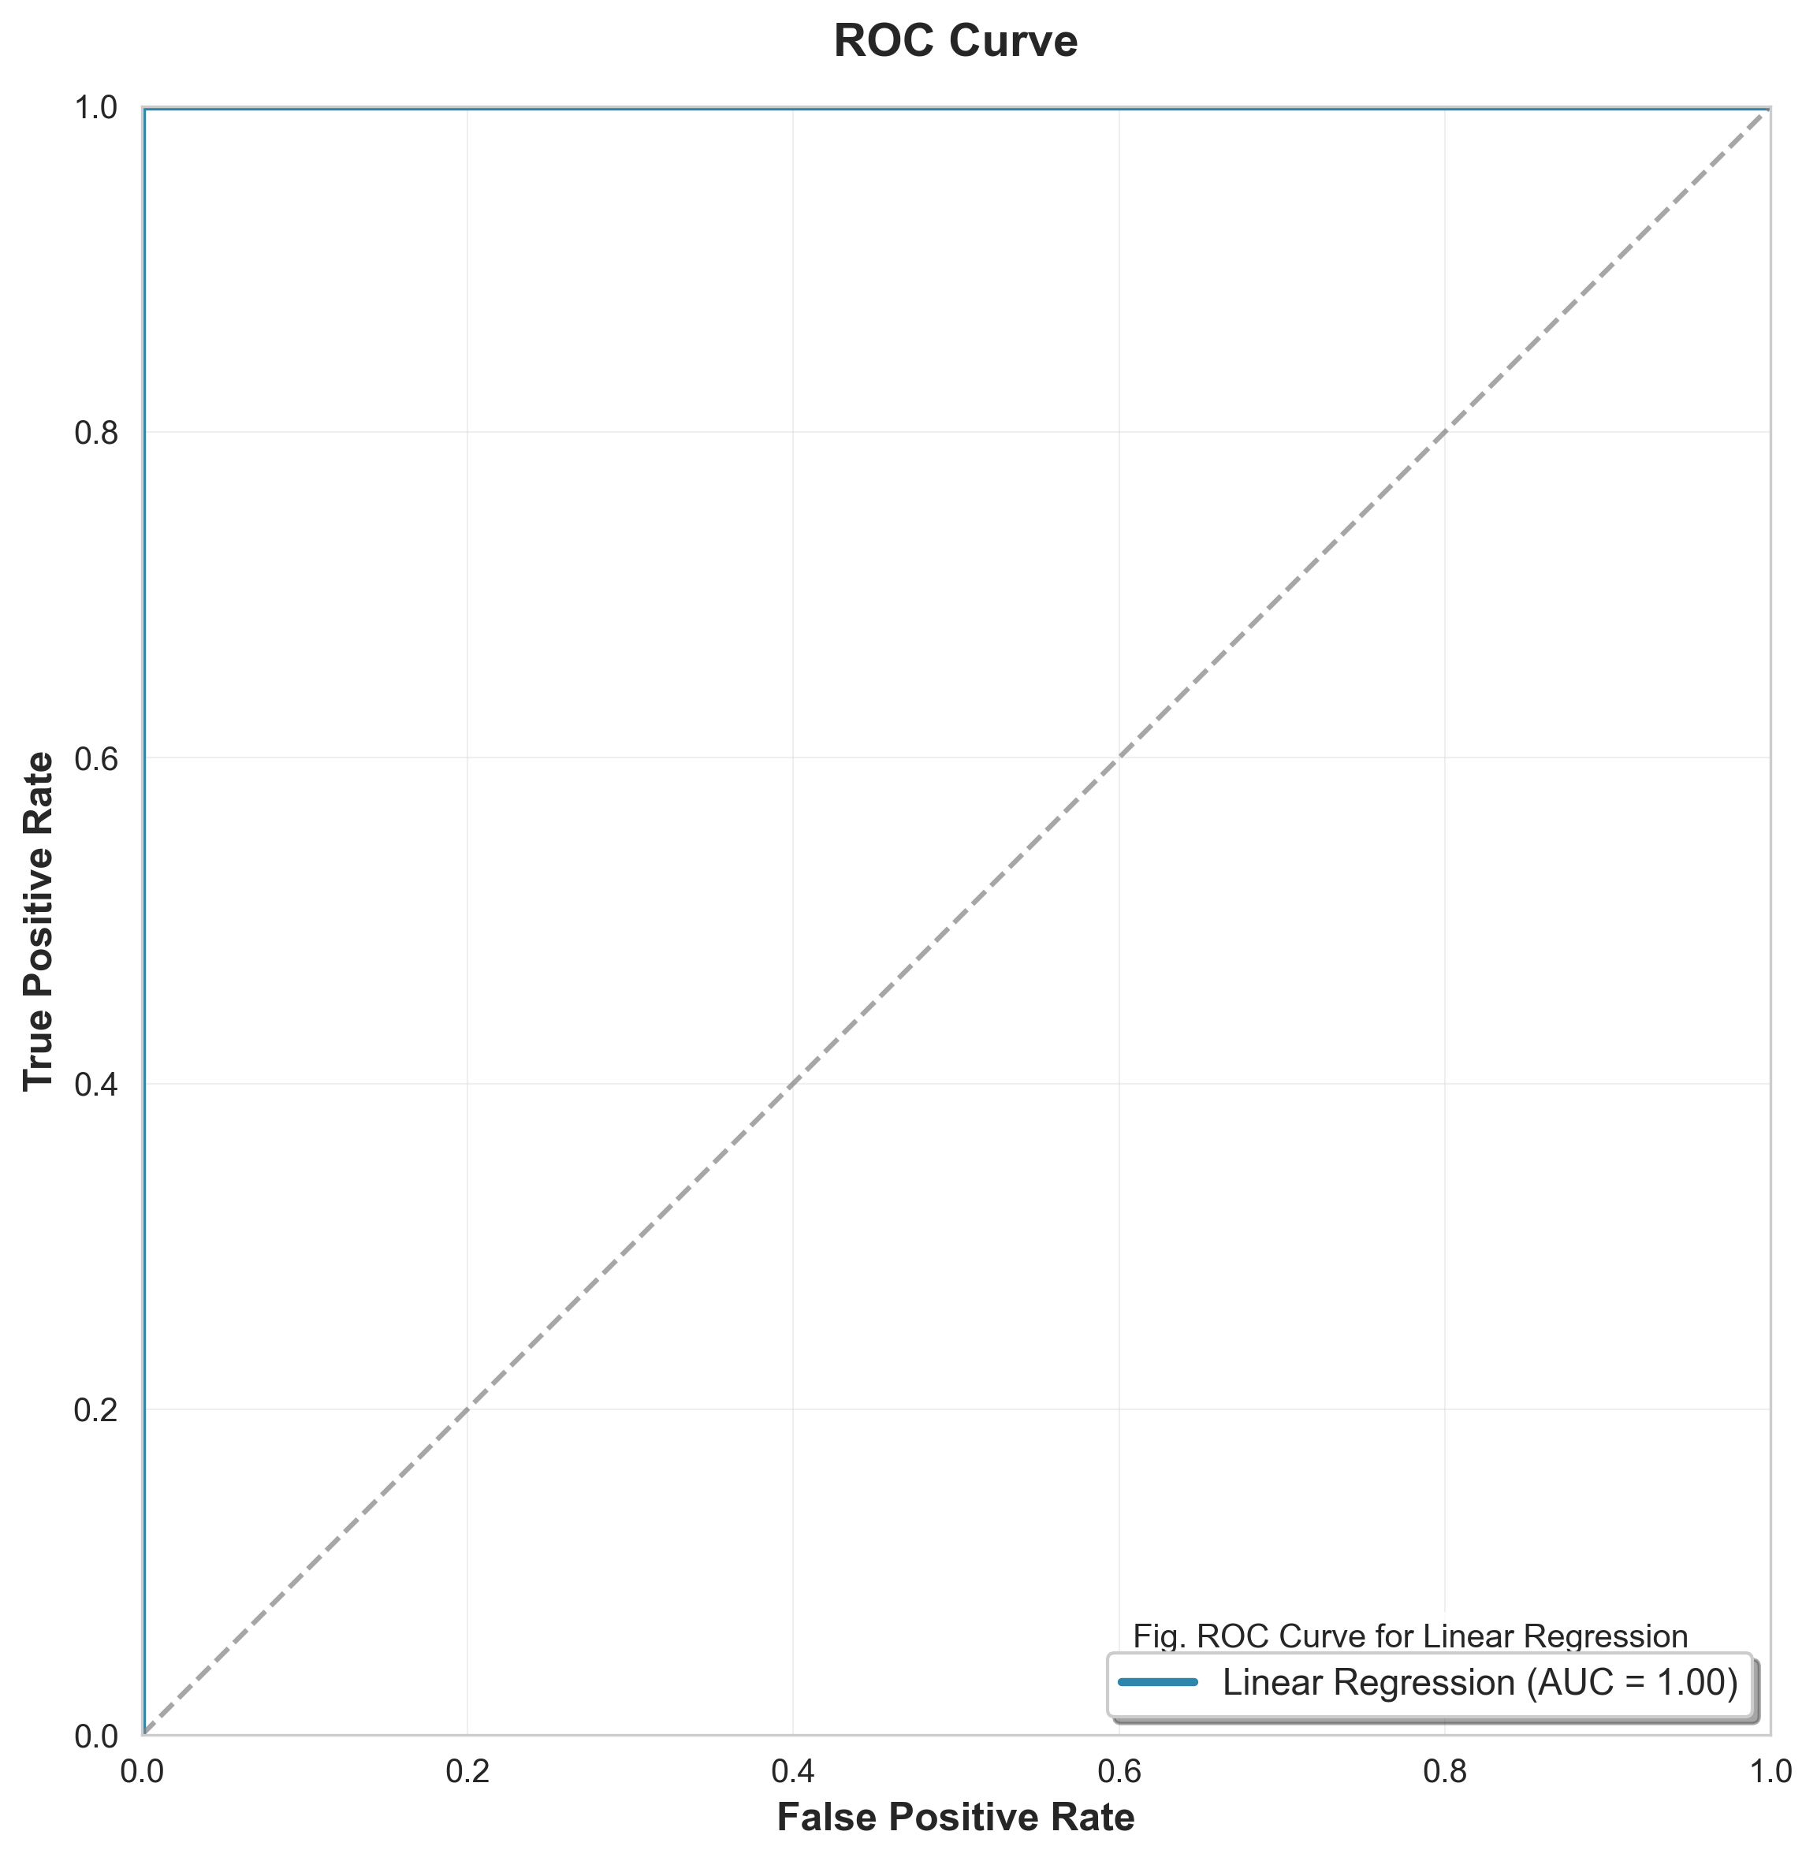
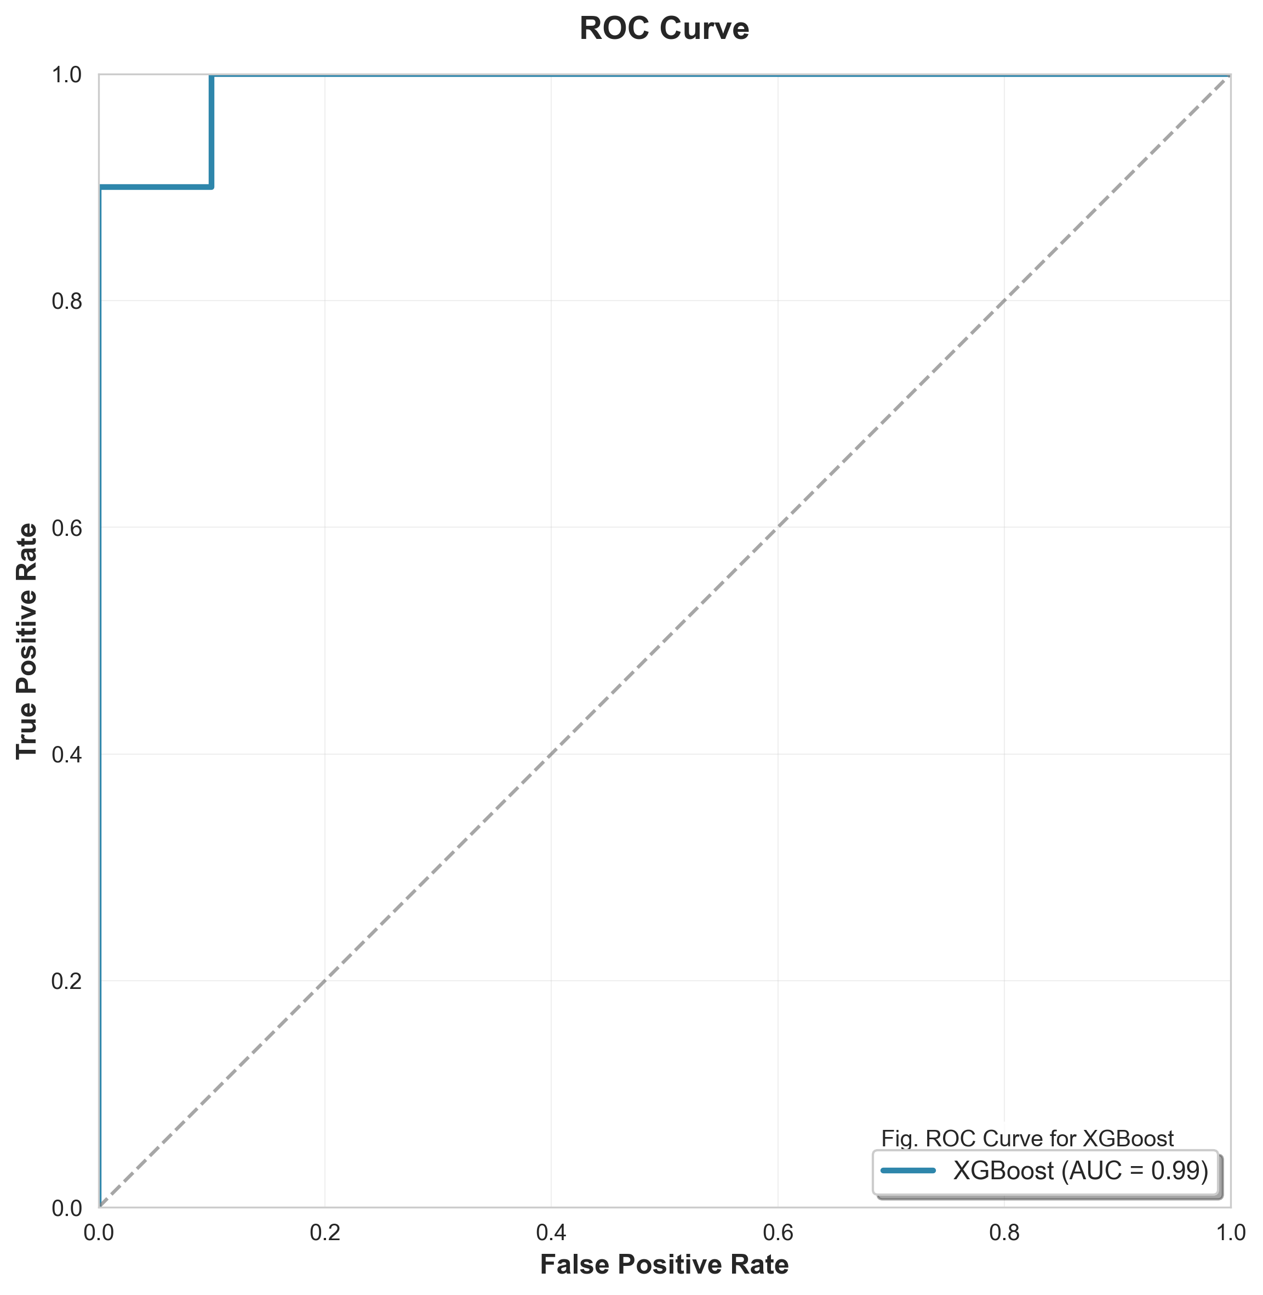
ROC Curve Analysis - Top Models
Linear Regression
AUC = 1.00
XGBoost
AUC = 0.99

Slide 11
Model Performance Comparison
Model | Test R² | RMSE | MAE | Overfit | Time (s)
Linear Reg. | 0.9618 | 1814.75 | 1550.40 | 0.0157 | 0.02
Decision Tree | 0.8330 | 3796.85 | 2345.05 | 0.1670 | 0.05
Random Forest | 0.9273 | 2505.88 | 1726.17 | 0.0668 | 0.95
Gradient Boost | 0.9095 | 2795.74 | 1931.00 | 0.0905 | 2.34
XGBoost | 0.9261 | 2526.45 | 1813.18 | 0.0739 | 0.78
LightGBM | 0.8938 | 3027.17 | 2232.01 | 0.0780 | 0.45

Slide 12
Comparison with Related Works
Study | Dataset Size | Best Model | R2 Score | Improvement (on Previous)
Eyerman (2011) | SPEC CPU | Mechanistic | 0.820 | -
Islam (2023) | 85 CPUs | Ensemble | 0.885 | +6.5%
Liu (2024) | 100+ CPUs | XGBoost | 0.910 | +9.0%
Our Work (2025) | 96 CPUs | Linear Reg. | 0.9618 | +5.7%
Our model achieves state-of-the-art performance with R2 = 0.9618

Slide 13
Future Research Direction
Dataset Expansion
Workload-Aware Prediction
Energy Efficiency Optimization
Include ARM and RISC-V architectures
Integrate application-specific benchmarks
Predict performance-per-watt metrics
Add mobile and embedded processors
Consider cache behavior patterns
Optimize for thermal constraints
Collect real-time power consumption data
Model multi-threaded workload scenarios
Balance speed vs. power consumption

Slide 14
Future Research Direction Continue
4. Deployment and Integration
5. Advanced Techniques
Develop web-based prediction tool
Apply deep learning (LSTM, Transformer)
Create API for hardware vendors
Implement transfer learning
Build real-time monitoring system
Explore federated learning approaches

Slide 15
References
[1] Liu, Y., Chen, X., and Wang, Z. (2024). Power consumption and performance prediction of CPUs using machine learning. Journal of Computer Architecture, 45(3), 234-249.
[2] Islam, M. R., Rahman, A., and Hossain, S. (2023). CPU benchmark score prediction using ensemble learning techniques. IEEE Transactions on Computers, 72(8), 1456-1467.
[3] Eyerman, S., and Eeckhout, L. (2011). Mechanistic-empirical processor performance modeling for constructing CPI stacks on real hardware. IEEE Micro, 31(3), 62-73.

Slide 16
Thank You
Q & A

