Slide 1
ExtraStoreWorkbook_Nihal_Jayan
File created on: 5/26/23 4:04:16 PM PDT

Slide 2
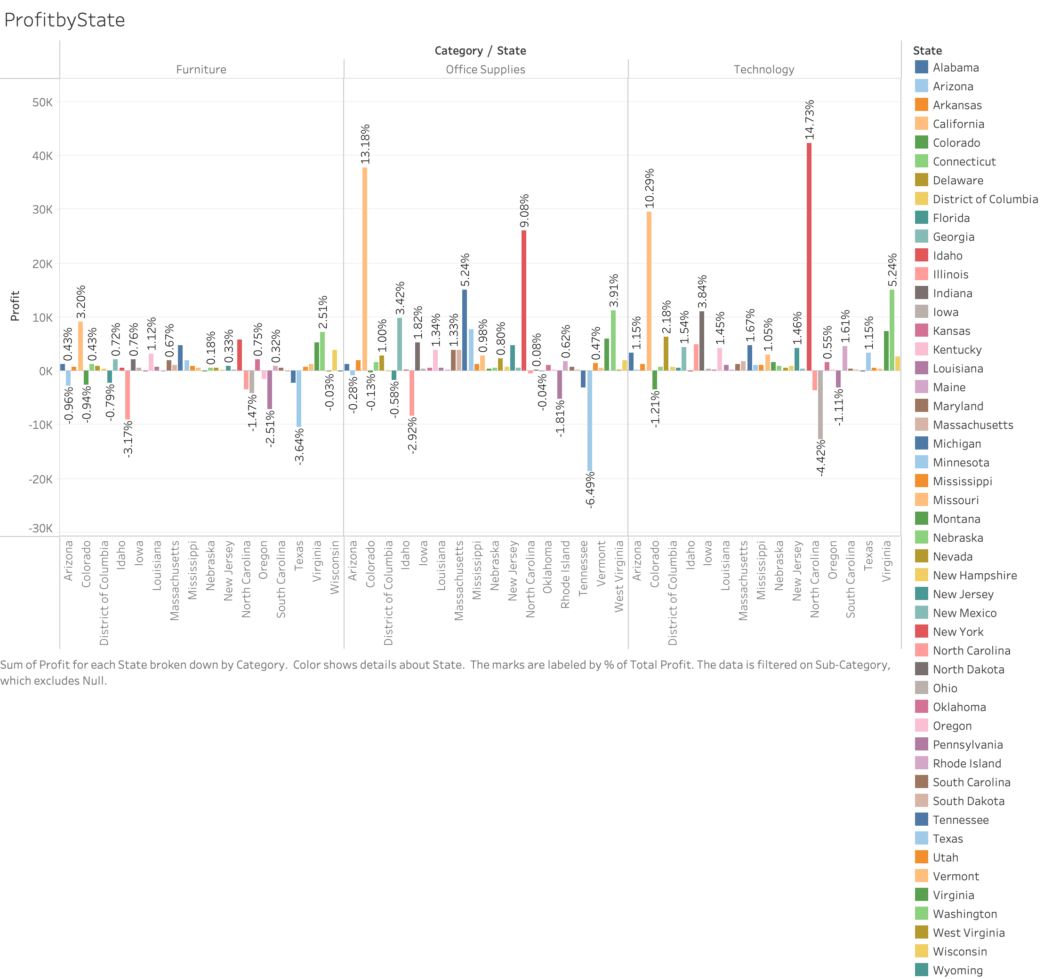

Slide 3
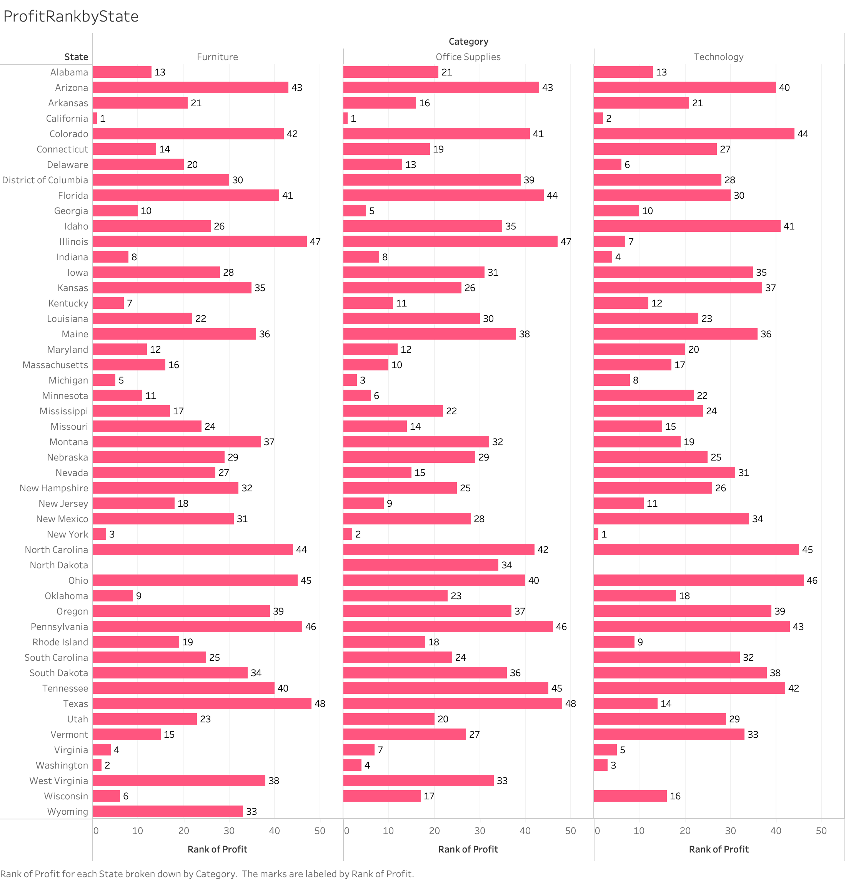

Slide 4
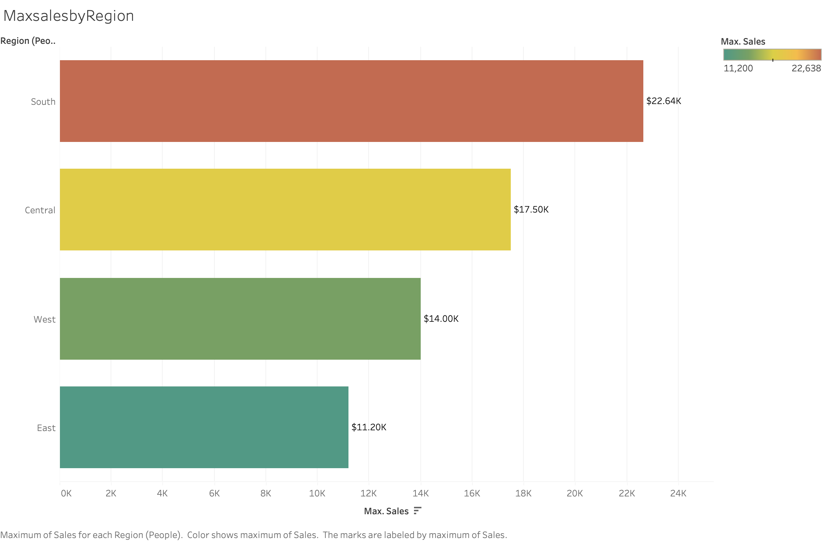

Slide 5
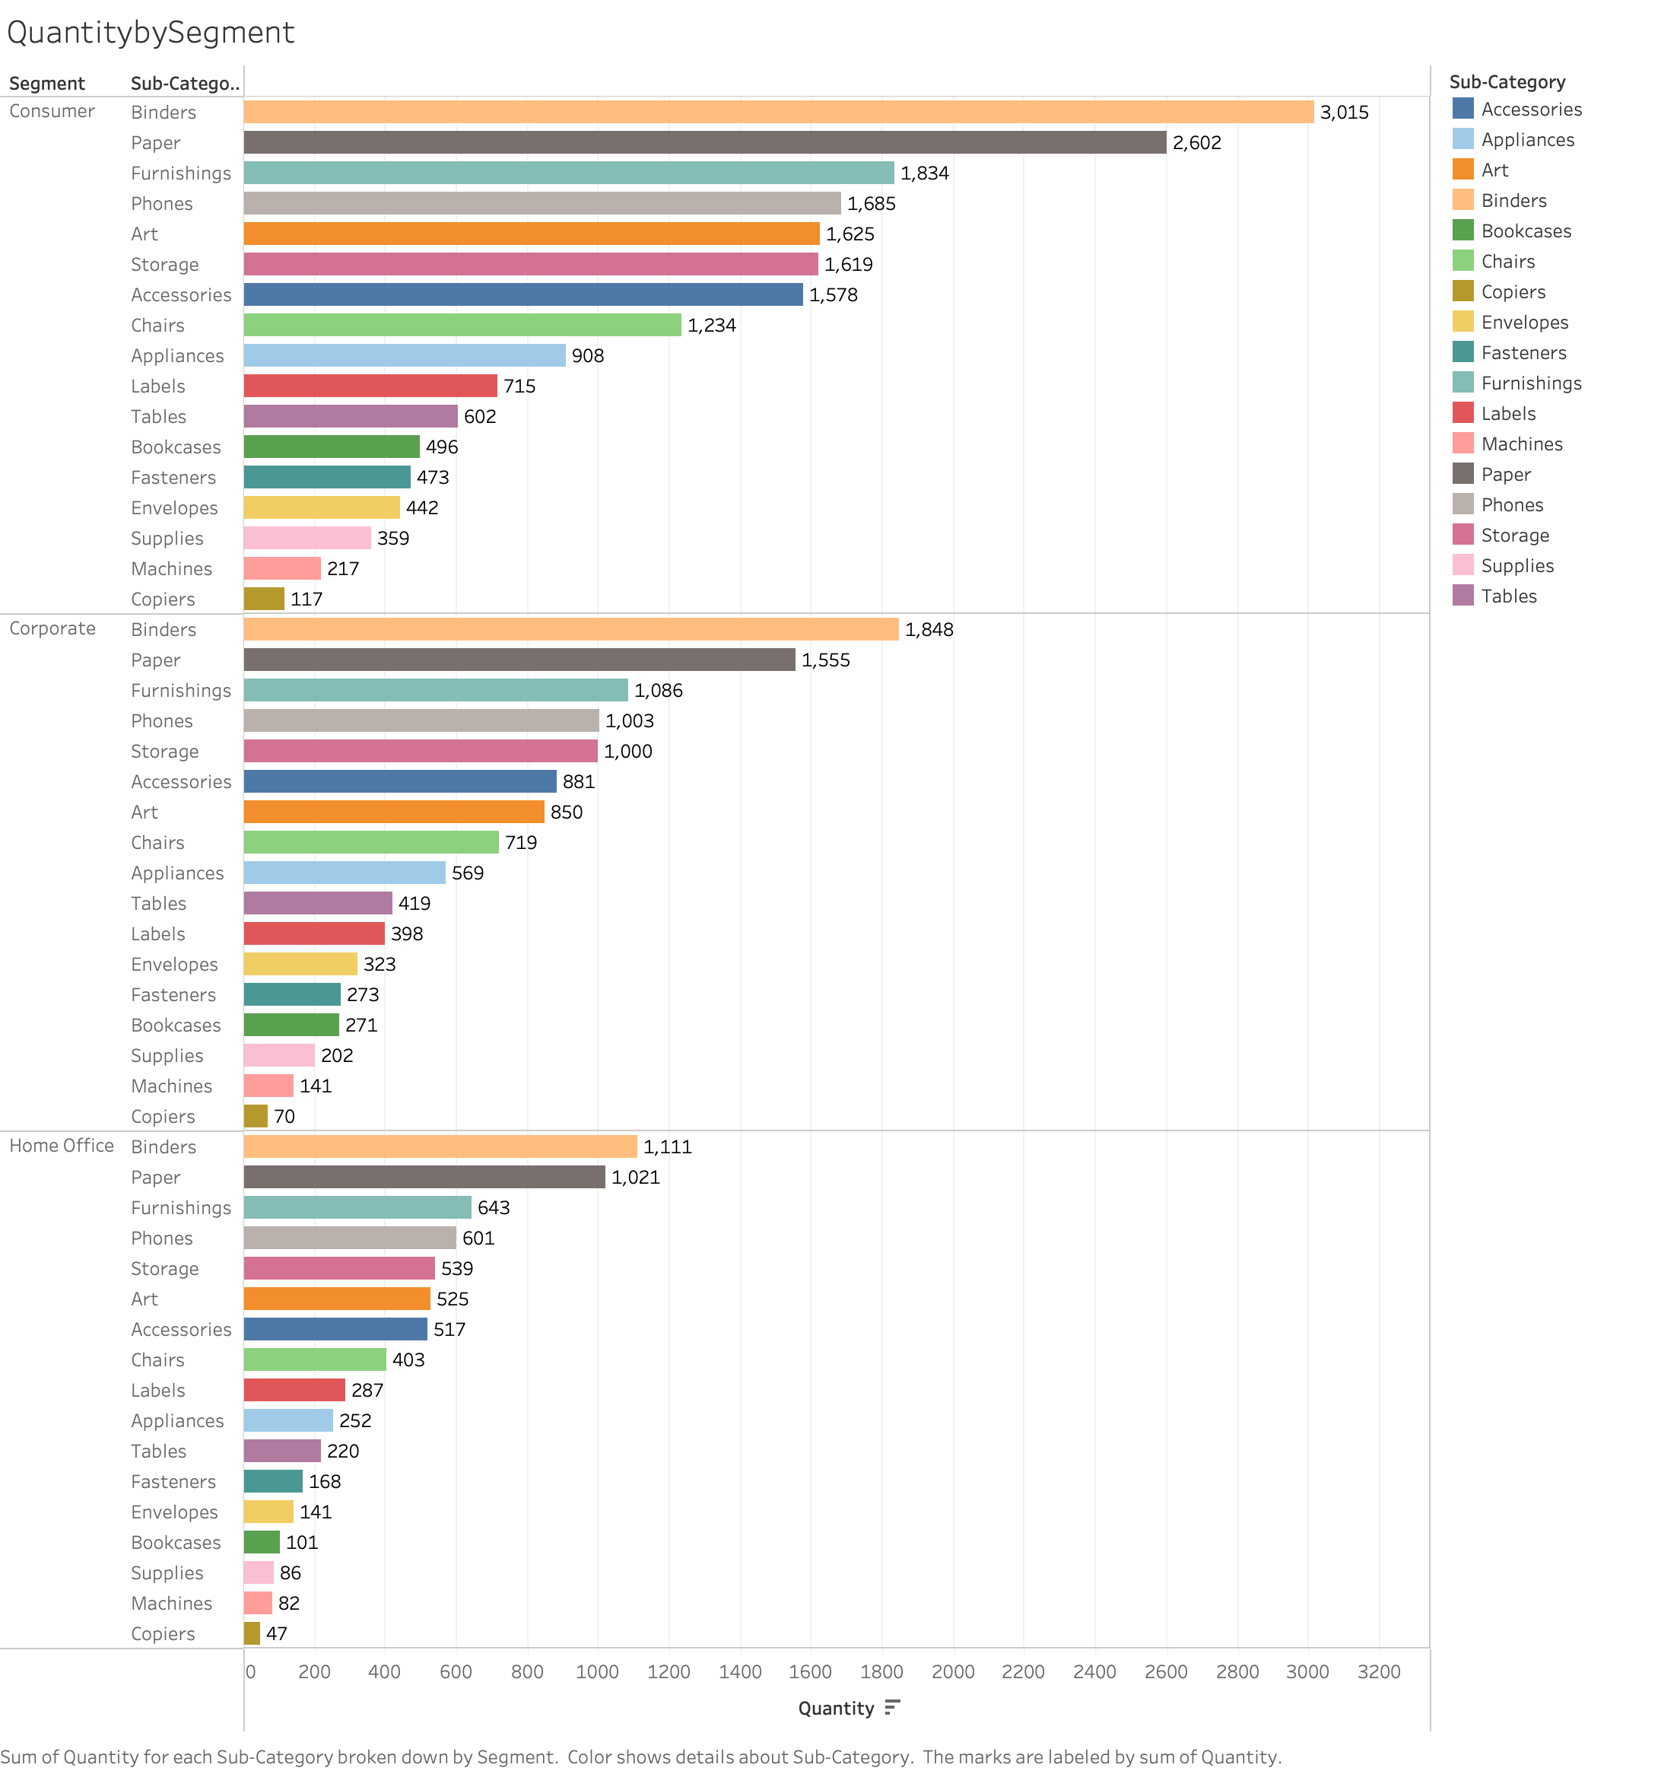

Slide 6
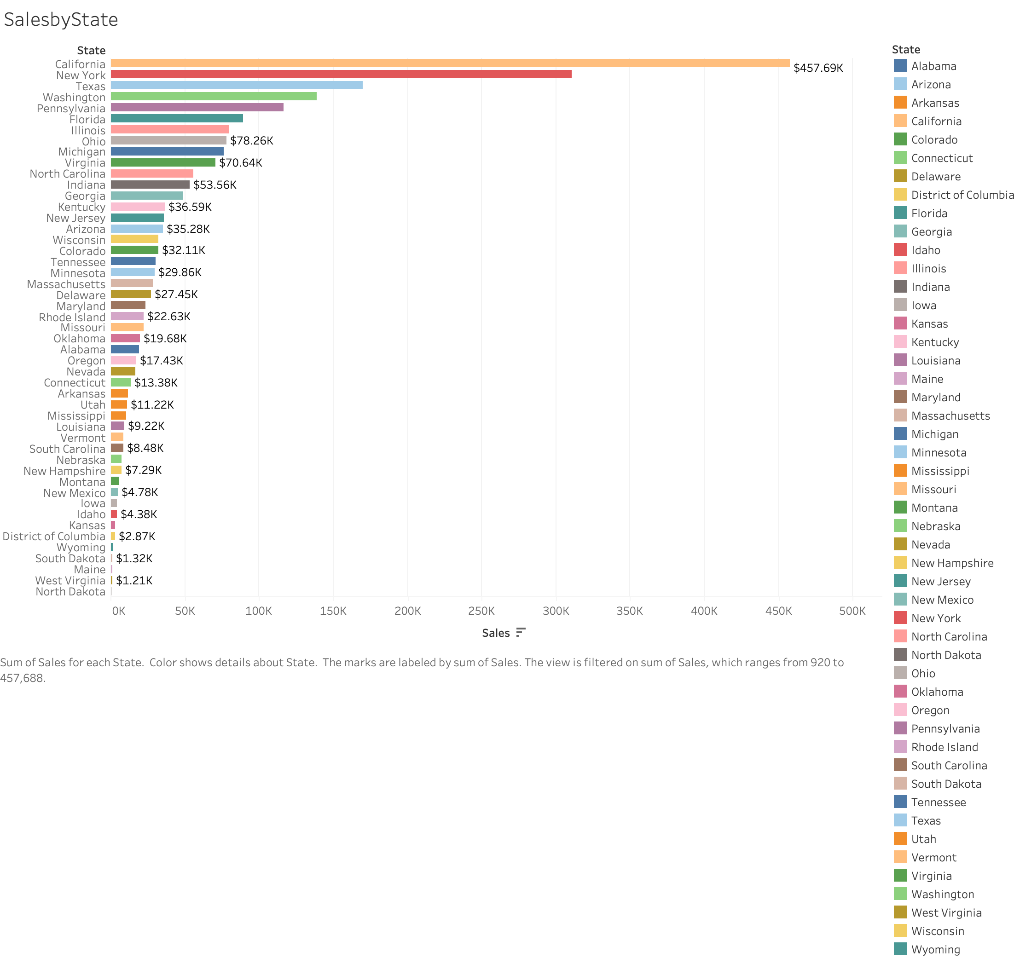

Slide 7
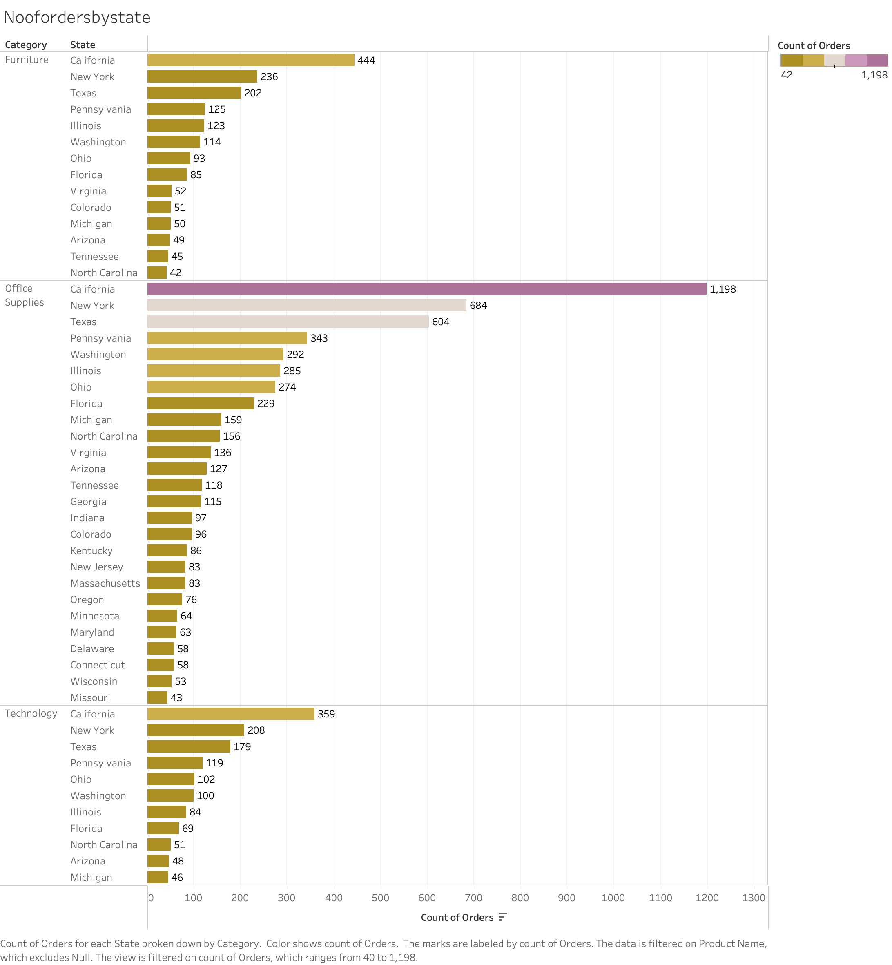

Slide 8
