Slide 1
Google Ad Dashboard
Nihal Jayan

Slide 2
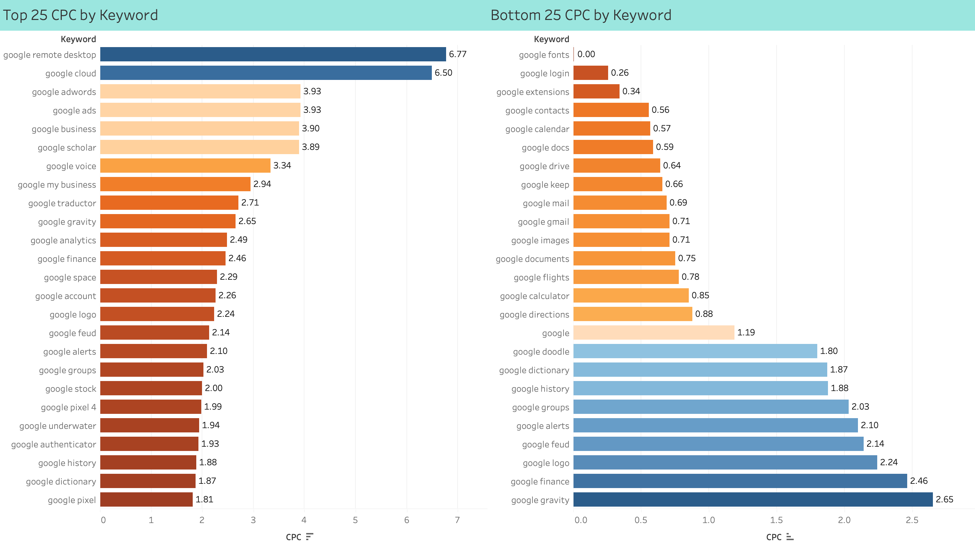
Notes:
Sum of CPC by Keyword (Top 25 and Bottom 25)

Slide 3
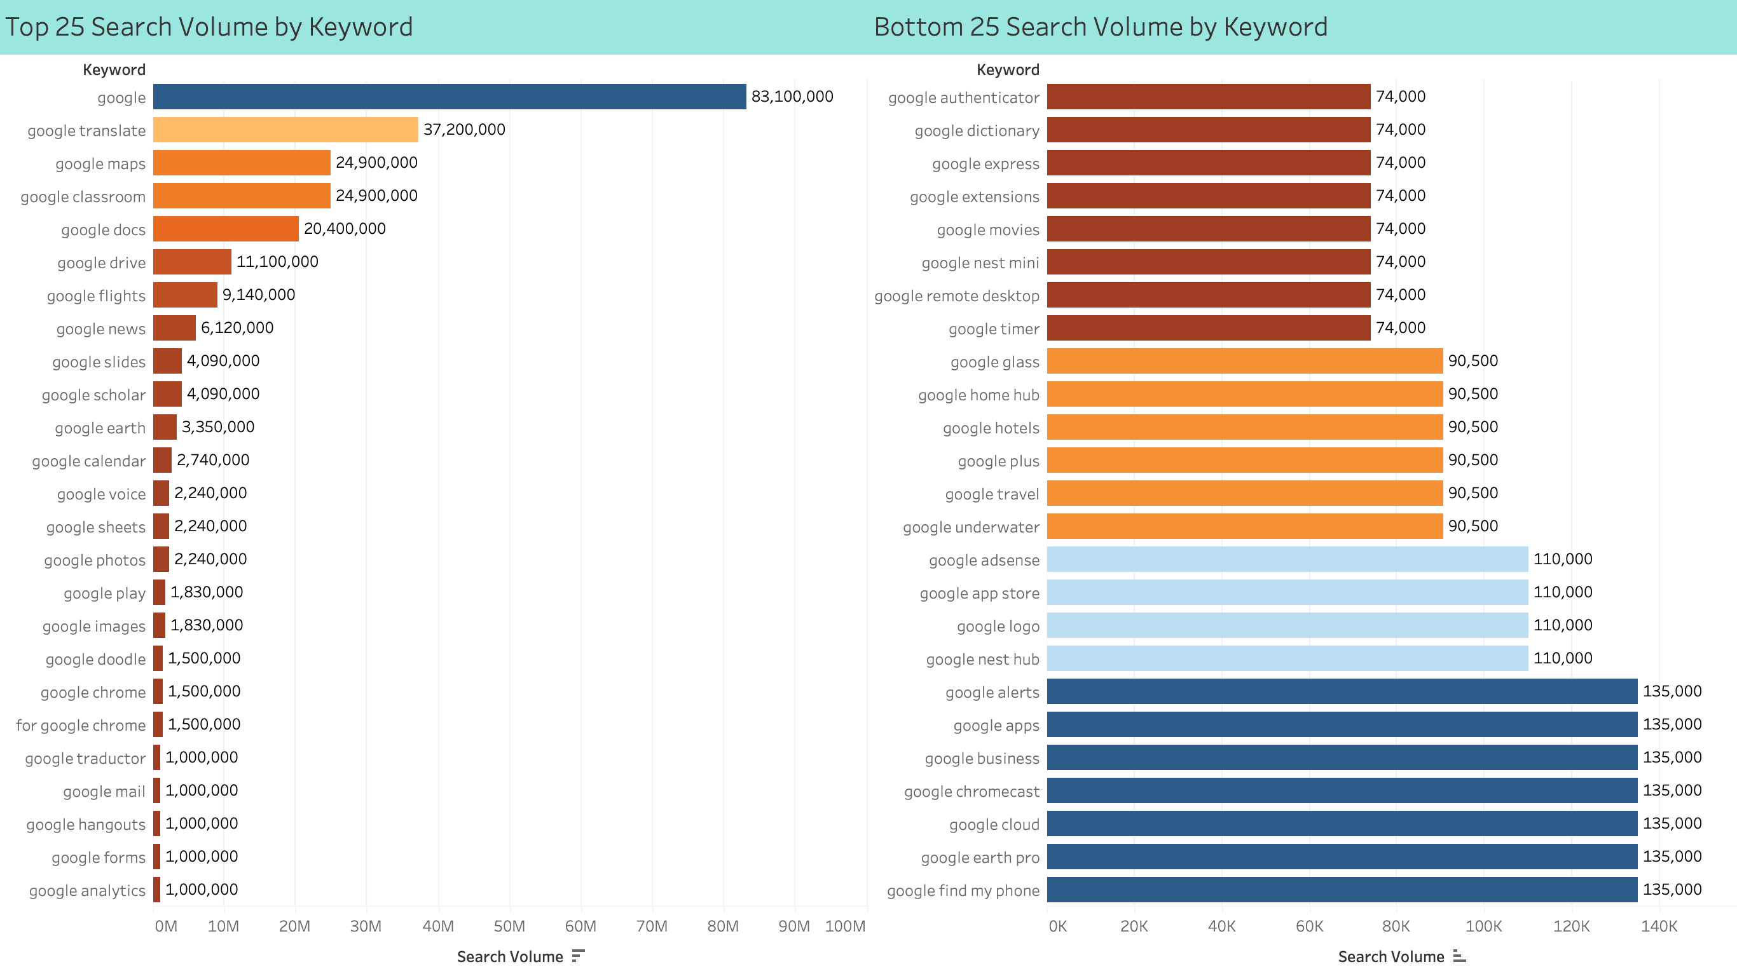
Notes:
Sum of Search Volume by Keyword (Top 25 and Bottom 25)

Slide 4
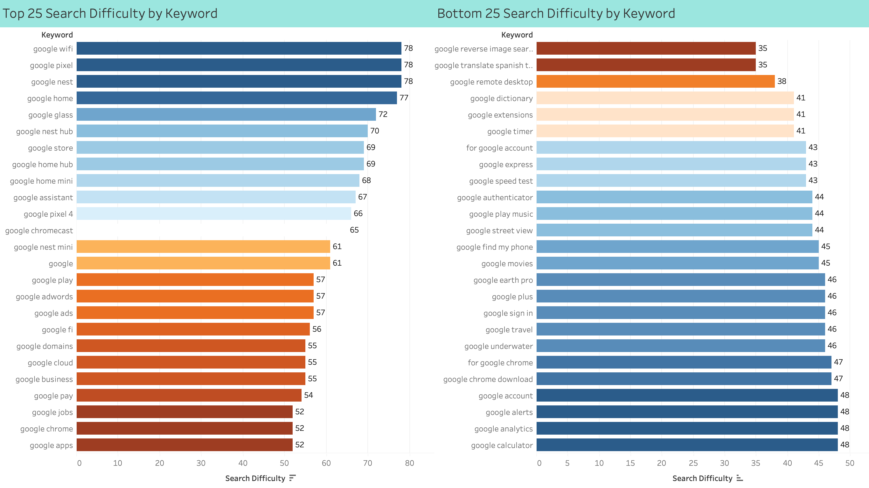
Notes:
Sum of Search Difficulty by Keyword (Top 25 and Bottom 25)

Slide 5
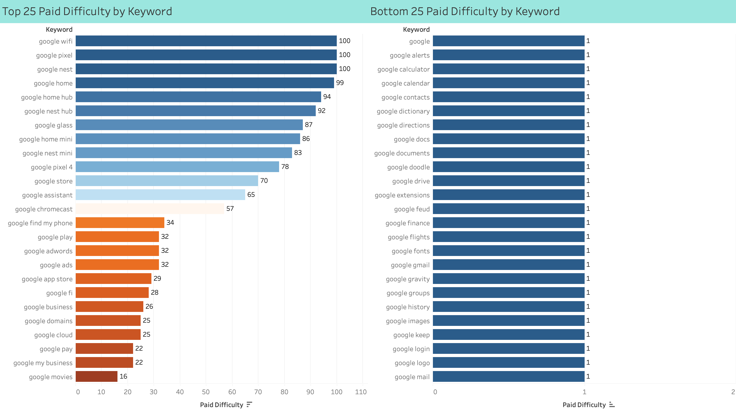
Notes:
Sum of Paid Difficulty by Keyword (Top 25 and Bottom 25)

Slide 6
Thank you
Nihal Jayan

