Slide 1
Gym Membership and Fitness Session Management System
DBMS COURSE PROJECT | PROJECT NO. 67
7
tables in 3NF
15
Design and Implementation of a Database Management System
SELECT queries
6
Sai Nihal Nellore (25WU0101118)
[Member 2 name] ([Roll number])
[Member 3 name] ([Roll number])
Section: [Section name]
Faculty: [Faculty name]
Academic year 2026-27
UI screens
Notes:
SPEAKER 1 (about 15 seconds). Introduce the team and the title. Our project is number 67: a database management system for gym membership and fitness session management. We built a MySQL database of 7 tables and a Flask web interface on top of it.

Slide 2
Paper registers lose track of members, fees and seats
Problem statement
Intended users
A gym has to track who its members are, which plan each one has paid for, which trainer runs which session, and who has booked a seat. Kept in registers and scattered spreadsheets, this data gets duplicated, goes out of date and cannot be queried.
Front desk staff
register members, sell plans, take bookings
Gym manager
1
2
3
revenue, plan and trainer reports
Duplicate data
Missed renewals
Overbooked sessions
Trainers
session timetable and who has booked
The same member is written in the fee register, the class list and the attendance sheet.
Nobody can list the plans that expire this week or the fees still due.
A class of 12 seats gets 15 names because nothing checks capacity.
Members
get correct plan dates and a confirmed seat
Notes:
SPEAKER 1 (about 25 seconds). Problem statement: most small gyms keep member details, fee receipts and class lists in paper registers or separate spreadsheets. So the same member is written in several places, nobody knows whose plan has expired, and a class can be overbooked. Our system keeps all of this in one relational database. Intended users are the front desk, the manager, trainers and, indirectly, the members.

Slide 3
Objectives and scope
Objectives
In scope
01
Store members, plans, trainers, sessions, bookings and payments in one MySQL database
Member registration and plan purchase
Fee payments, including part payments
Trainer and session scheduling
Session booking and attendance
Revenue, workload and attendance reports
02
Design the schema from an ER diagram and normalise it to 3NF
03
Let the DBMS protect the data with primary keys, foreign keys, UNIQUE, CHECK and NOT NULL
04
Answer day-to-day questions with joins, aggregates and subqueries
Out of scope
Online payment gateway
User login and roles
Equipment and inventory tracking
Mobile app for members
05
Give staff a simple web interface to insert, delete and view records
Notes:
SPEAKER 1 (about 20 seconds). Read the objectives briefly: one normalised database, integrity enforced by the DBMS itself through keys and constraints, useful queries, and a working interface for insert, delete and view. Scope: memberships, payments, trainers, sessions and bookings. Online payment and login are outside the scope.

Slide 4
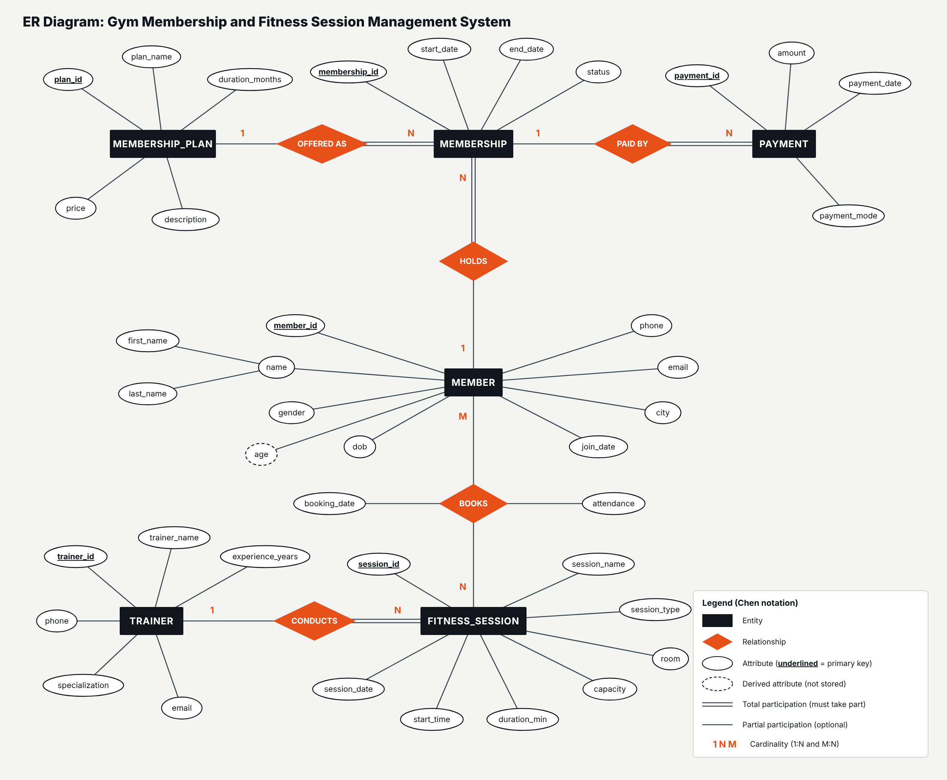
ER diagram: six entities joined by five relationships
Entities
MEMBER, MEMBERSHIP_PLAN, MEMBERSHIP, PAYMENT, TRAINER, FITNESS_SESSION
Many-to-many
MEMBER books FITNESS_SESSION, with its own attributes booking_date and attendance
Composite attribute
name = first_name + last_name
Derived attribute
age is calculated from dob, never stored
Total participation
Every MEMBERSHIP, PAYMENT and FITNESS_SESSION must have its parent (double line)
Notes:
SPEAKER 2 (about 45 seconds). Walk through the diagram. Rectangles are entities, diamonds are relationships, ovals are attributes and the underlined ones are primary keys. A MEMBER holds many MEMBERSHIPs over time; each membership is of exactly one MEMBERSHIP_PLAN and can have several PAYMENTs because we allow part payment. A TRAINER conducts many FITNESS_SESSIONs. MEMBER books FITNESS_SESSION is many-to-many: one member books many sessions and one session has many members. Double lines mean total participation, for example every payment must belong to a membership. Name is a composite attribute and age is derived from date of birth, so it is not stored.

Slide 5
Relationships, cardinality and participation
Relationship | Between | Cardinality | Participation | Meaning
HOLDS | MEMBER - MEMBERSHIP | 1 : N | Member partial, Membership total | A member buys or renews plans many times
OFFERED AS | MEMBERSHIP_PLAN - MEMBERSHIP | 1 : N | Plan partial, Membership total | Each membership is of exactly one plan
PAID BY | MEMBERSHIP - PAYMENT | 1 : N | Membership partial, Payment total | A membership can be paid in instalments
CONDUCTS | TRAINER - FITNESS_SESSION | 1 : N | Trainer partial, Session total | Every session has exactly one trainer
BOOKS | MEMBER - FITNESS_SESSION | M : N | Both partial | Members book many sessions; sessions have many members
Mapping rule used: each 1:N relationship becomes a foreign key on the N side; the M:N relationship BOOKS becomes its own table BOOKING with two foreign keys.
Notes:
SPEAKER 2 (about 20 seconds). This table states each relationship. Four are one-to-many and one is many-to-many. Participation is total on the 'many' side wherever the child cannot exist without the parent: a payment without a membership or a session without a trainer makes no sense. It is partial on the other side: a new member may not have bought a plan yet, and a trainer may have no session this week.

Slide 6
Relational schema: seven tables
MEMBERSHIP_PLAN (plan_id, plan_name, duration_months, price, description)
MEMBER (member_id, first_name, last_name, gender, dob, phone, email, city, join_date)
TRAINER (trainer_id, trainer_name, specialization, phone, email, experience_years)
MEMBERSHIP (membership_id, member_id, plan_id, start_date, end_date, status)
PAYMENT (payment_id, membership_id, amount, payment_date, payment_mode)
FITNESS_SESSION (session_id, session_name, session_type, trainer_id, session_date, start_time, duration_min, capacity, room)
BOOKING (booking_id, member_id, session_id, booking_date, attendance)
underlined = primary key orange = foreign key 6 foreign keys, 7 UNIQUE constraints, 12 CHECK constraints in total
Notes:
SPEAKER 2 (about 25 seconds). Mapping the ER diagram gives seven relations. Primary keys are underlined and foreign keys are shown in orange. Six entities give six tables, and the many-to-many BOOKS relationship gives the seventh table, BOOKING, which carries member_id and session_id as foreign keys with a UNIQUE constraint on the pair so a member cannot book the same session twice.

Slide 7
Normalisation: from one wide register to 3NF
UNF
1NF
2NF
3NF
One register
Atomic values
No partial dependency
No transitive dependency
GYM_REGISTER(member, phone, plan, price, sessions booked..., trainer, trainer phone, fees paid...)
One row per booking and per payment. name split into first_name and last_name.
Key was (member_id, session_id). member details depend on member_id only; session details on session_id only.
plan_id -> price, duration. trainer_id -> trainer name, phone. membership_id -> plan, dates.
Repeating groups; data repeated in every row
No multi-valued or repeating columns
Split into MEMBER, FITNESS_SESSION, BOOKING
Split out MEMBERSHIP_PLAN, TRAINER, MEMBERSHIP, PAYMENT
Result: in all seven tables, every non-key attribute depends on the key, the whole key and nothing but the key. Age is not stored because it can be derived from dob.
Notes:
SPEAKER 2 (about 30 seconds). We started from the single register a gym would keep, with member, plan, trainer and session details in one row. First normal form: we removed repeating groups, so one row per booking and name split into first and last name. Second normal form: with the key member plus session, the member's details depend only on the member and the session details only on the session, so we removed those partial dependencies into separate tables. Third normal form: plan price depends on plan, and trainer details depend on trainer, not on the key, so those transitive dependencies moved to MEMBERSHIP_PLAN and TRAINER. In the final schema every non-key attribute depends only on the primary key of its own table.

Slide 8
Tables are created with keys and constraints built in
CREATE DATABASE gym_management;
USE gym_management;
CREATE TABLE booking (
booking_id INT AUTO_INCREMENT,
member_id INT NOT NULL,
session_id INT NOT NULL,
booking_date DATE NOT NULL,
attendance VARCHAR(10) NOT NULL DEFAULT 'Booked',
CONSTRAINT pk_booking PRIMARY KEY (booking_id),
CONSTRAINT fk_booking_member FOREIGN KEY (member_id)
REFERENCES member (member_id)
ON DELETE CASCADE ON UPDATE CASCADE,
CONSTRAINT fk_booking_session FOREIGN KEY (session_id)
REFERENCES fitness_session (session_id)
ON DELETE CASCADE ON UPDATE CASCADE,
CONSTRAINT uq_booking UNIQUE (member_id, session_id),
CONSTRAINT chk_booking_att CHECK (attendance IN
('Booked','Attended','Missed','Cancelled'))
);
7
PRIMARY KEY
one per table, AUTO_INCREMENT
6
FOREIGN KEY
CASCADE for child rows, RESTRICT for plans and trainers
7
UNIQUE
phone, email, plan name, room slot, member + session
12
CHECK
price > 0, end_date > start_date, allowed status values
Notes:
SPEAKER 3 (about 30 seconds, LIVE in MySQL). Run CREATE DATABASE and the CREATE TABLE statements from gym_management.sql. Point at the BOOKING table on the slide: primary key, two foreign keys with ON DELETE CASCADE, a UNIQUE constraint on member plus session, a CHECK on attendance and a DEFAULT. Then run SHOW TABLES and DESCRIBE booking. This slide is the backup if the live run has a problem.

Slide 9
Every table holds more than the required five records
INSERT INTO member (first_name, last_name, gender, dob,
phone, email, city, join_date) VALUES
('Arjun', 'Reddy', 'M', '2001-03-14', '9876543210',
'arjun.reddy@example.com', 'Hyderabad', '2026-06-01'),
('Sneha', 'Iyer', 'F', '1999-11-02', '9876543211',
'sneha.iyer@example.com', 'Secunderabad', '2026-07-10'),
... 6 more rows;
INSERT INTO booking (member_id, session_id, booking_date,
attendance) VALUES
(1, 1, '2026-10-03', 'Attended'), ... 14 more rows;
Table | Rows
membership_plan | 6
member | 8
trainer | 6
membership | 8
payment | 9
fitness_session | 7
booking | 15
Test data chosen on purpose
A member with no plan and a plan nobody bought (shows LEFT JOIN)
A session with zero bookings and a part-paid membership
Past sessions with Attended / Missed, future ones with Booked
59 records in total
Notes:
SPEAKER 3 (about 20 seconds, LIVE). Run the INSERT statements and then the row-count query. Every table has at least five records: 6 plans, 8 members, 6 trainers, 8 memberships, 9 payments, 7 sessions and 15 bookings. The data was chosen so the queries are interesting: one member has no plan, one plan has never been sold, one session has no bookings and one membership is only part paid.

Slide 10
A four-table join shows who booked which session
SELECT b.booking_id,
CONCAT(m.first_name,' ',m.last_name) AS member_name,
s.session_name, t.trainer_name, b.attendance
FROM booking b
JOIN member m ON m.member_id = b.member_id
JOIN fitness_session s ON s.session_id = b.session_id
JOIN trainer t ON t.trainer_id = s.trainer_id
ORDER BY s.session_date, member_name;
-- LEFT JOIN + COUNT: seats left per session
SELECT s.session_name, s.capacity,
COUNT(b.booking_id) AS seats_booked,
s.capacity - COUNT(b.booking_id) AS seats_left
FROM fitness_session s
LEFT JOIN booking b ON b.session_id = s.session_id
GROUP BY s.session_id, s.session_name, s.capacity
ORDER BY seats_booked DESC;
+--------------+-------------------+----------------+------------+
| member_name | session_name | trainer_name | attendance |
+--------------+-------------------+----------------+------------+
| Ananya Gupta | Morning Yoga Flow | Divya Menon | Attended |
| Arjun Reddy | Morning Yoga Flow | Divya Menon | Attended |
| Arjun Reddy | Strength Basics | Rohit Malhotra | Attended |
| Priya Sharma | Morning Yoga Flow | Divya Menon | Missed |
... 15 rows in set
+-------------------+--------------+------------+
| session_name | seats_booked | seats_left |
+-------------------+--------------+------------+
| Morning Yoga Flow | 4 | 16 |
| Strength Basics | 3 | 9 |
| Advanced Lifting | 2 | 8 |
| ... | | |
| Power Yoga | 0 | 20 |
Notes:
SPEAKER 3 (about 30 seconds, LIVE). Run Q5. It joins BOOKING with MEMBER, FITNESS_SESSION and TRAINER, so instead of three id numbers we see the member's name, the session and the trainer. Then run Q6, a LEFT JOIN with COUNT: Power Yoga appears with zero seats booked, which an inner join would have dropped.

Slide 11
Aggregate queries turn the records into answers
SELECT p.plan_name,
COUNT(DISTINCT ms.membership_id) AS times_sold,
COALESCE(SUM(pay.amount), 0) AS revenue
FROM membership_plan p
LEFT JOIN membership ms ON ms.plan_id = p.plan_id
LEFT JOIN payment pay ON pay.membership_id = ms.membership_id
GROUP BY p.plan_id, p.plan_name
ORDER BY revenue DESC;
9
50,000
payments
rupees collected
COUNT(*)
SUM(amount)
5,555.56
1,000 / 13,000
average payment
smallest / largest
AVG(amount)
MIN, MAX
+--------------------+------------+----------+
| plan_name | times_sold | revenue |
+--------------------+------------+----------+
| Annual Premium | 2 | 26000.00 |
| Half-Yearly Plus | 2 | 13500.00 |
| Quarterly Standard | 2 | 8000.00 |
| Monthly Basic | 1 | 1500.00 |
| Student Monthly | 1 | 1000.00 |
| Annual Elite | 0 | 0.00 |
+--------------------+------------+----------+
-- GROUP BY + HAVING
SELECT CONCAT(m.first_name,' ',m.last_name)
AS member_name,
COUNT(*) AS sessions_booked
FROM booking b
JOIN member m ON m.member_id = b.member_id
GROUP BY m.member_id, member_name
HAVING COUNT(*) > 2; -- returns 3 members
Notes:
SPEAKER 3 (about 30 seconds, LIVE). Run Q7: revenue per plan using LEFT JOIN, COUNT, SUM and GROUP BY. Annual Elite shows zero because nobody has bought it. Run Q8 for COUNT, SUM, AVG, MIN and MAX on payments: 9 payments, 50,000 rupees collected. Run Q10 for GROUP BY with HAVING: members with more than two bookings. The file has 15 queries in all, including subqueries and a view.

Slide 12
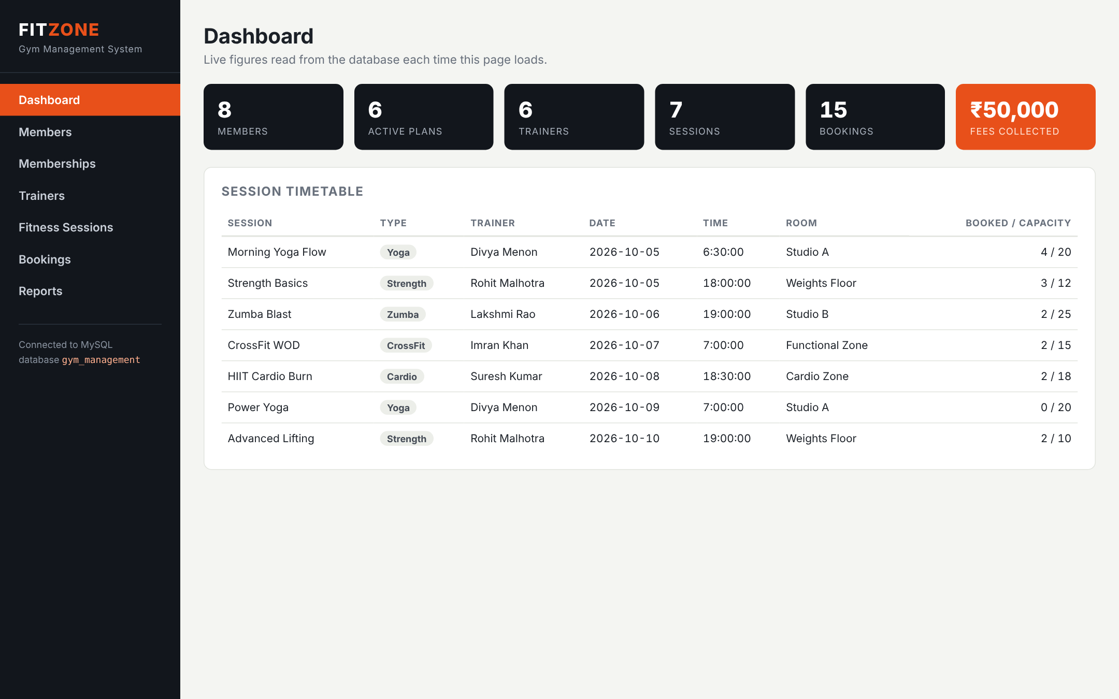
The interface is a Flask web app connected to MySQL
Browser
Flask (app.py)
PyMySQL
MySQL
HTML forms and tables
routes build SQL
driver, parameterised queries
gym_management
def get_connection():
return pymysql.connect(host=config.DB_HOST,
user=config.DB_USER, password=config.DB_PASSWORD,
database=config.DB_NAME,
cursorclass=pymysql.cursors.DictCursor)
@app.route("/members/delete/<int:member_id>",
methods=["POST"])
def delete_member(member_id):
save("DELETE FROM member WHERE member_id = %s",
(member_id,), "Member deleted.")
return redirect(url_for("members"))
Dashboard: live counts read from the database
Notes:
SPEAKER 1 (about 25 seconds). The UI is written in Python with Flask. The browser sends a form, Flask builds a parameterised SQL statement, the PyMySQL driver sends it to MySQL, and the page is redrawn from a fresh SELECT. So what you see on screen is always what is in the database. There are six screens: Members, Memberships, Trainers, Fitness Sessions and Bookings each support insert, delete and view, and Reports shows the join and aggregate queries.

Slide 13
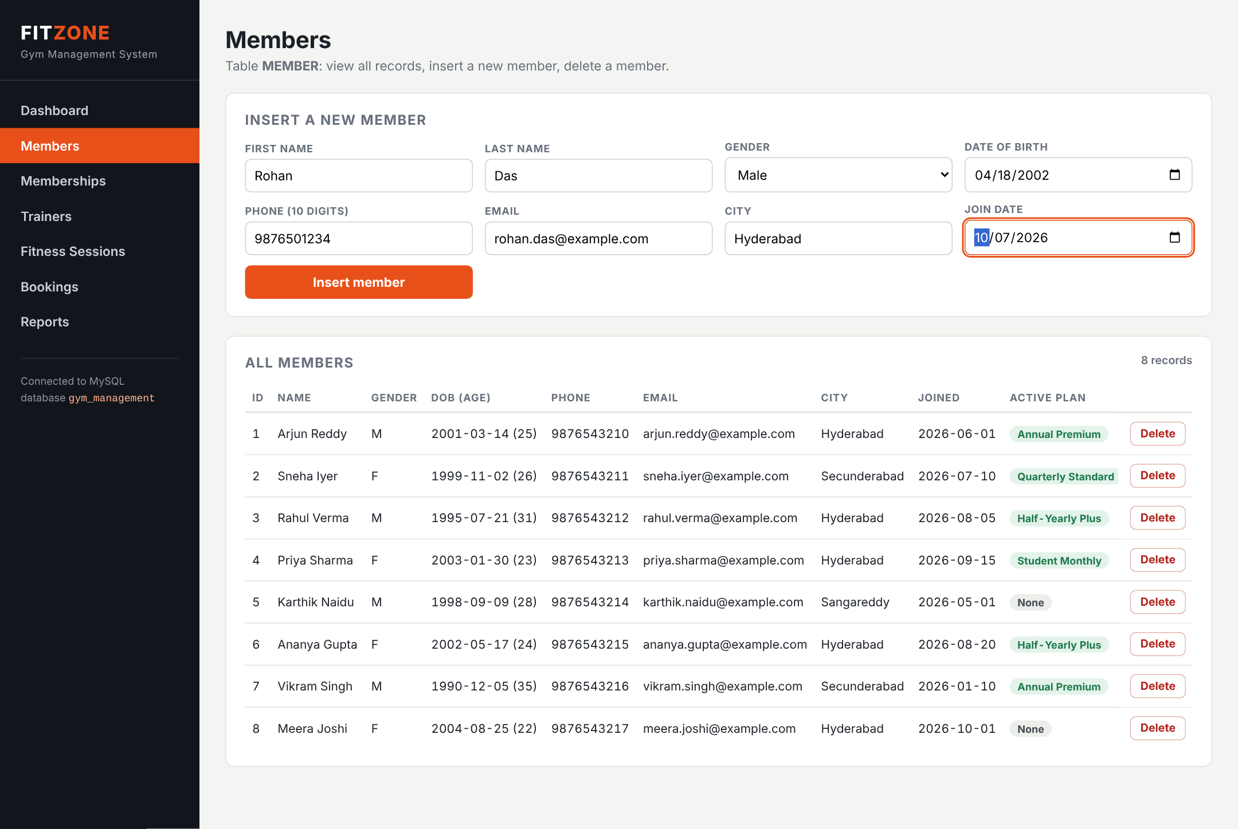
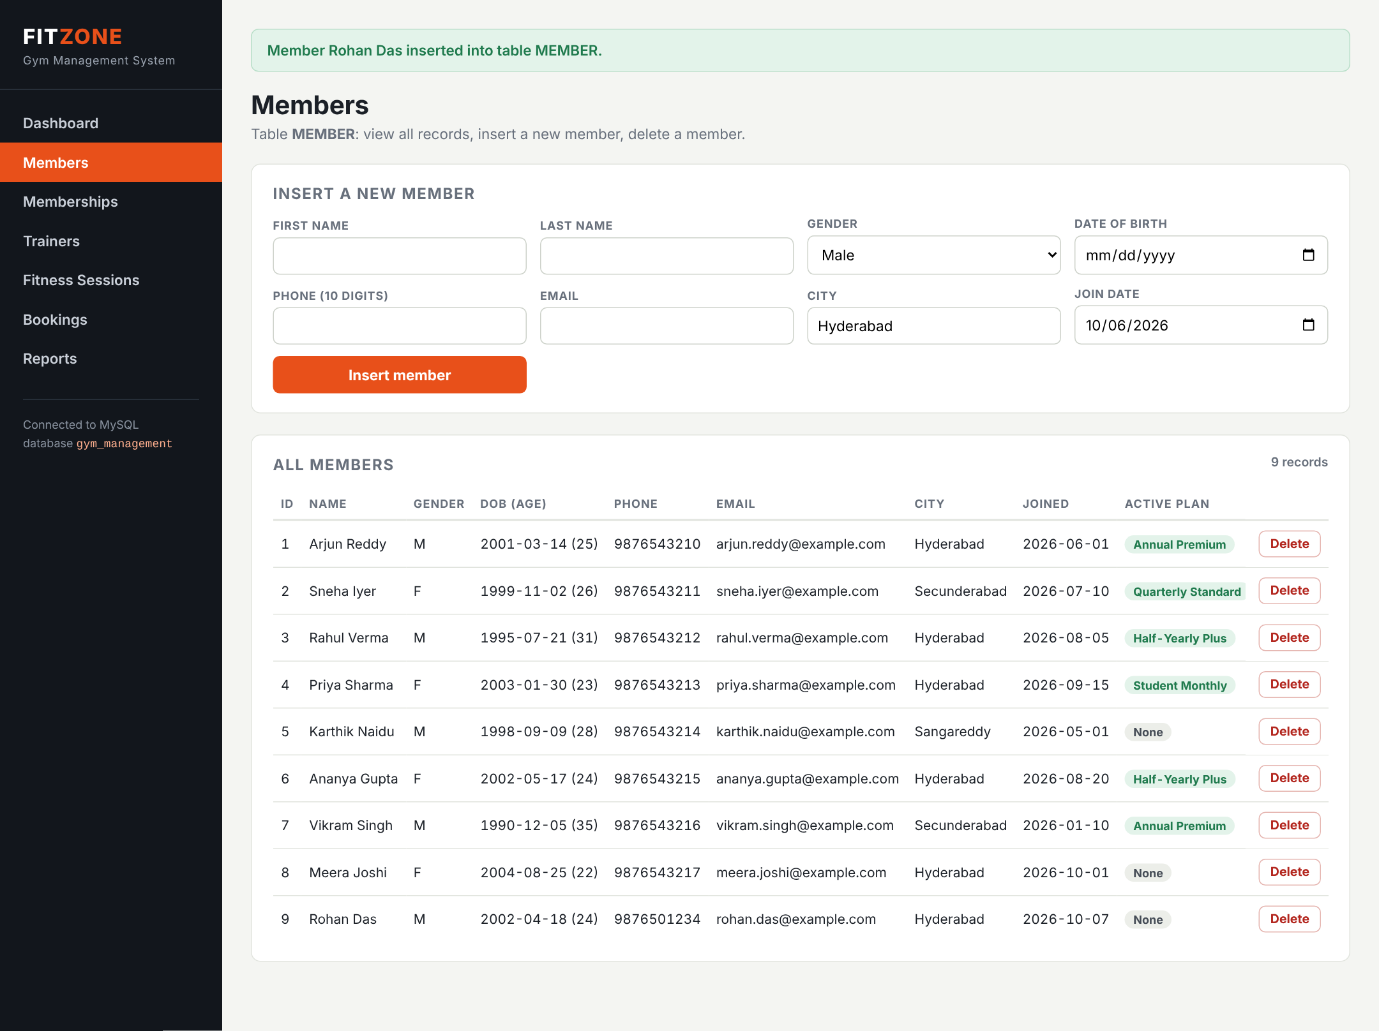
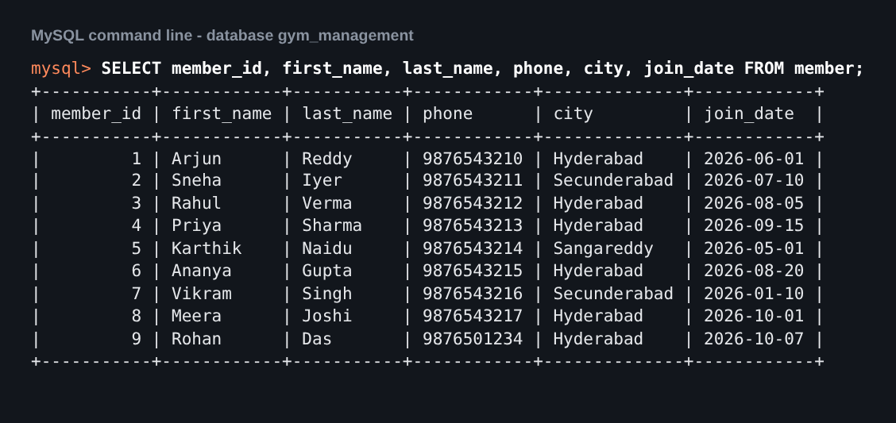
Insert: a new member appears in the page and in MySQL
3. Same row seen from the MySQL prompt
1. Before: 8 members, form filled
2. After: 9 members, Rohan Das added
SQL sent by the UI: INSERT INTO member (first_name, last_name, gender, dob, phone, email, city, join_date) VALUES (%s, %s, %s, %s, %s, %s, %s, %s)
Notes:
SPEAKER 1 (about 60 seconds, LIVE DEMO). Open Members. Show the 8 existing records (VIEW). Fill the form: Rohan Das, date of birth, phone 9876501234, email, and press Insert member. The green message appears and the list now shows 9 records. Switch to the MySQL window and run SELECT * FROM member; to prove row 9 is in the database. Then try to insert another member with Arjun's phone number: the UNIQUE constraint rejects it and the UI shows the error.

Slide 14
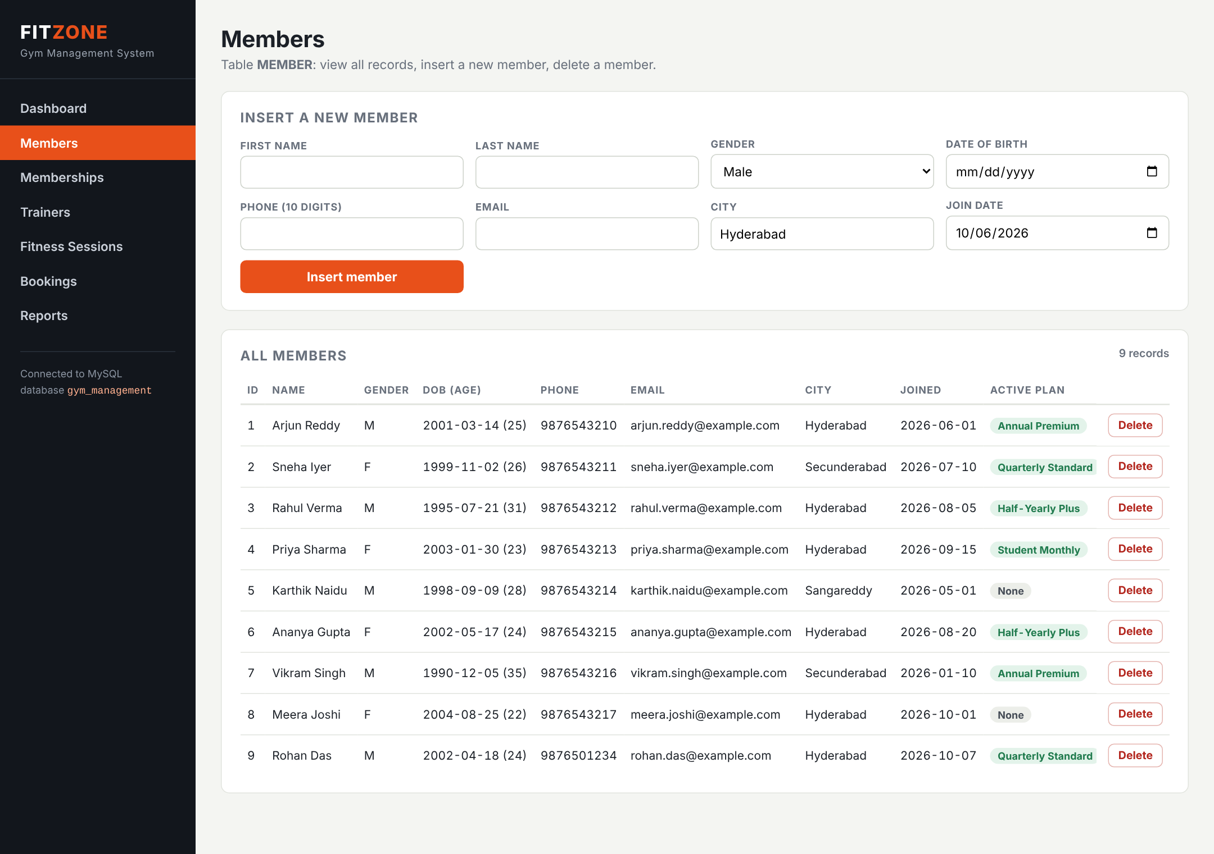
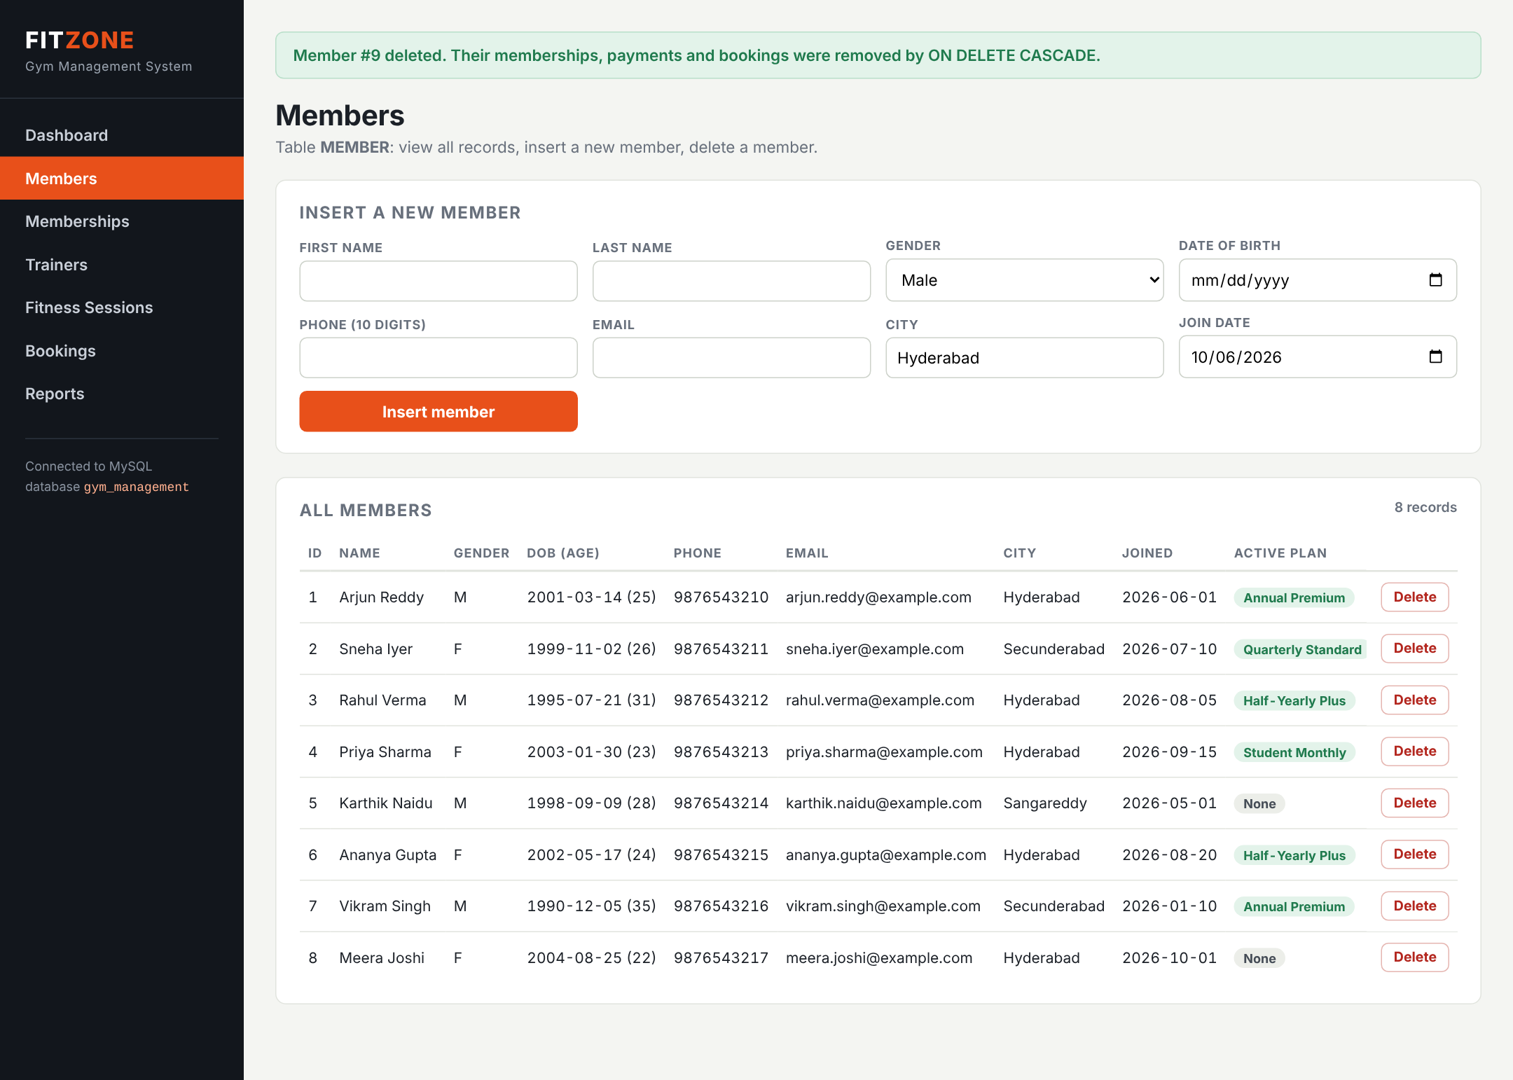
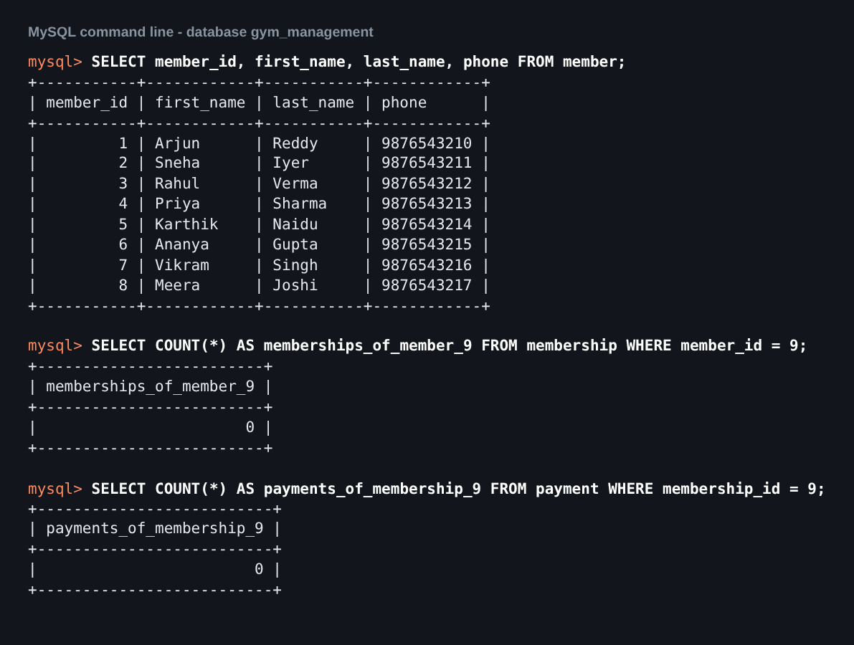
Delete: a member's dependent rows are removed too
1. Before: Rohan Das is member 9
2. After: back to 8 members
3. MySQL: member, membership, payment all gone
SQL sent by the UI: DELETE FROM member WHERE member_id = %s ON DELETE CASCADE then removes that member's rows in MEMBERSHIP, PAYMENT and BOOKING.
Notes:
SPEAKER 1 (about 60 seconds, LIVE DEMO). First sell Rohan a plan on the Memberships screen and book him into a session on the Bookings screen, so he has dependent rows. Go back to Members and press Delete on Rohan Das. The list returns to 8 records. In MySQL run SELECT on member, membership and payment: his membership and payment rows are gone too, because the foreign keys use ON DELETE CASCADE. Nothing is left pointing to a member who does not exist.

Slide 15
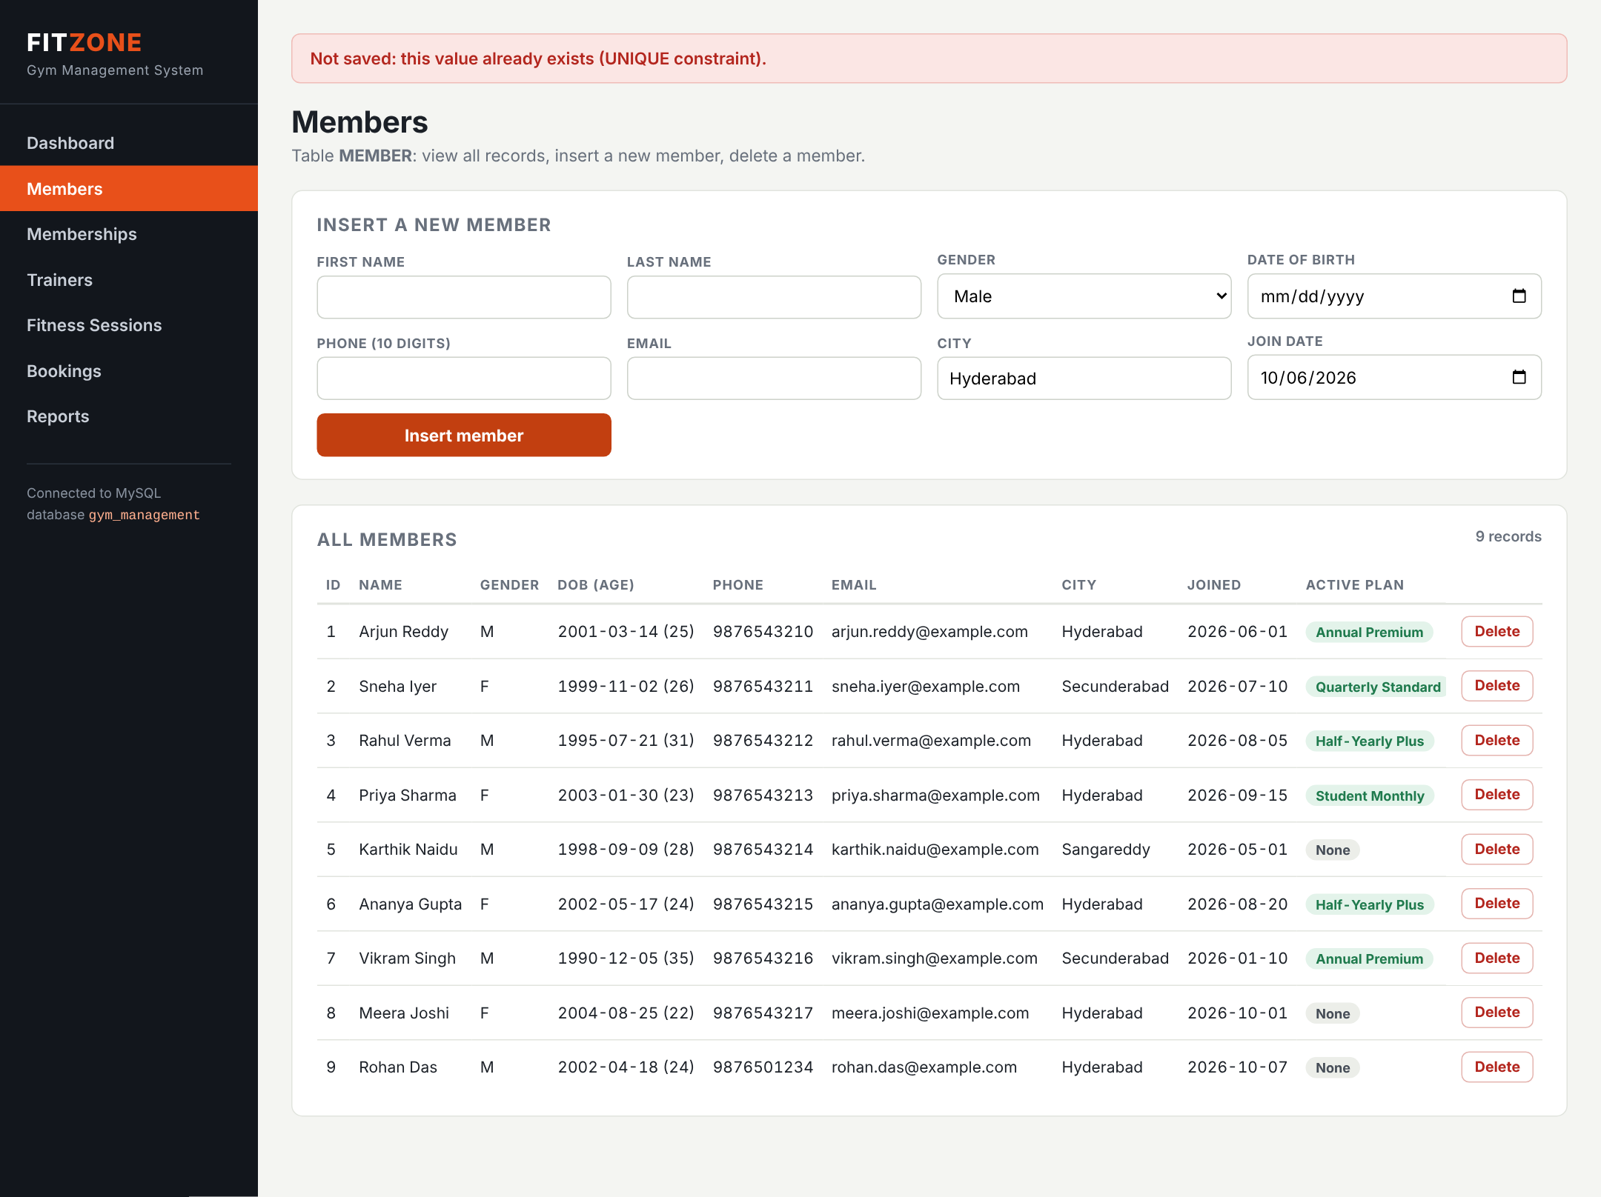
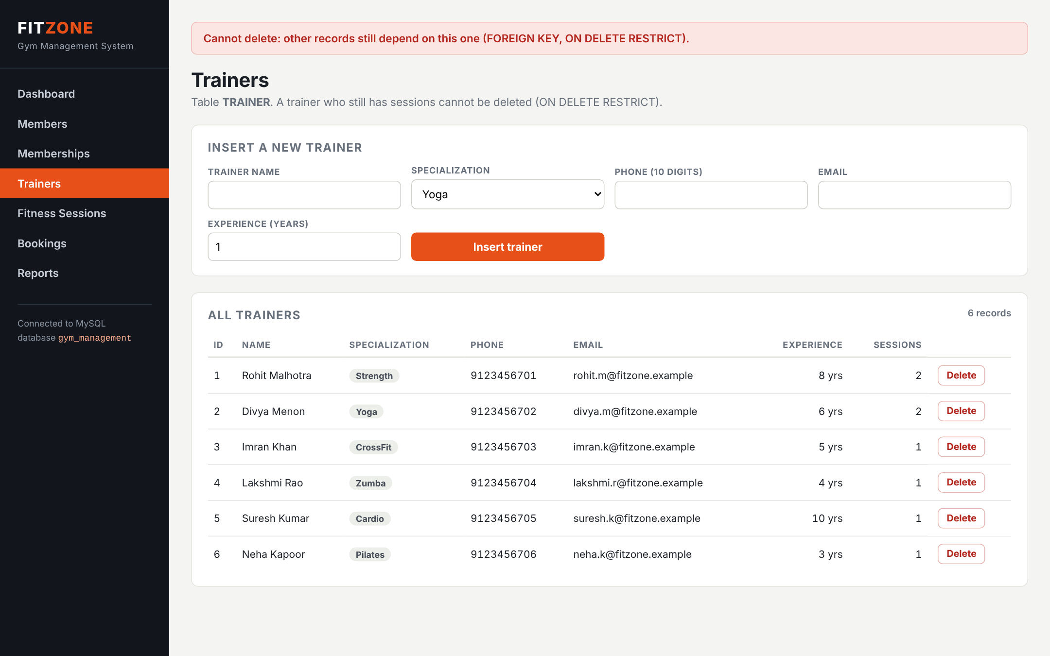
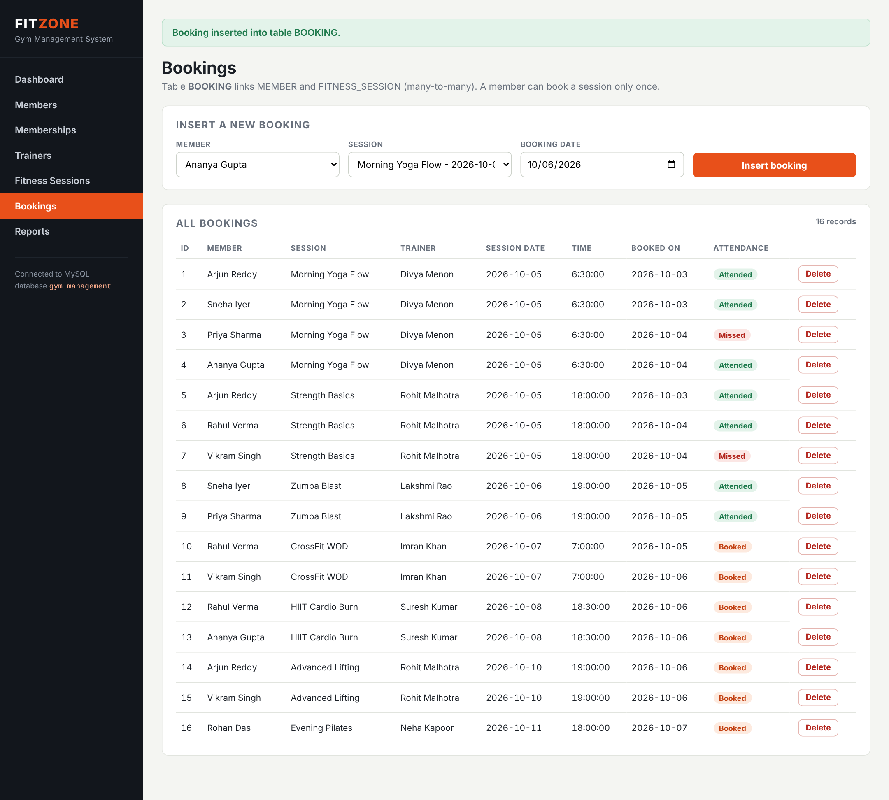
The database refuses bad data, and the UI reports why
FOREIGN KEY: trainer with sessions cannot be deleted
UNIQUE: duplicate phone number rejected
Bookings screen: insert, view and delete
Test | Constraint | Result
Insert member with an existing phone | UNIQUE | Rejected, error 1062
Delete a trainer who has sessions | FOREIGN KEY, RESTRICT | Rejected, error 1451
Notes:
SPEAKER 1 (about 30 seconds, LIVE DEMO if time allows). Two quick checks. On Trainers, press Delete on Rohit Malhotra: MySQL refuses because he still has sessions and the foreign key is ON DELETE RESTRICT. On Bookings, insert a booking for a new session and then delete it. The point is that the rules live in the database, so they hold even if someone bypasses the UI and uses the MySQL prompt.

Slide 16
One database now answers what three registers could not
Questions?
What we built
Future enhancements
ER design mapped to 7 tables in 3NF
Keys and 25 UNIQUE / CHECK / FK constraints
15 queries: joins, aggregates, subqueries, a view
Flask UI for insert, delete and view
Login with staff, trainer and member roles
MySQL event to mark expired memberships
Trigger to stop bookings beyond capacity
Online fee payment and renewal reminders
Notes:
ANY SPEAKER (about 20 seconds), then questions. Summarise: we designed the ER diagram, mapped it to seven tables in third normal form, enforced the rules with constraints, wrote fifteen queries and built a working interface. Future work: login with roles, automatic expiry of memberships using a MySQL event, a trigger to block bookings when a session is full, and online payment. Thank you, we are happy to take questions. Likely questions: why is BOOKING a separate table; difference between CASCADE and RESTRICT; why age is not stored; why the schema is in 3NF; what happens if two people book the last seat.

