Slide 1
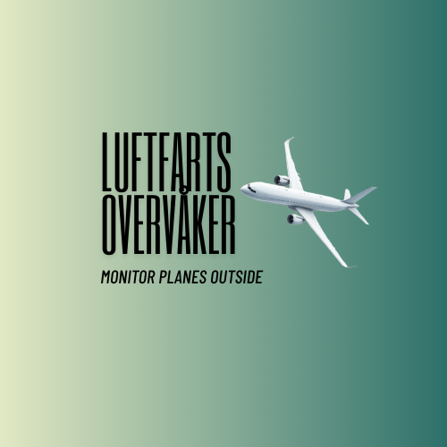
AI-Powered Aviation Safety Analysis System
Detecting Damage • Ensuring Safety • Saving Lives

Slide 2




System Overview
Advanced AI system that analyzes aircraft videos during landing, takeoff, and taxi operations to detect safety issues, structural damage, and operational anomalies in real-time.
Damage Detection
Identifies structural damage to wings, fuselage, engines, and landing gear
Hazard Recognition
Detects birds, vehicles, FOD, and proximity issues
Anomaly Analysis
Monitors speed, angle, configuration, and operational parameters

Slide 3
Detection Capabilities
Structural Damage
Operational Anomalies
Wing damage & deformation
Fuselage cracks or holes
Engine cowling damage
Landing gear issues
Missing panels
Fluid leaks
Hard landings
Wrong angles
Speed issues
Late touchdown
Configuration errors
Brake/spoiler problems
External Hazards
Critical Indicators
Bird strikes
Airport vehicles
Foreign object debris (FOD)
Aircraft proximity
Ground equipment
Fire or smoke
Engine failure
RAT deployment
Emergency systems
Fuel dumping

Slide 4
Automated Safety Grading
✅ OK
No issues detected - aircraft safe for operation
⚠️ CAUTION
Minor issues requiring inspection before next flight
🔧 REPAIR NEEDED
Damage requiring repair before next operation
🛑 IMMEDIATE GROUNDING
Critical safety issue - aircraft must be grounded

Slide 5




Application Workflow
1
Upload Video
2
Frame Extraction
3
AI Analysis
User uploads aircraft video (landing/takeoff/taxi)
System extracts key frames for analysis (10-30 frames)
GPT-4 Vision analyzes frames for issues & anomalies
4
Identification
5
Safety Assessment
6
Generate Report
Identifies aircraft type, airline, registration
Comprehensive safety analysis & grading
Professional PDF report with findings & recommendations

Slide 6
Technical Architecture
Frontend
Streamlit
AI Engine
OpenAI GPT-4o Vision
Framework
LangChain
Video Processing
OpenCV
Reporting
ReportLab PDF

Slide 7




Key Features & Benefits
Real-time Analysis
AI-Powered
Safety Focused
Process videos in minutes with progress tracking
State-of-the-art GPT-4 Vision technology
Aviation-specific damage detection
Professional Reports
Automated Grading
Configurable
Comprehensive PDF documentation
Consistent safety assessments
Adjustable analysis depth & detail

Slide 8
Use Cases & Applications
1
Post-Flight Safety Checks
Routine inspection after every landing to detect any damage or anomalies
2
Incident Investigation
Detailed analysis of hard landings, bird strikes, or unusual events
3
Training & Education
Teaching aviation students to recognize safety issues and proper procedures
4
Fleet Monitoring
Continuous monitoring across multiple aircraft for safety trends
5
Maintenance Planning
Early detection of issues to schedule preventive maintenance
6
Regulatory Compliance
Documentation for aviation authorities and safety audits

Slide 9
Deployment & Access
Available Platforms
Streamlit Cloud
Free hosting with auto-deployment from GitHub
Quick Start
1. Enter OpenAI API key
2. Upload aircraft video (MP4, MOV, AVI)
3. Click 'Analyze Aircraft Safety'
4. Download comprehensive PDF report

Slide 10
Ensuring Aviation Safety
Through AI-Powered Analysis
4
20+
< 2min
Safety Grades
Detection Types
Analysis Time
AI-Assisted • Not a Replacement for Qualified Inspectors

