Slide 1
Syntax Analyzer For C Language
Presented by:
E019 – Ishaan Kangriwala
E020 – Paarth Kapasi
E035 – Dhruv Patel
E050 – Nihal Shetty
Mentor:
Prof. Ameyaa Biwalkar

Slide 2
Outline
Introduction
Problem definition
Literature review in brief
System Design
Lexical Analyzer
Syntax Analyzer
Conflicts and their resolution
Methods Implemented
Results
Conclusion & Future work
References

Slide 3
Introduction
A compiler is a tool that converts a high-level language into a low-level machine understandable language.
Analysis Phase – An intermediate representation is created from the give source code: Lexical Analyzer, Syntax Analyzer, Semantic Analyzer and Intermediate Code Generator.
Lexical analyser divides the program into “tokens”, Syntax analyser recognizes “sentences” in the program using syntax of language and Semantic analyser checks static semantics of each construct. Intermediate Code Generator generates “abstract” code.
In this project we aim to implement a syntax analyser for the C language, and we do so by using the Flex and Bison tools and the GCC compiler.

Slide 4
Problem Definition
This project aims to develop a syntax analyser for a subset of the C language using Flex and Bison

Slide 5
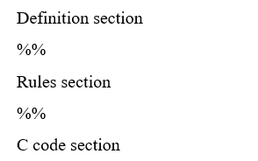
Literature Review
Structure of Lex File
Structure of YACC File
The definition section defines macros and imports header files written in C.
The rules section associates regular expression patterns with C statements.
The C code section contains C statements and functions.
The definition section and routines section is structurally similar to the Lex File.
The rules section has rules which are of the form of a context free grammar.
(E.g., Nonterminal: sentential form | sentential form ;)
Notes:
2nd paper drawback: The UI is more focused on the changes in the array elements rather than the visualization of the algorithm.

Slide 6
Literature Review
Mini C Compiler by Kaushik Kalmady and Karthik M:
This is a project in which the developers have implemented a C compiler using Flex and Bison on a Linux OS.
This project is for a subset of the C language as the language is very vast and implementing all the functionalities would not be feasible.
The parser implemented checks for the declaration of variables, type mismatch, scope, return types, etc.
Mini C Compiler by Mishal Shah, Samyak Jain and Pavan Vachhani:
The project was implemented in a phased manner, and they too have used bison and flex as the software for implementation.
The lexical analyser implemented by them took care of almost all C constructs.
After a detailed review of these projects and after careful consideration of the time constraints we identified the problem statement and scope of our project
Notes:
2nd paper drawback: The UI is more focused on the changes in the array elements rather than the visualization of the algorithm.

Slide 7
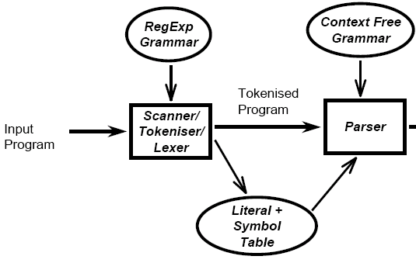
System Design

Slide 8
Lexical Analyzer
In this phase, we defined the keywords, identifiers, function names, operators, return statements, etc. using regular expressions. Once the lexical analyser comes across a pre-defined match, it returns the keyword associated with it to the parser.
While writing the code for the Lexical Analyzer, we must specify rules for each Token type using Regular Expression.
Definition Section: In the definition section of the program, all necessary header files were included. The structure declaration for the symbol table and corresponding hash function are also included.
Rules section: In this section, rules related to the specification of C language were written in the form of valid regular expressions.
C code section: In this section the symbol table was initialized to 0 and yylex() function was called to run the program on the given input file.
Multiple functions like void display (), void insertToHash (), int hashIndex, multicomment() and singlecomment() were defined.

Slide 9
Syntax Analyzer
The YACC program in our project specifies the productions for the following: Looping constructs, data types, arithmetic and relational operators, data structure, identifiers and constant errors, selection statements, etc. The productions for most of them are straight-forward.
A few important ones are:
Selection_statement : IF '(' expression ')' statement %prec NO_ELSE | IF '(' expression ')' statement ELSE statement ;
Iteration_statement : WHILE '(' expression ')' statement | DO statement WHILE '(' expression ')' ‘;’ | FOR '(' expression_statement expression_statement ')' statement | FOR '(' expression_statement expression_statement expression ')' statement ;
After parsing, if there are errors then the line numbers of those errors are displayed along with a ‘parsing failed’ message on the terminal. Otherwise, a ‘parsing complete’ message is displayed on the console.

Slide 10
Conflicts and their Resolution:
Handling Shift-Reduce and Reduce-Reduce Conflicts:
The yacc command is built with two internal rules for resolving these two ambiguities, sometimes called the disambiguating rules.
1. yacc resolves the Shift/Reduce Conflict in favor of shift operation
2. yacc resolves the Reduce/Reduce Conflict in favor of the first grammar rule.
It is important to write unambiguous grammar with no conflicts.
Solving Dangling Else Problem:
In this case, the problem of dangling is represented by #: IF '(' expression ')' statement # ELSE statement
We should specify the parser generator that "when there is a shift/reduce conflict between the token ELSE and the rule “selection_statement -> IF (expression) statement", then the token must win". To do so, a name is given to the precedence of your rule and specify that NO_ELSE has less precedence than ELSE.

Slide 11
Methods Implemented
void insertToConstTable (char *num, int l, char *type)
int hashIndex(char *token)
void insertToHash(char *token, char *attr, int l)
void display ()
multicomment ()
singlecomment ()

Slide 12
Conclusion & Future work
To conclude, we have worked on a system which has helped us understand the working of a compiler and how errors are detected in detail.
This project has acted as a mode of practical implementation of the concepts learnt in the Compiler Design course.
We have observed and noted the following topics to work on in the future:
Semantic Analysis
ICG
Custom Syntax Error Messages
Wider range of rules
Custom Language

Slide 13
References
https://github.com/westes/flex
https://www.gnu.org/software/bison/
https://github.com/mishal23/mini-c-compiler
https://github.com/kaushiksk/mini-c-compiler
https://silcnitc.github.io/yacc.html
https://www.javatpoint.com/lex
https://www.researchgate.net/publication/330667340_Compiler_report
https://www.geeksforgeeks.org/phases-of-a-compiler/
https://www.oreilly.com/library/view/flex-bison/9780596805418/ch01.html

