Slide 1

Maximizing Guest Retention through Cross-Property Analytics
Advance Data Analytics - Final Project
Group 3:
Gerald Abbey
Ansu Joy
Nihal Vellaramkallingal Sulaiman
Souren Chowdhury

Slide 2
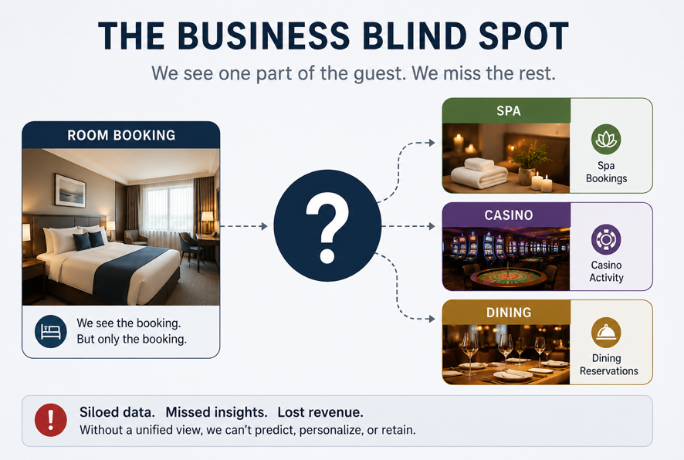
The Business Blind Spot
The Problem
Revenue loss from late-stage booking cancellations
The Blind Spot
Guest data is analyzed in silos
Room bookings are separated from spa, casino, and dining data
No unified view of guest behavior
Key Question
Do engaged guests (cross-property spenders) cancel less often?

Slide 3
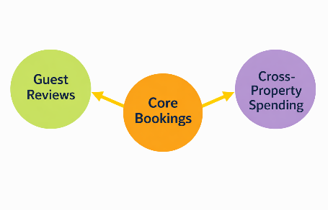
Unifying the Data in the Cloud Cloud-based analytics pipeline (Databricks)
Data Sources
119,000+ hotel booking records
Guest reviews (TripAdvisor dataset)
Cross-property spending data (synthetic POS logs)
Cloud Integration
Unified processing on Databricks / GCP
Scalable data pipeline for large datasets
Outcome
Unified 360° guest profile in the cloud

Slide 4
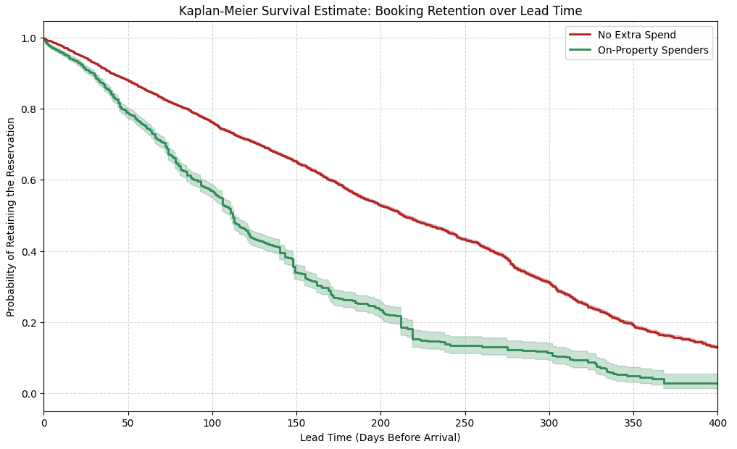
Predicting Guest Cancellation Risk
Key Finding
Guests who engage with on-property amenities are significantly less likely to cancel their reservations.
Survival Analysis Results
Applied Kaplan-Meier for guest retention modelling.
Compared On‑Property vs Room‑Only guests.
Identified high‑risk pre‑arrival cancellation windows.
Cross‑property guests showed stronger retention
Business Insight
Room-only guests are more vulnerable to cancellation.
The highest cancellation risk occurs approximately 14–30 days before arrival.
Early identification enables proactive retention campaigns.
Personalized offers can be triggered before guests reach peak cancellation risk.

Slide 5
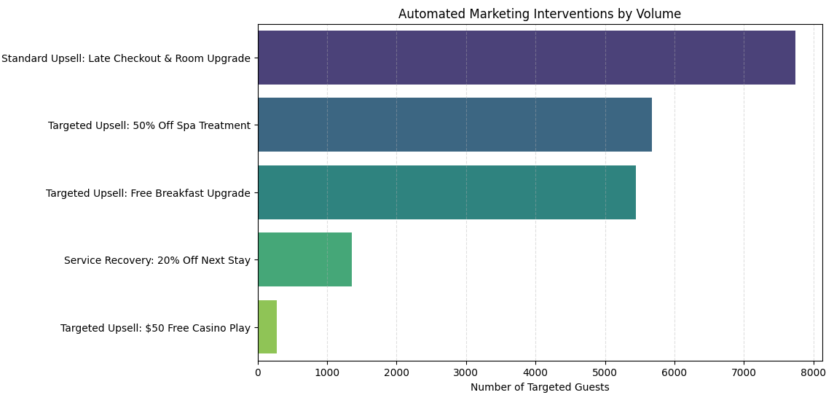
AI-Driven Guest Personalization System
Intelligent Guest Targeting System
Converts guest feedback into actionable decisions
Combines sentiment analysis + guest behavior patterns
Automated Actions (An automated NLP recommendation engine)
Negative experience Service Recovery offer (discounts, apology incentives)
Positive experience Targeted upsell (spa, casino, dining packages)
How It Works
Analyzes guest reviews using sentiment scoring
Assigns personalized offers automatically
Goal
Right offer → Right guest → Right time

Slide 6


Business Impact (ROI)
Revenue Protection
Reduced booking cancellations
Improved revenue retention
Revenue Growth
Higher cross-property spending
Increased conversion from personalized offers
Customer Value
Improved guest satisfaction
Higher customer lifetime value (CLV)
Strategy Shift:
Shift from reactive to predictive revenue management

Slide 7

Recommendations & Next Steps
Recommendations
Trigger offers before high-risk cancellation periods
Use guest sentiment for real-time service recovery
Promote bundled experiences (hotel + spa + casino)
Integrate system into CRM for automation
Final Goal
Maximize guest lifetime value across all properties

Slide 8
Thank You

