Slide 1
SAN JOSE TRAFFIC ACCIDENTS PREDICTION
Ping Chen 013855049
Mandy Wong 014558570
Nihanjali Mallavarapu 014492933
Dhruwaksh Dave 014533545

Slide 2
Agenda
Introduction & Background
Data Collection
Data Visualization
Data Preprocessing
Algorithm & Results
Rubric we met

Slide 3
Introduction & Background
Traffic Accidents are everywhere and happened every time all over the world. According to the statistics showing in the Association for Safe International Road Travel, nearly 1.25 million people die in road crashes each year and 20-50 million people are injured or disabled. There are so many factors to make this happen. The Bad weather conditions, for example, rain, snow, ice, and windy, etc, is one of the major factors and will be increasing the possibility of a road crash than sunny days. This project will be focusing on weather-related factors and the traffic volume to predict the possibility of traffic accidents will occur in San Jose, CA. In order to do that, we need to analyze the relationship between
weather conditions and the number of car accidents.
traffic volume and the number of car accidents.
We need to find out the common causes and how the weather impact. Then, we can predict the possibility of traffic accidents occurred in different weather conditions.

Slide 4
Data Collection
Data Type | Data Source | Description
Motor Vehicle Crash Data | City of San Jose DOT open GIS Data | Crash record from 2013 to 2017 including crash location, date, number of injuries, etc
Road Network Data | City of San Jose DOT open GIS Data | Road info including road name, speed limit, historical accident counts, etc.
Traffic Volume Data | City of San Jose DOT open GIS Data | Average traffic volume data in every intersection in San Jose
Weather Data | website of California Agriculture & Natural Resources | Weather record from 2000 to 2019 including record time, highest & lowest temperature, precipitation

Slide 5
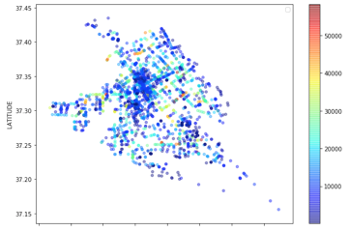
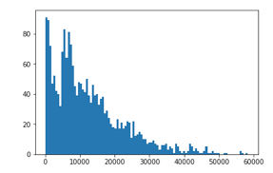
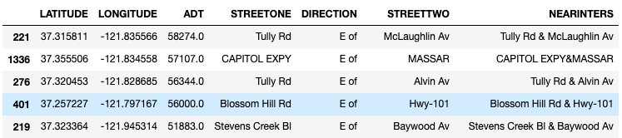
Data Visualization: Traffic Volume Data
A geographical scatter plot of average traffic volume:
Histogram:
Check the veracity:

Slide 6
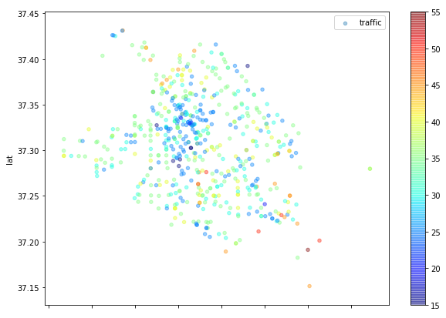
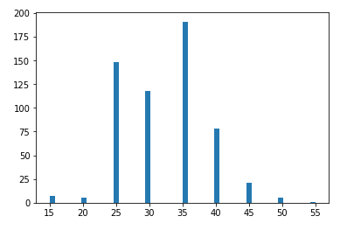
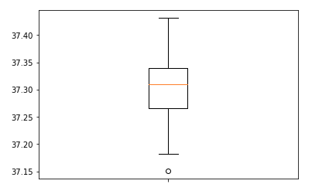
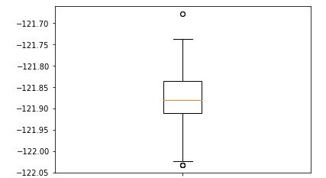
Data Visualization: Road Network Data
A geographical scatter plot of speed limit:
Histogram:
Latitude box plot
Longitude box plot

Slide 7
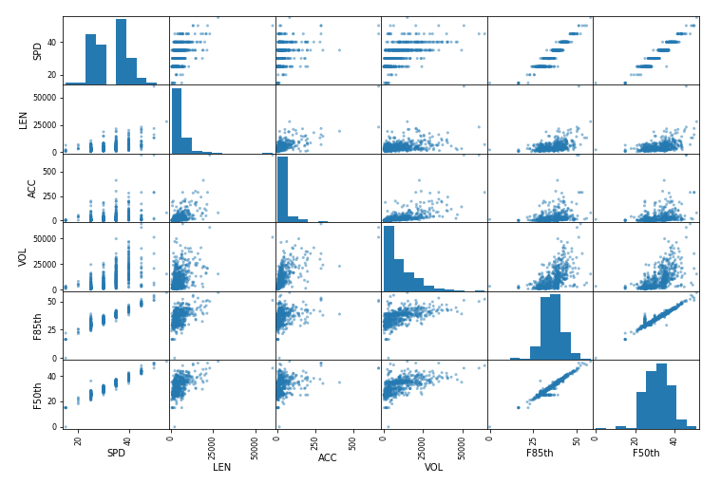
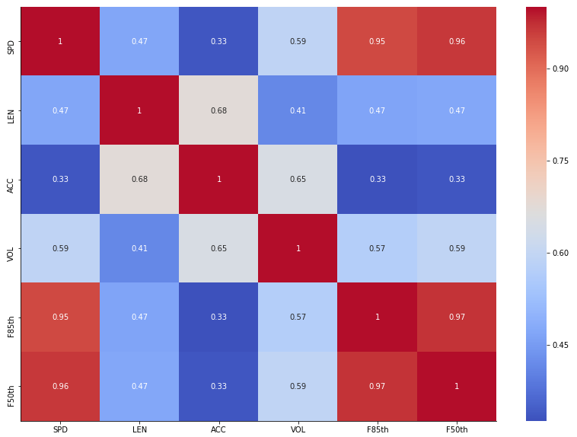
Data Visualization: Road Network Data
Correlation Matrix
Correlation Heatmap

Slide 8
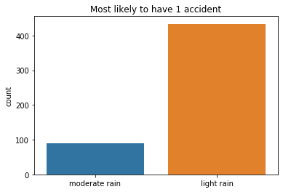
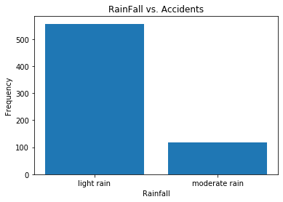
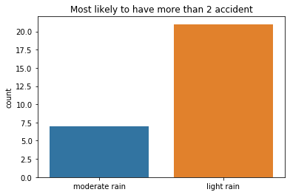
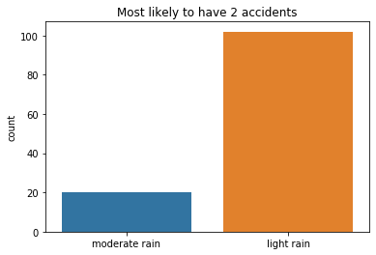
Data Visualization: Weather Data
Bar Plot showing the relationship between Rainfall and number of accidents:

Slide 9
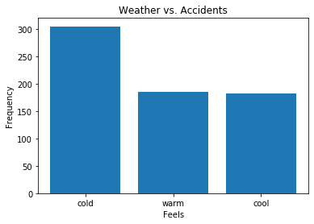
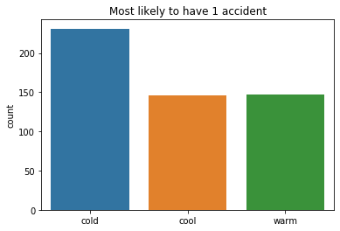
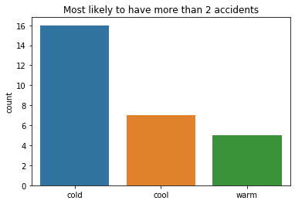
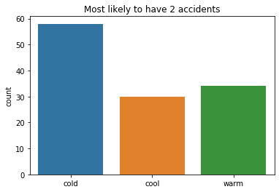
Data Visualization: Weather Data
Bar Plot showing the relationship between the weather and number of accidents:

Slide 10
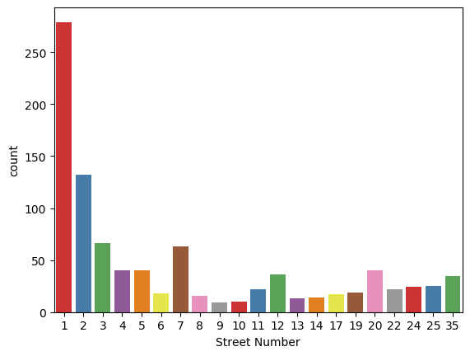
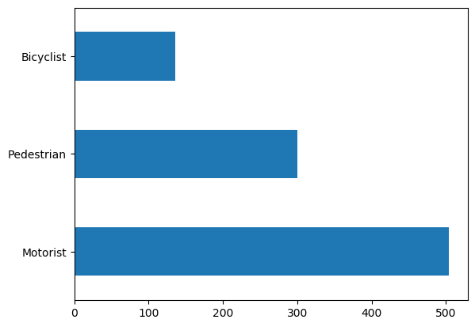
Data Visualization: Crash Data
Bar plots showing the actors involved in the crashes and the geographic locations of the crashes which have been mapped as numbers for representative purpose.

Slide 11
Data Preprocessing:
Handle Missing Data:
- traffic volume: fill in with the value of the nearest intersection by computing the Euclidean distance.
- Historical traffic accident record: fill in with the value of the nearest intersection.
- F85th speed value: fill in with 1.1 times of its corresponding average speed values.
- weather data: delete the columns that all cells are null, use the mean of high temp and low temp to fill in obs temp.
- Others fill in with mean values

Slide 12
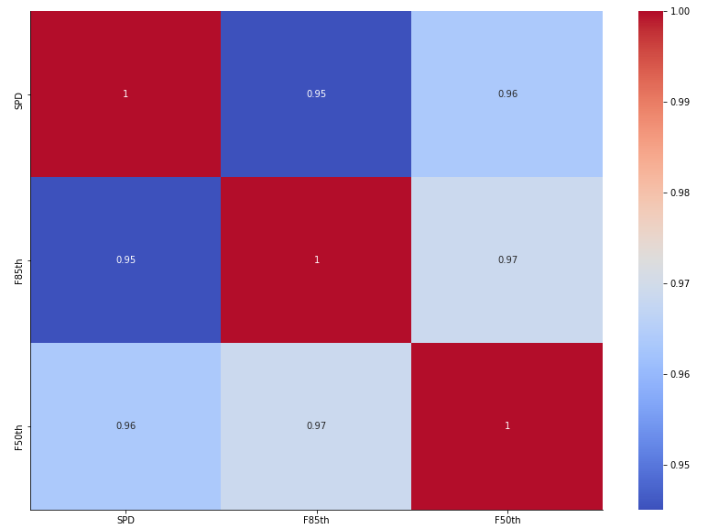
Data Preprocessing
Data Reduction
-remove irrelevant features, eg. edit person, global ID, etc
-remove redundant features, eg. speed limit, average speed and 85 percent speed, correlation coefficients are 0.96
Correlation heatmap of speed limit, average speed and 85 percent speed

Slide 13
Data Preprocessing: Data Integration
Motor Vehicle Crash Data with traffic volume and road network based on location:
- Entity Identification:
eg. TULLY RD & KING RD, Tully Rd & King Rd,
KING RD & TULLY RD
- Missing value: use the nearest location instead
After the data of Traffic volume, Road network and traffic accident have been integrated, the last step is to combine all data with the weather condition.
Data has been integrated based on the accident date. The precipitation and the temperature are mainly used from this weather dataset to be considered as factors in this prediction model to find the correlation between the weather and the possibility of traffic accidents happened.

Slide 14
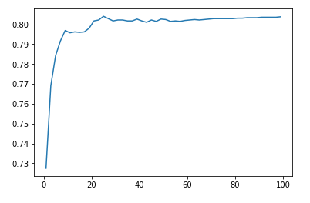
Algorithm & Results: KNN
Use 5-folds cross validation
plot the relationship between accuracy and k.
maximum k is 25 and accuracy is 80.39

Slide 15
Algorithm & Results: SVM
Split the final_data.csv into training set and testing set with the test size=0.3
Build the SVM model with linear kernel, C= 2 and gamma = 0.1
results:
# of run | Accuracy
1 | 81.09%
2 | 78.79%
3 | 79.25%
4 | 80.02%

Slide 16
Algorithm & Results: Logistic Regression
-Split the training and test data into a 70-30 ratio.
-Built the model using predefined Python libraries for the implementation of Logistic Regression
-Results:
Iteration | Accuracy
1 | 80.32%
2 | 81.06%
3 | 80.19%

Slide 17
Algorithm & Results: Random Forest
-Split the training and test data into a 70-30 ratio.
-Built the model using predefined Python libraries for the implementation of Random Forests Classifier.
-Results:
Iteration | Accuracy
1 | 81.24%
2 | 81.54%
3 | 80.32%

Slide 18
Thank You!

