Slide 1


ś
Student Name: Nihanshu Bhanderi
Roll no: 30
Enrollment No: 23002170110007
Branch: CE
Batch: 1
Project Name :- Gym Management System

Slide 2

Introduction to the Gym Management System
The gym management system is a comprehensive platform designed to streamline the operations of fitness centers and provide an enhanced experience for both staff and members. It integrates various functionalities to optimize the management of memberships, facilities, and services.

Slide 3
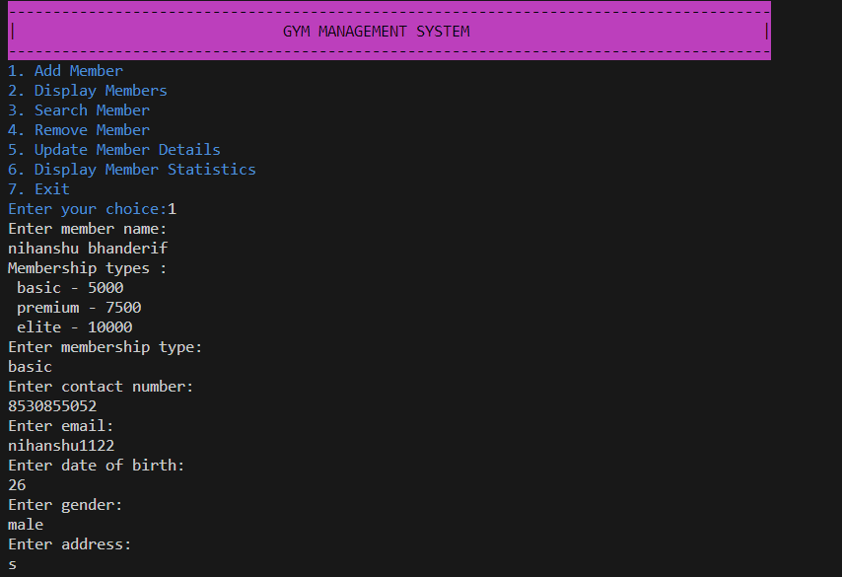
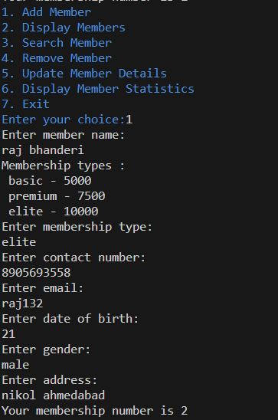
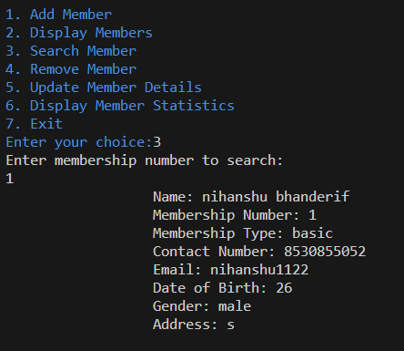
Output of code :-

Slide 4
Algorithm
1. **GymMember Class**:
- Define a class `GymMember` with attributes such as name, membership number, membership type, contact number, email, date of birth, gender, and address.
- Define a constructor to initialize the member's attributes.
- Include a method `display()` to print the member's details.
2. **Gym Class**:
- Define a class `Gym` responsible for managing gym members.
- Declare a static array `members` to store instances of `GymMember` with an initial size of 100.
- Declare static variables to track the next available membership number.
- Include methods to add a member, get the membership number, set membership type, set gender, validate contact number, display members, search member by membership number, remove member, update member details, and display member statistics.
- Use loops to iterate through the member array for searching, removing, and updating operations.
3. **Main Class - GymSystem**:
- Define the main class `GymSystem`.
- Create an instance of `Gym` to access its methods.
- Provide a menu-driven interface using a do-while loop to repeatedly prompt the user for actions.
- Inside the loop, display the menu options: add member, display members, search member, remove member, update member details, display member statistics, and exit.
- Based on the user's choice, call the corresponding method of the `Gym` class.
4. **Member Addition**:
- When adding a member, prompt the user for member details such as name, membership type, contact number, email, date of birth, gender, and address.
- Validate the membership type, contact number, and gender input.
- Generate and assign the membership number.
- Create a `GymMember` object with the provided details and add it to the `members` array.
5. **Member Removal**:
- Prompt the user for the membership number of the member to be removed.
- Iterate through the `members` array to find the member with the provided membership number.
6. **Member Update**:
- Prompt the user for the membership number of the member to be updated.
- Display options for updating member details such as name, membership type, contact number, email, date of birth, gender, and address.
- Based on the user's choice, update the corresponding attribute of the selected member.
7. **Display Member Statistics**:
- Iterate through the `members` array to count the number of members for each membership type (Basic, Premium, Elite).
- Print the counts to display the membership statistics.
8. **Exit**:
- Terminate the program when the user chooses to exit.

Slide 5
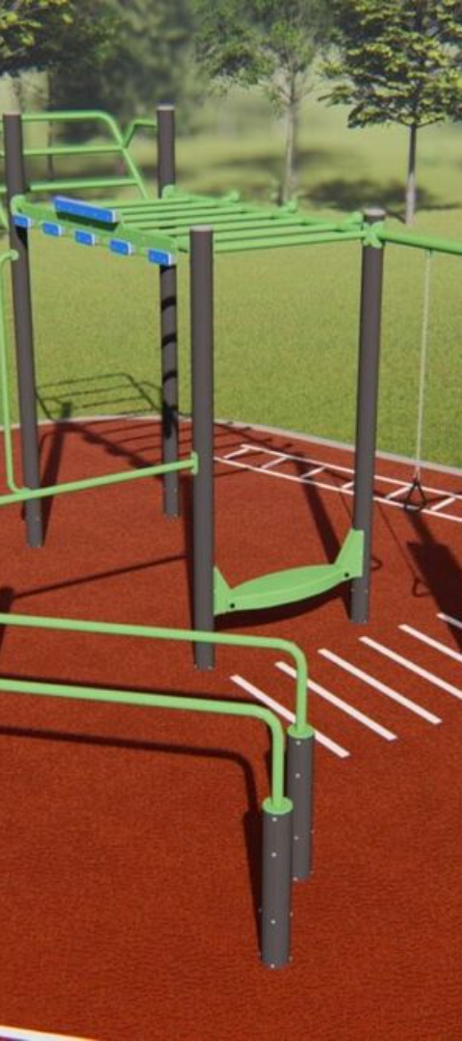
Features and Benefits
1
Manage System without more knowledge of System
That system do manager work very simple because manager change all type of information without any difficulties.
2
Add and Remove Member
Add and remove members are very easy by using methods and also manager get members details any time by search with membership number.
3
Financial Reporting
Provides detailed financial reports to assist in making informed business decisions and strategizing for growth by using member statistic.

Slide 6

Membership Types and Pricing Options
Basic Membership
Premium Membership
Access to basic facilities and group classes at an affordable monthly rate.
Includes additional perks such as access to premium facilities, personal training, and nutrition counseling.
Elite membership
Access to all facilities ,access to all training , trainer and nutrition who have lot of experience are guide them.

Slide 7

Scope of Business and Target Audience
1
Fitness Centers
2
Target Audience
Designed to cater to gyms, health clubs, and wellness centers of varying sizes and capacities.
Primarily aimed at fitness enthusiasts, gym owners, and health-conscious individuals seeking a modern and efficient fitness management system.
3
Global Reach
Capable of catering to fitness centers worldwide, accommodating diverse business models and customer preferences.

Slide 8
User Interface and Functionality Overview
Intuitive Interface
Facility Management
Mobile Accessibility
The system offers a user-friendly interface that is easy to navigate and comprehend for both staff and members.
Enables efficient management of equipment, classes, bookings, and schedules for smooth day-to-day operations.
Members can access the system via a mobile app, allowing them to book classes, and interact with the facility on-the-go.

Slide 9
Thank You

