Slide 1


smart irrigation system
by JONNADA NIHANTH REDDY

Slide 2

Learning Objectives
Understand real-world application of machine learning in agriculture.
Learn to preprocess sensor data for predictive modeling.
Build a prediction system using Scikit-learn and Streamlit.
Deploy a simple ML-based web app.
GOAL
Source :
www.freepik.com/

Slide 3
Tools and Technology used
Python
Scikit-learn
Joblib (for model serialization)
Streamlit (for web app)
CSV files (for dataset)
Jupyter Notebook (for data processing and model training)

Slide 4
Methodology
Step 1: Load and clean the dataset ___________irrigation_machine.csv)
Step 2: Scale the input features
Step 3: Train a classifier to predict sprinkler ON/OFF status
Step 4: Serialize model using joblib
Step 5: Create UI using Streamlit to accept sensor values and display prediction

Slide 5
Problem Statement:
In traditional agricultural practices, irrigation is often performed manually or with basic timers that do not account for the variability in soil conditions, weather, or crop needs. This leads to inefficient water usage, over-irrigation, or under-irrigation, all of which negatively impact crop health and yield. Farmers face challenges in monitoring real-time environmental conditions and making informed decisions about when and where to irrigate. Given the rising global concerns over water scarcity and the need for sustainable farming, there is a critical demand for smart, data-driven solutions that can enhance irrigation efficiency, reduce human dependency, and optimize agricultural productivity.

Slide 6
Solution:
To address this problem, we propose a Smart Sprinkler System powered by Machine Learning that uses sensor data to automate irrigation decisions. The system is trained on a dataset representing various sensor readings from different zones of a farm. Using this data, a machine learning model predicts whether each sprinkler should be ON or OFF based on environmental conditions. The model is deployed using a user-friendly Streamlit web interface, where farmers can input real-time sensor values and instantly receive irrigation recommendations for each zone. This solution not only saves water by preventing unnecessary irrigation but also ensures that crops receive the optimal amount of water needed for healthy growth. The system is scalable, cost-effective, and can be integrated with real-time IoT sensor networks for fully autonomous smart farming.

Slide 7
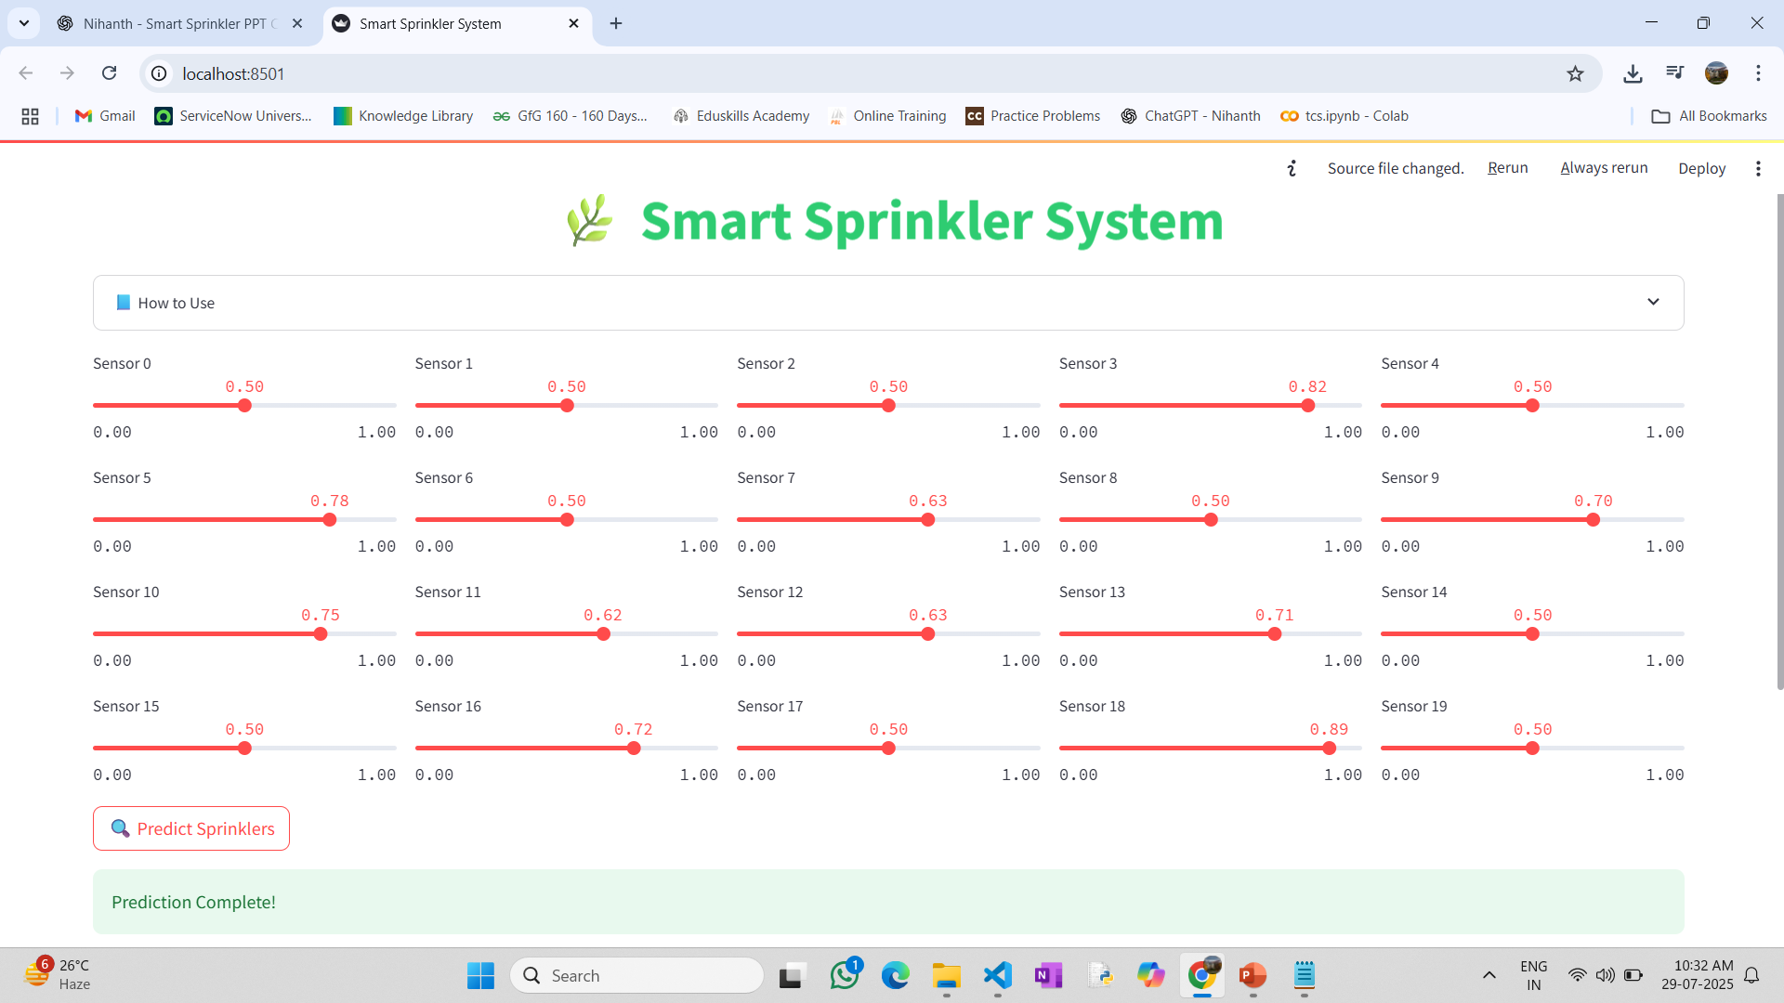
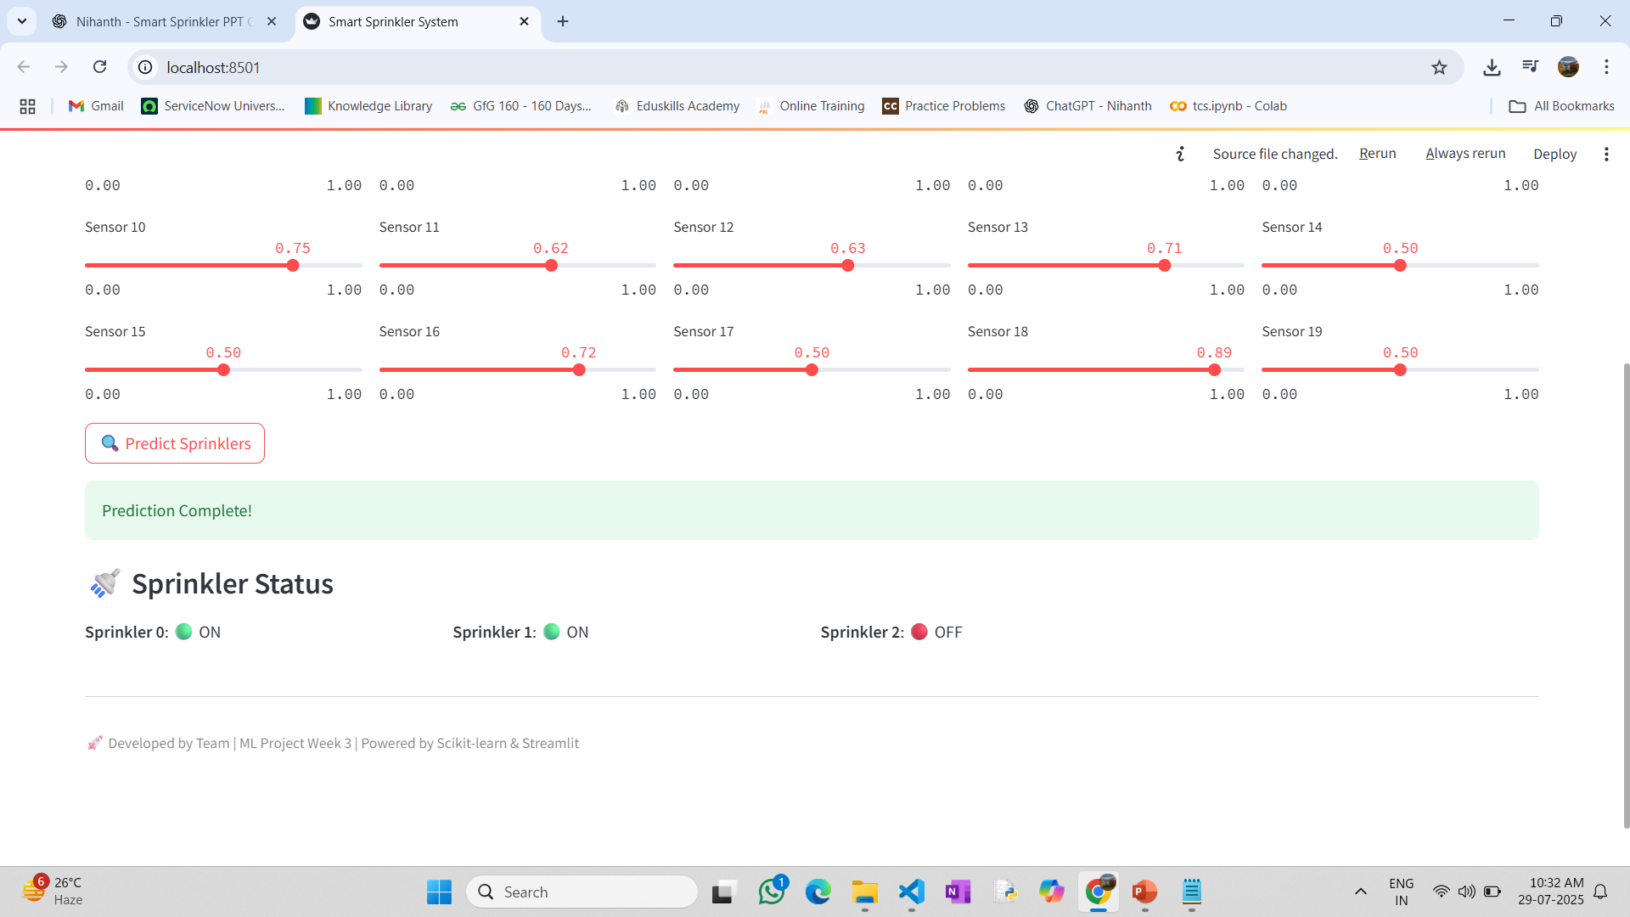
Screenshot of Output:

Slide 8
Conclusion:
The Smart Sprinkler System demonstrates the practical integration of machine learning into agriculture, enabling data-driven irrigation that enhances both efficiency and sustainability. By predicting sprinkler status based on real-time sensor values, the system automates critical decisions, reducing water wastage and minimizing manual intervention. This approach not only promotes resource optimization but also supports the long-term goal of sustainable farming through smart technology. The solution is scalable and adaptable, making it suitable for various farm sizes and environmental conditions. With further integration of IoT devices and weather forecasting APIs, the system can evolve into a fully autonomous irrigation controller, revolutionizing modern agricultural practices.

