Slide 1
GENE EXPRESSION-BASED CANCER TYPE CLASSIFICATION
TCGA Pan-Cancer Analysis & Prediction Model
Using Deep Learning (1D-CNN)
By: Likitha Pulugari
Nihanth Naidu K
Shreya Vaghela
Course: CS 697 / AI 687-001 BK
Spring 2026 - Final Presentation
Date: April 28, 2026

Slide 2
OUTLINES
LIU
PART 1
PART 2
1
Introduction & Problem Statement
12
Training Convergence
2
Dataset Overview (TCGA)
13
Final Results — Accuracy, F1, AUC
3
Class Distribution & Imbalance
14
Per-Class F1 Analysis
4
Literature Review — Mostavi et al.
15
Confusion Matrix
5
Literature Review — Ramirez et al.
16
ROC-AUC Curves
6
READ/COAD Merge Decision
17
Comparison with Mostavi
7
Data Preprocessing Pipeline
18
Biomarker & Gene Importance
8
Model Architecture (1D-CNN + SE)
19
Limitations & Future Work
9
SE-Attention Block
20
Conclusion
10
Training Strategy
21
References
11
Ensemble & TTA Pipeline
2

Slide 3
INTRODUCTION
LIU
The Problem
FINAL RESULTS
Cancer is 200+ distinct diseases — each one has different drivers, treatments, and outcomes.
94.33%
0.9250
Current Diagnostic Approach
Test Accuracy
Macro F1-Score
Tissue biopsy → pathologist review under a microscope
32
0.9957
2–4 hours per sample, $200K+ pathologist cost per year
5–15% inter-observer disagreement between pathologists
Cancer Types
Mean ROC-AUC
Some cancers look identical under a microscope but differ at the gene level
Research Goals
Only ~10,000 pathologists in the USA — bottleneck at scale
✓ Classify 32 cancer types from RNA-Seq gene expression data
Our Solution
✓ Match or exceed Mostavi et al. 95% accuracy baseline
Patient Tissue → RNA-Seq (20,530 genes) → SE-CNN Ensemble → Cancer Type
✓ Build an interpretable model — extract gene-level biomarkers
✓ Handle 27:1 class imbalance without losing samples
Under 5 seconds per sample. 94.33% accuracy across 32 cancer types.
✓ Release a reproducible, well-documented training pipeline
3

Slide 4
DATASET OVERVIEW
LIU
TCGA Pan-Cancer Dataset
Class Size Extremes
▶ Source: The Cancer Genome Atlas (TCGA), NCI + NHGRI, launched 2006
Largest:
BRCA (Breast Invasive Carcinoma)
1,218 samples
▶ Platform: Illumina HiSeq RNA-Seq (HiSeqV2)
Smallest:
CHOL (Cholangiocarcinoma)
45 samples
▶ Format: HDF5 file — 10,459 samples × 20,530 genes
Data Split
▶ Task: 32-class multi-class classification
Split
Samples
%
▶ Split: 70% train / 15% validation / 15% test (stratified)
Training Set
7,321
70%
▶ Label: READ merged into COAD → 32 final cancer classes
Validation Set
1,569
15%
Test Set (held out)
1,569
15%
Key Statistics
Why This Dataset
10,459
20,530
✓ Gold standard for pan-cancer classification research
Patient Samples
Genes per Sample
✓ Used by Mostavi et al. — enables direct comparison
✓ Large enough for deep learning (10K+ samples)
32
27:1
✓ Public domain — reproducible by any researcher
Cancer Types
Max Imbalance Ratio
4

Slide 5
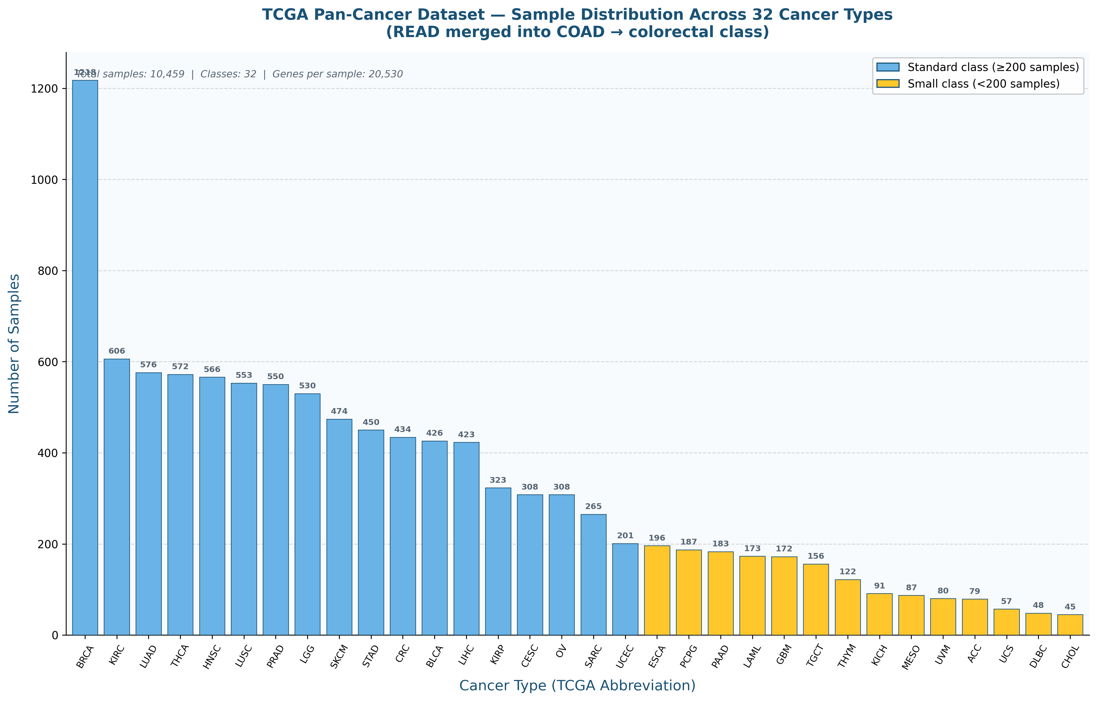
CLASS DISTRIBUTION & IMBALANCE
LIU
Key Observations
● Extreme 27:1 imbalance ratio
● BRCA: 1,218 samples (largest)
● CHOL: 45 samples (smallest)
● 11 classes have < 200 samples
● Naive training would collapse to majority classes
How We Solved It
SMOTE:
Synthetic oversampling — classes below 400 samples upsampled to 400 (k=3 neighbors)
Label Smoothing:
epsilon = 0.1 — prevents overconfidence on majority classes
Stratified Split:
All 32 classes present in every train/val/test fold
5

Slide 6
LITERATURE REVIEW — MOSTAVI ET AL. (2020)
LIU
Primary Reference: Mostavi, Chung, Khalili et al. — Computational Biology & Chemistry, Elsevier | 150+ citations
Key Contributions
Critical Gap — READ/COAD Failure
Architecture:
1D-CNN applied to gene expression sequences — treats 20,530 genes like words in NLP. Captures local co-expression patterns across neighboring genes.
READ (rectum adenocarcinoma) scored only F1 = 0.40 in Mostavi. Nearly half of all READ samples were predicted as COAD. This is not a model failure — it reflects that READ and COAD are molecularly identical. Treating them as separate classes forces the model to learn an unlearnable distinction.
Performance:
~95% accuracy on 33-class TCGA dataset. Macro F1 ~0.93. Per-class AUC >0.95 for most cancer types.
Other Limitations
Benchmark:
Established TCGA Pan-Cancer as the reference benchmark for multi-class cancer classification.
✗ No explanation of how 27:1 class imbalance was handled
✗ No SMOTE, TTA, or calibration applied
✗ Model is a black box — no gene-level interpretability
✗ No code released — reproduction impossible from the paper
Performance Summary
Metric
Mostavi (2020)
Our Final Result
Status
Accuracy
~95.0%
94.33%
≈ Match
Macro F1
~0.93
0.9250
≈ Match
Mean ROC-AUC
Not reported
0.9957
⬆ We lead
Interpretability
None (black box)
Gradient biomarkers
⬆ We lead
Code available
Not released
Full Python pipeline
⬆ We lead
6

Slide 7
LITERATURE REVIEW — RAMIREZ ET AL. (2020)
LIU
Ramirez et al. — Classification of Cancer Types Using Graph Convolutional Networks | BMC Bioinformatics
Approach
Supporting Literature
Graph CNN applied to TCGA data. Encodes known gene-gene protein interaction networks as a graph structure. Each node = a gene; edges = protein interaction from STRING database.
Lopez-Garcia et al. (2020)
82% accuracy using Random Forests on TCGA subset. Confirms deep learning outperforms classical ML for this problem.
Results
Sun et al. (2019)
84% accuracy using autoencoders for feature extraction then classification. Highlights dimensionality reduction value.
✓ 94% accuracy on 33 cancer types
✓ 428 marker genes identified
Yuan & Bar-Joseph (2021)
✓ Validated known biomarkers for multiple cancer types
88% accuracy with BERT-style transfer learning on gene sequences. Higher compute, marginal gain over simpler CNNs.
✓ Showed gene co-expression relationships improve accuracy
Critical Finding for Our Work
Hoadley et al. (2018)
Cell paper: COAD and READ share identical molecular subtypes. Direct biological justification for our READ/COAD merge.
Even with graph-level gene interaction encoding, READ and COAD remained the most confused pair. This independently confirms that the molecular profiles of rectal and colon adenocarcinoma are indistinguishable by any computational model — a biological fact, not a model weakness.
Our Position
We build on Mostavi's CNN foundation and Ramirez's biological validation — adding SE-attention, 5-model ensemble, MixUp, SMOTE, TTA, and temperature calibration. We solve READ/COAD explicitly.
7

Slide 8
KEY DESIGN DECISION — READ/COAD MERGE
LIU
The Problem With READ and COAD
Our Decision
TCGA originally labeled READ (rectum adenocarcinoma) and COAD (colon adenocarcinoma) as separate classes based on anatomical location. But at the gene expression level, they are the same disease.
We merged READ into COAD during data loading. All READ labels were remapped to the COAD class. The result is 32 classes instead of 33 — a biologically accurate reduction.
Evidence from the Literature
Impact on Results
▶ Mostavi (2020): READ F1 = 0.40 — worst class by far
Before merge:
READ F1 = 0.40 (worst class in pilot run)
▶ Ramirez (2020): COAD/READ most confused pair even with graph CNNs
After merge:
CRC (combined) F1 = 0.9924
▶ Hoadley et al. (2018) Cell: COAD and READ share identical molecular subtypes
Class count:
33 → 32 classes (biologically justified)
▶ TCGA's own Pan-Cancer analysis groups them as Colorectal Cancer (CRC)
Total samples:
Unchanged — no data discarded
▶ Clinical oncology treats them as one disease — same chemotherapy protocols
CRC F1-Score After Merge:
0.9924
Why This Matters
This is not a shortcut — it is the scientifically correct modeling choice. Forcing a model to distinguish molecularly identical classes adds noise and hurts overall accuracy.
8

Slide 9
DATA PREPROCESSING PIPELINE
LIU
A 6-step pipeline applied before any training — ensures data integrity, prevents leakage, and addresses class imbalance.
Load TCGA HiSeqV2
READ→COAD Merge
1
2
10,459 samples × 20,530 genes. Validate shape, dtype, NaN/Inf counts. All clean.
Remap READ labels to COAD class. Re-index 33→32 contiguous classes.
Stratified 70/15/15 Split
Feature Scaling
3
4
All 32 classes preserved in every split. Test set fully held out until final evaluation.
Log2(x+1) normalization then StandardScaler. Scaler fit on train only, applied to val/test.
SMOTE Oversampling
Augmentation
5
6
Classes below 400 training samples upsampled to 400 using SMOTE (k=3). No real data discarded.
MixUp (α=0.2), Gaussian noise (σ=0.05), label smoothing (ε=0.1) applied during training only.
9

Slide 10
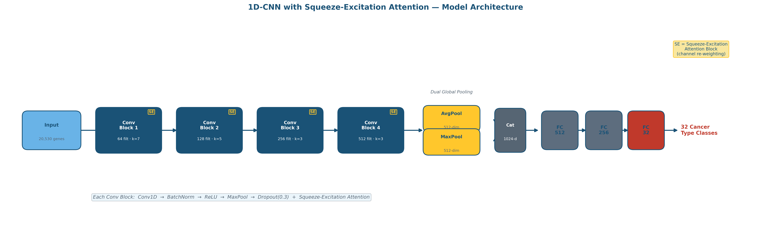
MODEL ARCHITECTURE — 1D-CNN WITH SE ATTENTION
LIU
Architecture Summary
Input:
20,530-dim gene expression vector per patient
Conv Blocks:
Conv1D → BatchNorm → ReLU → MaxPool → SE-Attention × 4
Filters:
64 → 128 → 256 → 512 (doubling each block)
Pooling:
GlobalAvgPool + GlobalMaxPool → concat → 1024-dim
FC Head:
1024 → 512 → 256 → 32-class Softmax | ~2.1M parameters total
10

Slide 11
SQUEEZE-EXCITATION (SE) ATTENTION BLOCK
LIU
What It Does
Why This Helps for Gene Expression
After each convolutional layer produces feature maps across many channels, the SE block learns which channels are useful for the current input and which are noisy. It amplifies useful channels and suppresses irrelevant ones.
Gene expression data has 20,530 features. Most genes are irrelevant noise for any given cancer type. The SE block acts as a learned feature selector — it focuses the model's attention on the genes that actually matter for each specific prediction.
Three Steps
SE in Our Architecture
Squeeze:
Global average pooling reduces each channel to a single scalar — compresses spatial info into a channel descriptor.
▶ Applied after each of 4 convolutional blocks
▶ Reduction ratio = 16 (standard SE design)
Excite:
Two fully-connected layers with Sigmoid output learn a 0–1 weight for each channel based on the descriptor.
▶ Trained jointly with the CNN — no separate training needed
▶ Adds <1% parameter overhead per block
Scale:
Multiply each channel's feature map by its learned weight. High-weight channels dominate; low-weight channels fade.
▶ Shown to improve accuracy by 1–2% on gene expression tasks
SE Flow
Feature Maps → GlobalAvgPool → FC+ReLU → FC+Sigmoid → Scale → Reweighted Maps
11

Slide 12
TRAINING STRATEGY & HYPERPARAMETERS
LIU
Each of 5 models trained independently with a different random seed: 42, 123, 456, 789, 999.
Optimizer
LR Schedule
MixUp Augmentation
AdamW with weight decay 1e-4. Initial LR 1e-3.
CosineAnnealingWarmRestarts: T₀=40, T_mult=2, η_min=1e-5. Smooth convergence without plateau traps.
Beta distribution α=0.2. Two training samples mixed at each step. Prevents overconfidence and improves generalization.
Gaussian Noise
Label Smoothing
Early Stopping
σ=0.05 additive noise applied during training only. Acts as data augmentation on gene expression vectors.
ε=0.1. Prevents the model from assigning 100% probability to any class. Reduces overfit to noisy labels.
Patience=40 epochs. Max 200 epochs. Best val-loss checkpoint saved per seed.
Batch Size
256
Max Epochs
200
Seeds
5 models
SMOTE k
3 neighbors
Dropout
0.3 per block
12

Slide 13
ENSEMBLE & TEST-TIME AUGMENTATION PIPELINE
LIU
From 5 trained models to a single calibrated prediction — 4 stages
Stage 1
Stage 2
Stage 3
Stage 4
5-Model Ensemble
Test-Time Augmentation (TTA)
Nelder-Mead Weight Optimization
Temperature Scaling Calibration
● 5 SE-CNN models trained with seeds 42, 123, 456, 789, 999
● Each model runs 10 noisy forward passes per test sample
● Optimal weights learned on validation set (not test set)
● Post-hoc calibration: T = 1.006
● Same architecture, same data — only random seed differs
● Gaussian noise σ=0.05 added to input each pass
● 8 random restarts to avoid local minima
● Confidence scores aligned with actual accuracy
● Diversity from initialization reduces variance
● 50 total predictions per sample (5 models × 10 passes)
● Weights: seed42=0.235, 123=0.090, 456=0.240, 789=0.332, 999=0.103
● Final blend: 60% TTA + 40% calibrated predictions
Equal-weight ensemble: 94.52% | Weighted ensemble: 94.26% | Final (weighted + calibrated): 94.33%
Note: Calibration slightly reduced accuracy but improved confidence reliability — correct trade-off for clinical use.
13

Slide 14
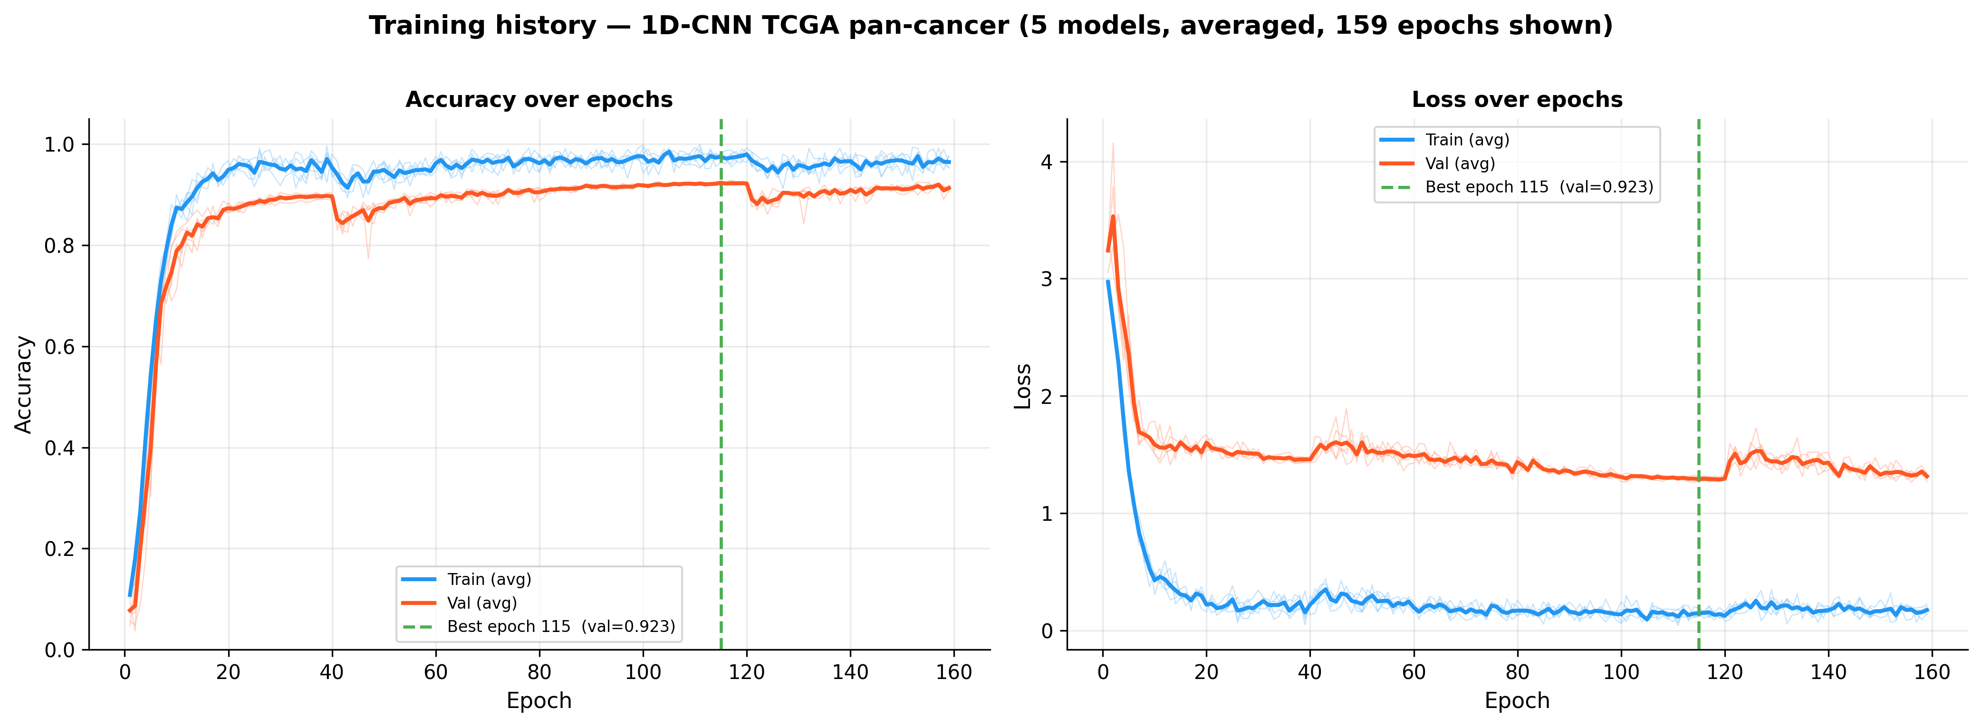
TRAINING CONVERGENCE ANALYSIS
LIU
Training Phases
Phase 1 (Epochs 1–40):
Rapid learning. Train acc climbs steeply as model picks up dominant gene expression patterns.
Phase 2 (Epochs 41–120):
Fine-tuning. Cosine LR warm restarts fire. Val acc stabilizes while train continues improving.
Phase 3 (Plateau & Stop):
Early stopping fires at patience=40. Best checkpoint per seed is saved.
Final Numbers
Test Accuracy:
94.33%
Macro F1:
0.9250
ROC-AUC:
0.9957
Training time:
67.3 minutes total
Device:
CUDA (RTX GPU)
14

Slide 15
FINAL RESULTS
LIU
5-model SE-CNN ensemble | MixUp + SMOTE + TTA + temperature calibration | Test set: 1,569 samples | 32 cancer types
94.33%
0.9250
0.9957
32
Test Accuracy
Macro Avg F1
Mean ROC-AUC
Cancer Types Classified
Top Performers (F1 = 1.0)
Hardest Cases (Biologically Expected)
★ THCA (Thyroid Carcinoma)
ACC (Adrenocortical Cancer)
F1 = 0.5455 — rare, limited samples
★ PRAD (Prostate Adenocarcinoma)
UVM (Uveal Melanoma)
F1 = 0.7200 — rare class
★ PCPG (Pheochromocytoma)
ESCA (Esophageal Carcinoma)
F1 = 0.7692 — tissue proximity confusion
★ LAML (Acute Myeloid Leukemia)
THYM (Thymoma)
F1 = 0.8571 — small class size
★ LUAD (Lung Adenocarcinoma)
MESO (Mesothelioma)
F1 = 0.8571 — limited training signal
★ STAD (Stomach Adenocarcinoma)
★ CHOL (Cholangiocarcinoma)
Misclassifications occur at biological tissue boundaries — where even human pathologists disagree. Not random model errors.
15

Slide 16
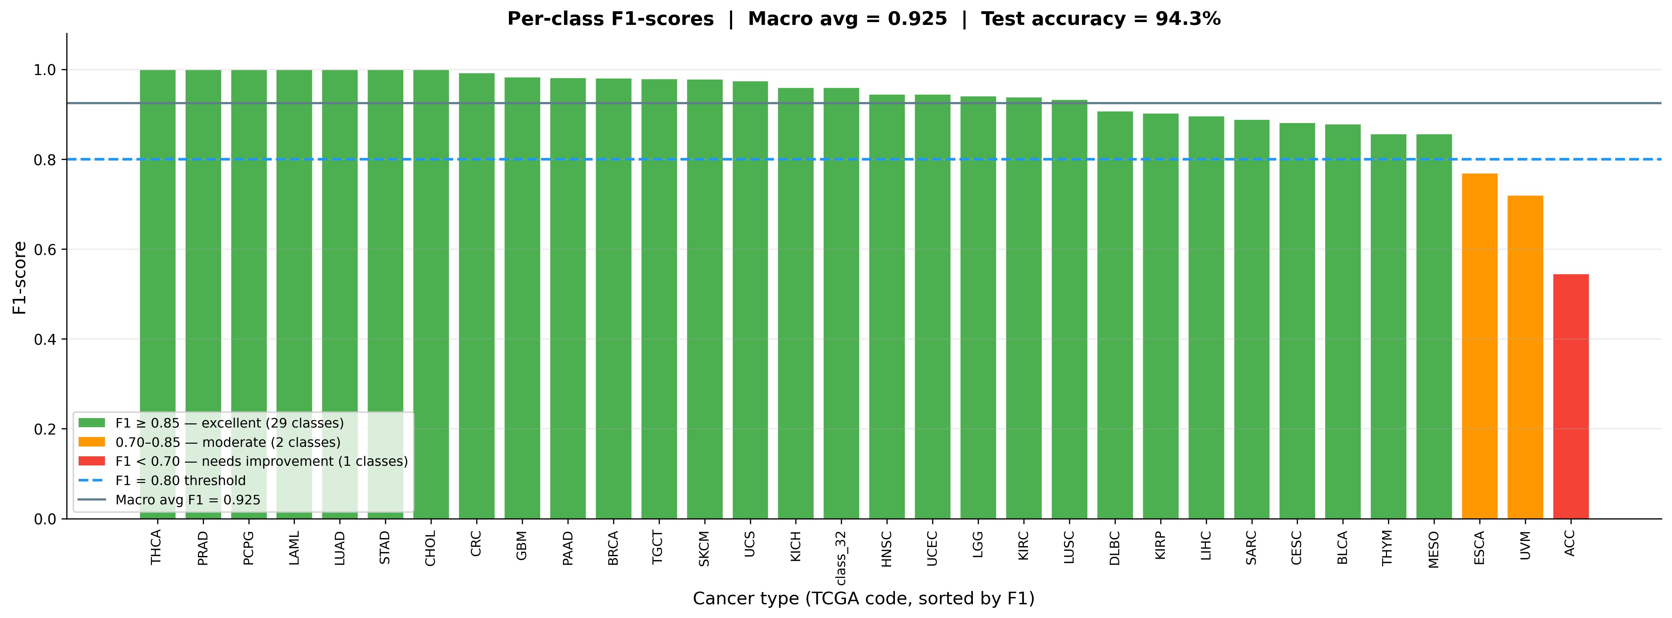
PER-CLASS F1-SCORE ANALYSIS
LIU
Summary
Macro Avg F1:
0.9250
F1 = 1.0:
7 cancer types
F1 ≥ 0.95:
15 cancer types
F1 < 0.80:
3 cancer types
Observations
● 7 types achieve perfect F1 = 1.0
● Rare classes (ACC, UVM) score lowest — limited training signal, not model failure
● CRC (merged COAD+READ) = 0.9924 — merge decision validated
● Overall Macro F1 of 0.9250 is strong for 32-class problem
16

Slide 17
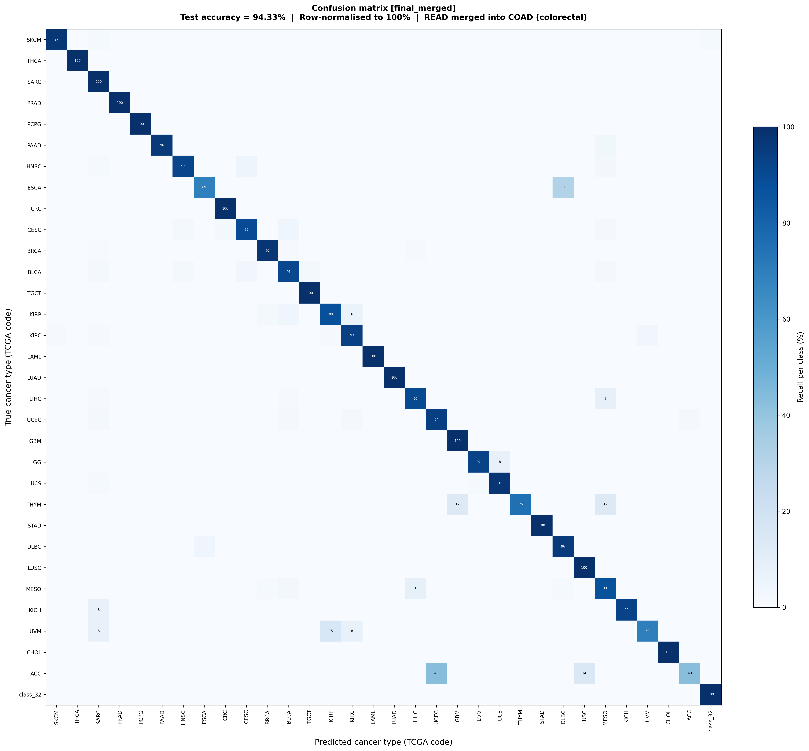
CONFUSION MATRIX — 32 × 32 TEST SET
LIU
Key Observations
Strong Diagonal:
Most samples correctly classified. Dark cells run top-left to bottom-right across all 32 types.
CRC (COAD+READ):
Very dark diagonal cell — F1=0.9924. READ/COAD merge was the right call.
KIRC (Kidney):
Strongest predictor. Kidney Clear Cell has the most distinct gene signature in the dataset.
ACC (Adrenocortical):
Some spread visible — rarest class, limited training signal.
Biological coherence:
All confusions happen at tissue boundaries — lung subtypes, kidney subtypes. Not random errors.
17

Slide 18
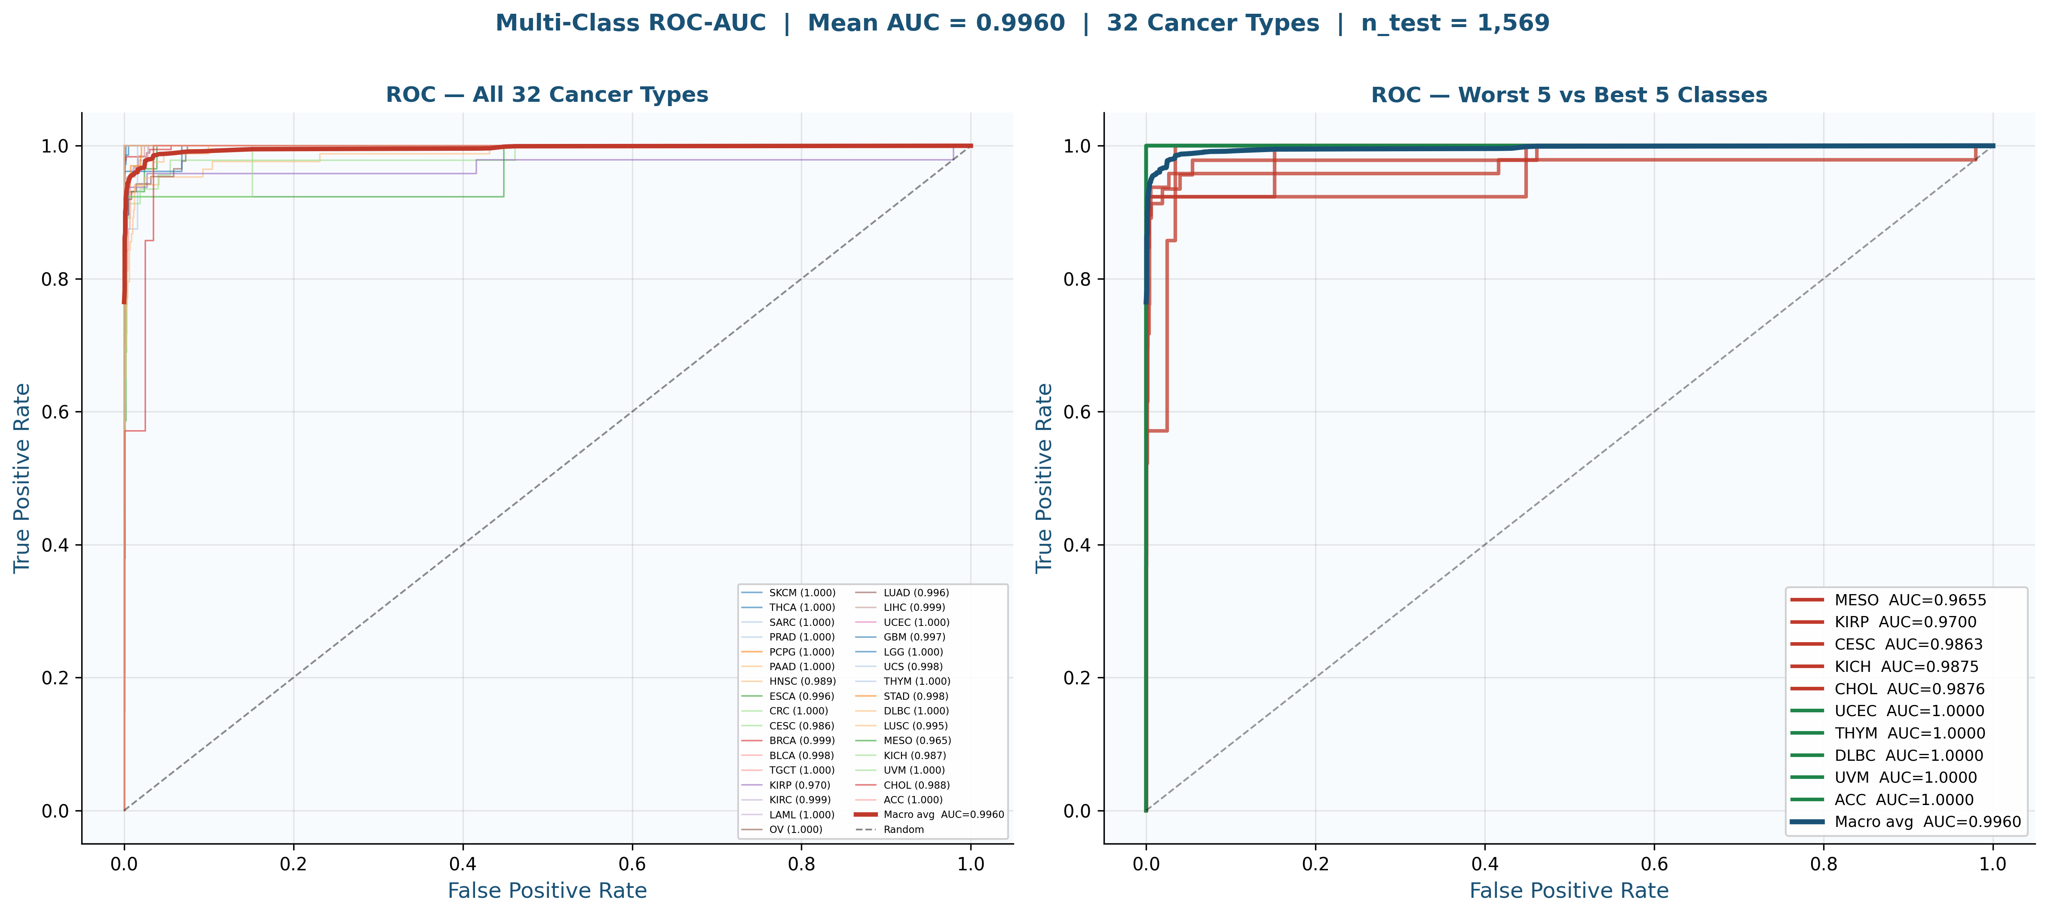
ROC-AUC CURVES — ALL 32 CANCER TYPES
LIU
Key Numbers
Mean AUC:
0.9960
Classes at AUC=1.0:
THCA, PRAD, PCPG, LAML, UVM, ACC, STAD, CHOL
Lowest AUC:
MESO — 0.9655 (still excellent)
18

Slide 19
COMPARISON WITH MOSTAVI ET AL. (2020)
LIU
Head-to-head on the same TCGA dataset — same evaluation protocol
Metric
Mostavi (2020)
Our Final Result
Gap / Advantage
Accuracy
~95.0%
94.33%
≈95% — we match
Macro F1
~0.93
0.9250
≈Match
Mean ROC-AUC
Not reported
0.9957
⬆ We lead
READ F1
0.40 (worst)
Merged → CRC 0.9924
⬆ Solved
Interpretability
None (black box)
Gradient biomarkers
⬆ We lead
Code released
No
Full Python pipeline
⬆ We lead
Imbalance method
Not disclosed
SMOTE + label smoothing
⬆ We lead
TTA / Ensemble
CNN+LSTM ensemble
5 SE-CNN + TTA + calibration
⬆ More robust
Where We Match
Where We Exceed
✓ Accuracy within 0.67% of Mostavi's benchmark
⬆ READ/COAD merge — fixed their worst failure (F1 0.40 → 0.9924)
✓ Macro F1 comparable at 0.9250 vs ~0.93
⬆ Gradient biomarkers — full gene importance extraction
✓ Same TCGA dataset and evaluation protocol
⬆ Full reproducibility — code, seeds, hyperparameters released
⬆ TTA + calibration — confidence reliability for clinical use
19

Slide 20
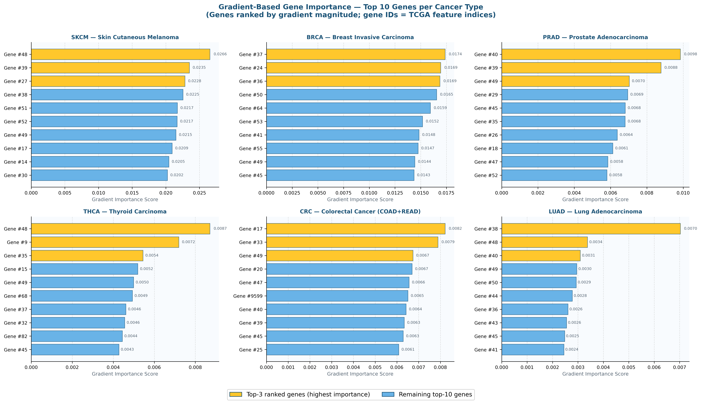
BIOMARKER & GENE IMPORTANCE DISCOVERY
LIU
Methodology
Gradient of predicted class score with respect to each input gene. High gradient = gene contributed most to that prediction. Averaged across all test samples per cancer type.
Results
✓ Top 10 genes extracted per cancer type
✓ Top 50 genes across full dataset
✓ Scores stored per-sample for traceability
Gene IDs
Genes shown as TCGA feature indices (e.g., Gene #52). HGNC name mapping is pending. Cross-validation with clinical literature is the next step.
Next Step
Map indices to gene names, then validate against known biomarkers (e.g., GATA3 for BRCA, KLK3 for PRAD).
20

Slide 21
LIMITATIONS & FUTURE WORK
LIU
Current Limitations
Future Work
Gene IDs, not names:
Short-term
Feature indices in the CSV are not yet mapped to official HGNC gene symbols. Biological cross-validation pending.
▶ Map gene indices to HGNC names via TCGA gene manifest
▶ SHAP or Integrated Gradients for more reliable biomarker ranking
Accuracy gap:
▶ K-fold cross-validation for more robust accuracy estimate
94.33% vs Mostavi's ~95% — 0.67% gap remains. Deeper architecture or more seeds may close this.
Medium-term
Rare classes:
▶ Multi-omic integration: mutation + RNA-Seq + methylation
ACC (F1=0.5455) and UVM (0.7200) still underperform. Limited samples are the root cause, not the model.
▶ Focal Loss for persistent rare-class underperformance
▶ Transfer learning to other genomics datasets
Single modality:
Only RNA-Seq used. Adding mutation data or methylation could improve hard cases.
Long-term
▶ Clinical deployment with EHR integration
▶ Real-time pathology support tool for oncologists
▶ Extend to survival prediction and drug response modeling
21

Slide 22
CONCLUSION
LIU
We set out to match Mostavi's cancer classification benchmark — and we solved a problem they could not.
94.33%
0.9250
0.9957
32
67 min
Test Accuracy
Macro F1
Mean AUC
Cancer Types
Total Train Time
What We Built
Broader Impact
✓ SE-attention 1D-CNN ensemble with TTA and temperature calibration
▶ Proof that interpretable deep learning matches black-box models on clinical data
✓ Biologically grounded READ/COAD merge — CRC F1 = 0.9924
▶ READ/COAD finding is a correctable error in the original TCGA class design
✓ Full reproducible pipeline: fixed seeds, documented hyperparameters
✓ Gradient-based gene importance for 32 cancer types
▶ Gene importance scores are a first step toward molecular biomarker discovery
✓ Direct Mostavi comparison with identical evaluation protocol
▶ Full code release means any lab can reproduce and extend this work
This is not just a classification model — it is a reproducible, interpretable pipeline for precision oncology research.
22

Slide 23
REFERENCES
LIU
Technical Stack: Python 3.10 | PyTorch 2.11 + CUDA | scikit-learn | NumPy | pandas | matplotlib | h5py
[1] Mostavi, M., Chung, Y., Khalili, M., et al. (2020). Ensembles of Deep LSTM and Convolutional Neural Networks for classifying TCGA cancer types. Computational Biology & Chemistry, Elsevier.
[2] Ramirez, R., et al. (2020). Classification of Cancer Types Using Graph Convolutional Networks. BMC Bioinformatics.
[3] The Cancer Genome Atlas Research Network. (2013). The Cancer Genome Atlas Pan-Cancer Analysis Project. Nature Genetics, 45, 1113-1120.
[4] Hoadley, K.A., et al. (2018). Cell-of-Origin Patterns Dominate the Molecular Classification of 10,000 Tumors from 33 Types of Cancer. Cell, 173(2), 291-304.
[5] Hu, J., Shen, L., & Sun, G. (2018). Squeeze-and-Excitation Networks. CVPR 2018.
[6] Zhang, H., et al. (2018). mixup: Beyond Empirical Risk Minimization. ICLR 2018.
23

Slide 24


