Slide 1
Flare
AIBoomi Startup Weekend
Idea to MVP
Find the PR that broke production
Prove it with code evidence
Hand the fix to your AI agent

Slide 2
AI ships faster than teams can debug.
Problem
Production errors force on-call engineers to stitch stack traces, deploys, PRs, and Slack by hand.
Who cares
AI-heavy founders and small teams shipping fast through GitHub with thin on-call capacity.

Slide 3
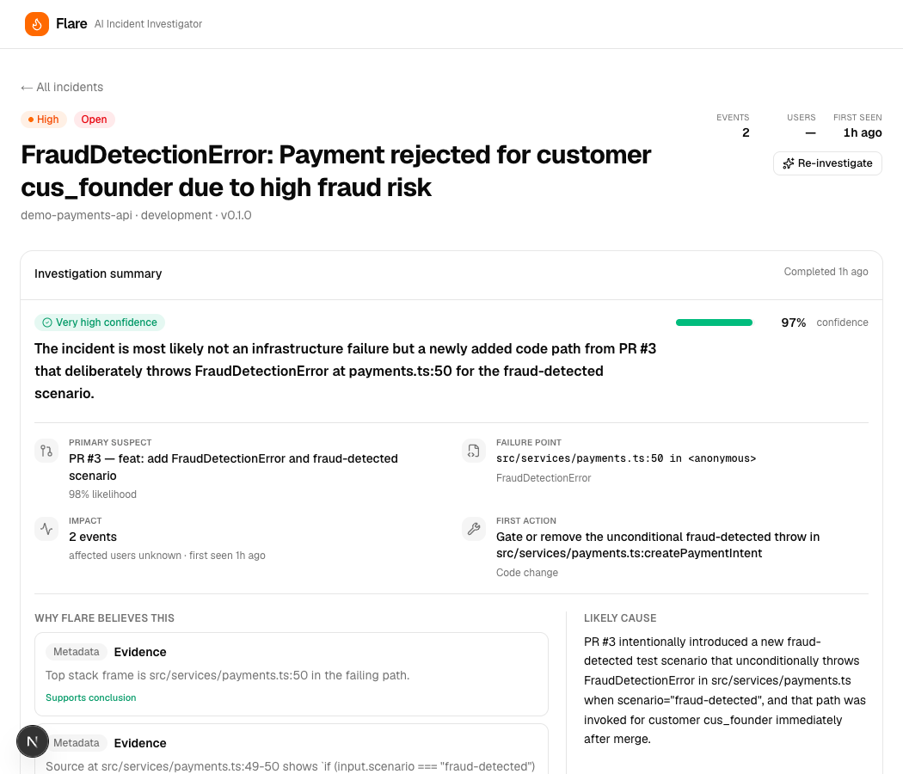
Demo: error to PR to fix
Real dashboard capture
Flare linked a live demo error to the suspect PR with confidence, stack frame evidence, and a first fix action.

Slide 4
How Flare works
Capture
SDK records errors, stack frames, release, request context, breadcrumbs, and spans.
Correlate
GitHub sync narrows to PRs, commits, deployments, source windows, and patches that touch stack files.
Investigate + hand off
Tool-calling AI returns a schema-validated report, evidence trail, suggested fix, and agent-ready payload.

Slide 5
Value & GTM
Wedge: the reliability layer for teams shipping AI-assisted code. Start GitHub-native; expand across error sources and coding agents.
MTTR
Buyer
Wedge
Motion
Cuts hours of context stitching
Technical founders and engineering leads
GitHub PR regression reports
Open-source SDK to usage-based SaaS

Slide 6
Roadmap & risks
01
Now
Live ingest, GitHub correlation, dashboard, evidence, and fix handoff.
Submit demo link
Polish 3-min story
Add team info
02
Next
GitHub App, multi-tenant auth, richer code evidence UI, and one-click fix PRs.
Slack delivery
Similarity memory
Org API keys
03
Risks
Model overclaims, repo access security, and incumbent AI features.
Schema checks
Narrow context budgets
Evidence-first UX

