Slide 1
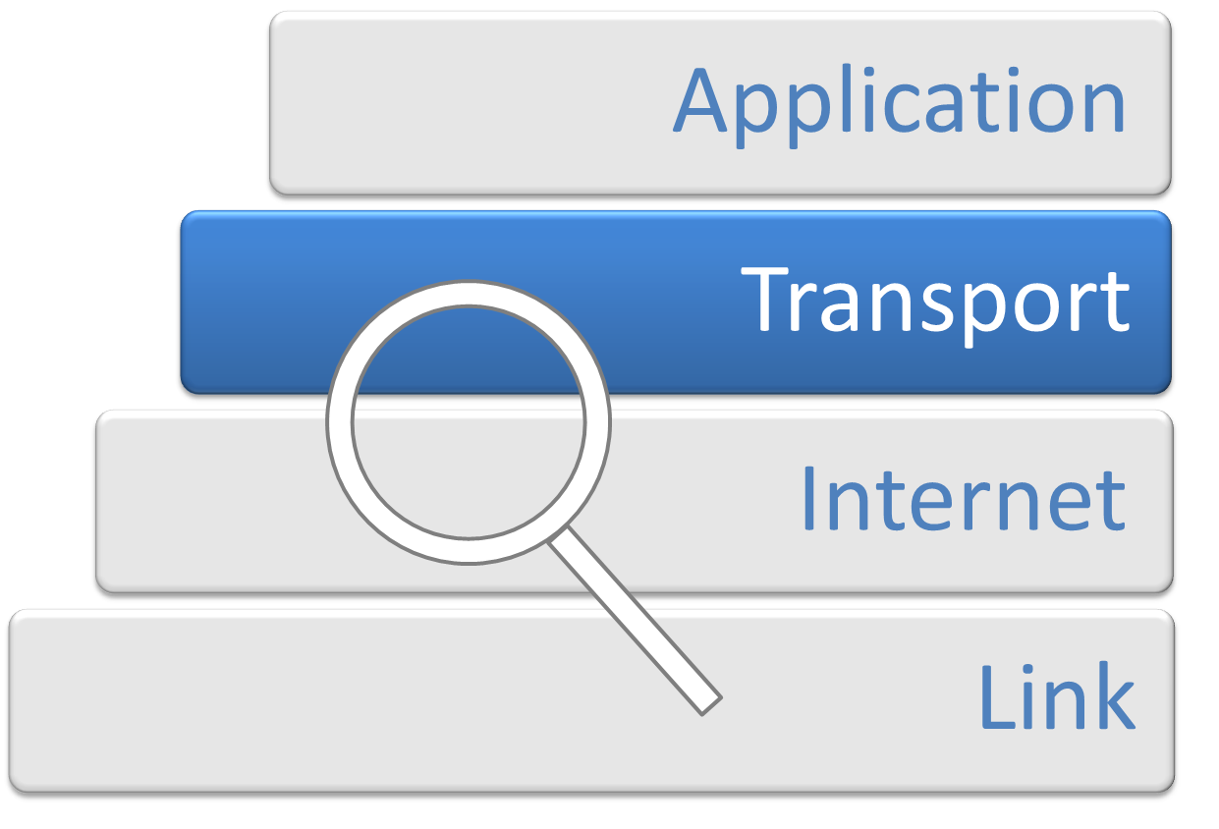
Transport Layer
Data communication and computer networks
Group number - 2
Group Members:
Nihar Singla
Saransh Bhargava
Karan Sharma
Abninav Vaddagiri
Aryan Pratap singh

Slide 2
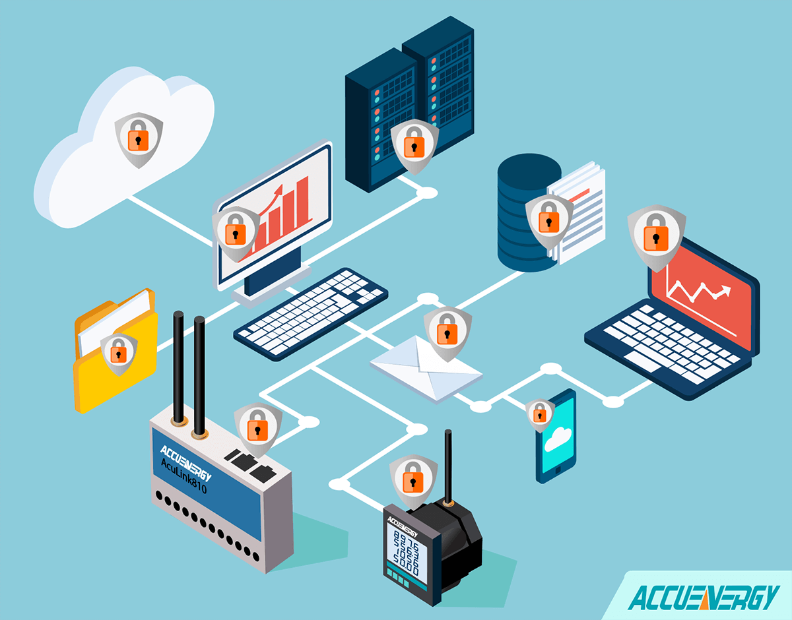
Introduction
The transport layer, positioned between the application and network layers, is a key element in network communication. Its primary function is to enable seamless end-to-end communication between applications on different devices. This layer achieves this by breaking down large messages into smaller segments, managing data flow, and ensuring the integrity of transmitted information through error control mechanisms. By regulating the rate of data transmission and overseeing error detection and correction, the transport layer plays a vital role in fostering reliable and efficient communication across computer networks

Slide 3







Transport Layer Functions
Flow Control (QoS - MUX & Demux)
Regulates the rate of data transfer, ensuring Quality of Service (QoS) by
Service Point Addressing Identifies and directs data to specific processes running on devices within
a network for precise
multiplexing multiple streams and
communication.
demultiplexing them at the receiving end.
Congestion Control
Segmentation and Reassembly
Divides large data into
Prevents network congestion by regulating the flow of data,
manageable segments for efficient
transmission and reassembles
optimizing performance, and
them at the destination.
avoiding bottlenecks.
Error Control (Error Checking and Recovery
Detects and corrects errors during
Connection Control
Manages the establishment,
data transmission, ensuring the
maintenance, and termination of
integrity of the communicated
connections for reliable communication.
information.

Slide 4






Protocols at the Transport Layer
Differences Between TCP and UDP
TCP establishes a connection before data transfer, while UDP does not.
TCP ensures reliable data delivery
Transmission Control Protocol
User Datagram Protocol
Connection-oriented protocol
with acknowledgment retransmission, whereas sacrifices reliability for transmission.
and UDP
faster
known for its reliability and error recovery mechanisms.
Connectionless protocol that
prioritizes speed and
Ensures ordered and accurate
efficiency over reliability.
TCP is best suited for applications
Ideal for real-time
delivery of data, suitable for applications requiring precision.
where accuracy is critical, while UDP is
applications like video
preferred for time-sensitive applications.
streaming and online gaming.

Slide 5
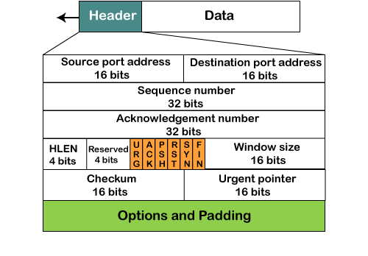
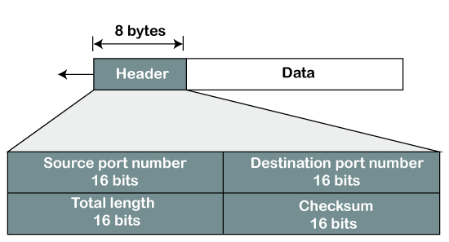
TCP Header Format V/S UDP Header Format

Slide 6

Transport Layer Ports
Within the Transport Layer, port numbers are crucial identifiers for directing incoming data to specific processes or services running on devices engaged in communication. Think of ports as doors or entry points on a device. Each application or service utilizes a unique port number, allowing for organized and efficient data exchange. Well-known ports, like Port 80 for HTTP and Port 443 for HTTPS, are examples of these identifiers. For instance, Port 22 is commonly associated with Secure Shell (SSH), showcasing how port numbers facilitate the proper routing of data to its intended destination process.

Slide 7
Challenges Faced
Challenges Faced
Congestion: The challenge of network congestion, where increased traffic leads to bottlenecks, affecting the efficient flow of data.
Flow: Flow challenges balance the pace
Solutions and Technologies Employing sophisticated algorithms like congestion detection + control - warning bit, choke packets, load shedding and congestion avoidance - random early access and traffic shaping.
of data transmission
to prevent or network effective
overwhelming recipients
congestion, ensuring
Implementing flow control strategies like stop and wait and sliding window.
communication.

Slide 8
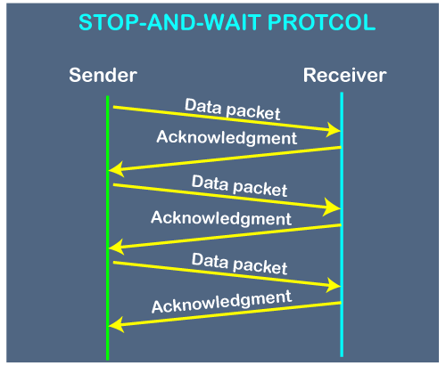
Flow Control - Stop and Wait
Stop-and-wait is a basic
flow control
technique used in the Transport Layer. In this method, after sending a data frame, the sender waits for an acknowledgment (ACK) from the receiver before sending the next frame. If an ACK isn't received within a specified time, the sender retransmits the frame. This ensures reliable, orderly data transmission.
Advantages: Simplicity.
Each packet is checked and acknowledged before the next packet is sent.

Slide 9
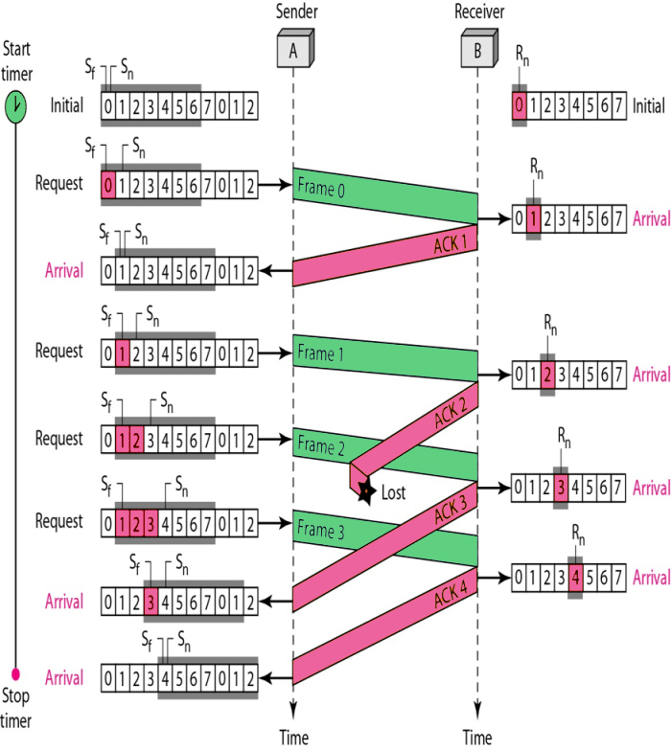
Flow Control - Sliding Window
Sliding window is another flow control technique used in the Transport layer of the Internet Protocol stack. It manages data transmission by allowing a sender to transmit multiple packets without waiting for individual acknowledgments. The receiver specifies a window size, dictating how many packets it can accept at once. TCP acknowledges receipt of data to the sender, and keep advertising new receive windows to the sending system. If the receive buffer is full, the receiving system advertises a receive window size of zero, and the sending system must wait to send more data.

Slide 10

Conclusion
In conclusion, the Transport Layer serves as the backbone in data communication and computer networks, arranging a reliable and secure information exchange. We've explored its key functions, protocols like TCP and UDP, and witnessed the impact of advancements such as QUIC on communication speed. As we address challenges through congestion control, latency reduction, and robust security, the future holds exciting prospects. Anticipated trends include further optimization for high-demand applications, the integration of artificial intelligence in congestion management, and continuous innovations in security protocols to adapt to evolving cyber threats. The Transport Layer's evolution promises a future of even more agile, responsive, and secure communication networks.

Slide 11

Thank You
F o r Y o u r A t t e n t i o n

