Slide 1

Time Series Forecasting for Electrical Load
University at Buffalo, Dec 10 , 2024
Nihar Madasu, Archana Bhusara, Pranavi Chintala, Divija Vasagiri

Slide 2
Introduction
Motivation:
The dataset captures minute-by-minute power consumption measurements from a household over almost four years (Dec 2006 - Nov 2010).
With the growing need for efficient energy management, accurate forecasting of electrical load is essential.
Understanding power demand patterns and spikes helps improve grid stability and efficiency.

Slide 3
Introduction
Significance:
The dataset is widely cited for time series forecasting in electrical load prediction.
Forecasting power consumption is crucial for optimizing energy distribution and reducing unnecessary costs.
Various studies have applied machine learning models to predict power demand, highlighting the potential of this dataset for deeper insights.

Slide 4
Methods
Software Description:
Tools used: R, Rstudio
Libraries: ggplot2, Statsmodels (ARIMA for time-series forecasting, ETS, Multiple Linear Regression, Seasonal Naïve), tibble, dplyr, tidyr, readr, lubridate, tsibble, fable, fabletools, feasts, tsibbledata, forecast, zoo, tseries, corrplot
Methodology:
Data Preprocessing:
Handling missing values via forward/backward filling or interpolation to maintain dataset integrity.

Slide 5
Methods
Data Source:
Dataset: UCI Machine Learning Repository
Features: Active power, reactive power, voltage, current intensity, and sub-meter readings from different household areas.
Missing data: Minor gaps (~1.25% missing), which will be handled through interpolation.
Reference for dataset : https://archive.ics.uci.edu/dataset/235/individual+household+electric+power+consumption

Slide 6
Methods
Methodology:
Modeling Techniques:
Conducted monthly time series analysis for attributes such as global active power, submeter 1, submeter 2, and submeter 3.
Analyzed seasonality and trend in the data.
Applied time series forecasting using ARIMA, ETS (Additive & Multiplicative Components), Seasonal Naïve, and Multiple Linear Regression to predict future power demand.
Utilized Box-Cox transformations, Augmented Dickey-Fuller Test, and checks for stationarity.
Examined the Autocorrelation Function (ACF) and Partial Autocorrelation Function (PACF) before fitting the ARIMA model.
Forecasted the next 6 months for each model and plotted the residuals.

Slide 7
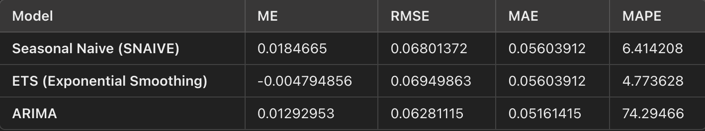
Results & Discussions
RMSE and MAE: ARIMA has the lowest RMSE (0.0628) and MAE (0.0516), making it the most accurate model for predictive error.
MAPE: ARIMA’s MAPE (74.29%) is high, indicating a larger relative error despite its low RMSE and MAE.
ME: ETS has a slight underestimation tendency (negative ME), while MLR and SNAIVE have nearly zero ME.

Slide 8
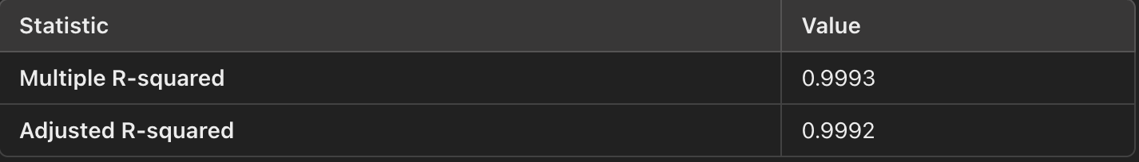
Results & Discussions
ARIMA is better for forecasting, as it captures time-series trends and seasonality, with strong performance in RMSE and MAE, though its MAPE is higher.MLR has very high R-squared and Adjusted R-squared values, indicating a good fit to the data, but it may not fully capture the temporal patterns like ARIMA.
Conclusion: ARIMA is the better model for accurate forecasting due to its lowest RMSE and MAE, along with a lower AIC and AICc. While MLR excels in explaining relationships, ARIMA outperforms it in time-based predictions, making it the preferred model for forecasting.

Slide 9
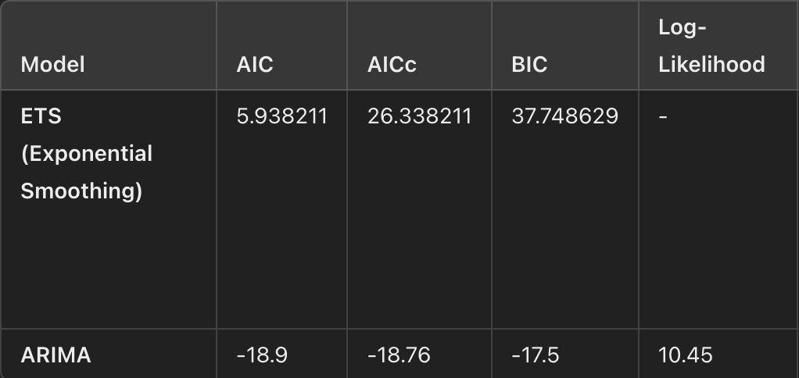
Results & Discussions
Evaluation: ARIMA has lower AIC and BIC values, indicating a better fit. The log-likelihood value also suggests ARIMA captures the data patterns more effectively.
Conclusion: ARIMA is the better model based on AIC and BIC values.

Slide 10
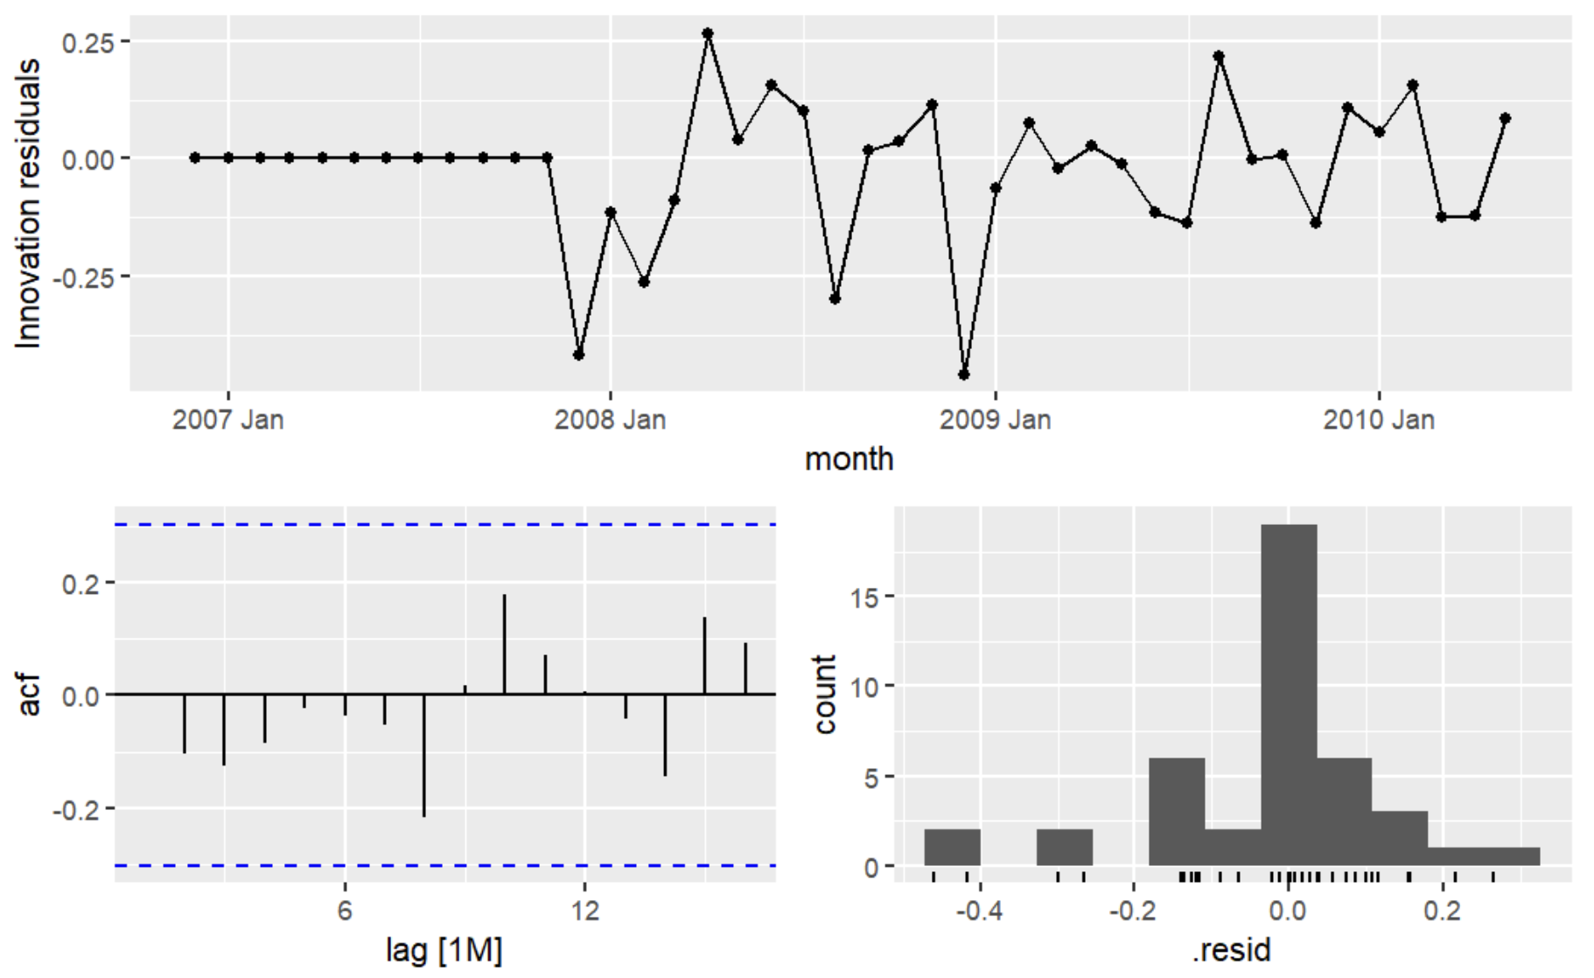
Results & Discussions
The plot analyzes the residuals from a time series model:
Innovation Residuals: The residuals fluctuate around zero, with some spikes, indicating occasional outliers or irregular patterns.
ACF (Autocorrelation Function): The lack of significant autocorrelations suggests the model has captured the underlying patterns well, leaving only random noise.
Histogram of Residuals: The residuals are somewhat skewed, but they appear to be roughly centered around zero, indicating the model fits the data fairly well.
Overall, the model is reasonable, capturing trends effectively, though it may not fully account for occasional outliers.

Slide 11
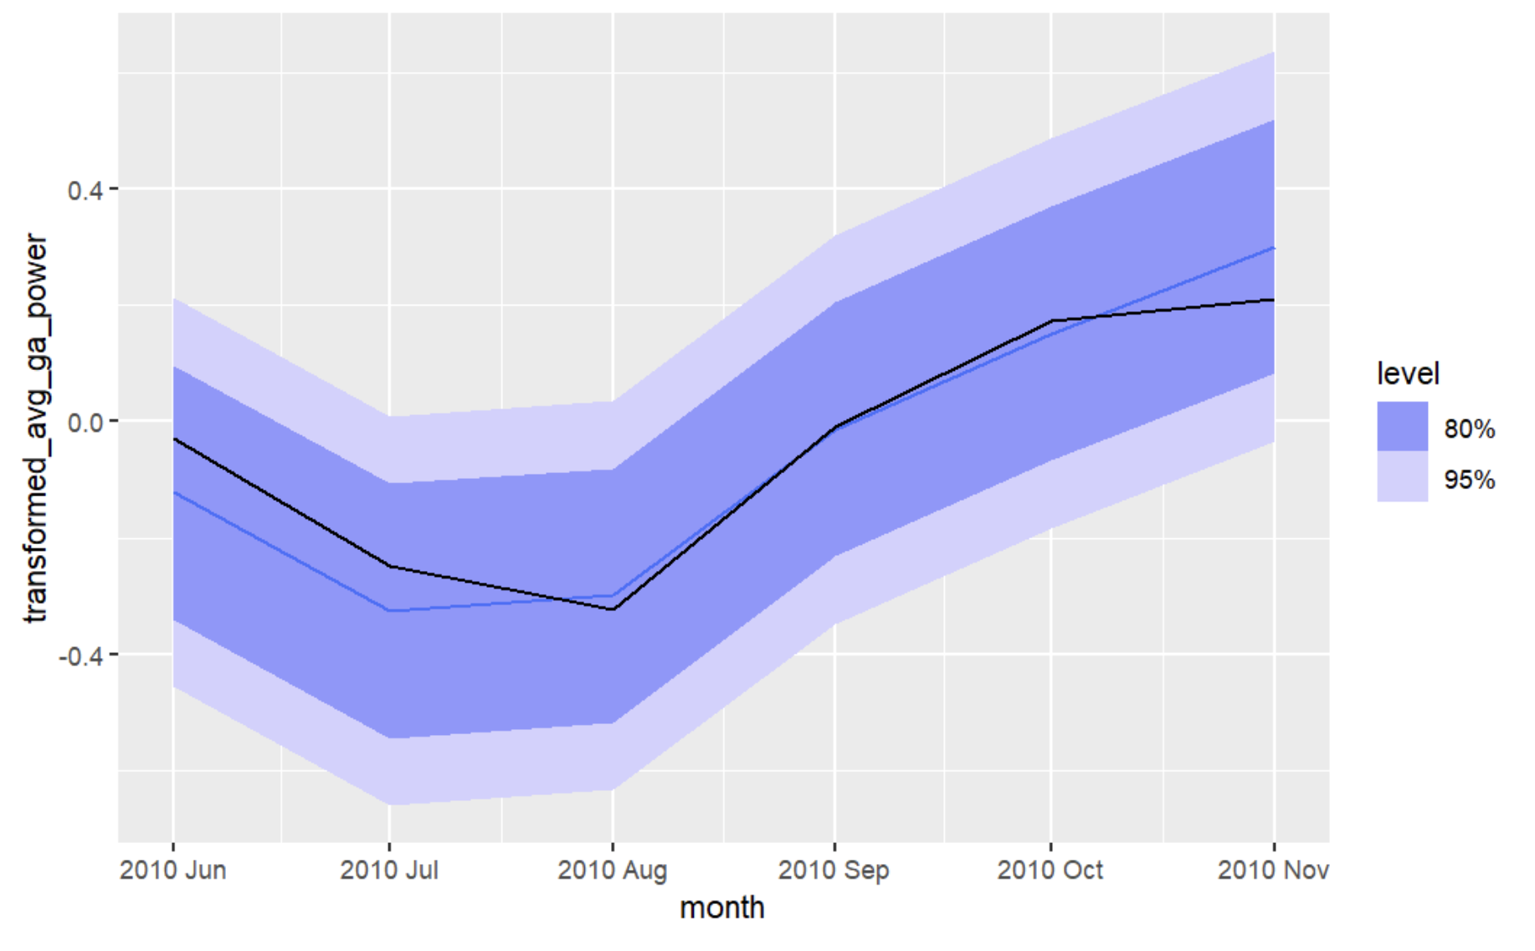
Illustrative Examples
The plot shows the forecast of electrical power consumption using the ARIMA model.
What the Plot Shows:
The black line represents actual historical values (June-November 2010).
The shaded areas represent forecasted values for October and November, with:
95% confidence interval (darker blue) indicating higher certainty.
80% confidence interval (lighter blue) showing a narrower range with less certainty.
Key Insights:
The forecast shows an increasing trend in electrical consumption.
The widening confidence intervals indicate higher uncertainty for long-term predictions.
ARIMA effectively captures the trend and provides reliable forecasts for decision-making.

Slide 12
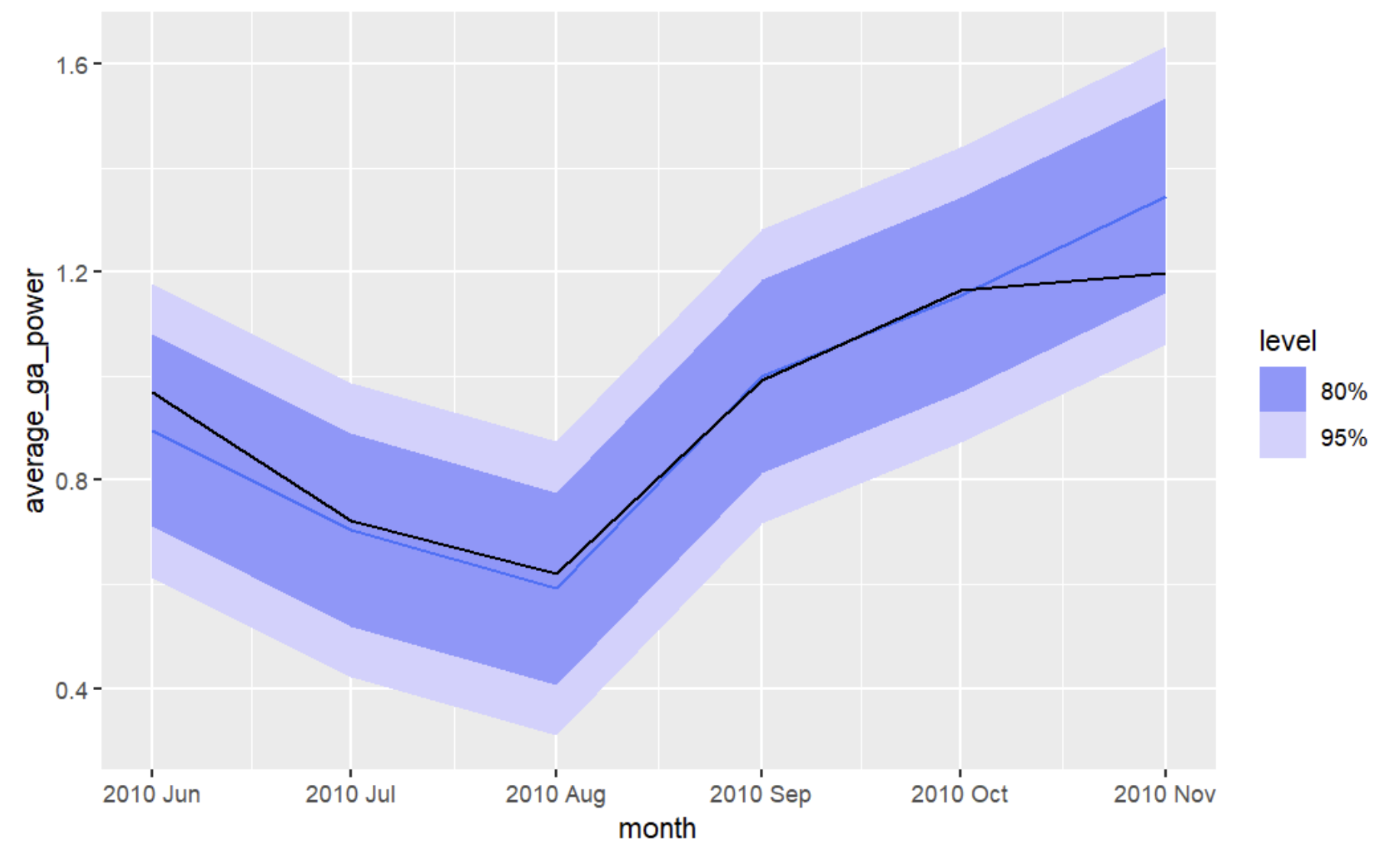
Illustrative Examples
ETS Model Forecasting
The plot shows the forecast of electrical power consumption using an ETS model for next 6 months, which predicts future values based on past data.
What the Plot Shows:
The black line represents the historical power consumption (June-November 2010).
The shaded area represents forecasted values for October and November 2010, with:
A 95% confidence interval (darker blue) indicating a 95% certainty that actual values will fall within this range.
An 80% confidence interval (lighter blue) showing a more narrow range with 80% certainty.
Key Insights:
The forecast indicates a rising trend in power consumption.
As the forecast period extends, the uncertainty increases (widening shaded area).
The ETS model captures trends and seasonality effectively, with confidence intervals guiding forecast reliability and decision-making for power demand management.

Slide 13
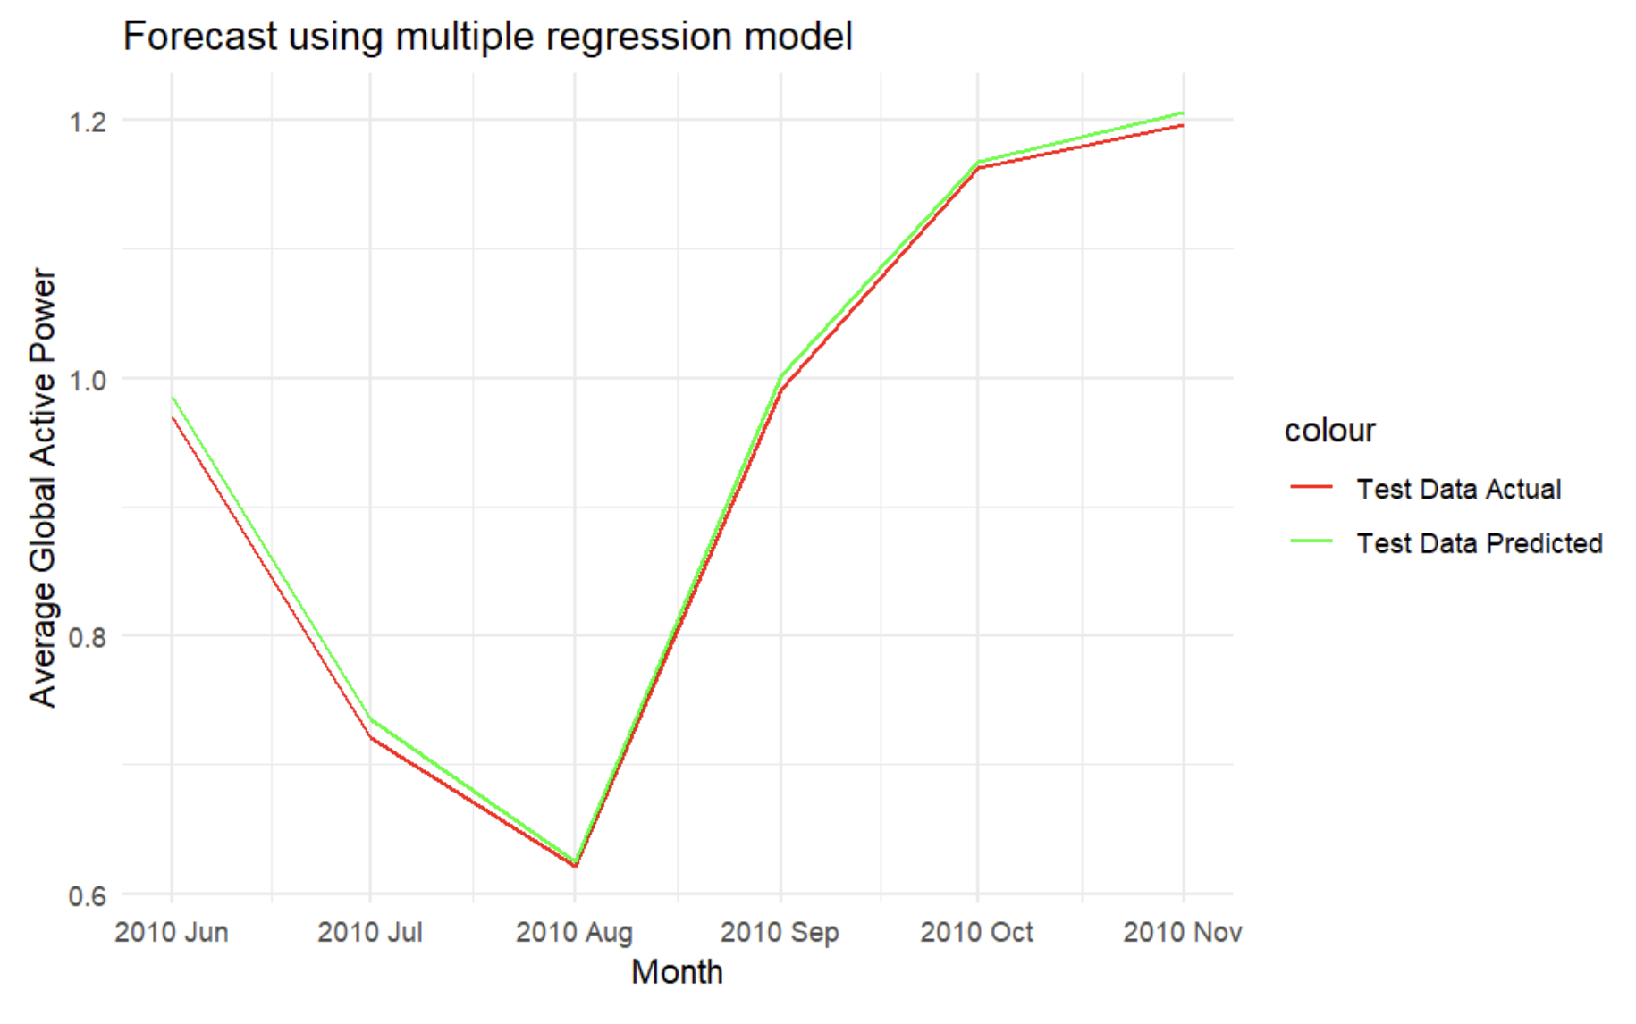
Illustrative Examples
Multiple Linear Regression Forecasting
The plot shows the forecast of electrical power consumption using an MLR model for next 6 months, which predicts future values based on past data.
What the Plot Shows:
The red line represents actual power consumption data (June-November 2010), while the green line represents predicted values from the model.
The close alignment of the lines indicates good model performance.
Key Insights:
Both actual and predicted values show a similar trend, with power consumption rising in the later months of 2010.
The model accurately predicts power consumption, demonstrating its reliability for forecasting future demand based on historical data.

Slide 14
Impact and Sustainability
Impact on Power Consumption Management:
The models developed (ARIMA, ETS, etc.) can significantly improve the forecasting of electrical load, aiding in better energy management.
Accurate load forecasting helps reduce unnecessary energy production, enabling energy providers to optimize power grid usage and avoid overproduction, which can result in lower costs and less environmental impact.
Support for Smart Grid Development:
The ability to predict electrical demand at a granular level (e.g., minute-by-minute) supports the development of smarter grids, where power is distributed based on real-time demand rather than static or overly broad forecasts.

Slide 15
Impact and Sustainability
Sustainability:
By enhancing energy efficiency, these forecasting models contribute to sustainable practices, reducing energy wastage, lowering carbon emissions, and supporting the transition to more renewable energy sources.
Improved load prediction can lead to better integration of renewable energy into the grid, ensuring that intermittent power sources (like solar or wind) are better managed.

Slide 16
Conclusion
Summary:
This project demonstrates the application of time series forecasting techniques like ARIMA and ETS to predict electrical power consumption, providing insights into which model performs best.
ARIMA emerged as the superior model based on AIC, BIC, RMSE, and MAE, effectively capturing trends and seasonality in the data.
Future Work:
Future research can explore more advanced forecasting techniques, such as deep learning models, to further improve prediction accuracy.
The models can also be expanded to multiple households or larger datasets to enhance the scalability of the predictions.
Final Takeaway:
The results show the potential for machine learning and time series forecasting to transform energy management, supporting both economic and environmental sustainability goals.

