Slide 1

Virtualization & Cloud Computing
Harnessing Cloud Computing for Fraud Detection in Online Payment
Final Project
Team Members:
1. Shubhankit Dutt (G23AI2070)
2. Nihar Dave (G23AI2097)
3. Priyank Bhardwaj (G23AI2038)

Slide 2
OVERVIEW
The rise of online payment fraud is a growing concern in the rapidly evolving digital transaction landscape. It presents significant risks to both financial institutions and consumers, resulting in monetary losses and diminishing trust in online payment systems.
The goal of this project is to develop an advanced machine learning solution capable of detecting fraudulent transactions and harness cloud computing for deployment.
We have used Random Forest Algorithm for data classification and google cloud app engine platform for deployment of our model.
We have created a Flask application along with a web page built using html which predicts the results.
The flask app is then deployed on google cloud platform for accessibility and scalability.
Showcased benefits of deploying a web application on cloud platforms rather than the traditional methods.

Slide 3

Github Links and Project URL
Github link of our project:
https://github.com/nihardave19/VCC_Project
Web Application URL:
https://vcc-final-project.el.r.appspot.com/

Slide 4
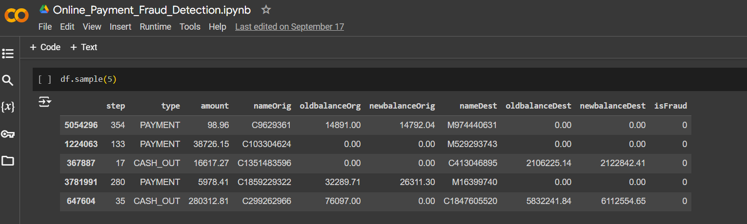
ML Model Code
We have used Random Forest Algorithm for classification of Fraud transactions.
Below is a snippet of the columns we have in the data.

Slide 5
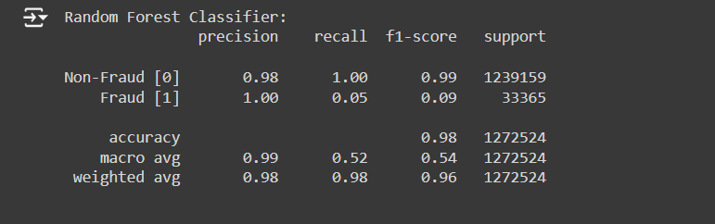
The features for the prediction of the model are as follows:
Step, type, amount, oldbalanceOrg, oldbalanceDest
We got the below scores for our model.

Slide 6
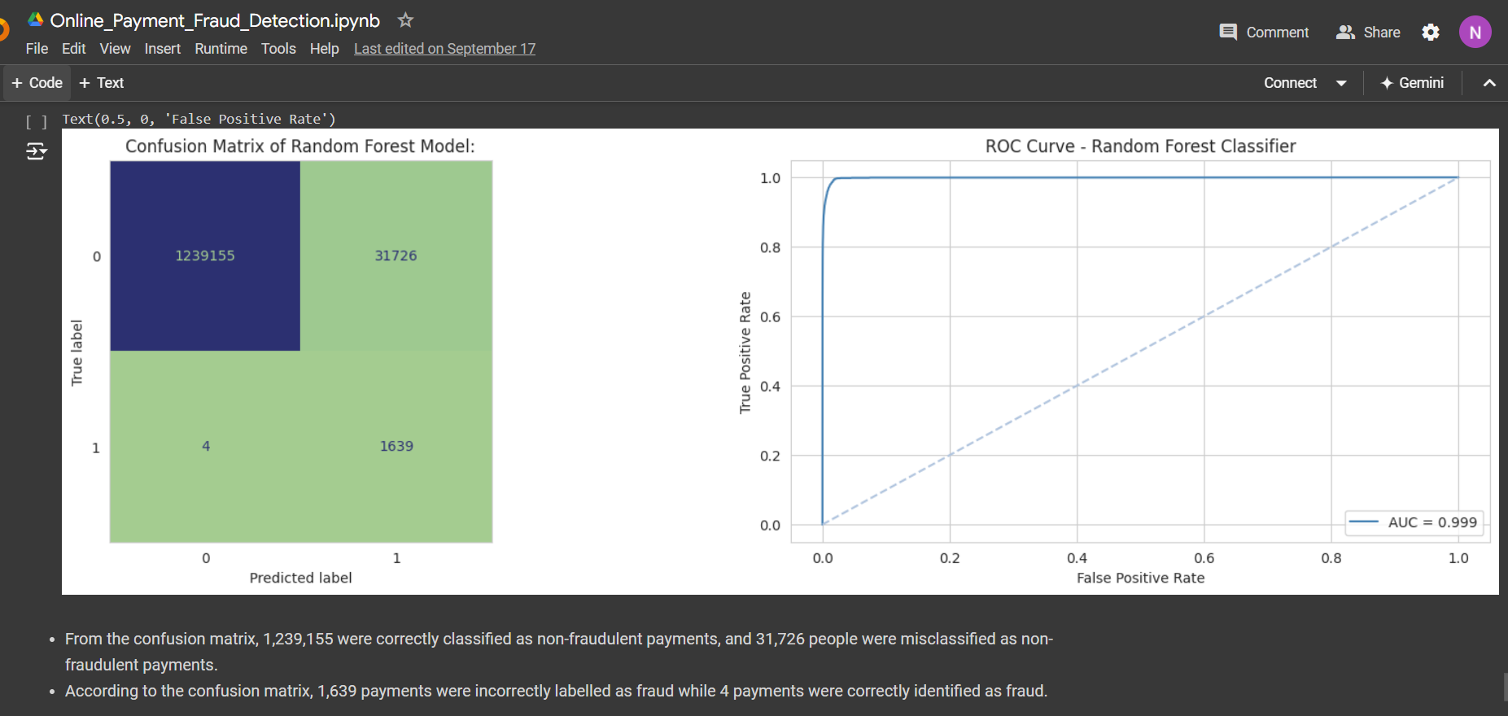
Below is the snippet for the model confusion matrix and ROC curve
Here we completed training our model with required data.

Slide 7
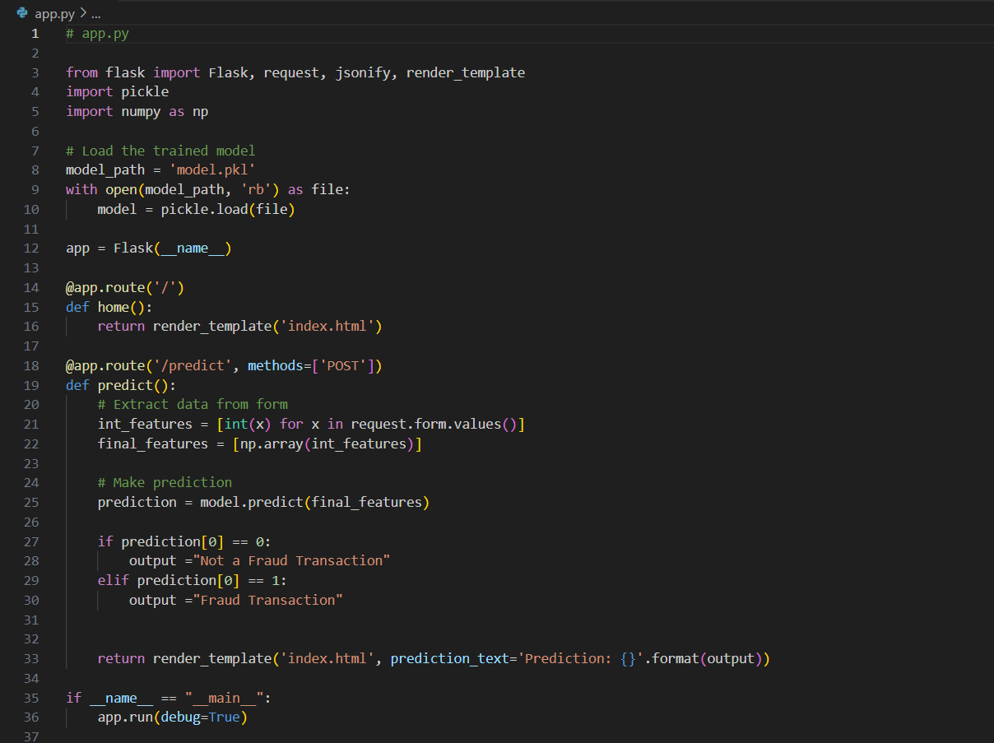
We created a pickle file for our python code and downloaded it to our local directory of the project.
After that, we created a flask application for its usage.

Slide 8
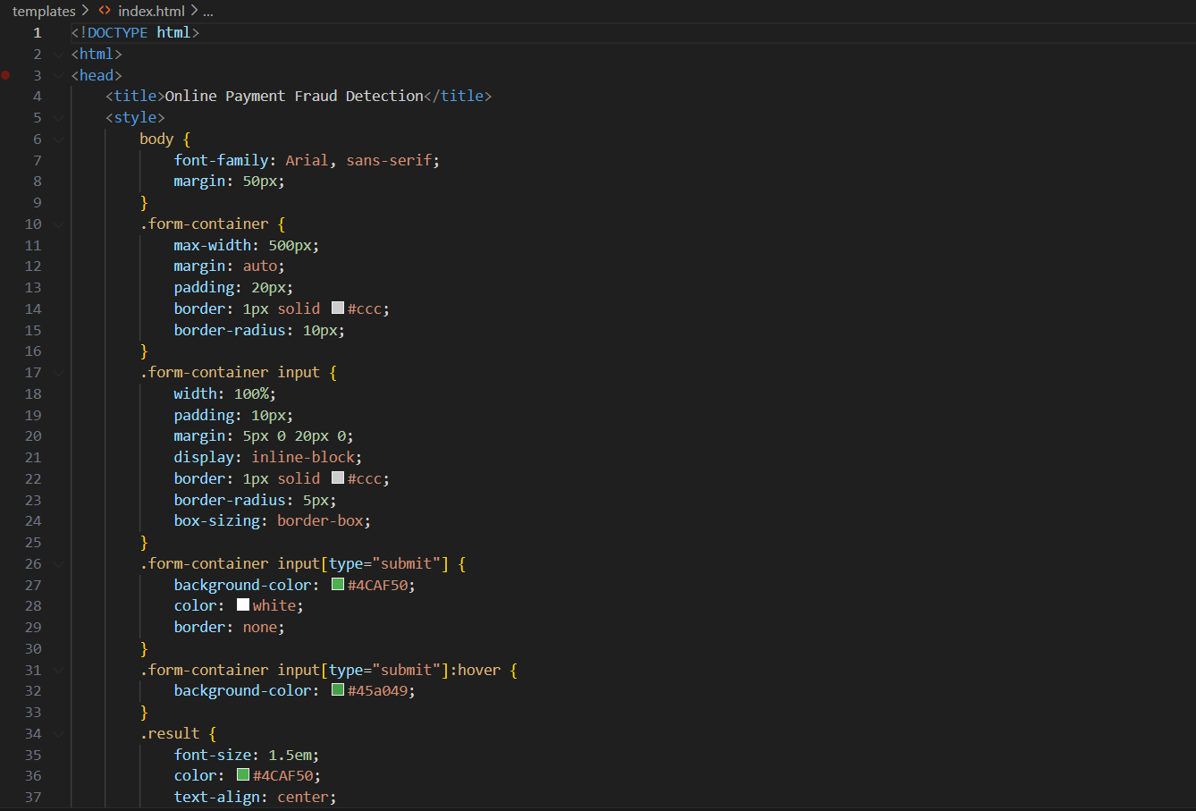
We also created a html file for providing a user interface for predicting the model
We then created a virtual environment using venv and tested the application on local machine whether its working or not.

Slide 9
Deployment of Web App on Google Cloud
First we created a Project named VCC-Final-Project on google cloud where we will host our web application.
We have used Google App Engine to deploy our application.
We installed Google Cloud SDK in our local machine.
Then we created app.yaml file which is required to deployment
We also created a requirements.txt file which has all the libraries and its versions which are required to be installed.
Finally after checking all files, we deployed the app on Google App Engine.

Slide 10
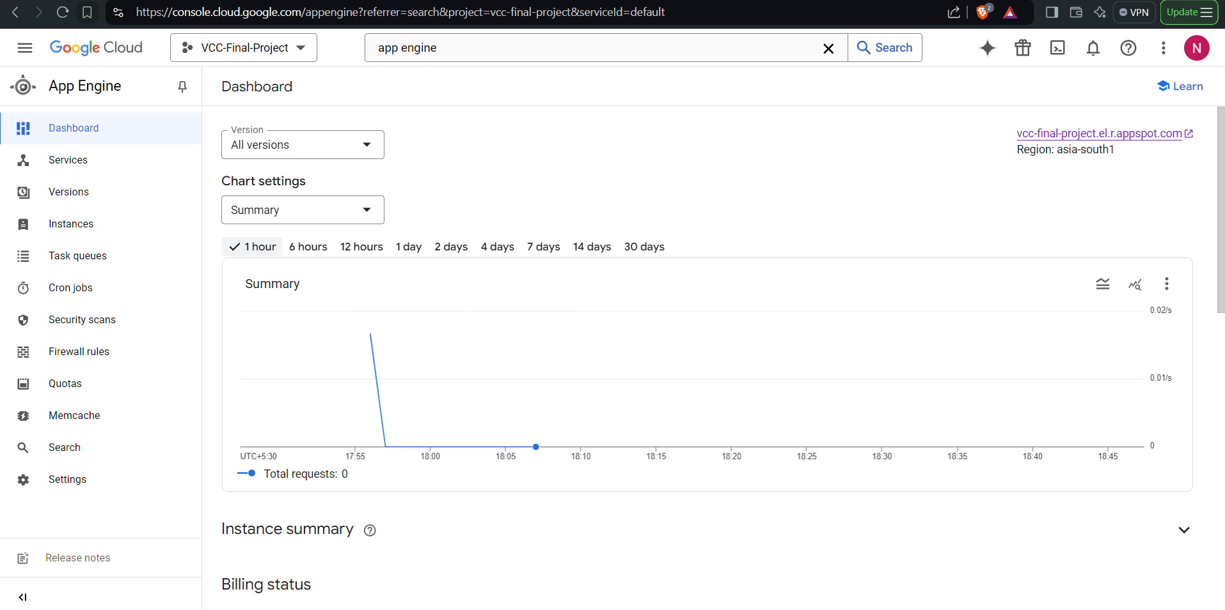
Below are the screenshots of the deployment on Google Cloud.

Slide 11
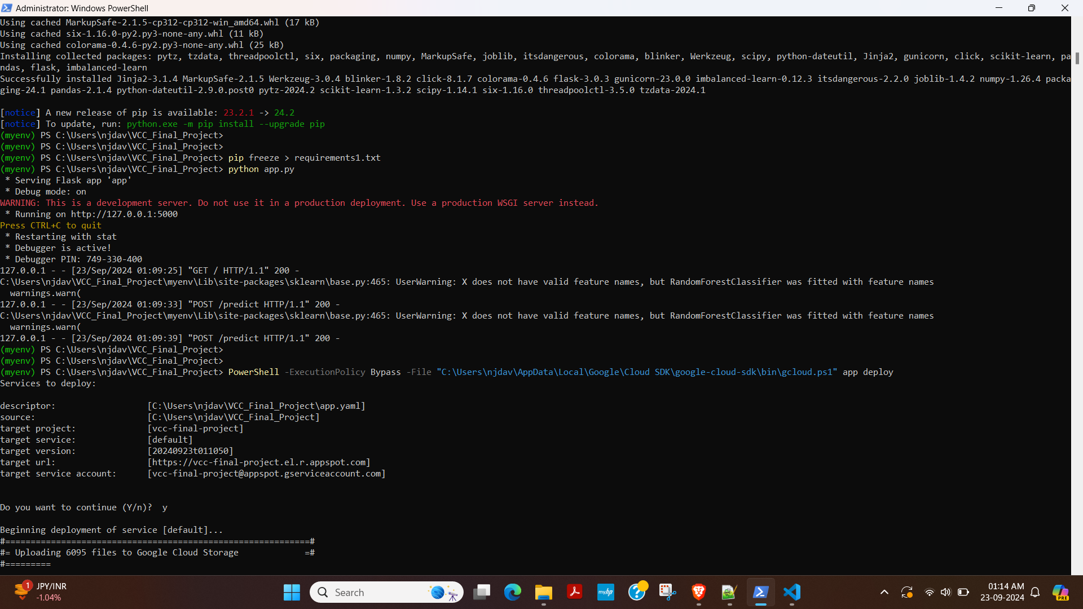
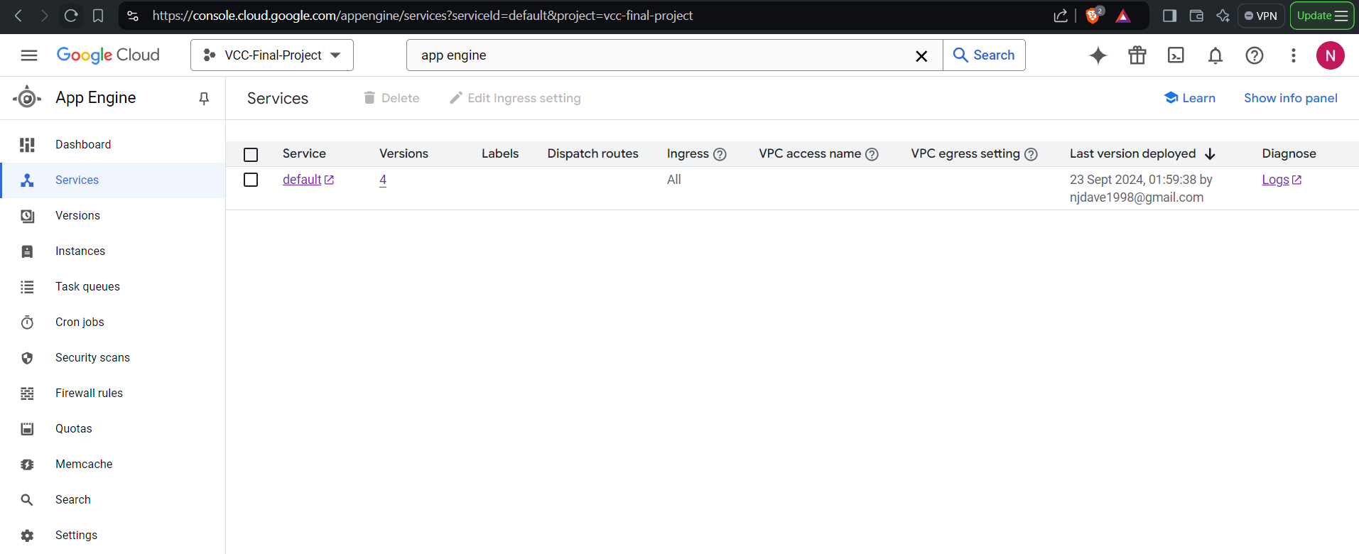

Slide 12
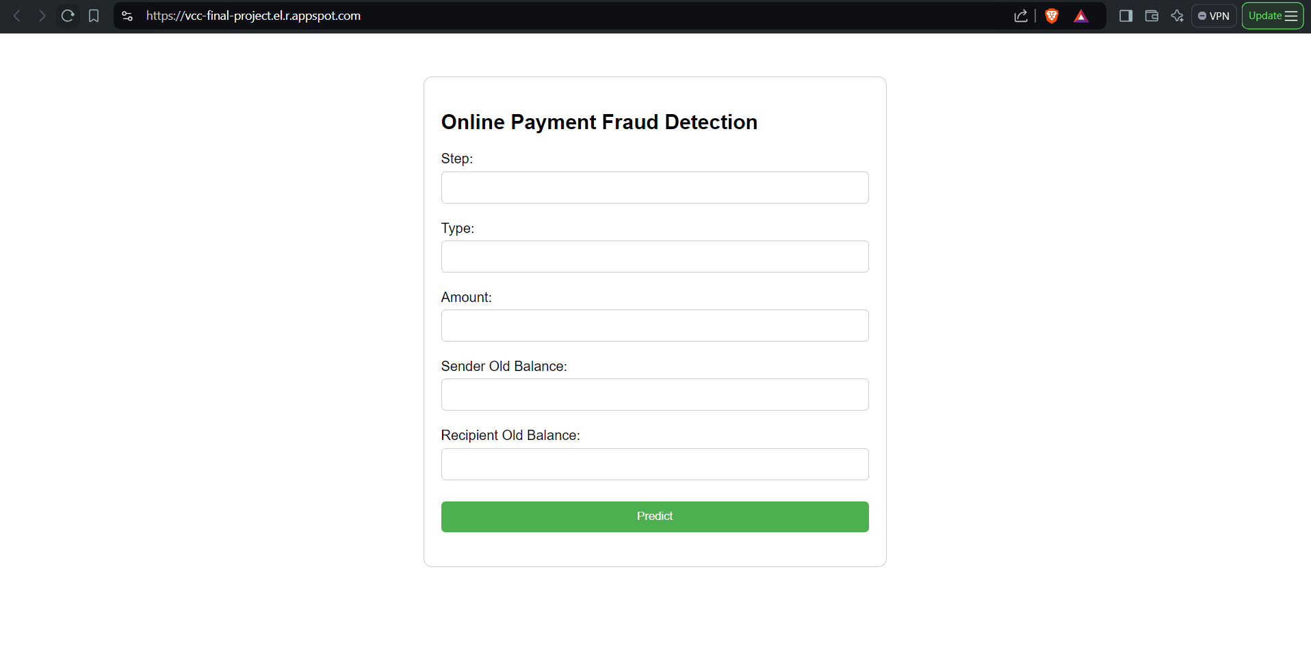
Project and App Engine service was already enabled from the google cloud console. So the commands used for deployment on Google App Engine are:
gcloud init
gcloud app deploy
The UI of our project is shown below:

Slide 13
Benefits of Google App Engine over traditional methods of Deploying Web Applications
Fully managed: App Engine handles infrastructure management tasks like server provisioning, load balancing, and scaling, allowing developers to focus on writing code.
Scalability: App Engine automatically scales resources based on demand, ensuring optimal performance and cost-efficiency.
Reliability: Google's infrastructure provides high availability and reliability, minimizing downtime and ensuring consistent performance.
Cost-effective: App Engine's pay-as-you-go pricing model makes it cost-effective for various application sizes.
Integration: It seamlessly integrates with other Google Cloud Platform services, offering a comprehensive solution for building and deploying applications.

Slide 14
Conclusion
Google App Engine offers a compelling alternative to traditional methods of deploying web applications. Its fully managed infrastructure, scalability, reliability, cost-effectiveness, and seamless integration with other Google Cloud Platform services make it a strong choice for developers seeking a simplified and efficient deployment solution.
While traditional methods might offer more granular control over infrastructure, App Engine's benefits can outweigh these factors for many applications. By automating routine tasks and optimizing resource allocation, App Engine can help developers focus on building and improving their applications, ultimately leading to faster development cycles and better user experiences.

