Slide 1
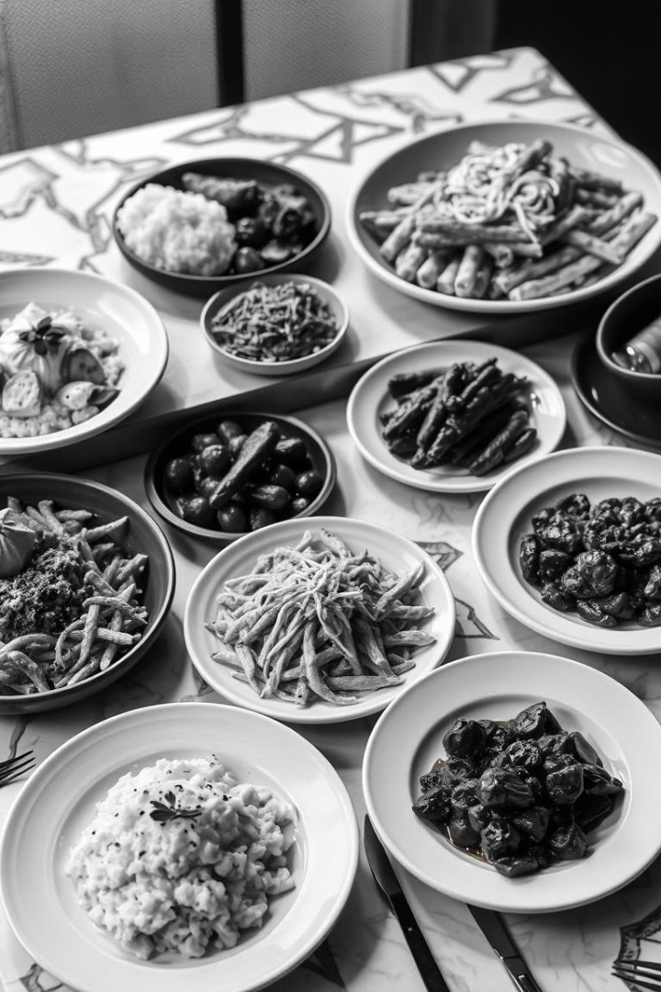
Flavor Fusion: A Culinary Adventure Awaits
Embark on a culinary journey where diverse flavors collide, creating a symphony of taste. Welcome to Flavor Fusion.

Slide 2
Understanding Flavor Profiles: The Building Blocks
Sweet
Sour
Salty
Bitter
Sugars, fruits, honey, and syrups bring a delightful sweetness that balances savory and acidic notes.
Acids like citrus, vinegar, and yogurt add brightness and complexity to dishes.
Salt enhances flavors and balances other taste components.
Coffee, chocolate, and certain vegetables contribute bitterness, adding depth and intrigue.

Slide 3

Global Influences: Exploring International Cuisine
Asian
From the fiery heat of Thai chili to the delicate umami of Japanese dashi, Asian cuisine offers a world of flavor.
Latin American
Latin American flavors are vibrant and bold, with spices like cumin, coriander, and chili peppers adding heat and depth.
Mediterranean
Mediterranean cuisine is known for its use of fresh herbs, citrus fruits, olive oil, and flavorful spices.
Indian
The diverse flavors of India are a testament to the country's rich culinary heritage. From fragrant curries to tangy chutneys, Indian cuisine offers a unique and delicious experience.

Slide 4
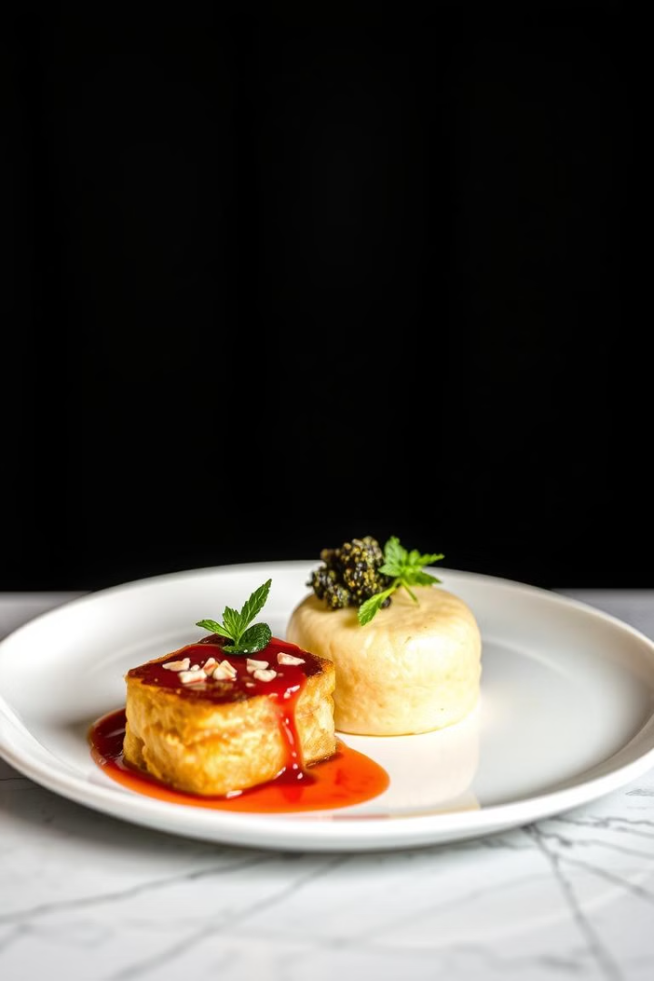




Sweet Meets Savory: Unexpected Pairings
Chocolate & Chili
This classic pairing balances the sweetness of chocolate with the heat of chili, creating a surprising and delicious combination.
Mango & Shrimp
The sweetness of mango complements the delicate flavor of shrimp, creating a refreshing and unique dish.
Caramel & Bacon
This pairing plays on the savory-sweet notes of both ingredients, creating a rich and satisfying experience.
Pineapple & Pork
The sweetness of pineapple balances the richness of pork, creating a dish that is both flavorful and refreshing.

Slide 5




Texture is Key: Adding Dimension to Your Dishes
Crispy
Smooth
Soft
Chewy
Crispy textures add a satisfying crunch to dishes, providing a contrast to soft and smooth ingredients.
Smooth textures create a luxurious and creamy feel, enhancing the flavor profile of the dish.
Soft textures are comforting and comforting and provide a balance to crunchy and crispy elements.
Chewy textures add a delightful bite to dishes, creating a satisfying experience.

Slide 6

The Art of Seasoning: Herbs, Spices, and More
1
Fresh Herbs
Fresh herbs add a burst of flavor and aroma to dishes, complementing the base ingredients.
2
Dried Spices
Dried spices offer a concentrated flavor that can be used to create complex and layered dishes.
3
Seasoning Blends
Pre-made blends offer convenience and a consistent flavor profile for various dishes.
4
Salt & Pepper
These essential seasonings enhance the flavor of any dish, balancing other taste components.

Slide 7
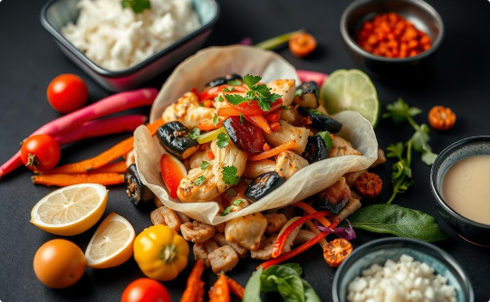
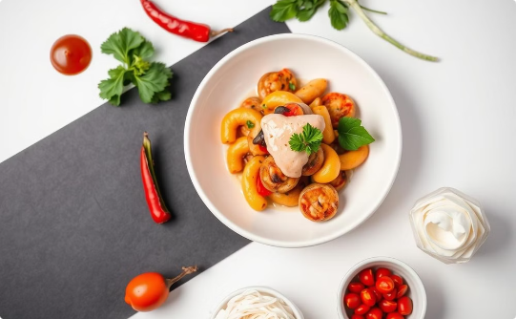
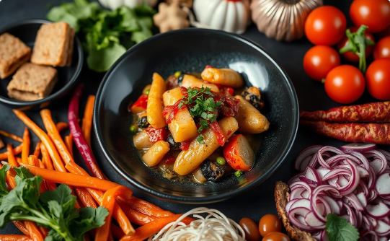
Fusion Recipes to Try at Home: Get Cooking!
Spicy Mango Shrimp Tacos
Coconut Curry Noodle Soup
Lemon-Garlic Grilled Salmon with Roasted Vegetables
A blend of sweet mango, spicy chili, and juicy shrimp creates a delightful taco experience.
This creamy soup combines the rich flavors of coconut milk, aromatic curry spices, and fresh noodles for a satisfying meal.
The tangy citrus notes of lemon and garlic complement the delicate flavor of grilled salmon, while roasted vegetables add a touch of sweetness and earthy flavors.

Slide 8
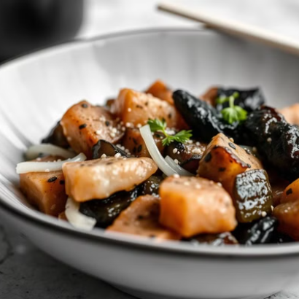
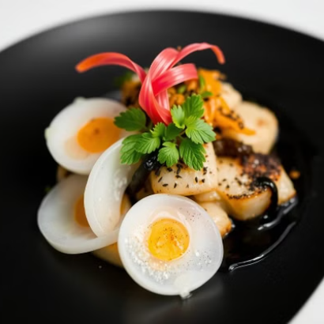
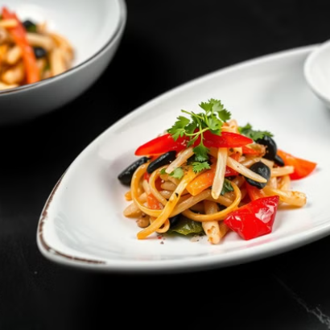

Share Your Fusion Creations: Join Our Community

