Slide 1


Module 3: Indian Intellectual Property Laws
Overview of Legal Framework and Protection in India
By:
Niharika Ravi Kumar
Roll no: 31
Branch: E&CS

Slide 2
Introduction to Indian IP Laws
Definition
Importance
Rights protecting creations of the mind: inventions, literary works, designs, symbols.
Encourages innovation
Safeguards creators’ interests
Fosters economic growth
Example: Indian pharmaceutical companies patenting COVID-19 vaccines, ensuring their rights while contributing to global health.

Slide 3






Types of Intellectual Property Rights in India
Patents
Trademarks
Copyrights
Protects new inventions. E.g., Tata Motors’ electric vehicle technology patent.
Distinguishes goods/services. E.g., Amul logo and slogan “The Taste of India”.
Protects literary/artistic works. E.g., Chetan Bhagat’s novels.
Industrial Designs
Geographical Indications
Aesthetic features of products. E.g., Royal Enfield motorcycle fuel tank design.
Origin-based products. E.g., Darjeeling Tea, Mysore Silk.

Slide 4

Patent Law in India
The Patents Act, 1970
Governs patent grant and protection in India. Regular amendments ensure adaptability.
Criteria: Novelty, Inventive Step, Industrial Application
Term: 20 years from filing date, non-renewable
Acquisition: 3 to 5 years
Case Study: CSIR developed and patented a novel anti-cancer molecule (1D-142). The patent was licensed to a pharmaceutical firm, which developed it further. This case illustrates effective IP management from R&D to product development, demonstrating economic and societal benefits.

Slide 5
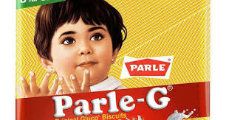
Trademark Law in India
The Trade Marks Act, 1999
The Trade Marks Act, 1999
Governs the registration, protection, and enforcement of trademarks in India.
Criteria: Distinctiveness, Non-descriptive nature, No conflict with existing marks Term: 10 years from registration date, renewable indefinitely Acquisition: 6 months to 2 years
Case Study: Parle Products registered and protected the Parle-G trademark, including its iconic yellow-and-red packaging and the “Parle-G” word mark. The trademark’s legal protection has prevented misuse by counterfeit biscuit brands, ensuring brand loyalty and market trust for decades.

Slide 6



Copyright Law in India
The Copyright Act, 1957
Protected Works
Protection Term
Comprehensive framework for protecting creative works.
Literary, dramatic, musical, artistic works, cinematograph films, sound recordings, and computer software.
Generally, lifetime of the author plus 60 years after their death.
I Example: A.R. Rahman’s globally acclaimed music compositions enjoy robust copyright protection, preventing unauthorized use.

Slide 7
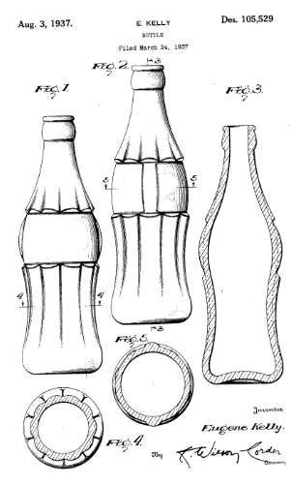
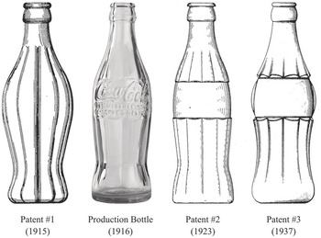
Industrial Designs
The Industrial Designs Act, 2000
Governs the protection of a product’s aesthetic, non-functional features in India.
Focuses on shape, configuration, pattern, ornament, or composition of lines or colors.
Criteria: Originality, Novelty, Visual Appeal, Industrial Applicability Term: 10 years from registration date, extendable by 5 years (maximum 15 years) Acquisition: 6 months to 1 year
Case Study: The Coca-Cola bottle’s unique contour shape is registered as an industrial design. This protection prevents competitors from copying its distinctive look, safeguarding brand identity and enhancing consumer recognition.

Slide 8

Geographical Indications
The Geographical Indications of Goods Act, 1999
Governs the registration and protection of goods that originate from a specific geographical region in India.
Ensures that only authorized users can use the registered GI name.
Criteria: Link between the product’s quality, reputation, or characteristics and its geographical origin
Term: 10 years from registration date, renewable indefinitely Acquisition: 1 to 2 years
Case Study: Darjeeling Tea was the first product in India to receive a GI tag. This registration ensures that only tea grown in the Darjeeling region can be marketed as “Darjeeling Tea,” protecting farmers’ livelihoods and preserving the product’s global reputation.

Slide 9


Enforcement and Remedies
Civil Remedies
Criminal Remedies
Key Agencies
Injunctions to stop infringement
Fines and imprisonment for severe cases like piracy and counterfeiting.
Police, Customs, and the Judiciary play crucial roles in enforcing IP rights.
Damages for losses incurred
Account of profits made by infringers
Deterrent against repeat offenders.
Landmark Case: Delhi High Court issuing an injunction against counterfeit Nike shoes, protecting brand integrity.

Slide 10

Challenges & Future of IP Laws in India
Current Challenges
Current Challenges
Pervasive piracy, especially in digital content
Rampant illegal distribution of movies, music, e-books, and software.
Example: Piracy websites like 123Movies leaking films before release.
Slow judicial processes leading to delayed justice
Lengthy litigation discourages creators from enforcing rights.
Example: Trademark disputes taking several years for resolution in Indian courts.
Sophisticated digital IP theft and cybercrime
Use of advanced hacking tools to steal trade secrets and copyrighted software.
Example: Source code leaks from IT companies via phishing attacks.
Future Landscape: Focus on protecting digital IP, regulating AI-generated works, and strengthening international cooperation through TRIPS and WIPO memberships.

Slide 11
Conclusion: The Future of Indian IP Law
Evolving Framework: Indian IP laws are TRIPS-compliant and constantly evolving to foster innovation and protect creators.
Empowering Stakeholders: Understanding IP law empowers creators, businesses, and policymakers to harness intellectual assets responsibly.
Balanced Growth: Continued balance needed between protection, access, and competition for sustainable growth.

