Slide 1
Parkinson's Disease Bioactivity Modeling
End-to-End Chemoinformatics Pipeline Results

Slide 2
Dataset Acquisition & Featurization
Retrieved bioactivity data from ChEMBL for 15 Parkinson's gene targets
Filtered for Human Single-Protein targets with standard IC50/Ki/EC50 values
Thresholds applied: Active ≤ 1000 nM, Inactive ≥ 10000 nM
Removed compounds with conflicting labels to ensure clean training data
Total Dataset: 35,909 unique compounds across 12 viable gene targets
Featurization: 1024-bit Morgan Fingerprints (ECFP4) + 7 Physicochemical Descriptors (e.g. MolWt, LogP)
3 targets (PARKIN, GRIN1_2, PINK1) dropped due to insufficient labeled data

Slide 3
Model Performance Summary (ROC-AUC)
Gene | N_total | XGBoost ROC-AUC | Logistic Reg ROC-AUC
ADORA2A | 7002 | 0.955 | 0.923
CHRM | 2669 | 0.939 | 0.884
COMT | 139 | 0.897 | 0.953
DRD1 | 1535 | 0.960 | 0.919
DRD2 | 8946 | 0.928 | 0.885
GBA1 | 750 | 0.893 | 0.862
GLP1R | 1679 | 0.954 | 0.926
LRRK2 | 4285 | 0.939 | 0.858
MAO_B | 5201 | 0.939 | 0.887
SLC18A2 | 220 | 0.981 | 0.953
SLC6A3 | 3205 | 0.949 | 0.940
SNCA | 272 | 0.874 | 0.986

Slide 4
Key Takeaways: XGBoost vs Logistic Regression
Both models performed exceptionally well (ROC-AUC consistently > 0.88)
XGBoost excels in SENSITIVITY (Recall) - catches almost all active compounds
Logistic Regression excels in SPECIFICITY - slightly more conservative, fewer false positives
Example on DRD2 (largest target): XGBoost achieved 98.4% Recall vs LR's 93.6%
Example on DRD2: LR achieved 65.3% Specificity vs XGBoost's 49.8%
On highly balanced datasets (e.g., MAO_B), XGBoost outperformed LR across all metrics (0.939 vs 0.887 ROC-AUC)

Slide 5
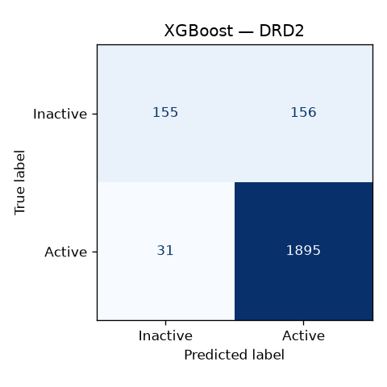
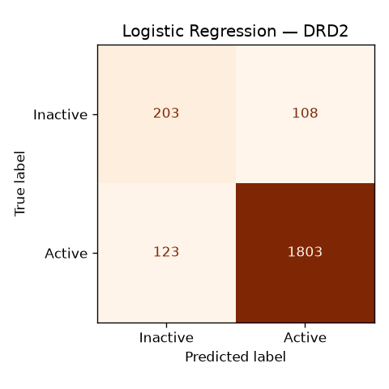
Confusion Matrix Comparison: DRD2 (Largest Dataset)
XGBoost
Logistic Regression

Slide 6
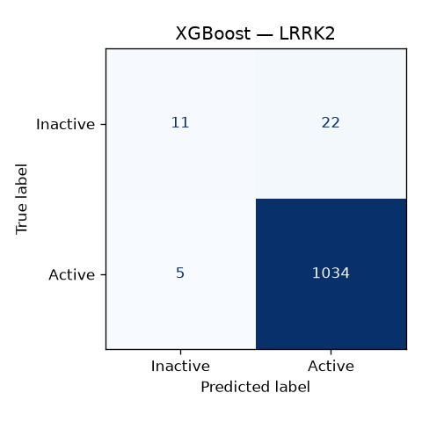
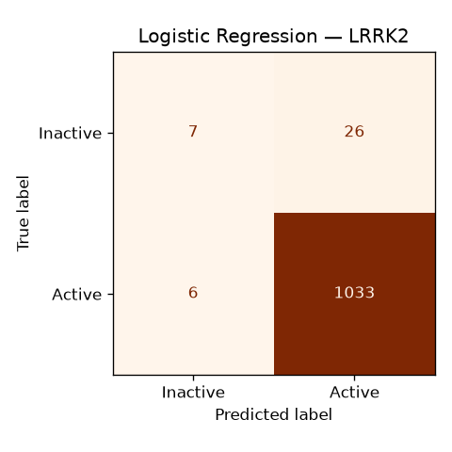
Confusion Matrix Comparison: LRRK2
XGBoost
Logistic Regression

Slide 7
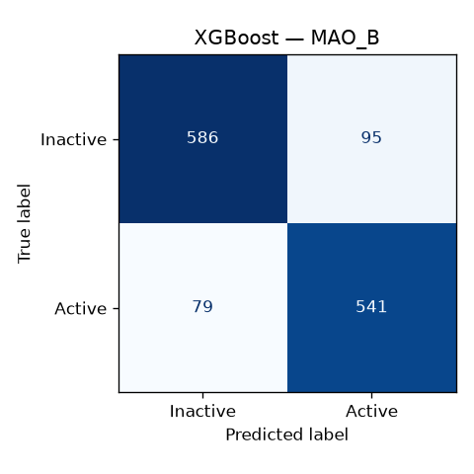
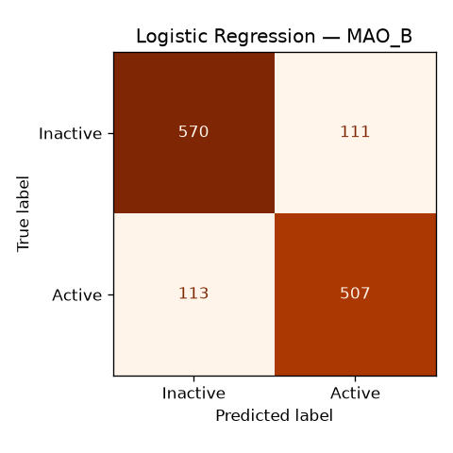
Confusion Matrix Comparison: MAO_B
XGBoost
Logistic Regression

Slide 8
Next Steps & Downstream Applications
Virtual Screening: Models are ready to predict activity of novel, unsynthesized compounds
Multi-Target Drug Design: We can screen compounds across all 12 targets to find selective multi-target profiles
Data Mining: The pipeline has successfully extracted the exact SMILES structures of the most potent known inhibitors for these PD targets

