Slide 1
Standard Chartered — Earnings Deep Dive
Synthetic Investment Research | Prototype Dataset

Slide 2
Executive Summary
Standard Chartered (STAN) — synthetic research case
Latest NIM: 1.64%
Latest ROE: 9.56%
CET1 ratio: 14.11%
P/B: 1.21x
All numbers are synthetic.

Slide 3
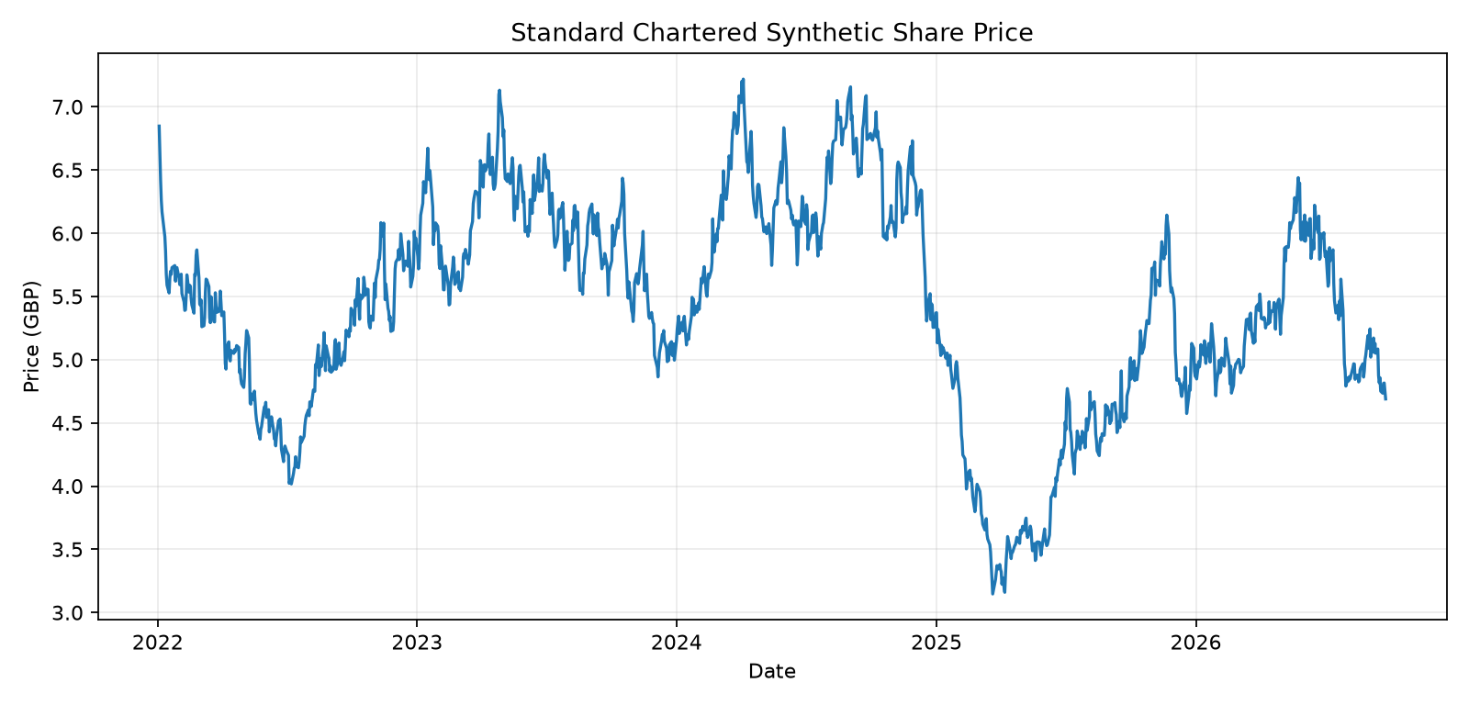
Historical Share Performance
Source: synthetic market.db / daily_prices

Slide 4
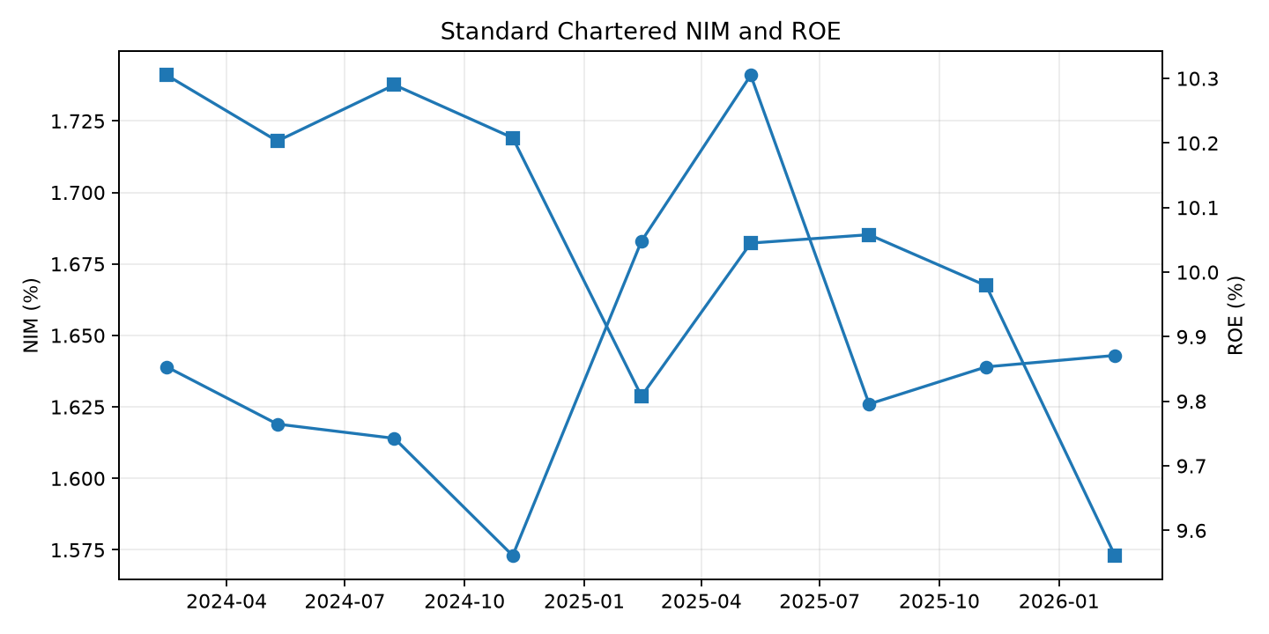
NIM and ROE
Source: synthetic market.db / fundamentals

Slide 5
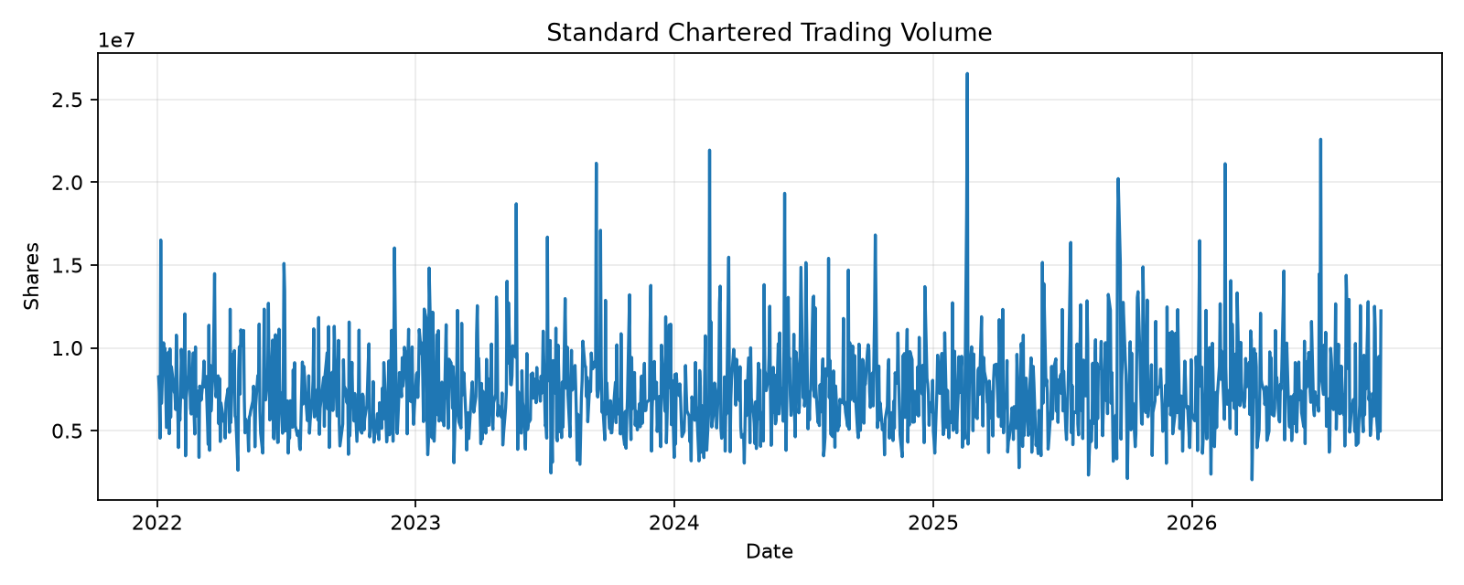
Trading Activity
Event dates contain synthetic volume spikes.

Slide 6
Latest Fundamental Snapshot
Date | Revenue | NIM | ROE | CET1 | NPL | P/E | P/B
2025-02-14 | 19196.87 | 1.683 | 9.808 | 14.278 | 2.259 | 10.324 | 1.294
2025-05-09 | 19140.7 | 1.741 | 10.045 | 14.088 | 2.308 | 10.095 | 1.184
2025-08-08 | 19593.39 | 1.626 | 10.058 | 13.984 | 2.178 | 9.963 | 1.332
2025-11-06 | 19938.56 | 1.639 | 9.979 | 14.16 | 2.129 | 11.208 | 1.37
2026-02-13 | 20148.23 | 1.643 | 9.561 | 14.107 | 2.194 | 10.521 | 1.205

Slide 7
Historical Event Map
EVENT-001 — FY2023 earnings
EVENT-002 — Q1 2024 earnings
EVENT-003 — Q2 2024 earnings
EVENT-004 — Q3 2024 earnings
EVENT-005 — FY2024 earnings
EVENT-006 — Q1 2025 earnings
EVENT-007 — Q2 2025 earnings
EVENT-008 — Q3 2025 earnings
EVENT-009 — FY2025 earnings
EVENT-010 — synthetic monetary-policy shock

Slide 8
Research Questions
Was the post-earnings share-price movement consistent with fundamentals?
How did trading volume change around the event?
How does valuation compare with sector peers?
Did NIM and ROE trends support the market reaction?
What additional evidence should an investment agent retrieve?

Slide 9
Data Provenance
Prices → market.db / daily_prices
Volume → market.db / daily_volume
Fundamentals → market.db / fundamentals
Events → data/reference/events.json
Document status → synthetic
Future versions will link this presentation to Outlook, news XML and API evidence.

