Slide 1
Singapore Banks — Sector Comparison
Synthetic Investment Research

Slide 2
Sector Thesis Framework
Compare profitability
Compare capital strength
Compare asset quality
Compare valuation
Compare share-price performance
Connect market reaction to historical events

Slide 3
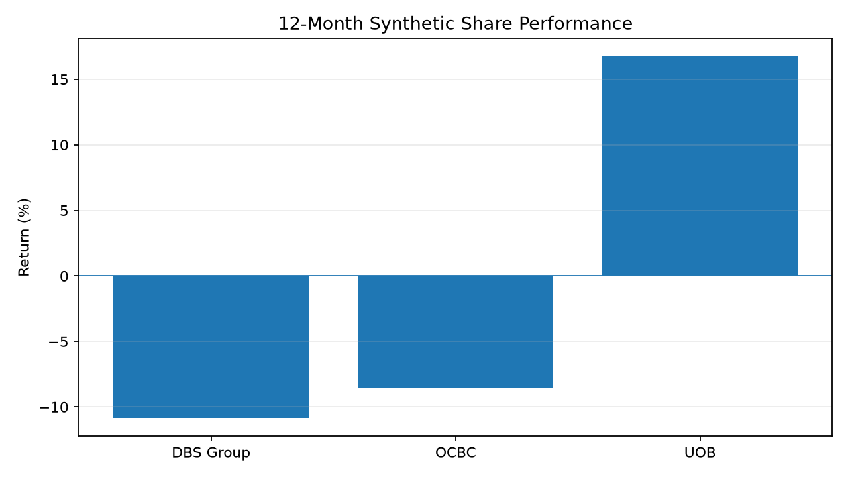
Relative Share Performance
Synthetic 12-month return comparison.

Slide 4
Relative Fundamental Positioning
Company | NIM | ROE | CET1 | NPL | P/E | P/B
DBS Group | 2.23% | 14.34% | 17.17% | 1.10% | 10.42x | 1.34x
OCBC | 2.17% | 12.78% | 15.64% | 1.17% | 9.56x | 1.39x
UOB | 2.02% | 12.23% | 16.11% | 1.30% | 9.64x | 1.15x

Slide 5
Agentic Research Questions
Which company has the strongest combination of profitability and capital?
Does valuation compensate for differences in profitability?
How did each company respond to earnings events?
Which conclusions require market data versus narrative evidence?

